Slide 1
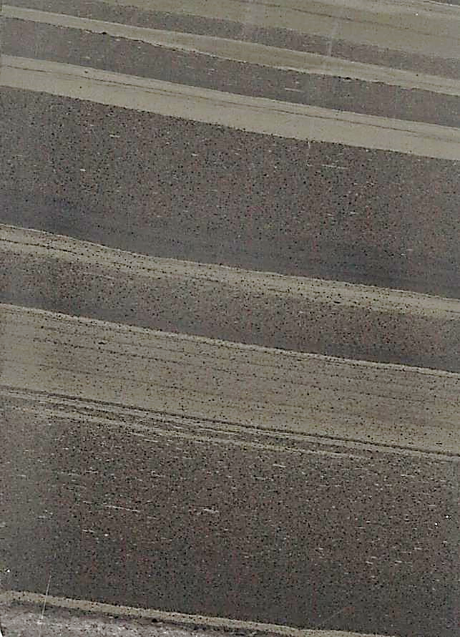
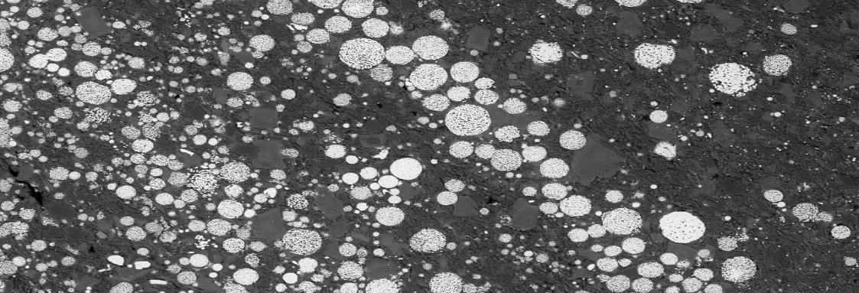



Laminated pyrite in TBU
Framboidal pyrite in TBU
Pyritic mineralization halo above the Tara Deep Zn-Pb deposit, Navan, Ireland: Evidence for sub-seafloor exhalative hydrothermal processes?
  Lola Yesares
  myesares@ucm.es
  Dep. Mineralogy and Petrology
  Complutense University of Madrid (Spain)
  iCRAG - University College Dublin (Ireland)

Slide 2
Geology of Navan
REFS.: Asthon et al., 2015; Blakeman et al., 2002; Yesares et al., 2019

Slide 3
Geology of Navan
Navan original resources of 135.7 Mt @ 7.7% Zn and 1.8% Pb
TARA DEEP inferred resources of 26.2 Mt @ 8.4% Zn and 1.6% Pb
TARA DEEP is ~2 km south of the Navan deposit, at a depth of 1.1–1.9 km
Tara Deep is between two major extensional structures → G Fault forms the N boundary and Navan at the S
Gainstown terrace, formed by the Navan and G faults, is cut by the S fault
Navan Terrace
Gainstown
Terrace
REFS.: Ashton et al., 2015; 2018; Boliden Summary Report, 2020; Yesares et al., 2019; 2021

Slide 4
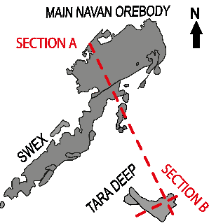
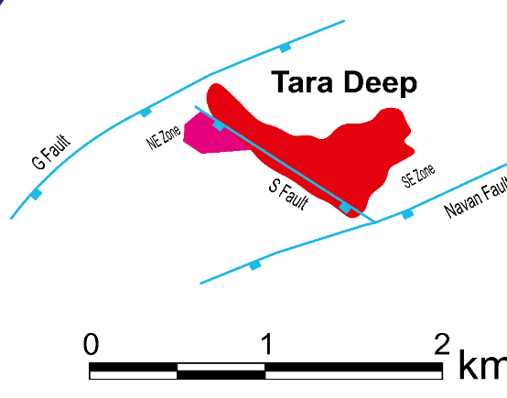
Tara Deep deposit
REFS.: Yesares et al., 2019; 2021; Drummond, 2021
SECTION A
SW
NE
SECTION B
NW Zone
Main zone
Zn-Pb ore hosted by Pale Beds
S fault
Zone two
Zn-Pb ore hosted by S Fault Conglomerates
Economic mineralization occurs in two host rocks

Slide 5
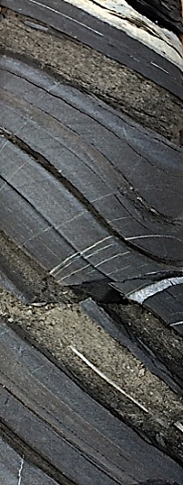
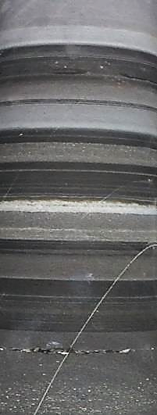
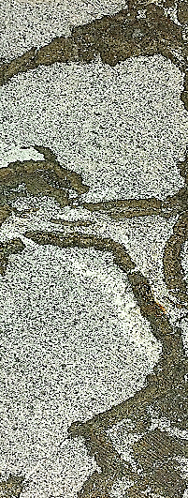
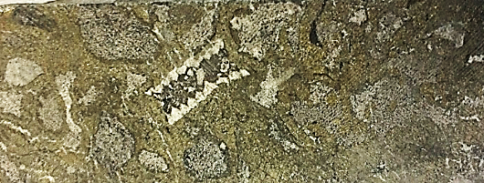
tuff
Thin Bedded Units
Tuffaceous horizon in black shales (TBU1)
black shales
tuff
Alternating sequences of calcarenites, calsilts and black shales (TBU1)
black shales
2cm
silts
calcarenites
1cm
mar
Micrite and reef pebbles cemented by marcasite (SB3)
micrite
clast
1cm
Reef and micrite pebbles and fossils cemented by marcasite(BSB)
crinoid
mar
REFS.: Yesares et al., 2019; 2021
micrite
pebbles
Dar paso a la siguiente diapo
1.5cm

Slide 6
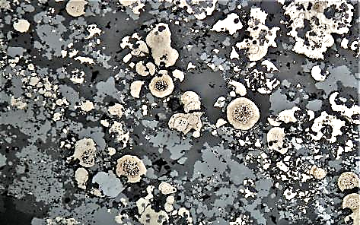
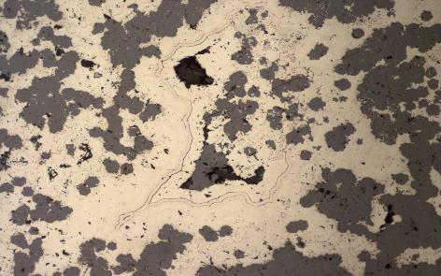
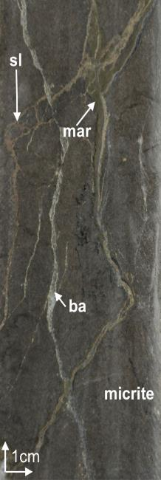
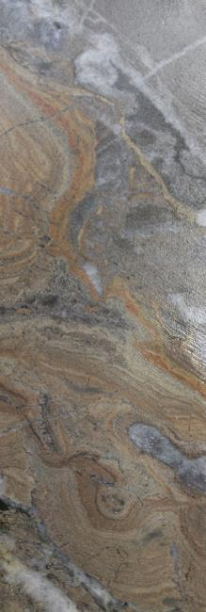
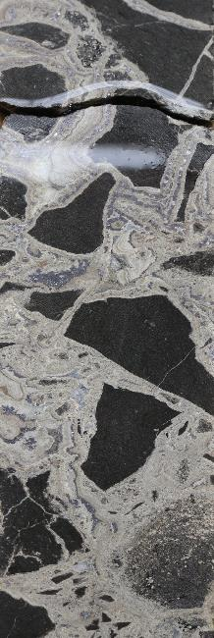
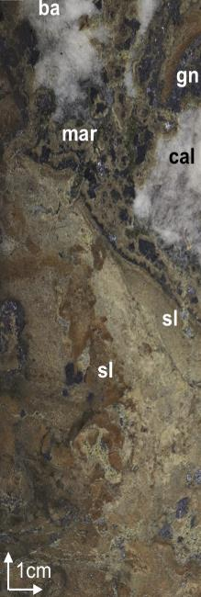
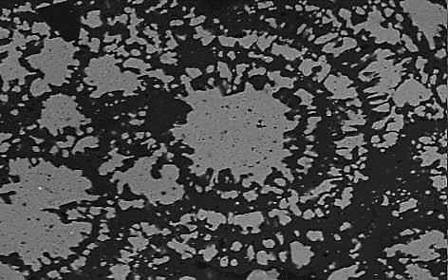
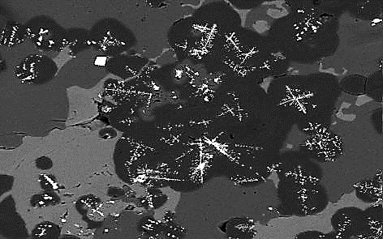
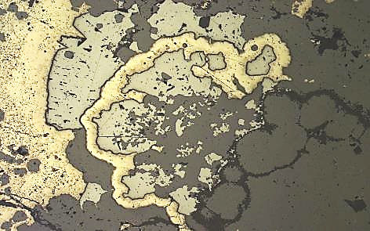
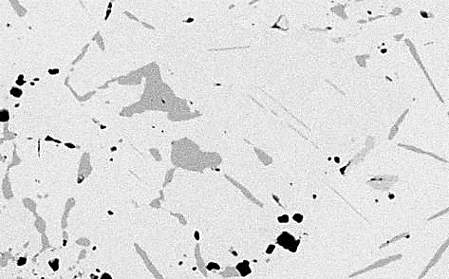
Main zone (Navan Group)
Sphalerite replacing framboidal and colloform pyrite
Sphalerite and galena dominate (>5:1)
Mineralogy and textures similar to Navan
Rapid precipitation textures (colloform, dendritic…)
Textures reflect a close relationship between bacteriogenic and hydrothermal conditions
py
sl
py
sl
gn
75µm
100µm
Veining
Infill/laminated
Brecciated
Massive
Colloform sphalerite
Skeletal galena enclosed in pyrite
cal
sl
py
sl
ba
sl
dol
dol
gn
sl
dol
gn
20µm
20µm
Galena and sphalerite in pyrite
Tetrahedrite and stibnite in galena
py
gn
gn
gn
td
sl
td
sl
stb
1.5cm
1cm
100µm
50µm
Micrites (Pale Beds- Navan Group) host ~92% of the total resource
REFS.: Ashton et al., 2018; Yesares et al., 2019; Drummond, 2021
Notes:
LP: Lower Palaeozoics
RB: Red Beds
LB: Laminated Beds:
ML: Muddly Limestone
MU: Mictrite Unit
PB: Pale Beds
ES: EROSION SURFACE/DEBRIS FLOW(S)
NEW TBU: New Thin Bedded Unit of the Upper Dark Limestone

Slide 7
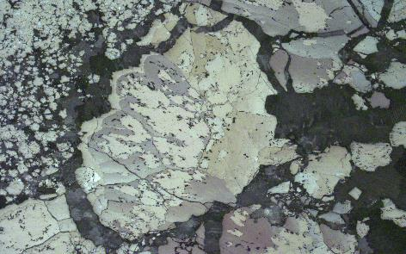
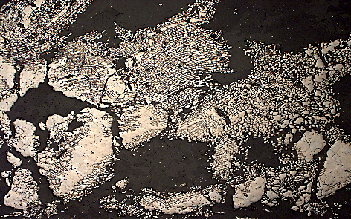
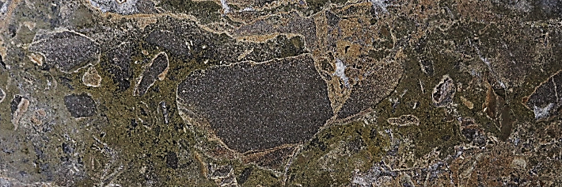
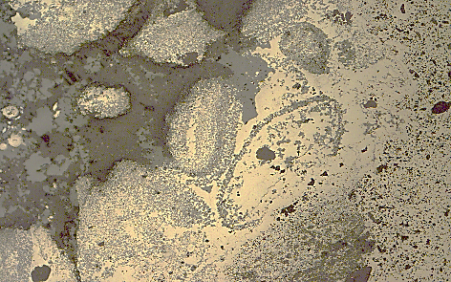
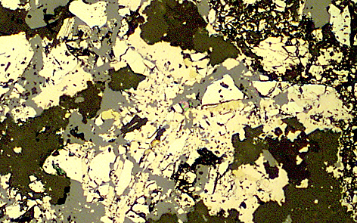
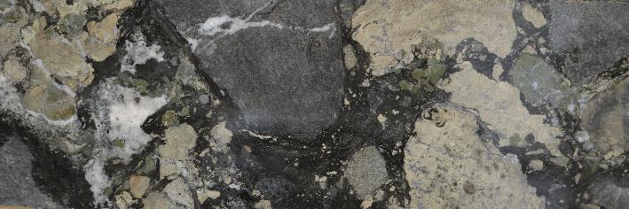
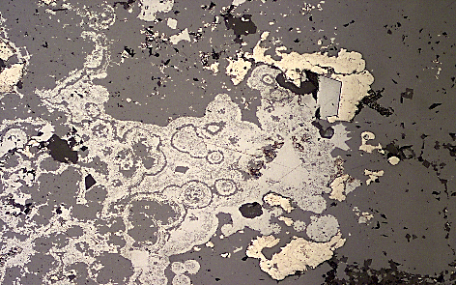
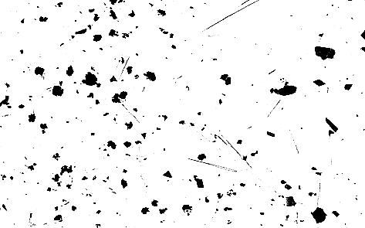
S fault conglomerate
Marcasite overgrowing pyrite
Marcasite and pyrite replacing wood cells
Pale Bed-rich conglomerates in the hanging walls of the G and S faults in the NW Zone
py
mrc+py
Allochthonous micrites clast encased by later marcasite and sphalerite
mrc
mrc+py
200µm
0.1mm
Pale Beds clast
Pyritized microforaminifera replaced by sphalerite
Chalcopyrite, sphalerite and Co-pentlandite filling open spaces in pyrite
sl
1cm
sl
sl
mrc+py
cp
Allochthonous mineralized micrite clasts
py
Co-pt
1cm
cal
sl
mrc
0.1mm
50µm
Pale Beds clast
sl
mineralized micrites pebble
Galena replacing colloform sphalerite, marcasite and pyrite
Siegenite and stibnite inclusions in galena
mrc+py
gn
Clasts of mineralization micrites + later phase of mineralization
Later mineralization during the slope instability?
Fe-sulfides dominates the matrix
sl
stb
gn
si
REFS.: Yesares et al., 2019; 2021
0.05mm
10µm
Notes:
LP: Lower Palaeozoics
RB: Red Beds
LB: Laminated Beds:
ML: Muddly Limestone
MU: Mictrite Unit
PB: Pale Beds
ES: EROSION SURFACE/DEBRIS FLOW(S)
NEW TBU: New Thin Bedded Unit of the Upper Dark Limestone

Slide 8
Laminated pyrite
Pyrite associated to organic matter
Laminated framboidal pyrite
Framboidal pyrite replaced by sphalerite and hosted in OM-rich mudstone
Colloform pyrite
Sphalerite replacing pyrite
Recrystallized framboidal pyrite
REFS.: Yesares et al., 2019; 2021

Slide 9
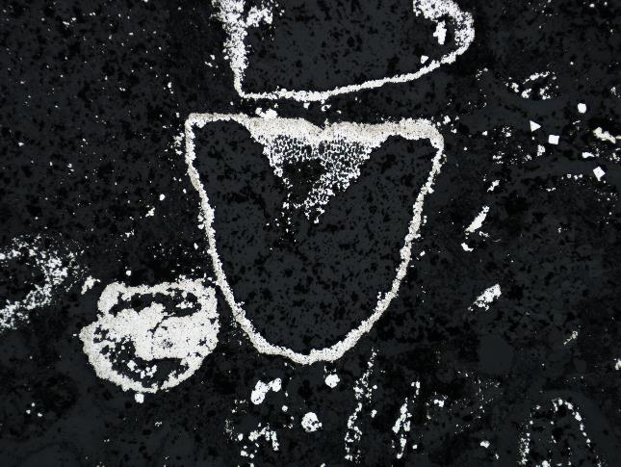
Pyritized fossils
REFS.: Yesares et al., 2019; 2021
Radiolaria replaced by pyrite
Microforaminifera embedded in pyrite
Sphalerite replacing microforaminifera
Pyrite rim on fossils
py
Bioclasts forming the calcarenite layers show a high degree of pyritization

Slide 10
Replacive assemblage
Marcasite filling interstices
Skeletal marcasite replacing radiolaria in calcarenite
More abundant in the area above the intersection of the G and S faults
parallel to the bedding, in which sulfides are infilling primary porosity, replacing the sediments and overgrowing bioclasts
crosscutting the bedding and deforming the sediments and associated earlier laminated pyrite
Marcasite vein crosscutting the bedding
Interstitial galena in pyrite
Co-pentlandite and chalcopyrite replacing fossils
Interstitial chalcopyrite in pyrite
Chalcopyrite and galena replacing a microforaminifera
REFS.: Yesares et al., 2019; 2021

Slide 11
Banded sulfide-rich cherts
Banded cherts included in reddish Mn-rich black shales
Chalcedonic colloform quartz
Mn-rich dolomite included in quartz
Mn-rich dolomite rimming chert
Cherts occur at higher stratigraphic levels in TBU1
More abundant near and above the intersection of the G and S faults
REFS.: Yesares et al., 2019; 2021

Slide 12
Banded sulfide-rich cherts
Banded cherts included in reddish Mn-rich black shales
Bird’s eye marcasite and pyrite rimming chert
Chalcopyrite, sphalerite and galena including stibnite and Ni-sulfosalts
Cherts are rimmed by carbonates associated with sulfides including marcasite, pyrite, sphalerite, chalcopyrite, galena, siegenite and stibnite
REFS.: Yesares et al., 2019; 2021

Slide 13


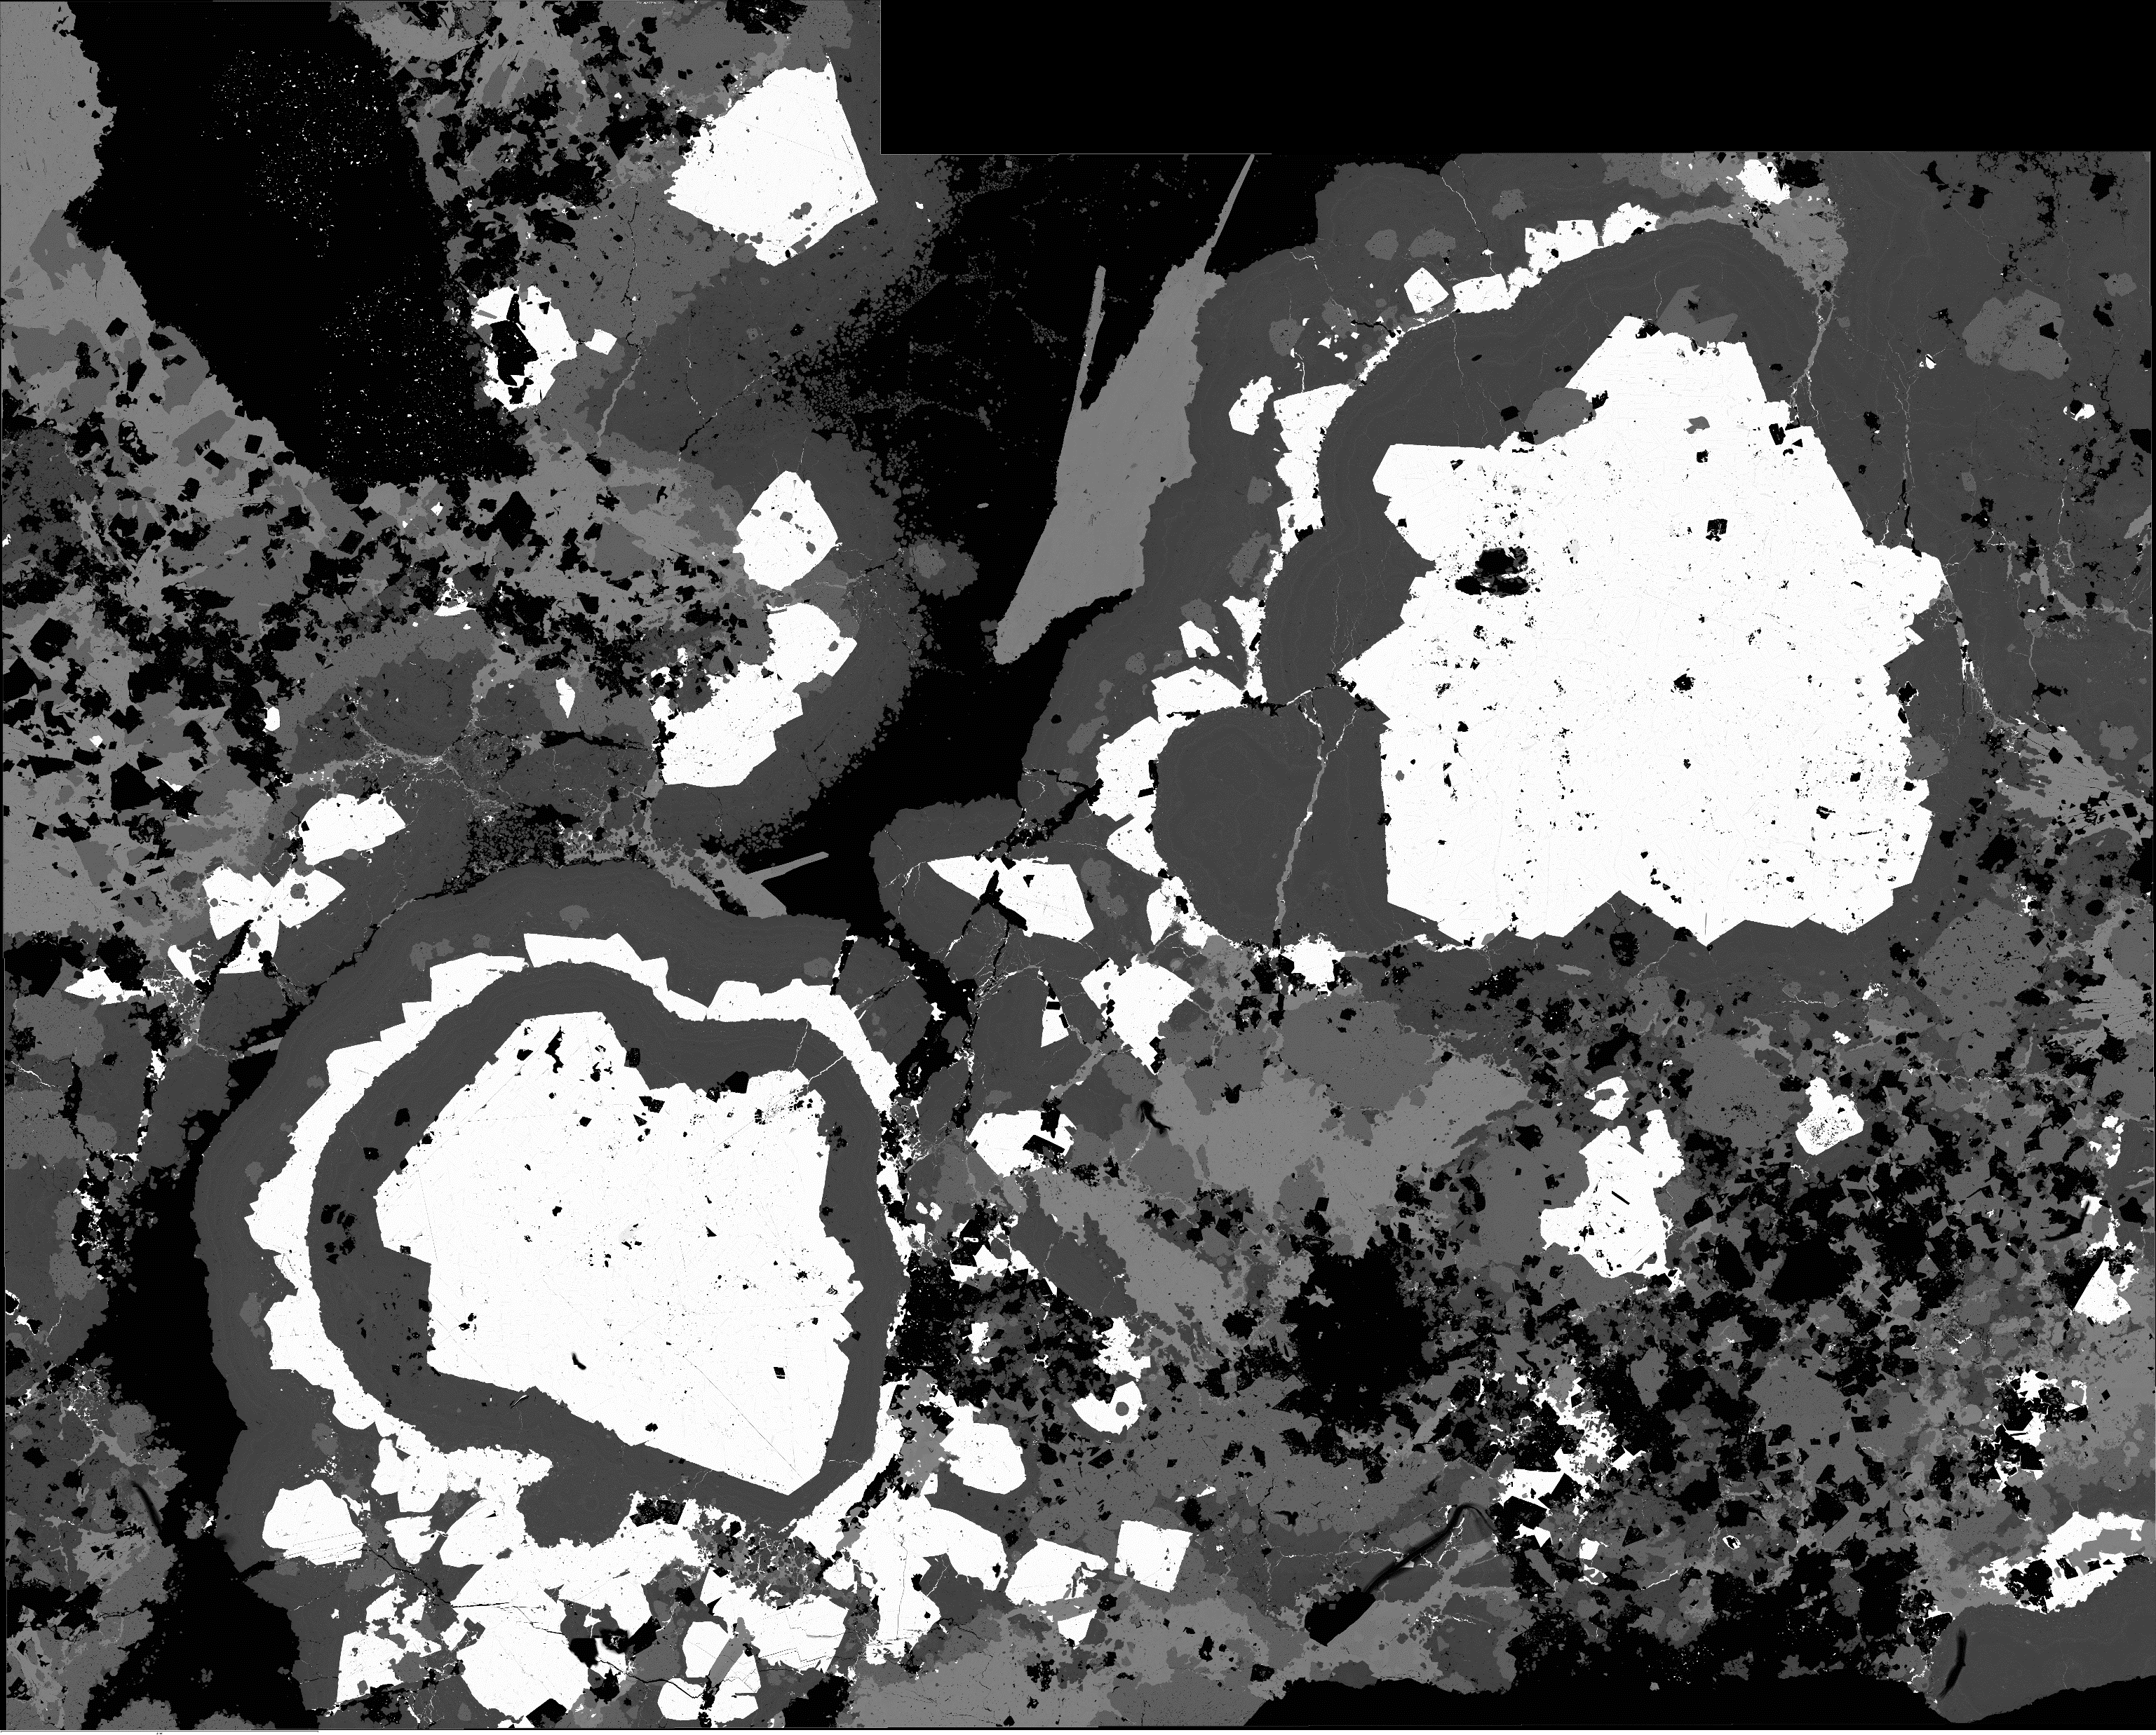
Sulphur isotopes analyses from Tara Deep - Main zone
py
-12‰
ba
py
-5 ‰
gn
+12‰
py
-21‰
sl
-7‰
ba
+25 ‰
gn
-0.5 ‰
sl
100µm
20µm
500µm
Framboids, colloforms and massive textures
Fast precipitation
textures
Cavity fill, veining, brecciated textures
15
sphalerite
galena
marcasite
pyrite
barite
10
5
-30
-25
-20
-15
-10
-5
0
5
10
15
20
25
30
δ³⁴S
Bacteriogenic sulphide
Hydrothermal sulphide
Seawater sulfate
Tara Deep economic ore shows a ³⁴S bimodal distribution
REFS.: Yesares et al., 2019; Drummond, 2021

Slide 14
Sulphur isotopes analyses from Tara Deep - Main zone
Bimodal S isotope distribution is key for economic ore deposits in Navan
The lowest value, that is the lightest isotopically, is characteristic of bacteriogenic reduction of seawater sulfate
15
sphalerite
galena
marcasite
pyrite
barite
Tara Deep-Main zone
The heavier value is interpreted to be hydrothermal sulfide, which has entered the deposit with metalliferous hydrothermal fluids
10
5
-30
-25
-20
-15
-10
-5
0
5
10
15
20
25
30
δ³⁴S
Bacteriogenic sulfide
Hydrothermal sulfide
Seawater sulfate
Tara Deep economic ore shows a ³⁴S bimodal distribution comparable with Navan
REFS.: Yesares et al., 2019; Drummond, 2021

Slide 15
S isotopes analyses from Tara Deep – S fault conglomerate
15
S fault conglomerate (Tara Deep)
py
-20‰
sl
-10 ‰
py
-5 ‰
sphalerite
galena
marcasite
pyrite
barite
mrc
+15 ‰
10
5
0.1mm
200µm
-30
-25
-20
-15
-10
-5
0
5
10
15
20
25
30
15
Main zone (Tara Deep)
sphalerite
galena
marcasite
pyrite
barite
10
5
-30
-25
-20
-15
-10
-5
0
5
10
15
20
25
30
δ³⁴S
Bacteriogenic sulfide
Hydrothermal sulfide
Seawater sulfate
A light signature dominates for sphalerite and galena at the S Fault Conglomerate
Marcasite shows heavy signature
REFS.: Yesares et al., 2019; 2021; Drummond, 2021

Slide 16
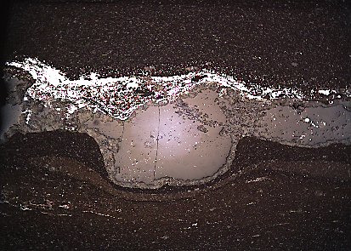
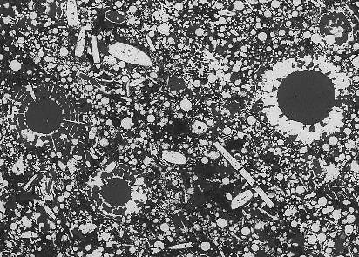
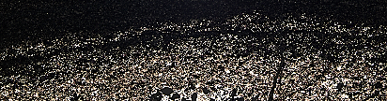
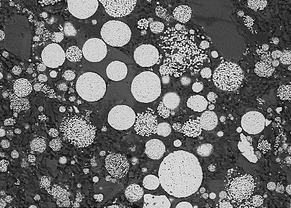
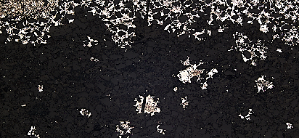
S isotopes analyses from Tara Deep – Thin Bedded Units
THIN BEDDED UNITS
Sulfide rim on cherts
Pyritized fossils
py
δ³⁴S vs Mineralogical Evolution
py
gn
sl
mrc
cp
mrc+py+sl+gn+cp
600µm
sulfide rim on cherts
Replacive assemblage
mrc+py+sl
Laminated pyrite
replacive assemblage
mrc (± py)
Mineralized matrix SFC
py+mrc+sl
py
pyritized fossils
mrc
py+sl
laminated pyrite
1mm
25µm
δ³⁴S
Early pyrite in TBU shows strongly negative δ³⁴S values → BSR-derived and acidic and H₂S-poor hydrothermal
Later sulfides in both the mineralized SFC matrix and TBU show higher positive δ³⁴S values → hydrothermal fluid leaching of heavy pyrite from underlying Lower Palaeozoic rocks
REFS.: Yesares et al., 2019; 2021

Slide 17
TBUs depositional paleoenvironment
Common methods: Ratios of redox sensitive elements
Elements predominantly dissolved in water: REEs, Re/Mo, V/Mo, S and TOC
Conservative elements under hydrothermal conditions: Ni/Co, V/(V + Ni), V/Cr, U/Th… but they depend of the sediment provenance

Slide 18
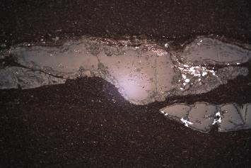
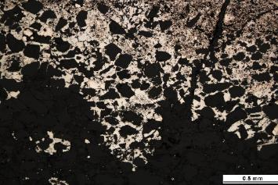
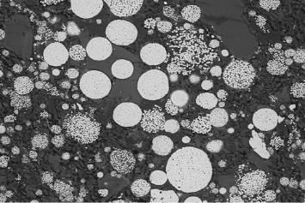
TBUs depositional paleoenvironment
V/Cr = 1 → redox boundary near the sediment–water interface (Jones and Manning,1994)
V/(V + Ni) > 0.6 < 0.9 → Anoxic conditions and > 0.9 → Euxinic conditions (Hoffman et al., 1998)
anoxic conditions
(Hoffman et al., 1998)
euxinic conditions
anoxic
oxic
(J & M,1994)
b
euxinic conditions
anoxic
conditions
oxic conditions
Fig. 2. Paleoredox plots of black shale samples from TBU. (a) V/Cr vs V/(V+Ni) diagram [3] and [4]; (b) U_{EF} vs Mo_{EF} diagram.
Mo_{EF}
U_{EF}
Ce/Ce*
TBU1
oxic
conditions
SB1
hydrothermal cherts
tuff
anoxic
conditions
chert
euxinia
1cm
TBU1
replacive assemblage
anoxic
conditions
SB2
TBU2
laminated pyrite
SB3
oxic
conditions
20µm
0
TBU3
Fig. 3. Stratigraphic log of measured section of drillhole N02444. Left: Stratigraphy; Downhole: geochemical paleoredox plots; Right: Interpreted depositional environment.

Slide 19
TBUs depositional paleoenvironment
Mo_{EF} = [(1/Al)_{sample}/(Mo/Al)_{PAAS}] (Algeo and Tribovillard 2009)
Mo is only enriched in sediment under euxinic conditions (Crusius et al., 1996)
euxinic conditions
anoxic
conditions
oxic conditions
Correlation between Mo_{EF} and U_{EF} → anoxia-euxinia
Mo_{EF} >1 and U_{EF} >1 → anoxia-euxinia

Slide 20
TBUs depositional paleoenvironment
Positive correlation C_{org}-U → authigenic origin for U (Algeo and Lyons, 2006)
U_{auth} >1 → anoxic condition
anoxic

Slide 21
TBUs depositional paleoenvironment
Mechanisms for S precipitation in seafloor is BSR → C_{org} control the S_{total} (Sageman and Lyons, 2004)
Black Sea
normal marine
Positive correlation C_{org}-S_{total} in TBU3 → BSR in anoxic conditions
S_{total} > C_{org} in TBU1 and TBU2 → Thermal C_{org} loss or euxinic (sulfidic) input to the water colum

Slide 22

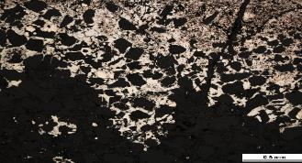

TBUs depositional paleoenvironment
N2444
Mo_{EF} = [(1/Al)_{sample}/(Mo/Al)_{PAAS}] (Algeo and Tribovillard 2009)
Ce/Ce*= 3X(Ce_{samples}/Ce_{average})/((2*La_{sample}/La_{average})+(Nd _{sample}/Nd _{average}))
Mo_{EF}
U_{EF}
Ce/Ce*
TBU1
suboxic
conditions
hydrothermal cherts
SB1
tuff
anoxic
conditions
Framboidal pyrite + minor sphalerite mineralization associated to underlying economic deposits only occurs in anoxic stratigraphical levels
Hence, to find halos within TBU which may indicate deeper economic deposits, we have to explore anoxic levels
chert
euxinia
1cm
TBU1
replacive assemblage
SB2
anoxic
conditions
TBU2
laminated pyrite
Correlation between Mo_{EF} and U_{EF} → anoxia-euxinia
Mo_{EF} >1 and U_{EF} >1 → anoxia-euxinia
Ce/Ce > 1 strongly anoxia to euxinia
Ce is leached by oxidizing hydrothermal fluid
SB3
suboxic
conditions
20µm
0
TBU3

Slide 23
Cherts formation estimate Temperature
Banded cherts included in reddish Mn-rich black shales
δ¹⁸O values range from 23.7 to 26.3‰
The lowest values are from the highest stratigraphically cherts just above the tuffaceous horizon
Chert-water fractionation curves indicates that chert crystallization T may range from 65 to 80 ◦C
Hydrothermal fluids were relatively warm but cooling by equilibration with seawater
REFS.: Yesares et al., 2021

Slide 24
Genetic model – Main zone
Early-rift
Syn-diagenetic mineralization of the Pale Beds
Circulation of Zn-Pb-rich fluids through out normal faults
Bimodal Sulfur → BSR + hydrothermal
Syn-rift
Syn-diagenetic mineralization of the Pale Beds
Circulation of mineralizing fluids continues
Ongoing extensional tectonic activity → erosion of parts of the early mineralized Pale Beds
SW
NE
SW
NE
Zn+Pb hydrothermal fluids
Bimodal δ³⁴S → BSR + hydrothermal
The deposition of fault-talus sedimentary breccias, including reworked mineralized clasts, supports a Lower Visean minimum age for the onset of sulfide mineralisation in the Pale Beds
REFS.: Yesares et al., 2019; 2021; Drummond, 2021

Slide 25
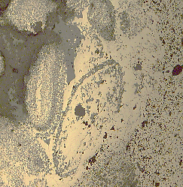
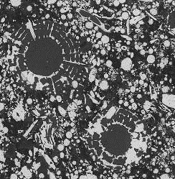

Genetic model – Thin Bedded Units
pyritized SFC matrix
pyritized fossils
laminated pyrite
STAGE I
Sub-seafloor replacement by pyrite
(Lower Viséan)
Deposition of the TBU coeval with the extensional tectonic activity
Circulation of Fe (Zn, Pb), acidic, H₂S-deficient, weaker mineralizing fluids through out the G Fault
Precipitation of early pyrite and minor sphalerite by BSR in the unconsolidated sediments
δ³⁴S_{py} = -5‰
δ³⁴S_{sl} = -10‰
δ³⁴S_{py} = -13‰
δ³⁴S_{sl} = -11‰
δ³⁴S_{py} = -24‰
δ³⁴S_{sl} = -32.4‰
oxic seawater
anoxic seawater
OM-bearing shales, silts and
calcarenites (N-TBU)
SO₄²⁻ + BSR → H₂S
SFC
Zn+Pb ore in
Pale Beds
Fe (Zn, Pb) hydrothermal fluid
(intermediate pH and H₂S poor)
syn-sedimentary normal fault
REFS.: Yesares et al., 2021

Slide 26
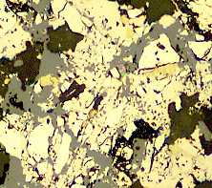
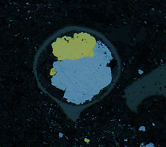
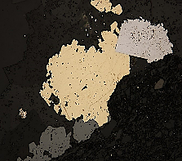
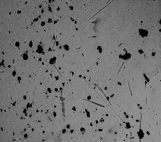
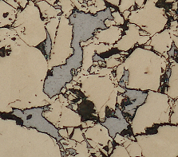
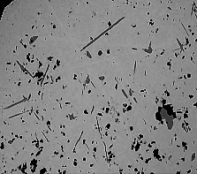
Genetic model
Thin Bedded Units
sulfides in SFC matrix
replacive association
sulfide-rimmed hydrothermal cherts
δ³⁴S_{mrc} = 18.6‰
δ³⁴S_{py} = 9.6‰
δ³⁴S_{sl} = 10.5‰
δ³⁴S_{cp} = 36.8‰
δ³⁴S = 17.5‰
δ¹⁸0_{chert} = 25.3‰
STAGE II
Deposition of minor higher-temperature sulfide assemblages (Lower Viséan)
Continues the deposition of the TBU
Circulation of Fe (Zn, Pb, Cu, Co, Sb), acidic, H₂S-rich, mineralizing fluids through out the G Fault
Precipitation of hydrothermal cherts on the seafloor and later sulfides in the unconsolidated sediments by rapid cooling of metal-bearing fluids by interaction with the cooler sedimentary environment
δ³⁴S_{mrc} = 18.6‰
δ³⁴S_{py} = 9.2‰
δ³⁴S_{sl} = 5.8‰
δ³⁴S_{mrc} = 17.3‰
oxic seawater
anoxic seawater
OM-bearing shales, silts and
calcarenites (N-TBU)
SFC
Zn+Pb ore in
Pale Beds
Fe (Zn, Pb, Cu, Co, Sb) hydrothermal
fluid (high pH and H₂S-rich)
syn-sedimentary normal fault
Navan hydrothermal system or Tara Deep hydrothermal system includes exhalative processes
REFS.: Yesares et al., 2021

Slide 27
Links with economic ores ores
The Navan system was long-lived
Mineralization in the TBU shows that mineralizing fluids continued circulating after the formation of economic ores, with hydrothermal cherts as the most distal part of the system
Metal exhausted and/or weaker brine exhalations were likely sourced from the G, and possibly S, faults immediately above the underlying micrite-hosted mineralization
G and S faluts were the pathways for ore forming fluid and links between different mineralization styles
The genetic linkage between sub-seafloor exhalative and underlying replacive mineralization in the Navan area have a clear geological and exploration implications

Slide 28
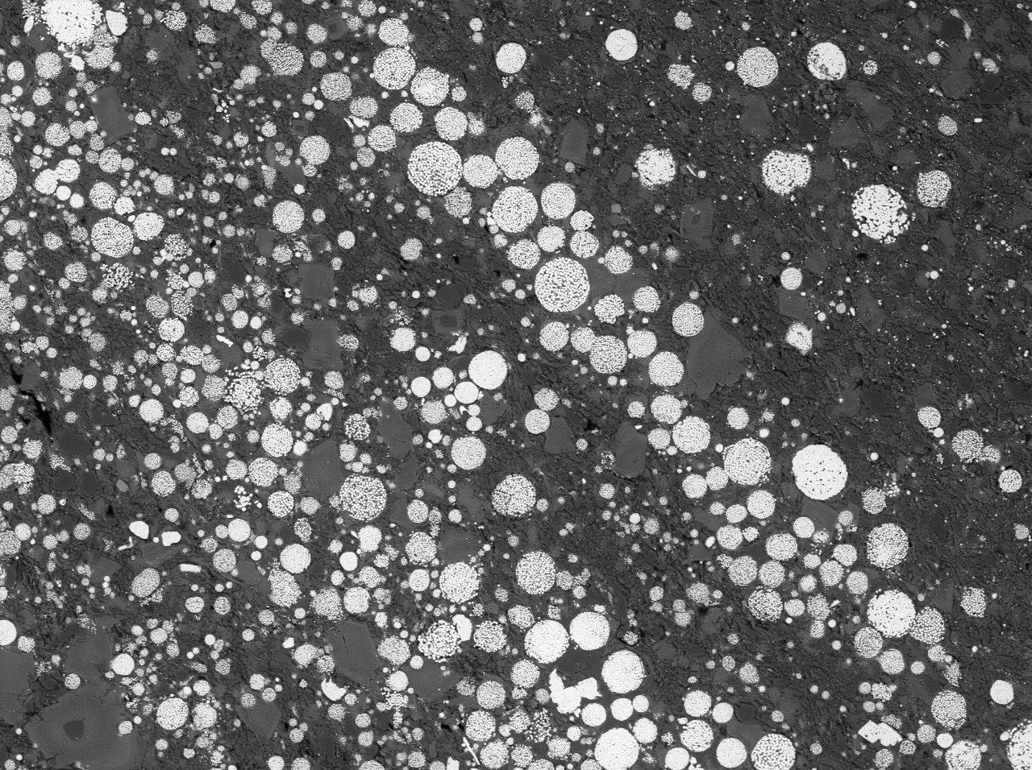



… Thank you very much!
… Any question?
  Lola Yesares
  myesares@ucm.es
Notes:
Textures are complicated but in general they correlate with what we see at Navan. The dominant micrite mineralisation texture is massive mineralisation, collomorphic and brecciated textures, hosted in a Micrite Unit that shows variable degrees of dolomitization. Whereas the conglomerate mineralisation on the right hand side shows a clast of micrite mineralisation and also an example where matrix replacement has occurred and encased an early clast of mineralisation.
The mineralogy dominantly consists of sphalerite and galena in a 7:1 ratio, with accessory pyrite, marcasite, barite and minor sulfosalts. These high grades can occur over 10s of metres.
These textures are absolutely typical of what you find in the 5 lens micrite at Navan

