Slide 1

Irish but not Irish-type
Gerry Stanley
and
Colin J. Andrew
Irish but not Irish-type
Irish-type Zn-Pb deposits around the world
Galway, September 8th – 10th 2023

Slide 2
Outline
Introduction
Kildare
Abbeytown
MVT vs Irish-type
Conclusion
Irish but not Irish-type
Irish-type Zn-Pb deposits around the world
Galway, September 8th – 10th 2023

Slide 3
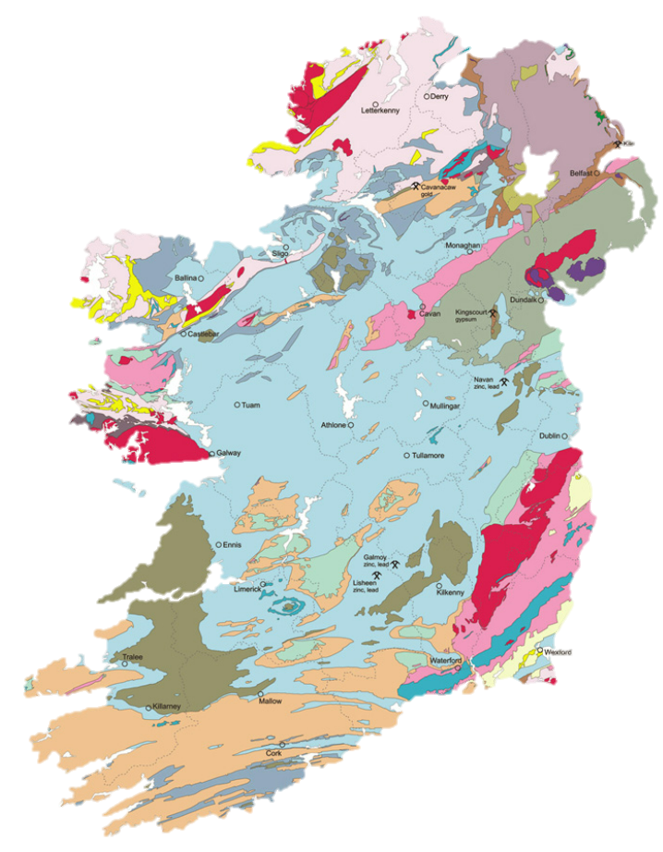

Introduction
Kildare
Abbeytown
MVT vs Irish-type
Conclusion
The Irish but not Irish-type Deposits
Abbeytown Zn-Pb deposits
Navan
Tynagh
S’mines
Galmoy
Lisheen
Kildare Zn-Pb deposits
Irish but not Irish-type
Irish-type Zn-Pb deposits around the world
Galway, September 8th – 10th 2023

Slide 4
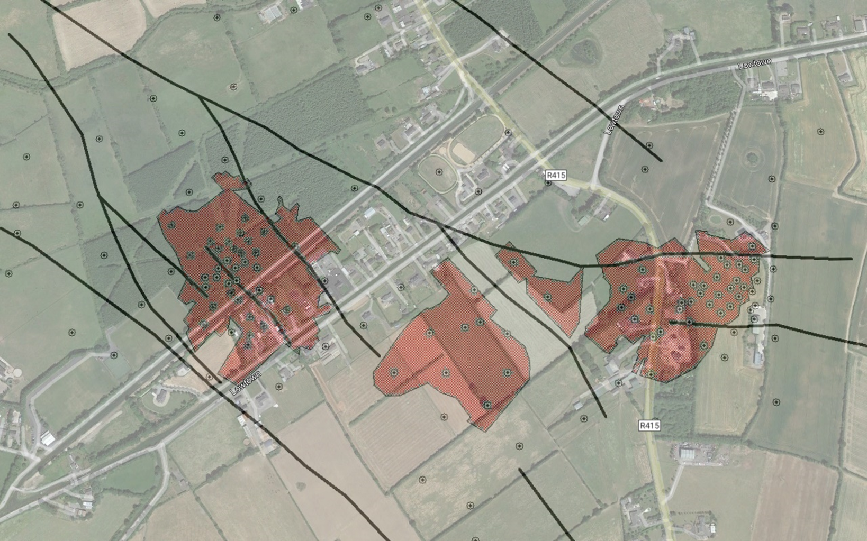

Introduction
Kildare
Abbeytown
MVT vs Irish-type
Conclusion
Kildare Resource
Harberton Bridge
Zinc of Ireland announced an updated resource for Kildare (dated September 8th 2020) :
11.3Mt @ 9.0% Zn + Pb (Inferred)
with thick, high grade zones of mineralization, for example:
19.89m @ 17.64% Zn+Pb at McGregor (Canal Zone)
15.65m @ 11.7% Zn+Pb at Shamrock (Bridge Zone)
Canal Zone
(“McGregor”)
Bridge Zone
(“Shamrock”)
“FC3”
Irish but not Irish-type
Irish-type Zn-Pb deposits around the world
Galway, September 8th – 10th 2023

Slide 5
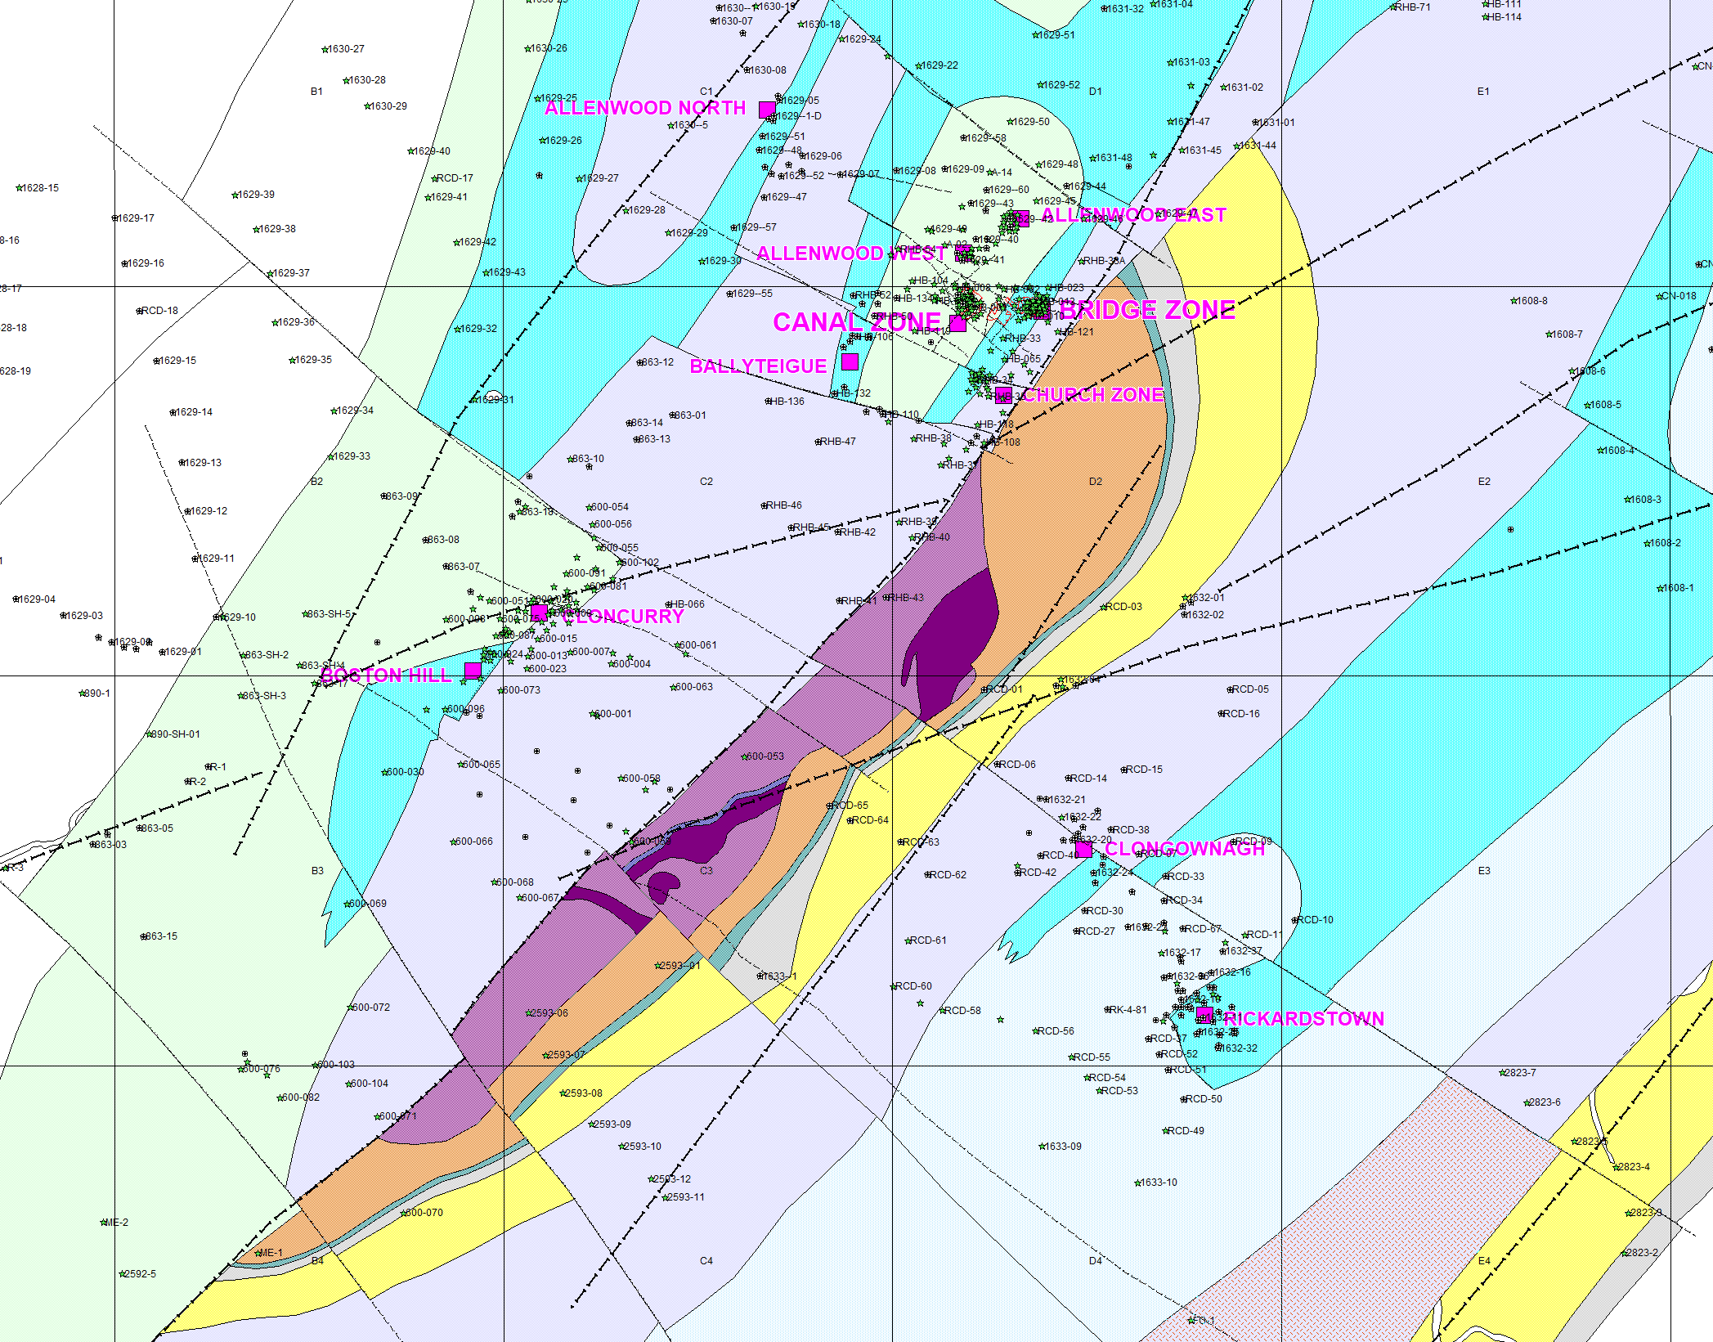





Introduction
Kildare
Abbeytown
MVT vs Irish-type
Conclusion
Kildare District Deposits
Allenwood Beds
Rickardstown Formation
Waulsortian Mudbank
ABC Group
Navan Group
Basal Clastics
Lower Palaeozoic
ALLENWOOD SOUTH
Irish but not Irish-type
Irish-type Zn-Pb deposits around the world
Galway, September 8th – 10th 2023

Slide 6
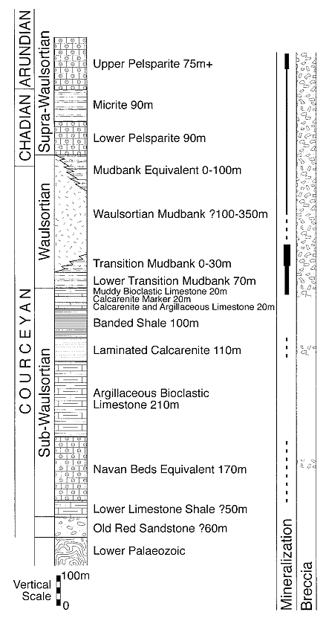
Introduction
Kildare
Abbeytown
MVT vs Irish-type
Conclusion
Kildare District: Stratigraphic Setting
  Sub-Waulsortian – Kildare Province of Philcox (1984) – twice as thick as the Limerick and North Midlands Provinces, and almost four times as thick as the Dunmore Province.
  Comprises a Navan Beds equivalent; Argillaceous Bioclastic Limestones; and laminated calcarenite; Banded Shale; and some thinner limestones at the top.
The Allenwood Formation comprise pale grey, massive shelf limestones and their dolomitized equivalents. It is thought that the Allenwood Formation passes laterally into Calp in the basinal areas.
Rickardstown Formation comprises thinly interbedded nodular crinoidal, cherty micrites, shales and reef-derived conglomerates overlain by a dark grey, fine-grained dolomite with abundant chert.
Irish but not Irish-type
Irish-type Zn-Pb deposits around the world
Galway, September 8th – 10th 2023

Slide 7
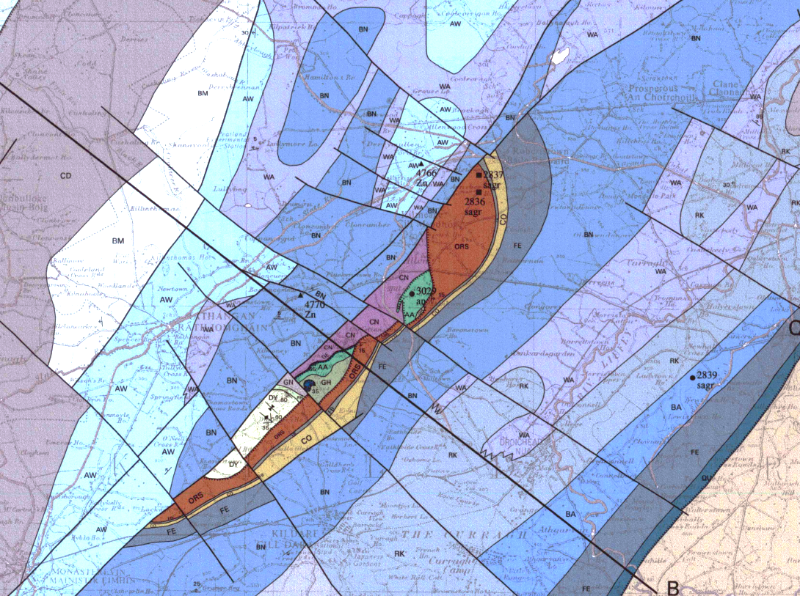
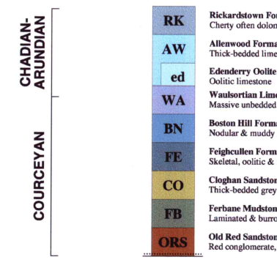
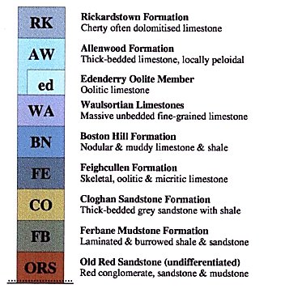
Introduction
Kildare
Abbeytown
MVT vs Irish-type
Conclusion
Regional Geology: Kildare District
Allenwood
Harberton Bridge
Cloncurry
Boston Hill
Clongownagh
Rickardstown
Extract from GSI 100,000 Sheet 16
Irish but not Irish-type
Irish-type Zn-Pb deposits around the world
Galway, September 8th – 10th 2023

Slide 8
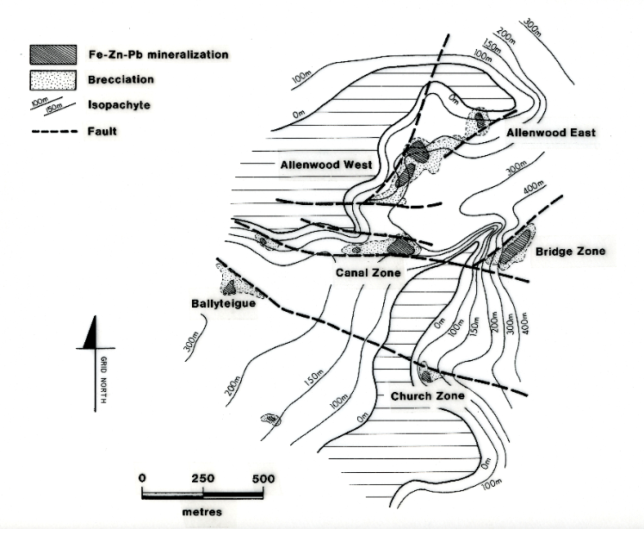
Introduction
Kildare
Abbeytown
MVT vs Irish-type
Conclusion
Waulsortian isopachytes (after Andrew, 1986)
Fe-Zn-Pb mineralization
Brecciation
Waulsortian isopachytes
Fault
Off bank facies
Irish but not Irish-type
Irish-type Zn-Pb deposits around the world
Galway, September 8th – 10th 2023
Notes:
Note the Waulsortian knoll form

Slide 9
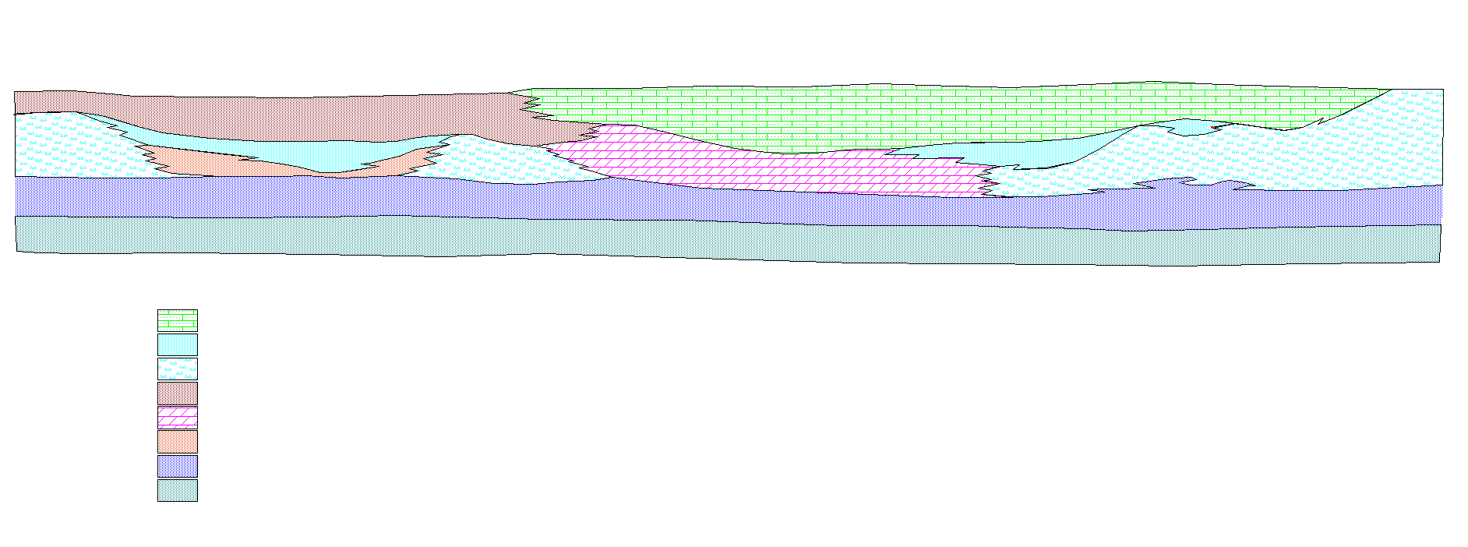
Introduction
Kildare
Abbeytown
MVT vs Irish-type
Conclusion
Schematic section through Kildare Deposits
(length of section approximately 35km)
Rickardstown Clongownagh Cloncurry Harberton Allenwood Prosperous
More Restricted Environments
Shelf and Open Marine Environments
Lucan Formation
Lucan Formation
0
“Brown Calp”
Allenwood Beds
Waulsortian
Lam Beds
Waul Eq
Waulsortian
Waul Eq
Waulsortian
Upper Dolomite
250
Argillaceous Bioclastic Limestones
Argillaceous Bioclastic Limestones
Silty Calcarenite
Silty Calcarenite
500
Peloidal skeletal grainstone and oolitic limestones
Crinoidal shaley limestones and occasional cherts
Coalesced and stacked stromatactid micrite mudbanks with a few interbedded shale and crinoidal limestone intervals
“Brown Calp”
“Upper Dolomite”
Laminated dolomitic mudstones and thin bioclastic horizons
Argillaceous Bioclastic Limestones and shales, transitional to Waulsortian in parts
Silty Calcarenites
Vertical scale
Irish but not Irish-type
Irish-type Zn-Pb deposits around the world
Galway, September 8th – 10th 2023

Slide 10
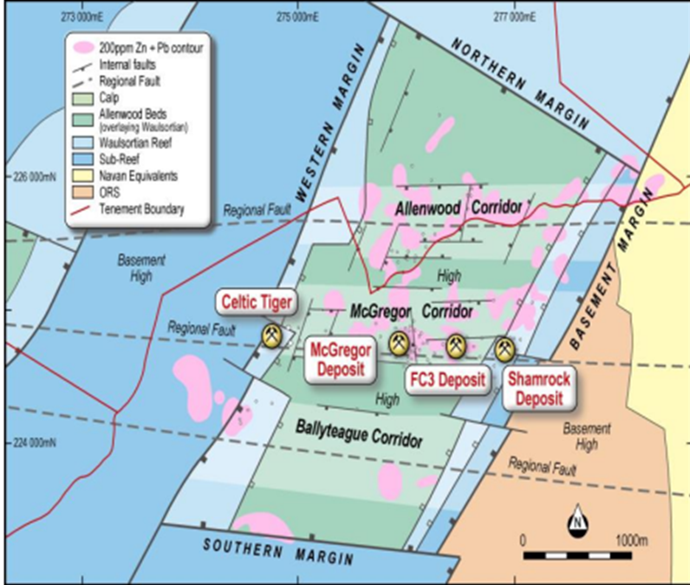
Introduction
Kildare
Abbeytown
MVT vs Irish-type
Conclusion
The Allenwood Graben, Faults and Corridor Nomenclature
Irish but not Irish-type
Irish-type Zn-Pb deposits around the world
Galway, September 8th – 10th 2023

Slide 11
Introduction
Kildare
Abbeytown
MVT vs Irish-type
Conclusion
Simplified structural plan at base of Waulsortian showing principal faults and distribution of mineralization within the “McGregor Corridor”.
Irish but not Irish-type
Irish-type Zn-Pb deposits around the world
Galway, September 8th – 10th 2023

Slide 12
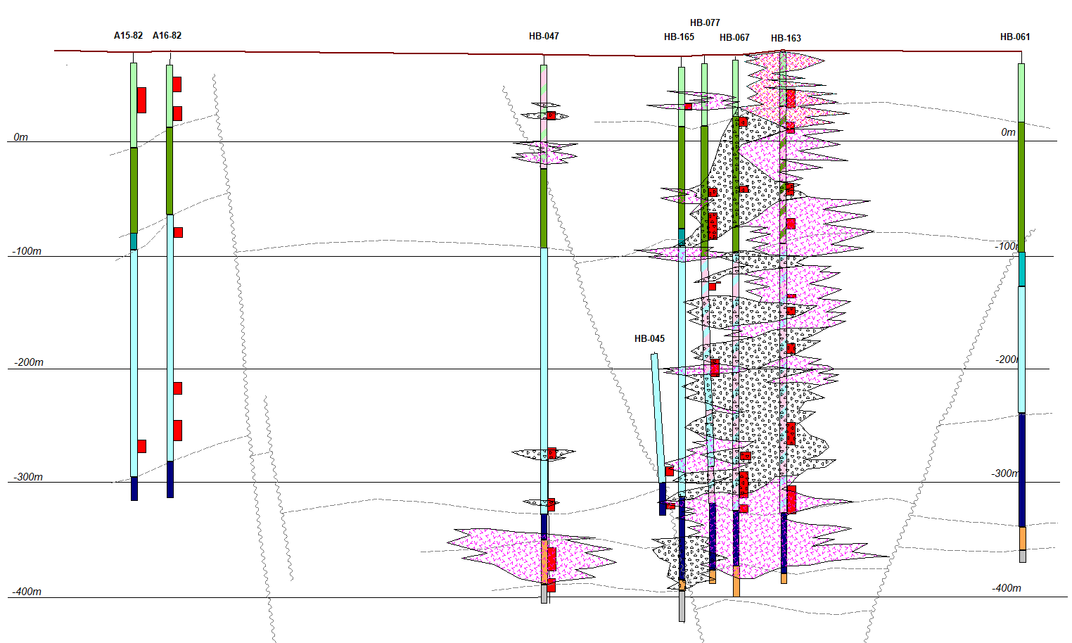


Introduction
Kildare
Abbeytown
MVT vs Irish-type
Conclusion
Canal Zone
Section 276000mE facing East
Fault Control at Harberton Bridge
Allenwood
Upper Allenwood Beds
Lower Allenwood Beds
Upper Waulsortian Transition
Waulsortian Mudbank
Argillaceous Bioclastic Limestone
Clean Calcarenite
Biosparites
Dolomitized Waulsortian
Dolomitized Allenwood Beds
>4% Zn+Pb
Rock Matrix Breccia
Crackle & Precipitate Breccias
Irish but not Irish-type
Irish-type Zn-Pb deposits around the world
Galway, September 8th – 10th 2023

Slide 13
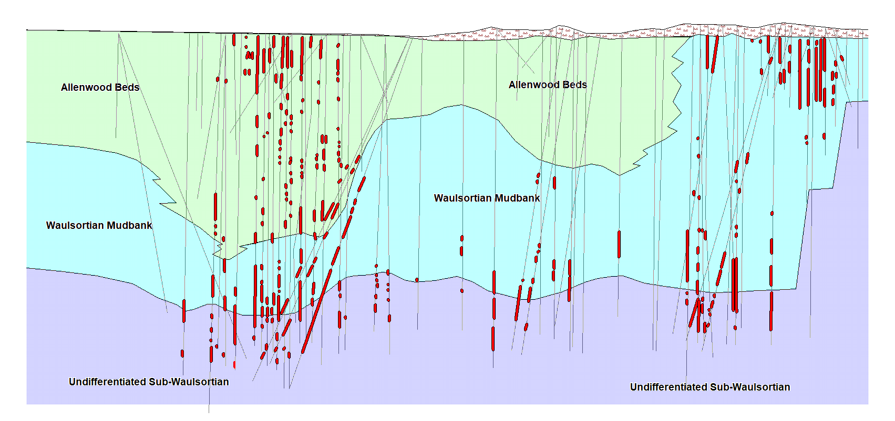

Introduction
Kildare
Abbeytown
MVT vs Irish-type
Conclusion
Section through Harberton Bridge with holes projected 100m either side of line of section
(Modified from Zinc of Ireland NL Investor Presentation, 24 Sept 2022)
Bridge Zone
Canal Zone
0m OD
0m OD
-200m
-200m
-400m
-400m
0 50 100 150m
Irish but not Irish-type
Irish-type Zn-Pb deposits around the world
Galway, September 8th – 10th 2023

Slide 14
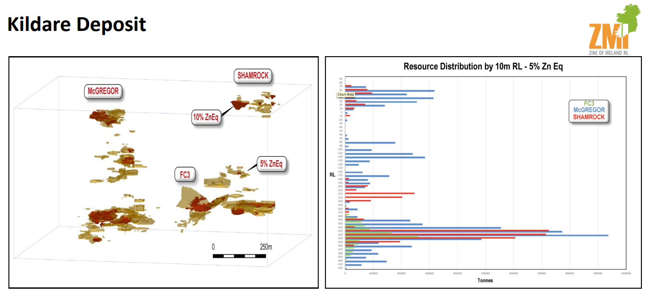
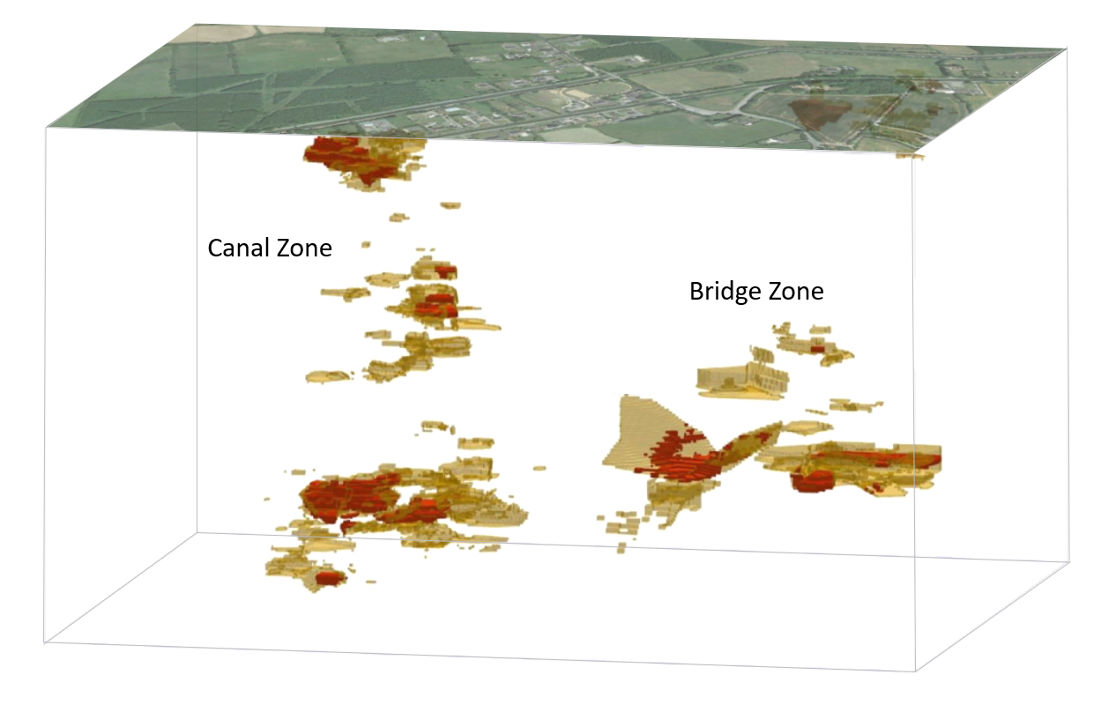
Introduction
Kildare
Abbeytown
MVT vs Irish-type
Conclusion
Mineralization distribution
Inferred Resource 11.3Mt @ 7.8%Zn, 1.2%Pb.
-100m
-200m
-300m
-400m
>5% Zn+Pb
>10% Zn+Pb
0 100 200m
McGregor = Canal; Shamrock = Bridge
ZMI investor presentation
Irish but not Irish-type
Irish-type Zn-Pb deposits around the world
Galway, September 8th – 10th 2023

Slide 15
Introduction
Kildare
Abbeytown
MVT vs Irish-type
Conclusion
Schematic section through Rickardstown
Irish but not Irish-type
Irish-type Zn-Pb deposits around the world
Galway, September 8th – 10th 2023

Slide 16
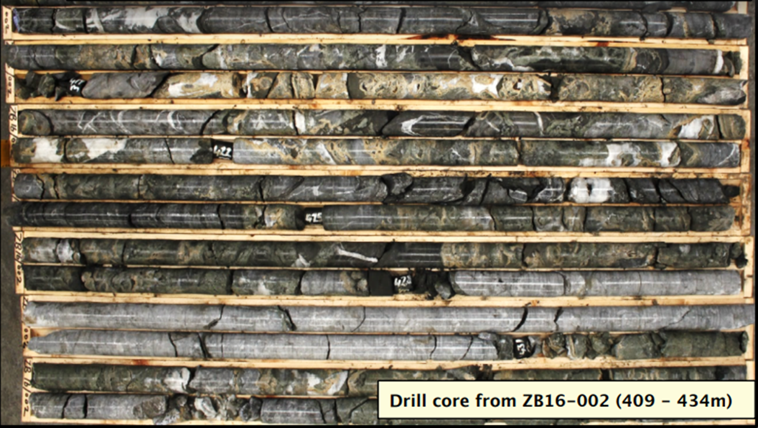
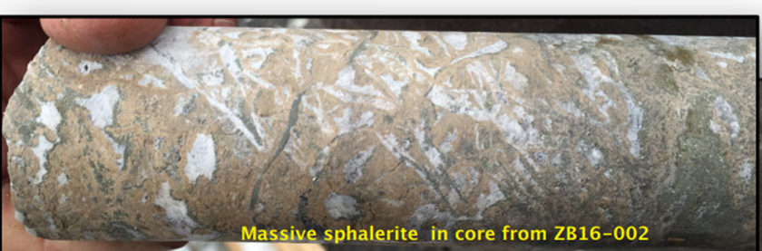
Introduction
Kildare
Abbeytown
MVT vs Irish-type
Conclusion
Mineralization
Hole ZB16-002 417m – 437m
Massive sphalerite
MVT style
From ZMI website
Irish but not Irish-type
Irish-type Zn-Pb deposits around the world
Galway, September 8th – 10th 2023

Slide 17
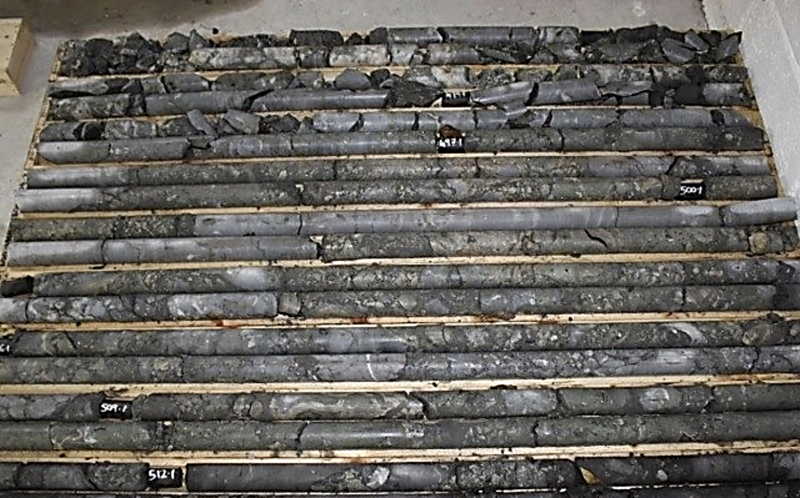
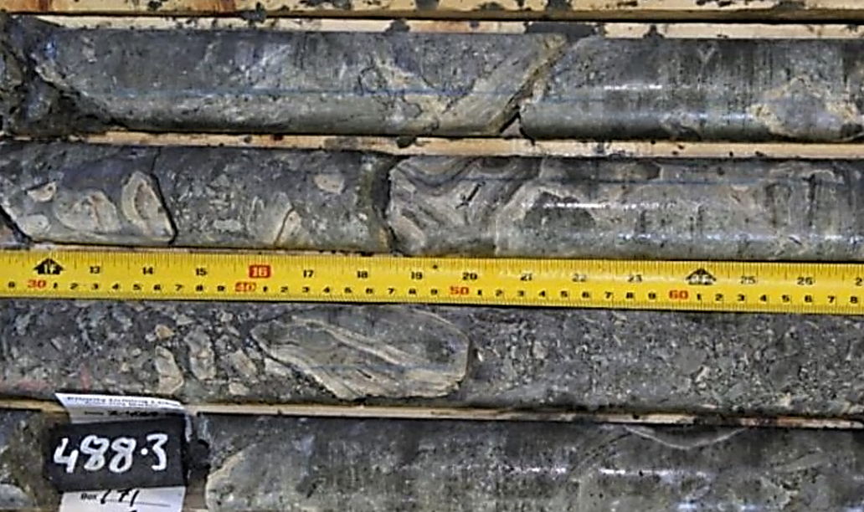
Introduction
Kildare
Abbeytown
MVT vs Irish-type
Conclusion
Mineralization
Z-4069-003
Irish but not Irish-type
Irish-type Zn-Pb deposits around the world
Galway, September 8th – 10th 2023

Slide 18

Introduction
Kildare
Abbeytown
MVT vs Irish-type
Conclusion
Mineralization
Z-4069-003 (McGregor) drill core showing massive sulphides at ~488m downhole.
Irish but not Irish-type
Irish-type Zn-Pb deposits around the world
Galway, September 8th – 10th 2023

Slide 19
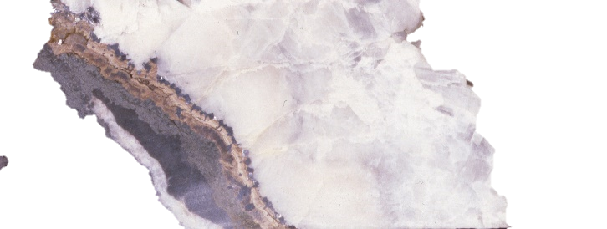
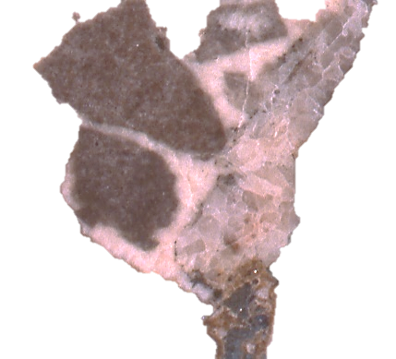
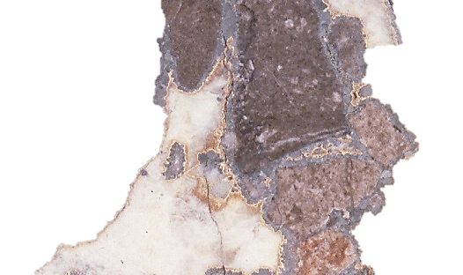
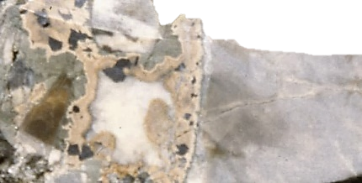
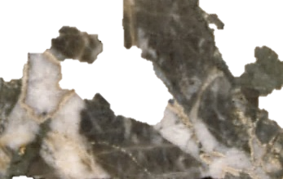
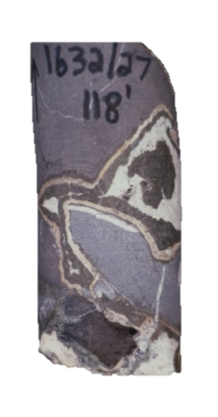
Introduction
Kildare
Abbeytown
MVT vs Irish-type
Conclusion
Mineralization
Harberton Bridge
1
Allenwood
cm
Rickardstown
Irish but not Irish-type
Irish-type Zn-Pb deposits around the world
Galway, September 8th – 10th 2023
Notes:
Note the Waulsortian knoll form

Slide 20
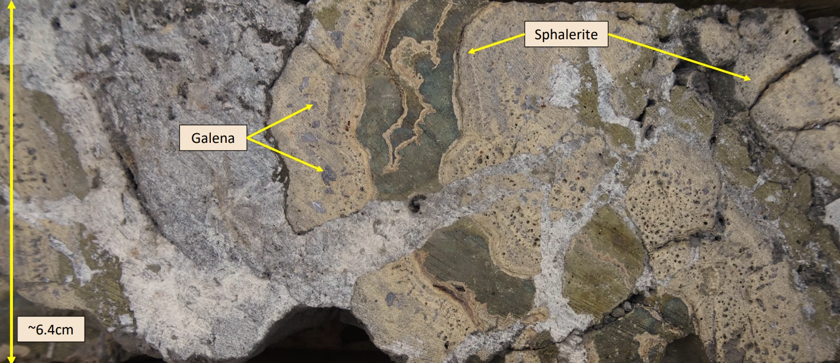

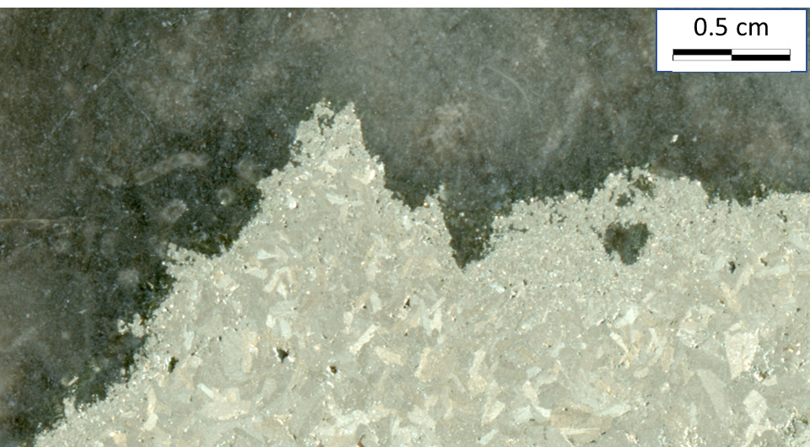
Introduction
Kildare
Abbeytown
MVT vs Irish-type
Conclusion
Mineralization
Marcasite and schallenblende in collapse breccia.
HB-98 - 98.9m
2 cm
Harberton Canal Zone – Massive sulphides
ZMI DDH Z-1046-027
Marcasite
HB-42 125.7m
Irish but not Irish-type
Irish-type Zn-Pb deposits around the world
Galway, September 8th – 10th 2023

Slide 21
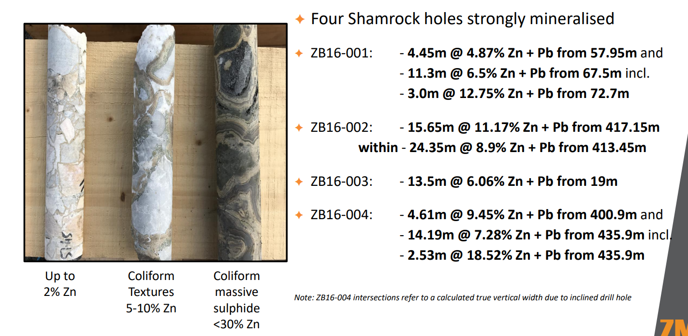
Introduction
Kildare
Abbeytown
MVT vs Irish-type
Conclusion
Shamrock zone
Up to 2% Zn
Colloform textures
5-10% Zn
Colloform massive sulphide
<30% Zn
From ZMI website
Irish but not Irish-type
Irish-type Zn-Pb deposits around the world
Galway, September 8th – 10th 2023

Slide 22
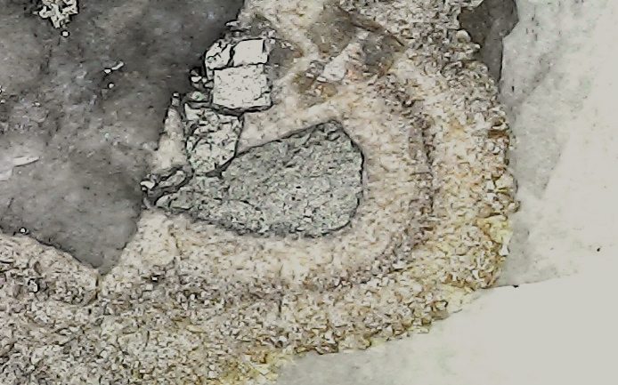
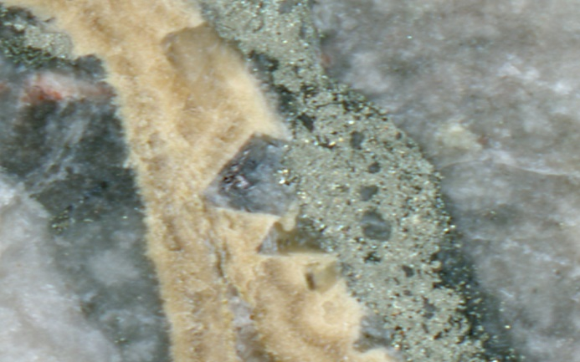
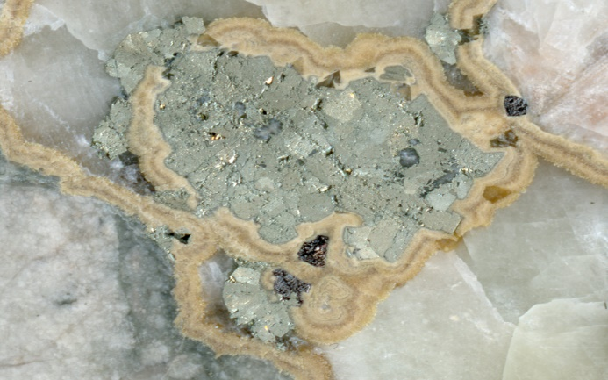
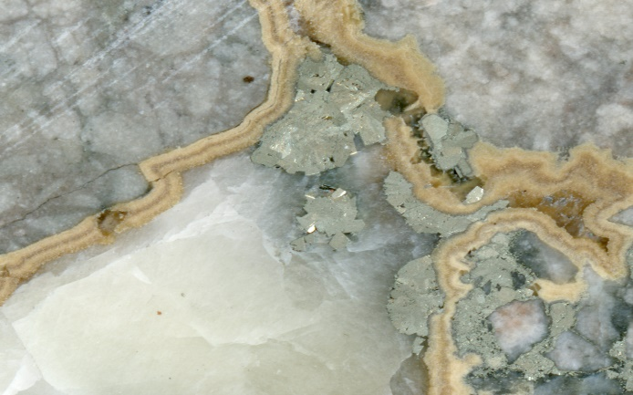
Introduction
Kildare
Abbeytown
MVT vs Irish-type
Conclusion
Paragenesis
Marcasite predating schallenblende Ferroan dolomite after marcasite Minor galena with sphalerite Late marcasite with calcite
Calcite
Dolomite
Ferroan Dolomite
Barite
Marcasite
Sphalerite
Galena
Bitumen
The paragenesis in the Kildare deposits is simple and schallenblende sphalerite shows little variation in chemistry (Fe only).
Barite is scarce and usually in late marcasite. Sulphosalts are virtually absent.
Zn-Pb
phase
Late
Fe
Modified after Trude & Wilkinson (2001)
Irish but not Irish-type
Irish-type Zn-Pb deposits around the world
Galway, September 8th – 10th 2023

Slide 23
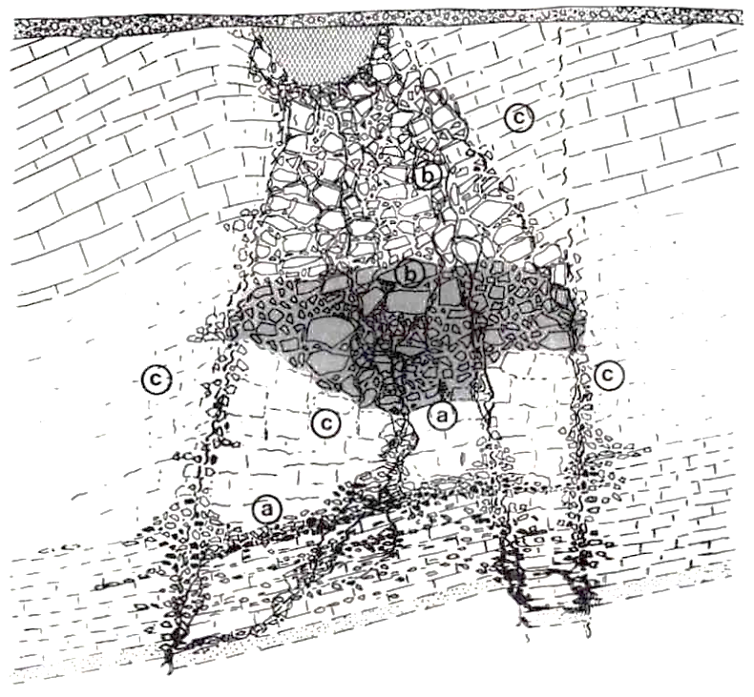
Introduction
Kildare
Abbeytown
MVT vs Irish-type
Conclusion
Breccia types
A
Rock Matrix Breccias
Precipitate Cemented Breccia
Crackle Breccia
Heterolithic Mud Matrix Breccia
B
C
D
C
Allenwood Beds
Allenwood Beds
B
B
D
Waulsortian
Mudbank
~500m
C
C
Waulsortian
Mudbank
C
A
A
Tz WML
Tz WML
Calcarenite Marker
After Emo (1986)
Irish but not Irish-type
Irish-type Zn-Pb deposits around the world
Galway, September 8th – 10th 2023

Slide 24
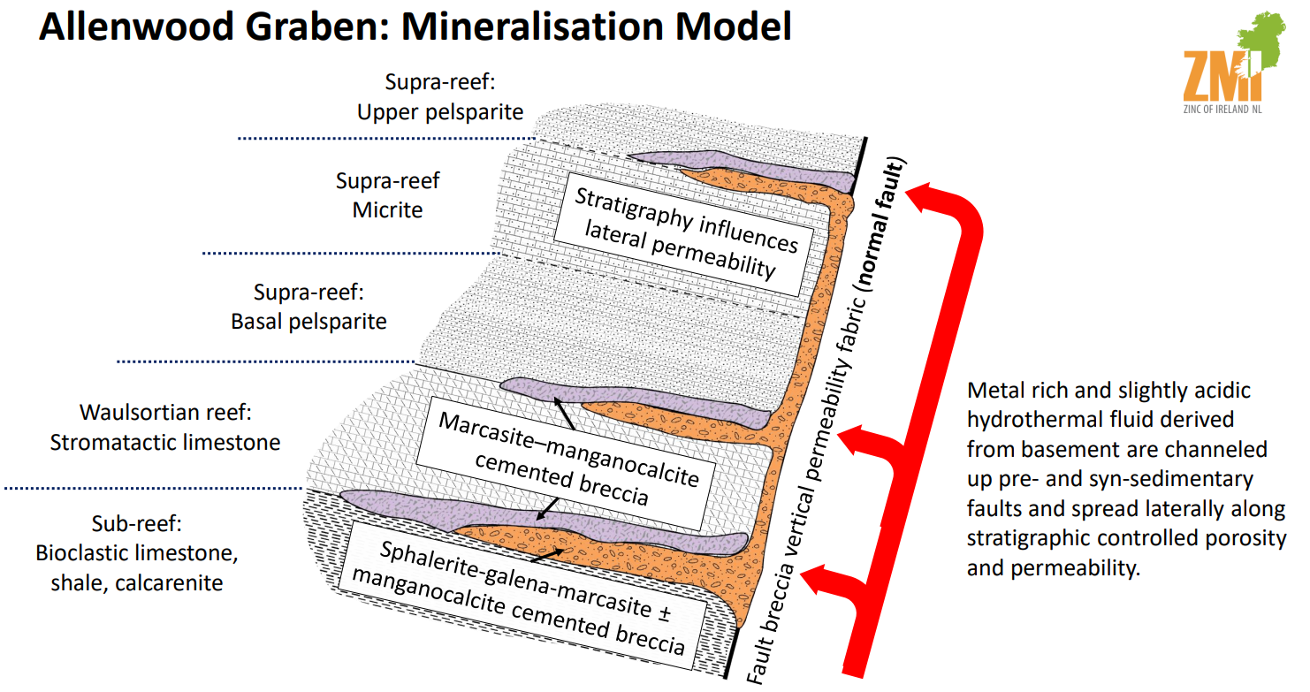
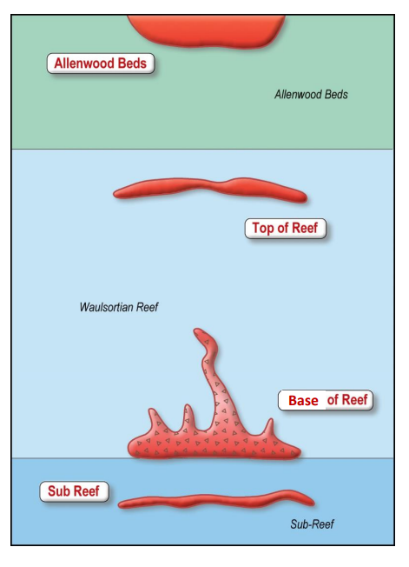
Introduction
Kildare
Abbeytown
MVT vs Irish-type
Conclusion
Allenwood graben – ZMI mineralization model
Multiple horizons
Base of reef
from ZMI website
Irish but not Irish-type
Irish-type Zn-Pb deposits around the world
Galway, September 8th – 10th 2023

Slide 25
Introduction
Kildare
Abbeytown
MVT vs Irish-type
Conclusion
Sulphur isotopes - 1
Kildare deposits
Irish-type deposits
Data from multiple sources including Gallagher et al. (1992); Dixon et al. (1986); Anderson et al. (1998).
Irish but not Irish-type
Irish-type Zn-Pb deposits around the world
Galway, September 8th – 10th 2023

Slide 26
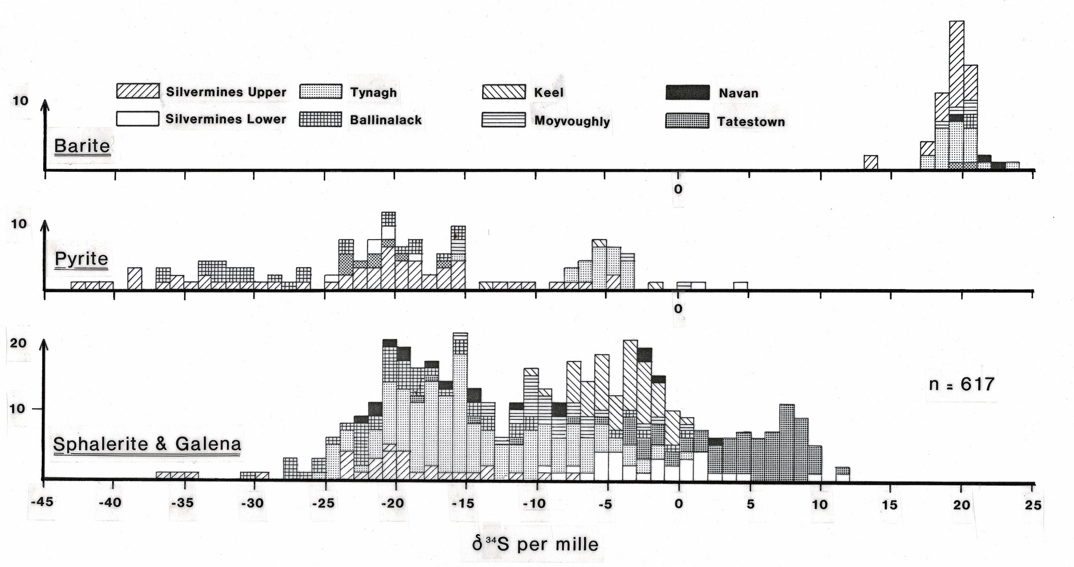
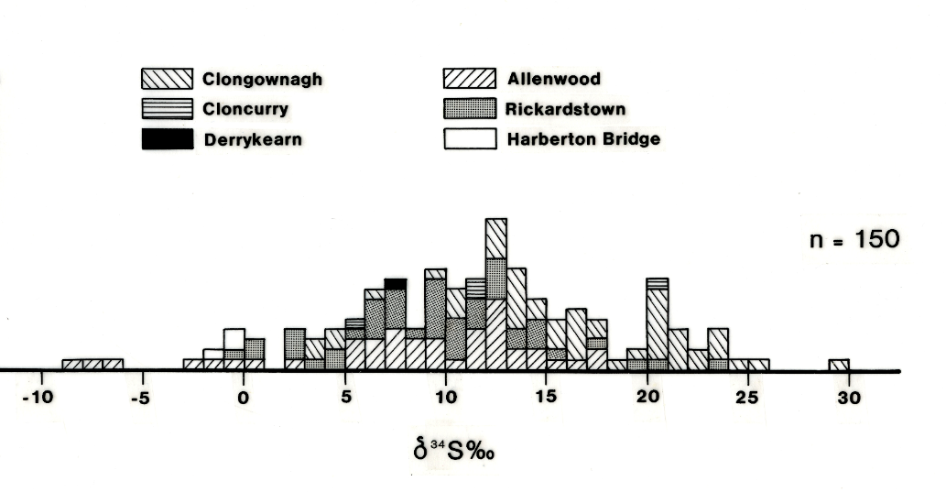
Introduction
Kildare
Abbeytown
MVT vs Irish-type
Conclusion
Sulphur isotopes - 2
Irish-type deposits
Bacteriogenic Hydrothermal Seawater SO₄
Irish but not Irish-type
Irish-type Zn-Pb deposits around the world
Galway, September 8th – 10th 2023
Notes:
Additionally the Pb isotope results from Harberton are distinctly different from other Irish deposits

Slide 27
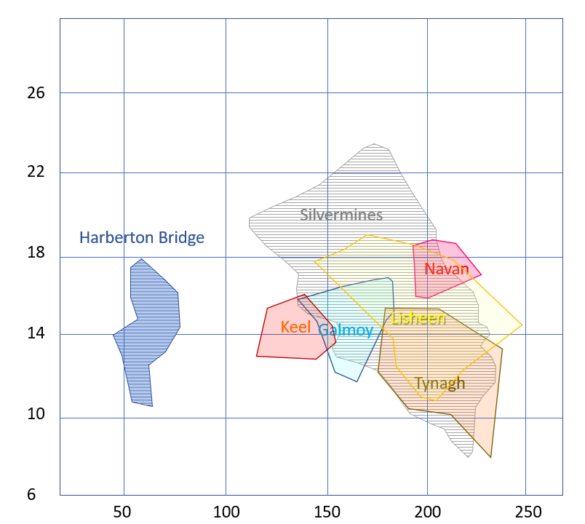
Introduction
Kildare
Abbeytown
MVT vs Irish-type
Conclusion
Fields for primary inclusions in deposit sphalerites and carbonates derived from data in Banks & Russell (1992), Everett et al. (1997, 1999), Eyre (1998) and Trude & Wilkinson (2001).
Fields for Silesia and Pine Point from Basuki & Spooner (2002).
Pine Point
Fluid inclusions
Harberton Bridge fluid inclusion homogenization temperature data is significantly different from the main Irish-type deposits.
The salinity and lower temperatures are indicative of an evaporitic source and coincident with the values for the classic MVT Districts, such as Silesia and Pine Point
Salinity (wt% NaCl equivalent)
Silesia
Homogenization Temperature (ºC)
Irish but not Irish-type
Irish-type Zn-Pb deposits around the world
Galway, September 8th – 10th 2023

Slide 28
Introduction
Kildare
Abbeytown
MVT vs Irish-type
Conclusion
Production
November 1950 to March 1958
Open Pit | 229,269
Index Bed Workings | 283,732
Lower Orebody 1 (Western Orebody) | 28,515
Total | 537,622t @ 2.6% Zn + 1.1% Pb
January 1959 to September 1961
Index Bed | 268
Lower Orebody 1 (Western Orebody) | 11,145
Lower orebody 2 (Under Index Bed) | 142,170
M Zone | 35,734
Total | 185,537t @ 2.0% Zn + 2.1% Pb
Total mined | 730,831t @ 2.45% Zn + 1.38% Pb
after Kelly, 2007
Irish but not Irish-type
Irish-type Zn-Pb deposits around the world
Galway, September 8th – 10th 2023

Slide 29
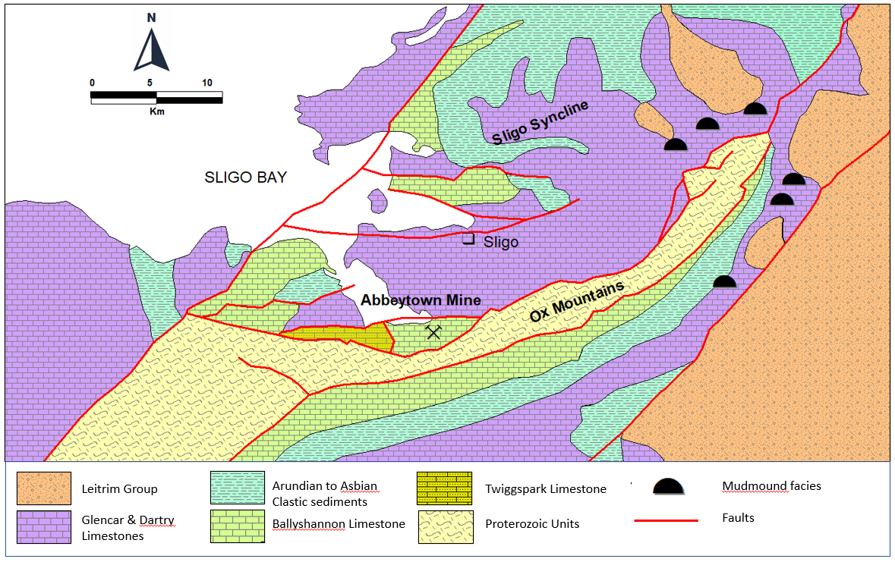
Introduction
Kildare
Abbeytown
MVT vs Irish-type
Conclusion
Regional geology
350000mN
340000mN
340000mN
150000mE
170000mE
190000mE
after Geological Survey Ireland (MacDermot et al., 1996) and Hitzman 1986
Irish but not Irish-type
Irish-type Zn-Pb deposits around the world
Galway, September 8th – 10th 2023

Slide 30
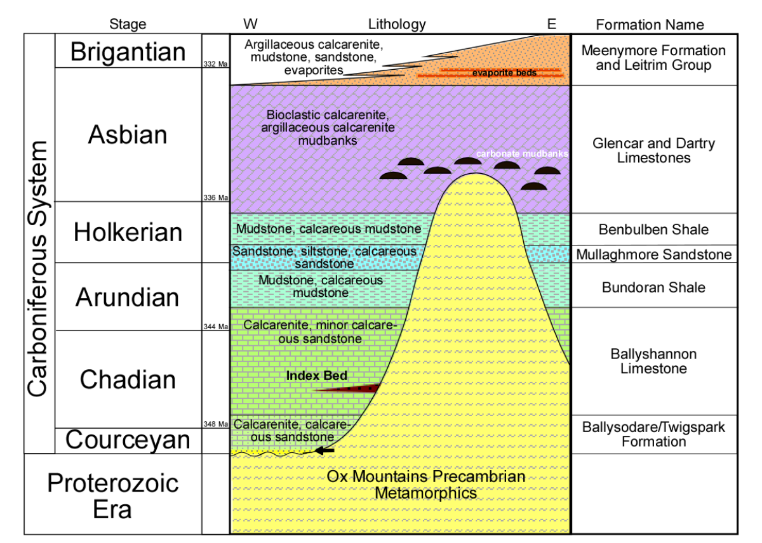
Introduction
Kildare
Abbeytown
MVT vs Irish-type
Conclusion
Stratigraphy
Meenymore Formation
Glencar and Dartry Limestones
Benbulben Shale
Mullaghmore Sandstone
Bundoran Shale
Ballyshannon Limestone
Abbeytown Lmst Mbr
Twigspark Formation
Irish but not Irish-type
Irish-type Zn-Pb deposits around the world
Galway, September 8th – 10th 2023

Slide 31
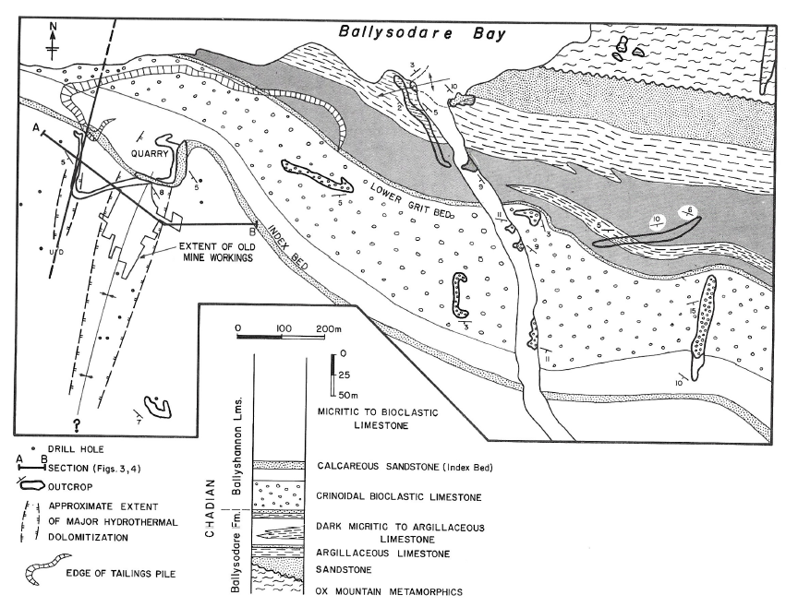
Introduction
Kildare
Abbeytown
MVT vs Irish-type
Conclusion
Mine geology
LOB 1
LOB 2
M zone
(Index workings)
after Hitzman, 1986
Irish but not Irish-type
Irish-type Zn-Pb deposits around the world
Galway, September 8th – 10th 2023

Slide 32
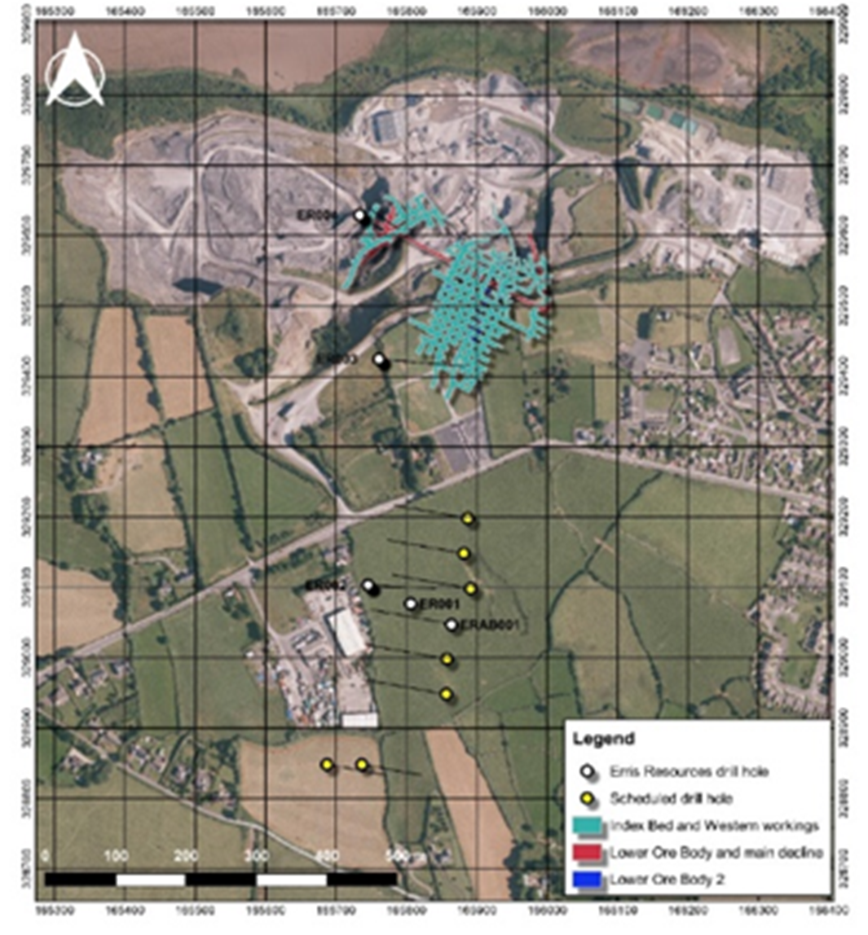
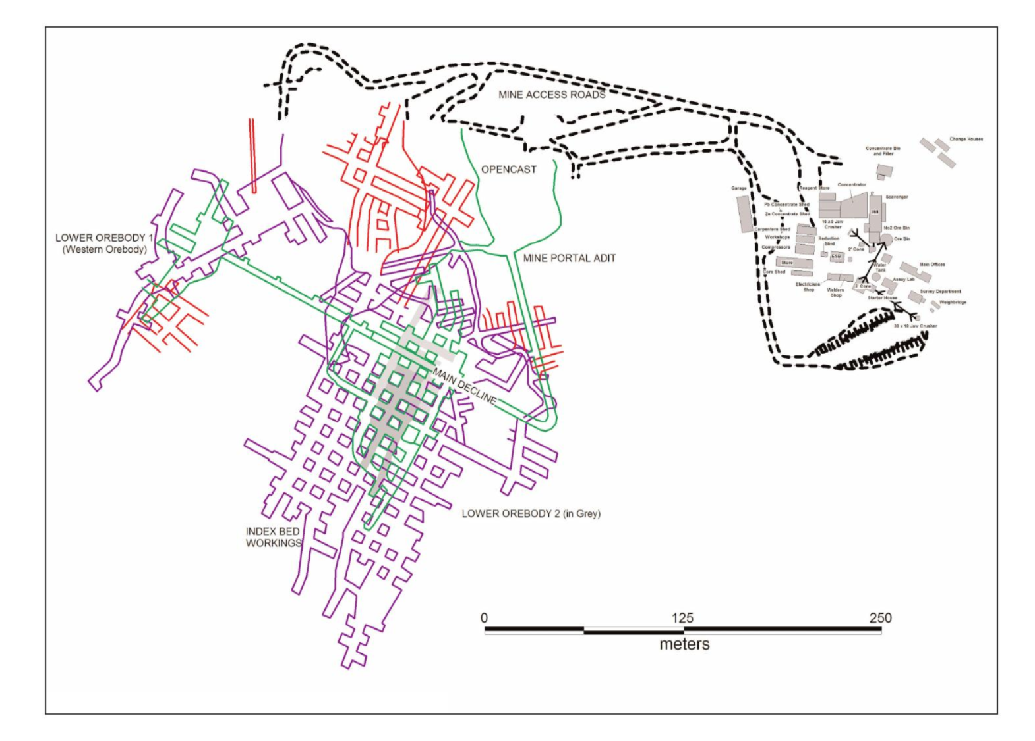
Introduction
Kildare
Abbeytown
MVT vs Irish-type
Conclusion
Mine workings
From Erris Resources website
after Kelly, 2007
Irish but not Irish-type
Irish-type Zn-Pb deposits around the world
Galway, September 8th – 10th 2023

Slide 33
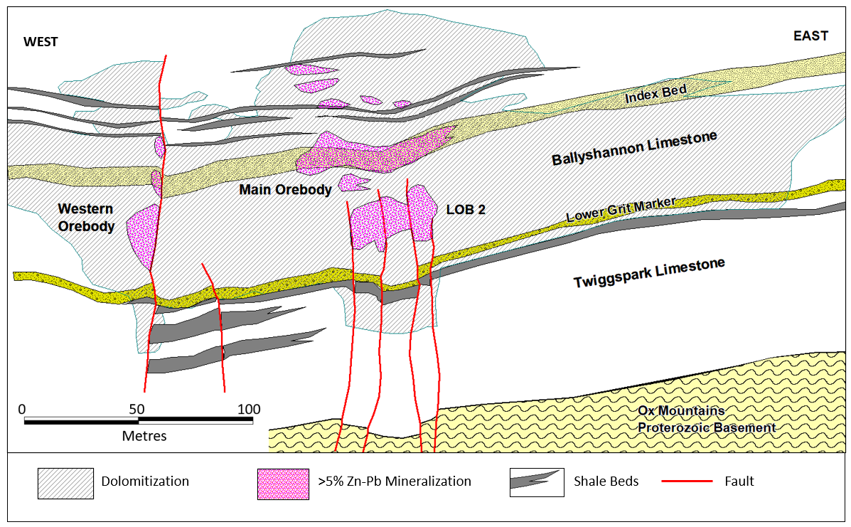
Introduction
Kildare
Abbeytown
MVT vs Irish-type
Conclusion
Mine section
after Hitzman (1986) and Persellin (2009)
Irish but not Irish-type
Irish-type Zn-Pb deposits around the world
Galway, September 8th – 10th 2023

Slide 34
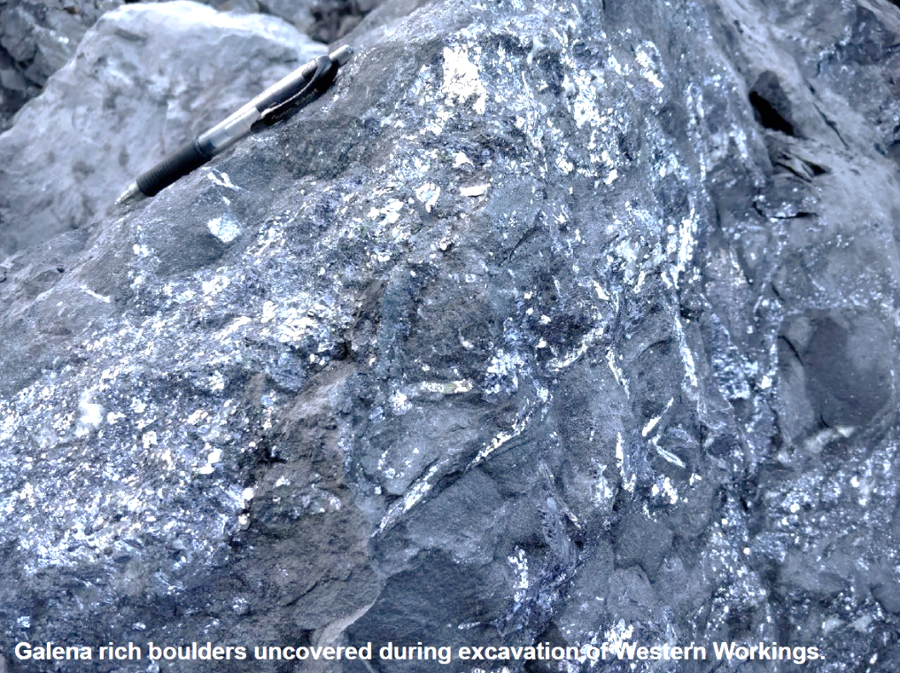
Introduction
Kildare
Abbeytown
MVT vs Irish-type
Conclusion
Mineralization
Crystalline sphalerite on dolomitized and brecciated host
Galena rich boulders from Western Workings
Irish but not Irish-type
Irish-type Zn-Pb deposits around the world
Galway, September 8th – 10th 2023

Slide 35
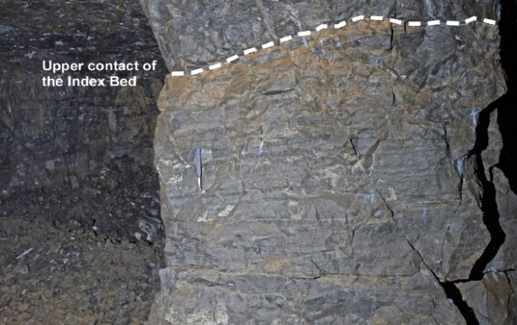
Introduction
Kildare
Abbeytown
MVT vs Irish-type
Conclusion
Index Bed mineralization
photo by Persellin
Irish but not Irish-type
Irish-type Zn-Pb deposits around the world
Galway, September 8th – 10th 2023

Slide 36
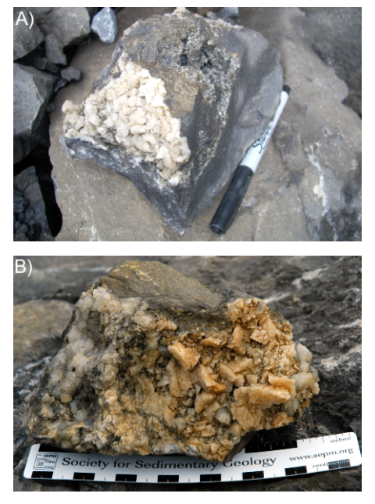
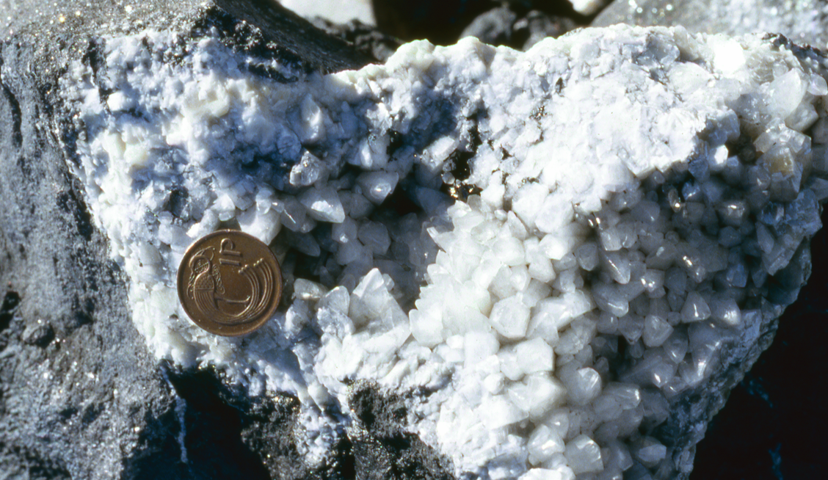
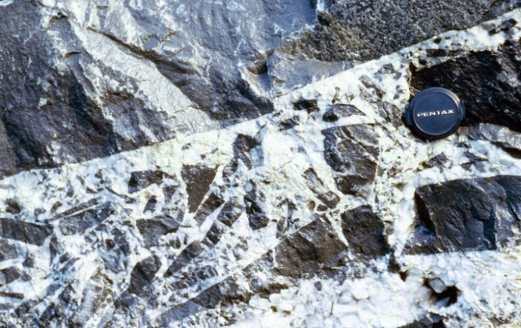
Introduction
Kildare
Abbeytown
MVT vs Irish-type
Conclusion
Dolomite and Hydrocarbons
C)
Dolomite cements
Large white saddle dolomite (left) and small grey dolomite rhombs (right)
Large, white-brown ferroan saddle dolomite with white calcite
Hydrocarbons
On calcite
On calcite
(after Persellin, 2009)
D)
Irish but not Irish-type
Irish-type Zn-Pb deposits around the world
Galway, September 8th – 10th 2023

Slide 37
Introduction
Kildare
Abbeytown
MVT vs Irish-type
Conclusion
Paragenesis
after Hitzman, 1986
Irish but not Irish-type
Irish-type Zn-Pb deposits around the world
Galway, September 8th – 10th 2023

Slide 38
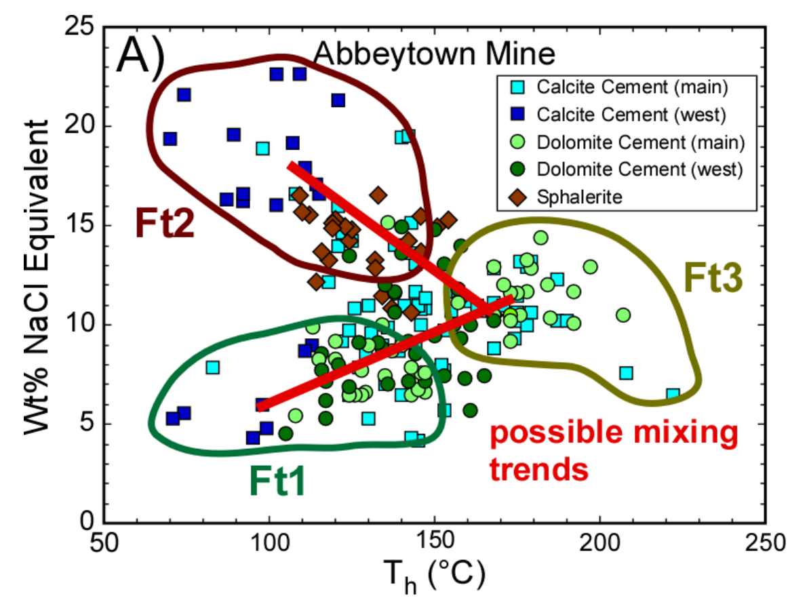
Introduction
Kildare
Abbeytown
MVT vs Irish-type
Conclusion
Fluid inclusions
after Persellin, 2009
Irish but not Irish-type
Irish-type Zn-Pb deposits around the world
Galway, September 8th – 10th 2023

Slide 39
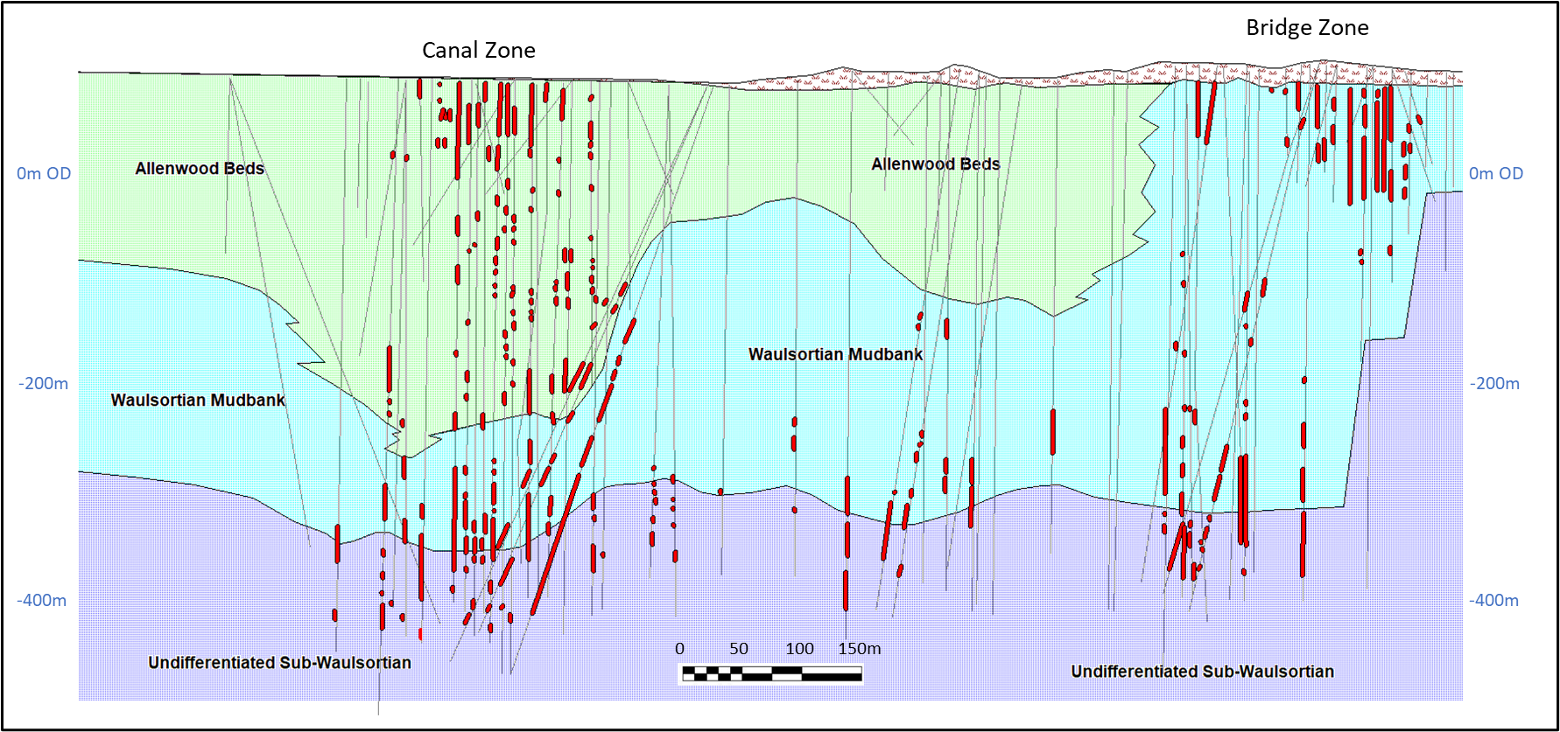

Introduction
Kildare
Abbeytown
MVT vs Irish-type
Conclusion
Deposit morphology
Irish but not Irish-type
Irish-type Zn-Pb deposits around the world
Galway, September 8th – 10th 2023

Slide 40




~60m
~400m
Pine Point, from Osisko Metals Inc website
Robb Lake, after Paradis (1999)
East Tennessee, after Leach and Sangster (1993)
Irish but not Irish-type
Irish-type Zn-Pb deposits around the world
Galway, September 8th – 10th 2023

Slide 41





Introduction
Kildare
Abbeytown
MVT vs Irish-type
Conclusion
Mineral textures
Gordonsville, Central Tennessee
Irish but not Irish-type
Irish-type Zn-Pb deposits around the world
Galway, September 8th – 10th 2023

Slide 42



Introduction
Kildare
Abbeytown
MVT vs Irish-type
Conclusion
Mineral textures
(Kildare and Abbeytown)
1
cm
Irish but not Irish-type
Irish-type Zn-Pb deposits around the world
Galway, September 8th – 10th 2023

Slide 43



Introduction
Kildare
Abbeytown
MVT vs Irish-type
Conclusion
Mineral textures
(MVT deposits from around the world)
Crackle breccia
Mosaic breccia
Pine Point, NWT
Polaris, Nunavut
Rubble breccia
20cm
Cadjebut, Western Australia
Rock matrix breccia
1cm
Robb Lake, British Columbia
Irish but not Irish-type
Irish-type Zn-Pb deposits around the world
Galway, September 8th – 10th 2023

Slide 44





Mineral textures
(MVT deposits from around the world)
Pomorzany
Trzebionka
Trzebionka
Upper Silesia, Poland
Lucky Dog, Arkansas
Nanisivik, Nunavut
Gordonsville, Tennessee
Irish but not Irish-type
Irish-type Zn-Pb deposits around the world
Galway, September 8th – 10th 2023

Slide 45


Mineral textures
(MVT deposits from around the world)
Buick, Viburnum, Missouri
Reocin, Spain
Irish but not Irish-type
Irish-type Zn-Pb deposits around the world
Galway, September 8th – 10th 2023

Slide 46




Other MVT Textures
Colloform textures
Pomorzany
Olkusz
Zebra textures
Daniel’s Harbour, Newfoundland
Cadjebut, Western Australia
Irish but not Irish-type
Irish-type Zn-Pb deposits around the world
Galway, September 8th – 10th 2023

Slide 47
Introduction
Kildare
Abbeytown
MVT vs Irish-type
Conclusion
Sulphur isotopes
Sulphur isotopes
Irish-type deposits
Bacteriogenic Hydrothermal Seawater SO₄
Irish but not Irish-type
Irish-type Zn-Pb deposits around the world
Galway, September 8th – 10th 2023

Slide 48
Introduction
Kildare
Abbeytown
MVT vs Irish-type
Conclusion
Age and timing of mineralization
Kildare
Hosted in late Chadian to early Arundian sedimentary rocks
Cut by NW-SE late faults which also displaces the Kildare Thrust which is of Variscan age (~310Ma)
Therefore, the mineralization must be post Variscan
Abbeytown
Hosted by Chadian sedimentary rocks
Post initial onset of movement (Asbian) on the faults associated with the up-lift of the Ox Mountains Inlier
Hitzman (1986) - Asbian or later age based on the structural history of the area
Halliday and Mitchell (1983) - Permian age based on K-Ar dating (270 and 285Ma) of chlorite intergrown with sphalerite and galena
Irish but not Irish-type
Irish-type Zn-Pb deposits around the world
Galway, September 8th – 10th 2023

Slide 49
Introduction
Kildare
Abbeytown
MVT vs Irish-type
Conclusion
Main differences with Irish-type deposits
Hosted by rocks younger than typical Irish-type deposits: Kildare deposits are developed over a stratigraphic interval of around 500m into post-Chadian sedimentary rocks. Abbeytown hosted by Chadian rocks.
Isotopically very different, notably with no bacteriogenic sulphur (in marked contrast to all Irish-type deposits) – evaporitic sulphur source likely.
Abundant marcasite in Kildare rather than pyrite as at the Irish-type deposits.
Simple paragenesis with limited phases.
Fluid inclusions: - 45-70°C, 12-17wt% NaCl equivalent (lower T).
Evidence suggests that both the Kildare and Abbeytown deposits are younger than Irish-type deposits.
Irish but not Irish-type
Irish-type Zn-Pb deposits around the world
Galway, September 8th – 10th 2023

Slide 50
Introduction
Kildare
Abbeytown
MVT vs Irish-type
Conclusion
Conclusion
The term ‘‘Irish-type’’ should be reserved for deposits that display the criteria usually associated with such deposits.
The Kildare and Abbeytown deposits have features that do not occur in Irish-type deposits.
The deposits in Kildare and at Abbeytown display many features that are typical of Mississippi Valley-type deposits.
However, the deposits in Kildare and at Abbeytown represent an end-member of the spectrum of mineral deposits observed in the Irish Orefield – they are Irish but not Irish-type.
Irish but not Irish-type
Irish-type Zn-Pb deposits around the world
Galway, September 8th – 10th 2023

