Slide 1
A review of the Limerick Igneous Suite (LIS): links to base metal mineralisation in the SW Irish orefield
Paul Slezak¹, Danny Hnatyshin², Alejandro Andrés³, Eoin Dunlevy⁴, Hilde Koch⁵, Mark Holdstock⁶, Murray W. Hitzman¹
¹iCRAG, School of Earth Science, University College Dublin, Dublin 4, Ireland
²Natural Resources Canada, Geological Survey of Canada, 601 Booth Street, Ottawa, Ontario K1A0EA, Canada
³STU Department of the Faculty of Sciences and Techniques, Nantes Université, 2 Chem. de la Houssinière Bâtiment 4, 44300 Nantes, France
⁴Terranta GmbH, Rathausstraße 37a | 52072 Aachen, Germany
⁵Earth Surface Research Laboratory (ESRL), Unit 6b, Trinity Technology & Enterprise Centre (TTEC), Pearce Street, Dublin 2, Ireland
⁶Group Eleven Mining & Exploration Ltd, 22 Northumberland Road, Dublin 4, Ireland

Slide 2
Outline
Location
Stratigraphic context
Limerick Igneous Suite
Different units (core and petrography)
How to distinguish geochemically
Why they’re so complicated (model)
4. Geochemical origins
5. Date & isotopes
6. Tectonic context and models

Slide 3
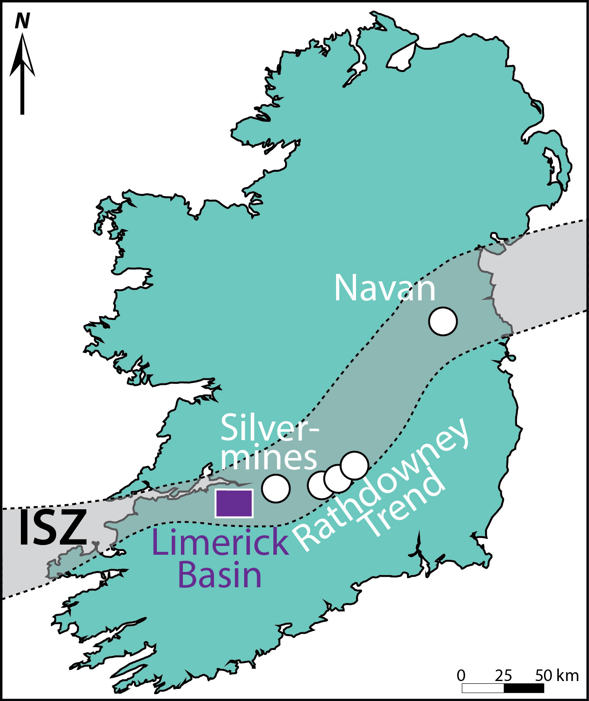
1. Location
3
Laurentia
Avalonia
(Modified from Slezak et al. 2023; Ashton et al. this volume)

Slide 4
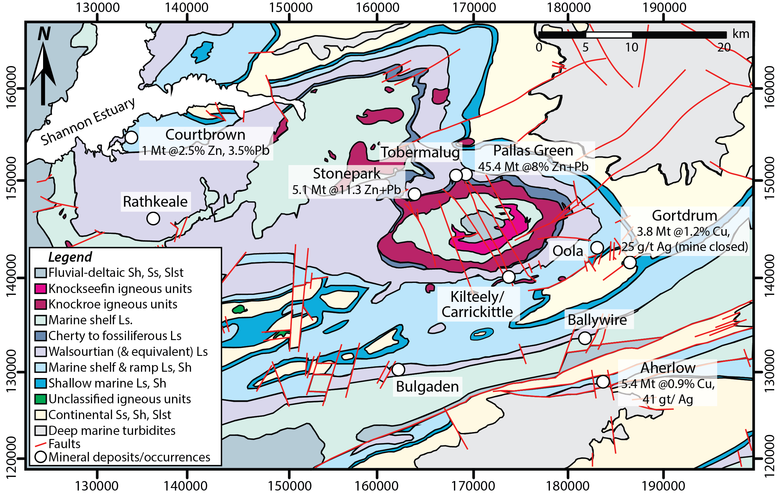
I. Location, Location
4
(Modified from Slezak et al. 2023)

Slide 5
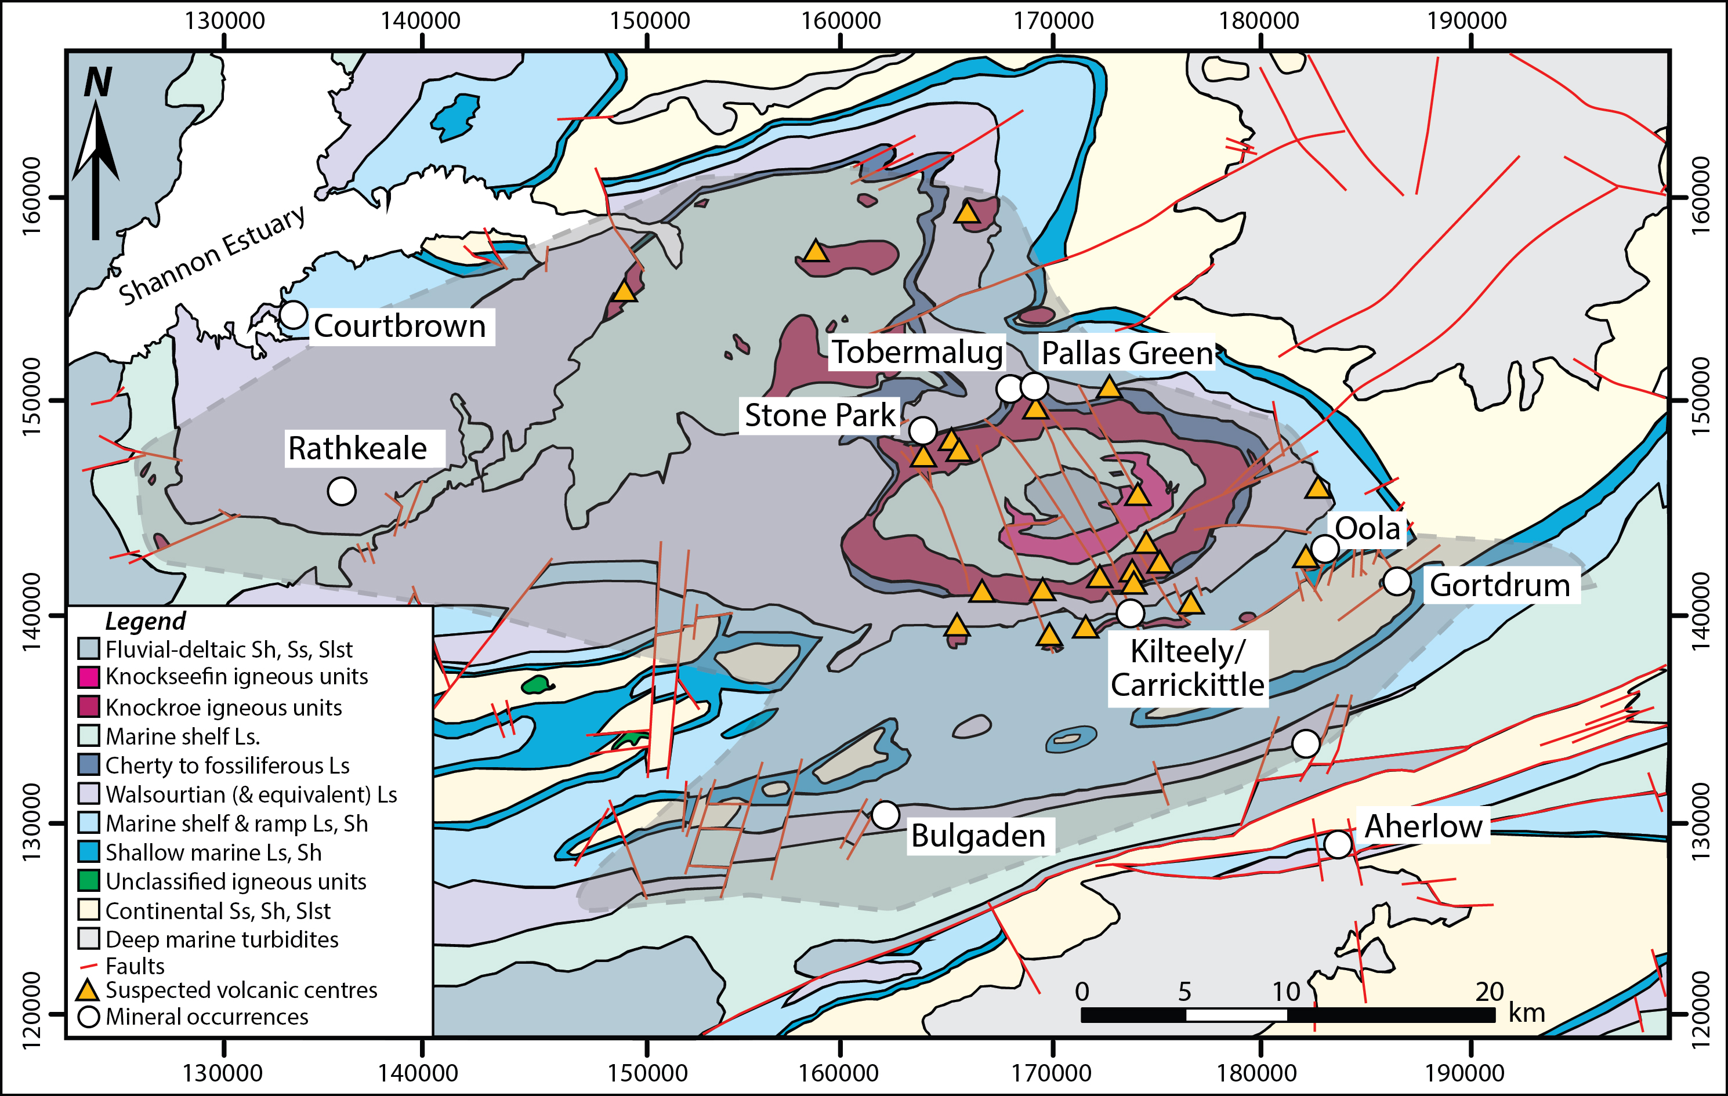
1. Location, Location, Location
5
(Modified from Slezak et al. 2023)

Slide 6
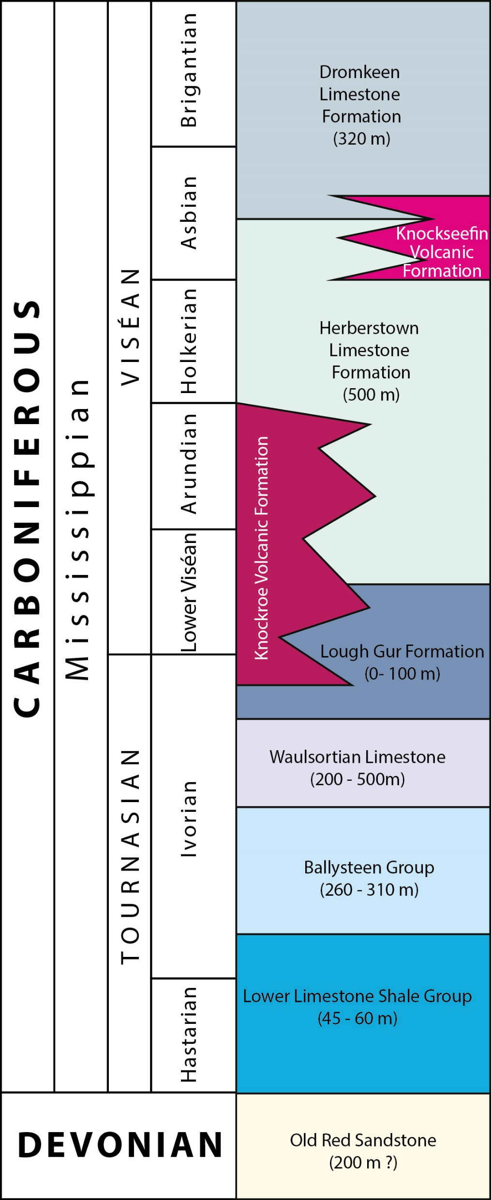
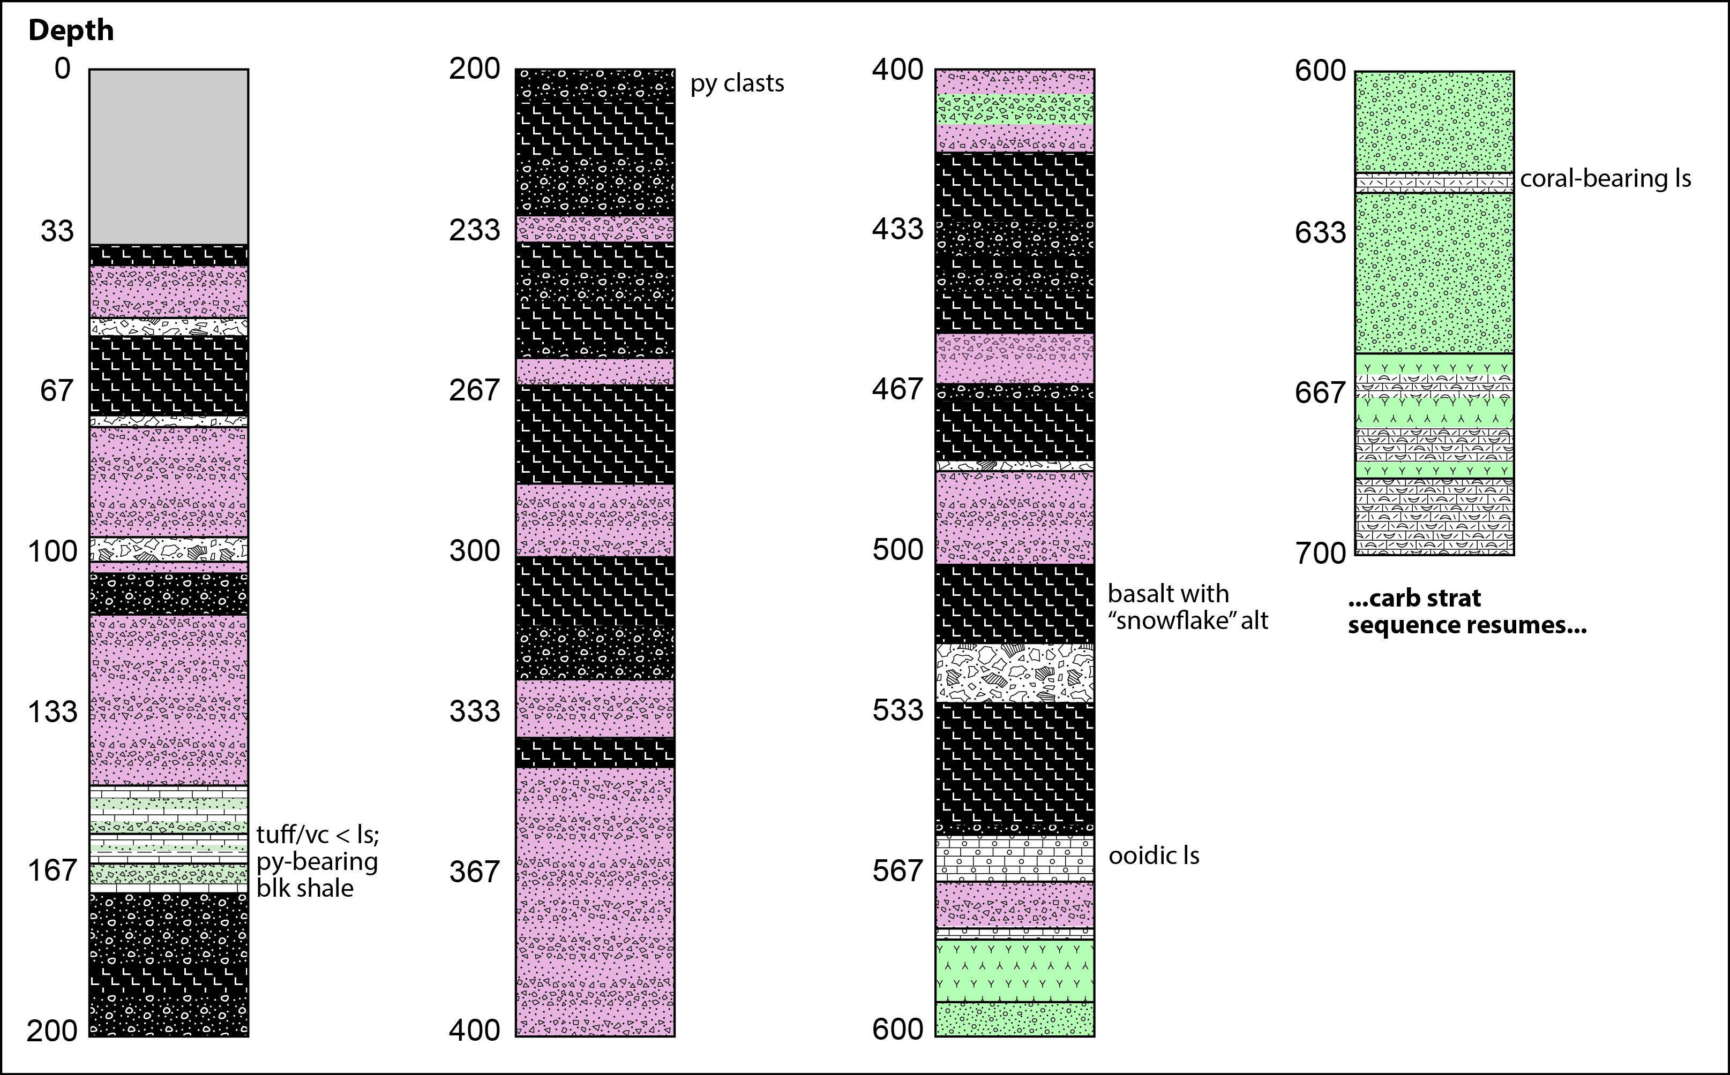
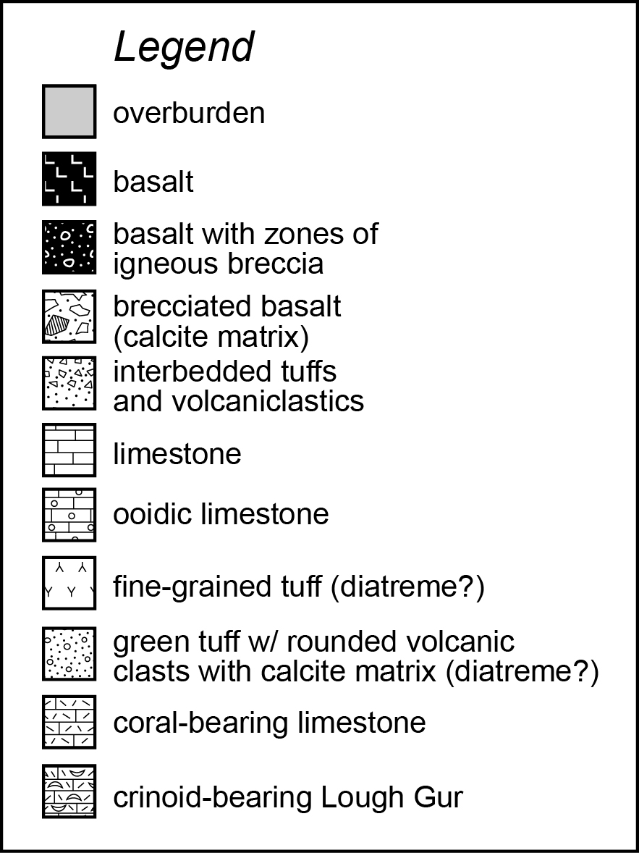
2. “Stratigraphy”
6
???

Slide 7
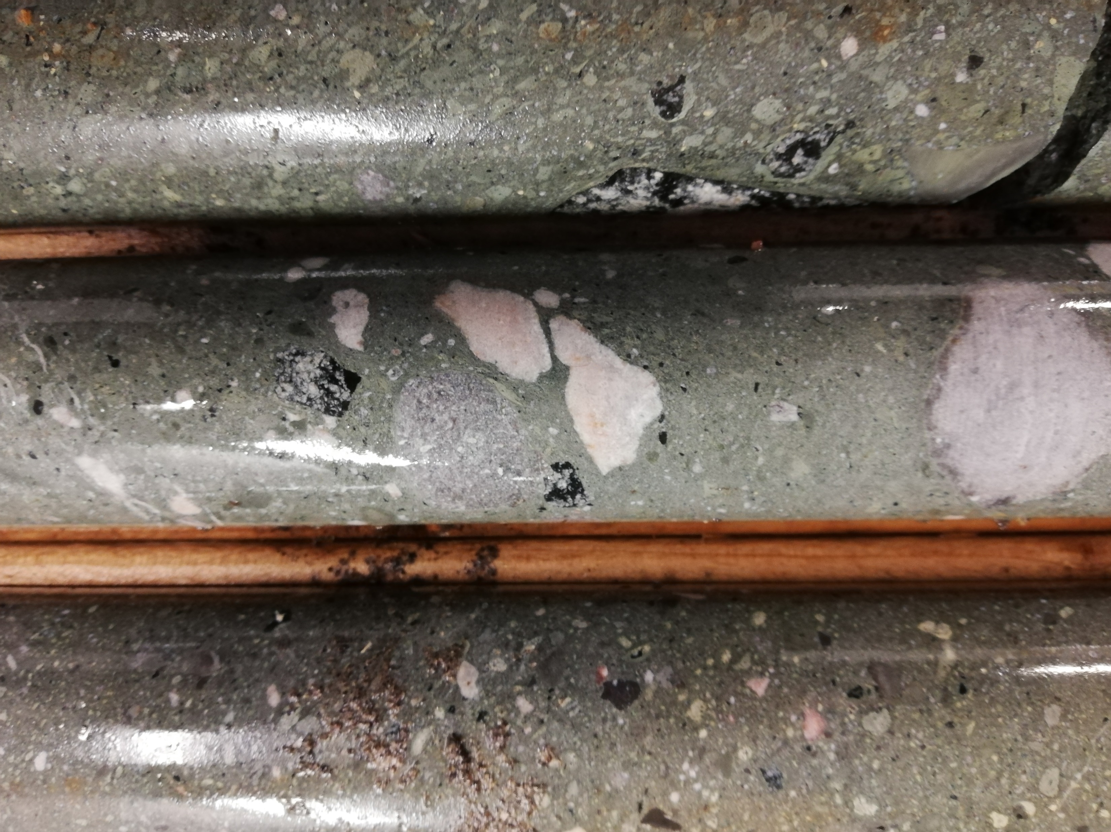
3. Diatremes
7

Slide 8
3. Diatremes
8

Slide 9
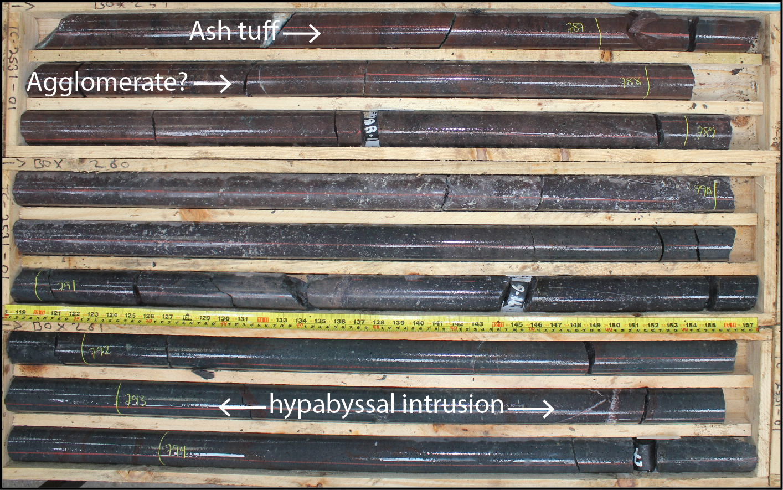
3. Knockroe units
9

Slide 10
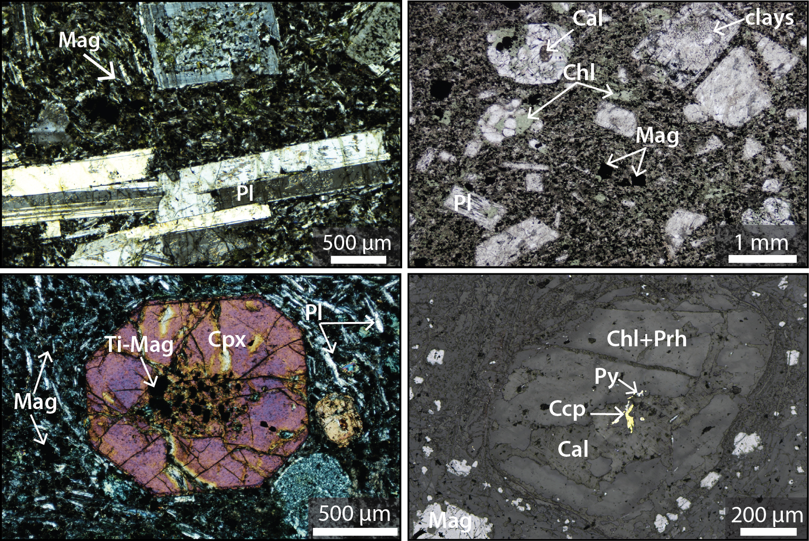
3. Knockroe
10

Slide 11
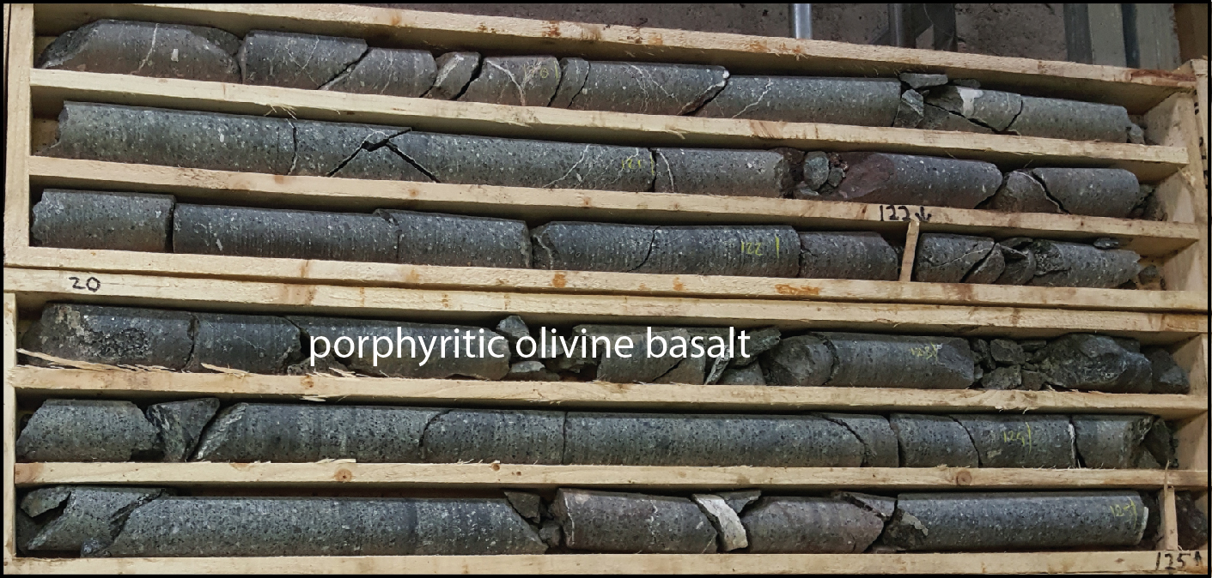
3. Knockroe: porphyritic olivine basalts
11

Slide 12
3. Knockroe: porphyritic olivine basalts
12

Slide 13
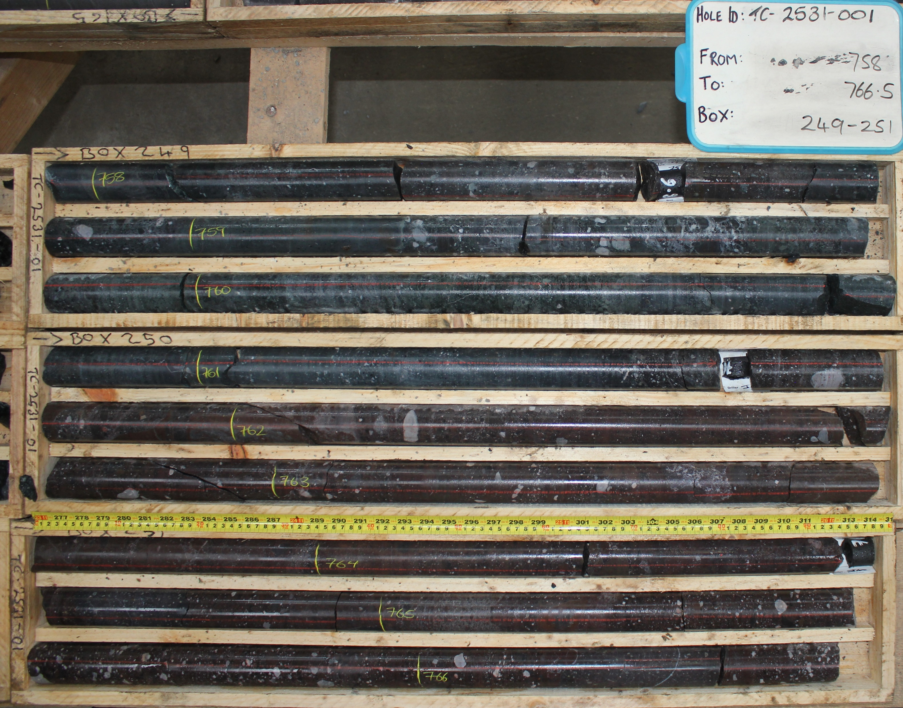
4. Knockroe/ Knockseefin contact
13

Slide 14
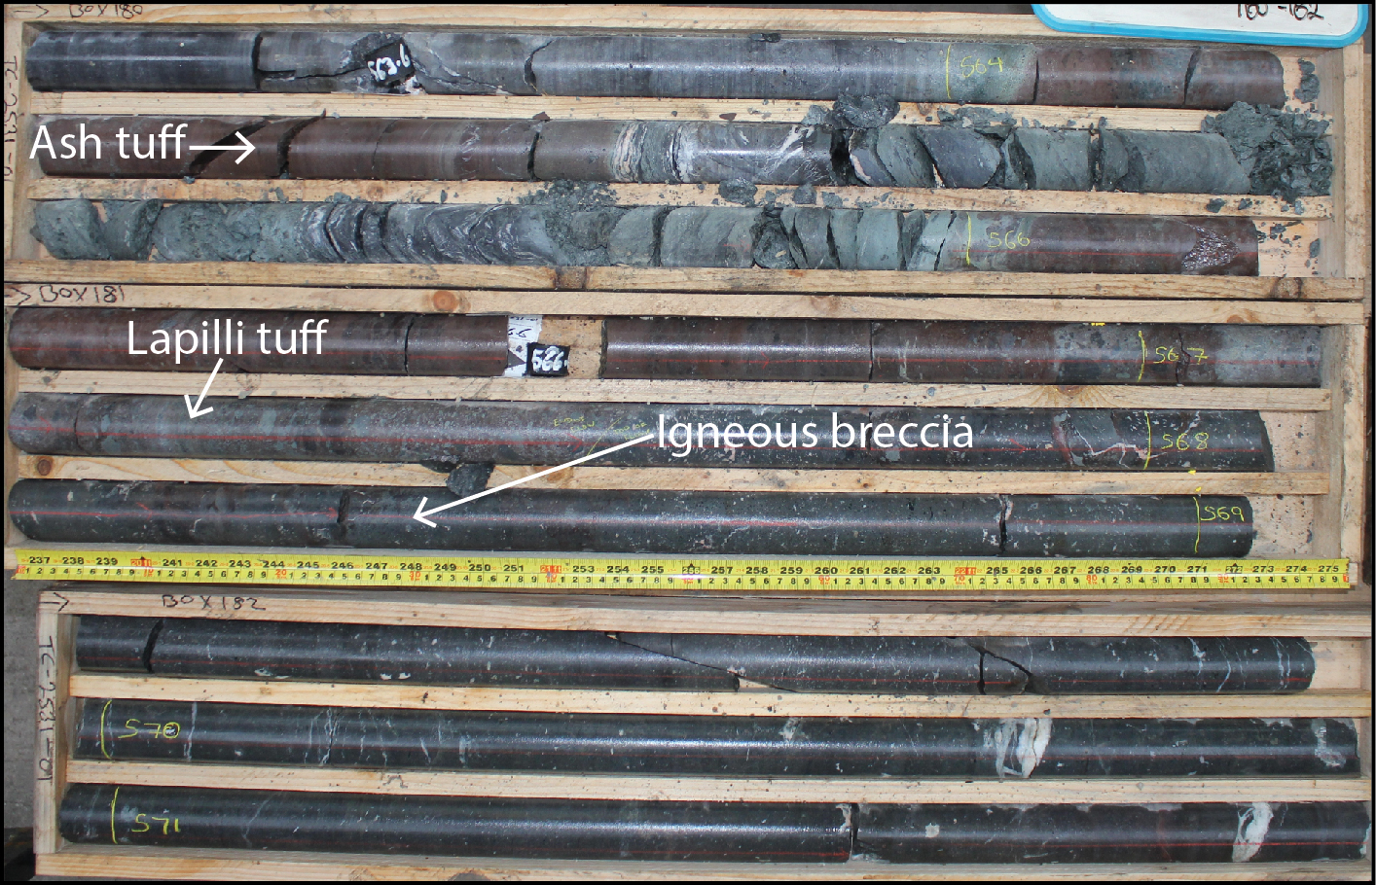
3. Knockseefin
14

Slide 15
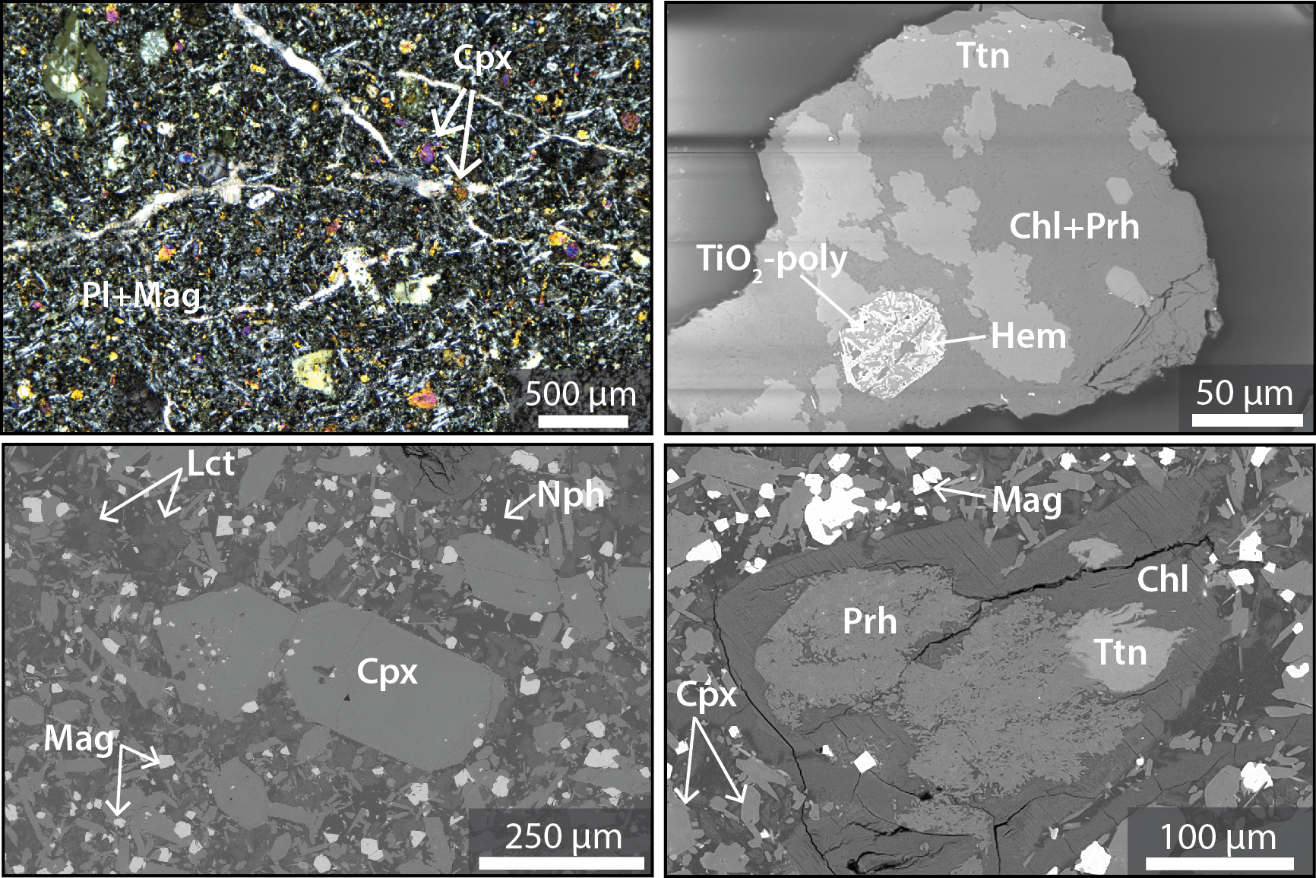
3. Knockseefin
15

Slide 16
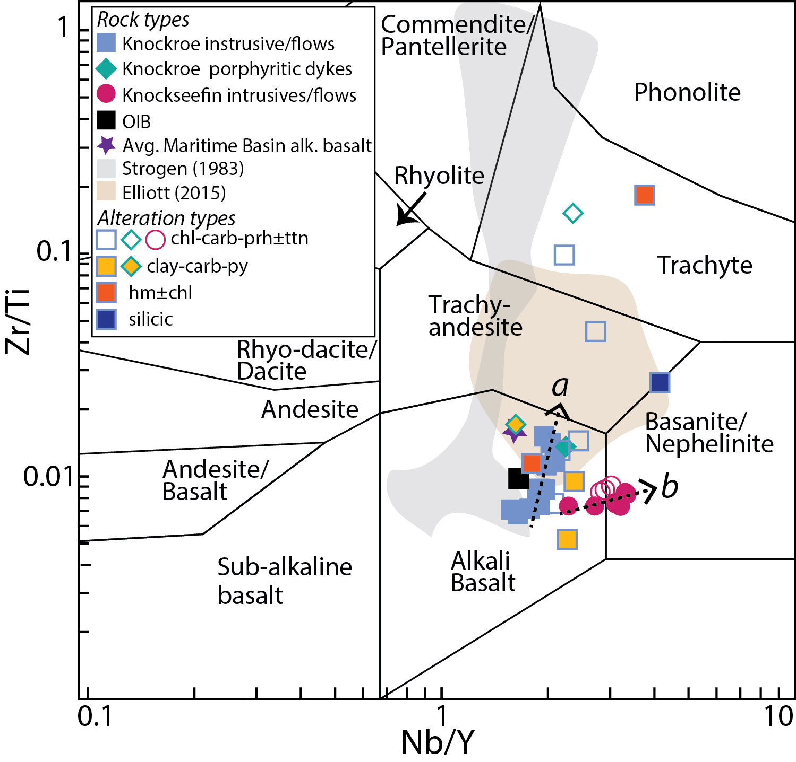
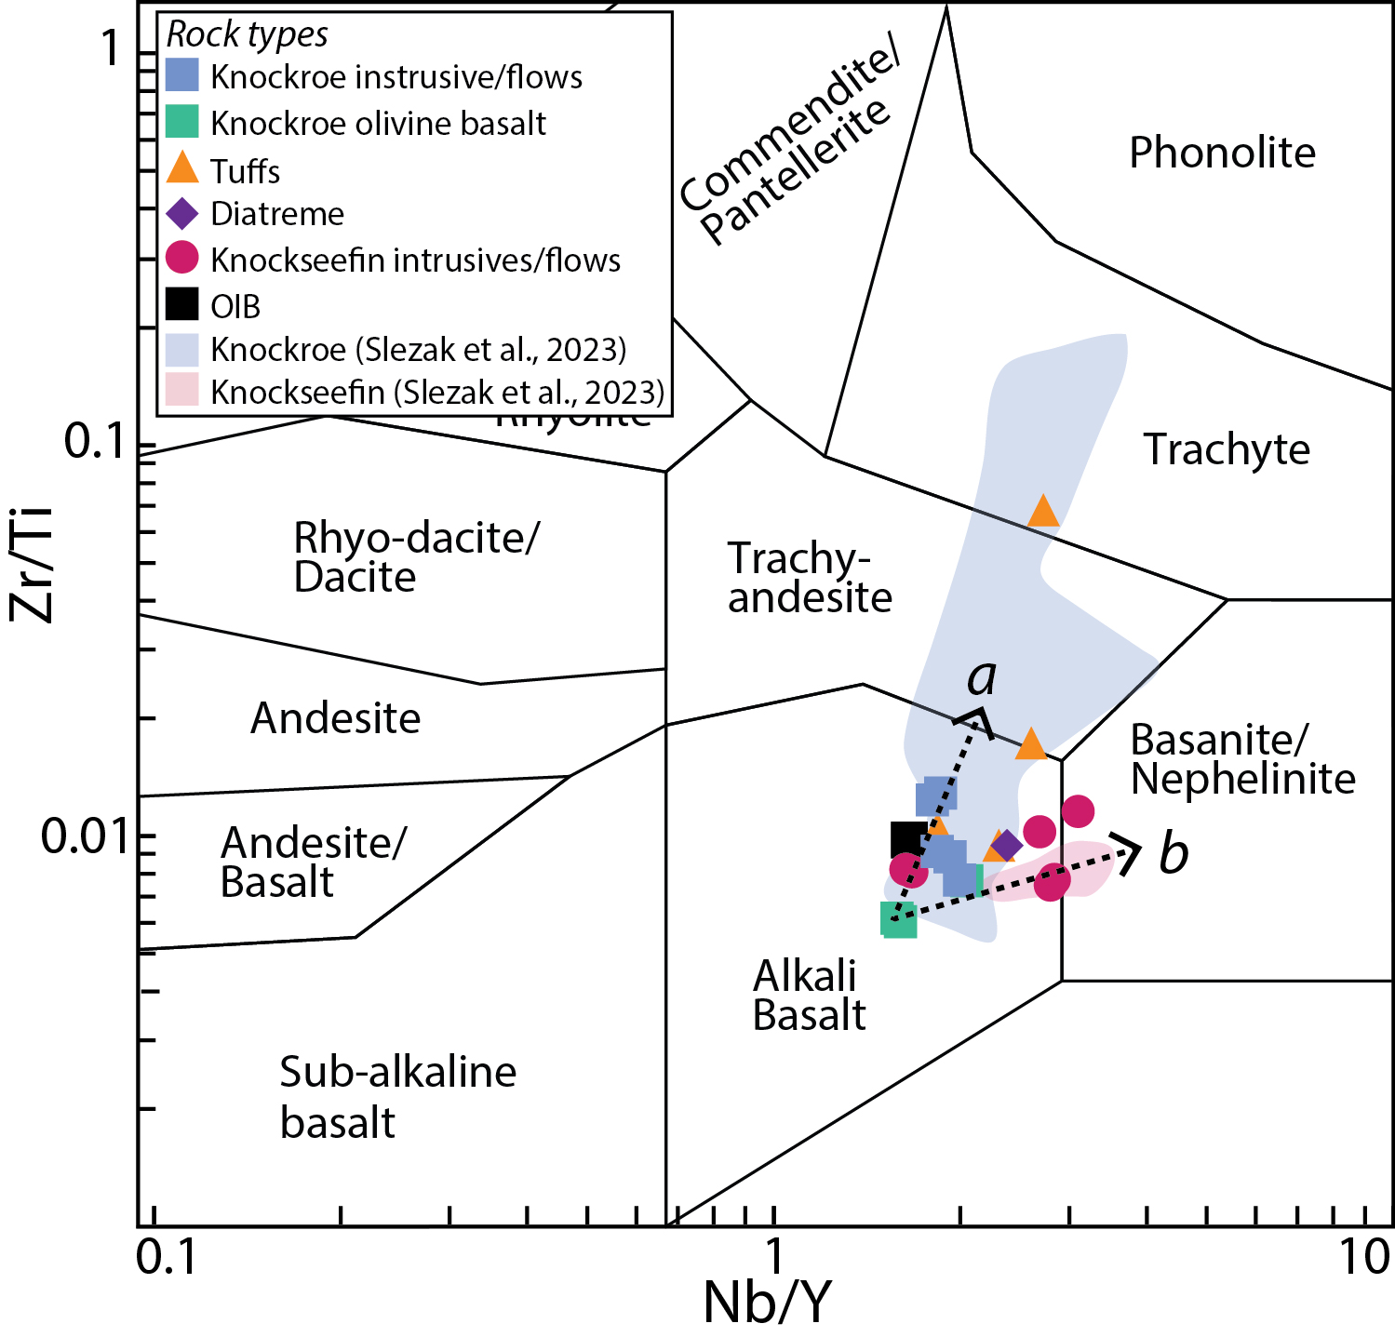
3. LIS bulk rock geochemistry
16
(Slezak et al. 2023)
Notes:
Only talk about Ti mobility here. Leave alteration with seawater until later

Slide 17
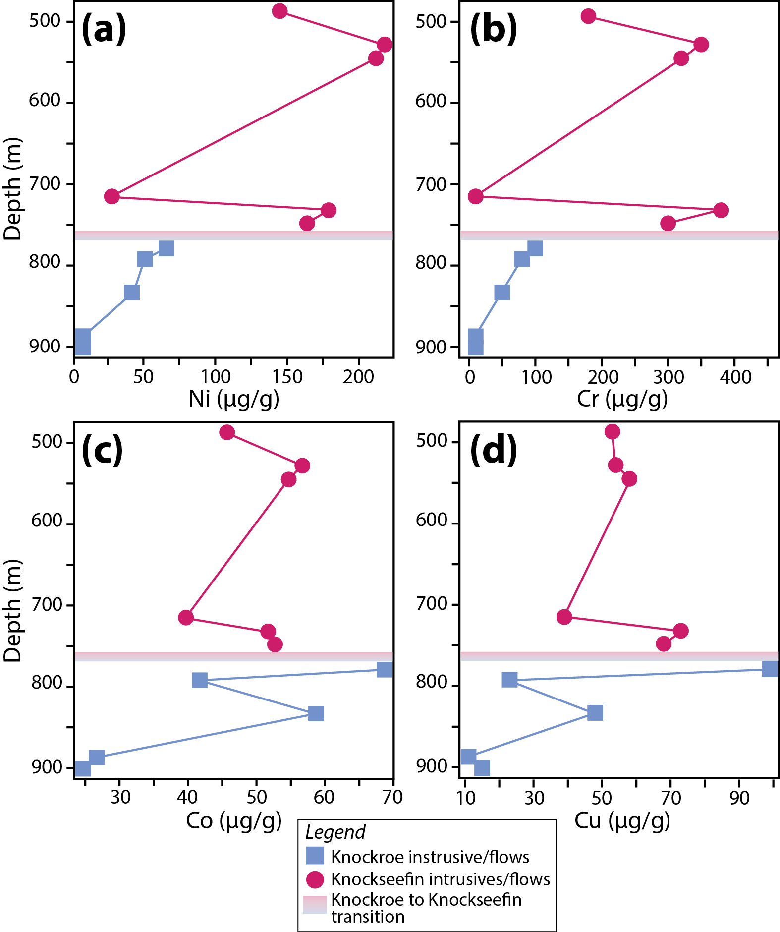
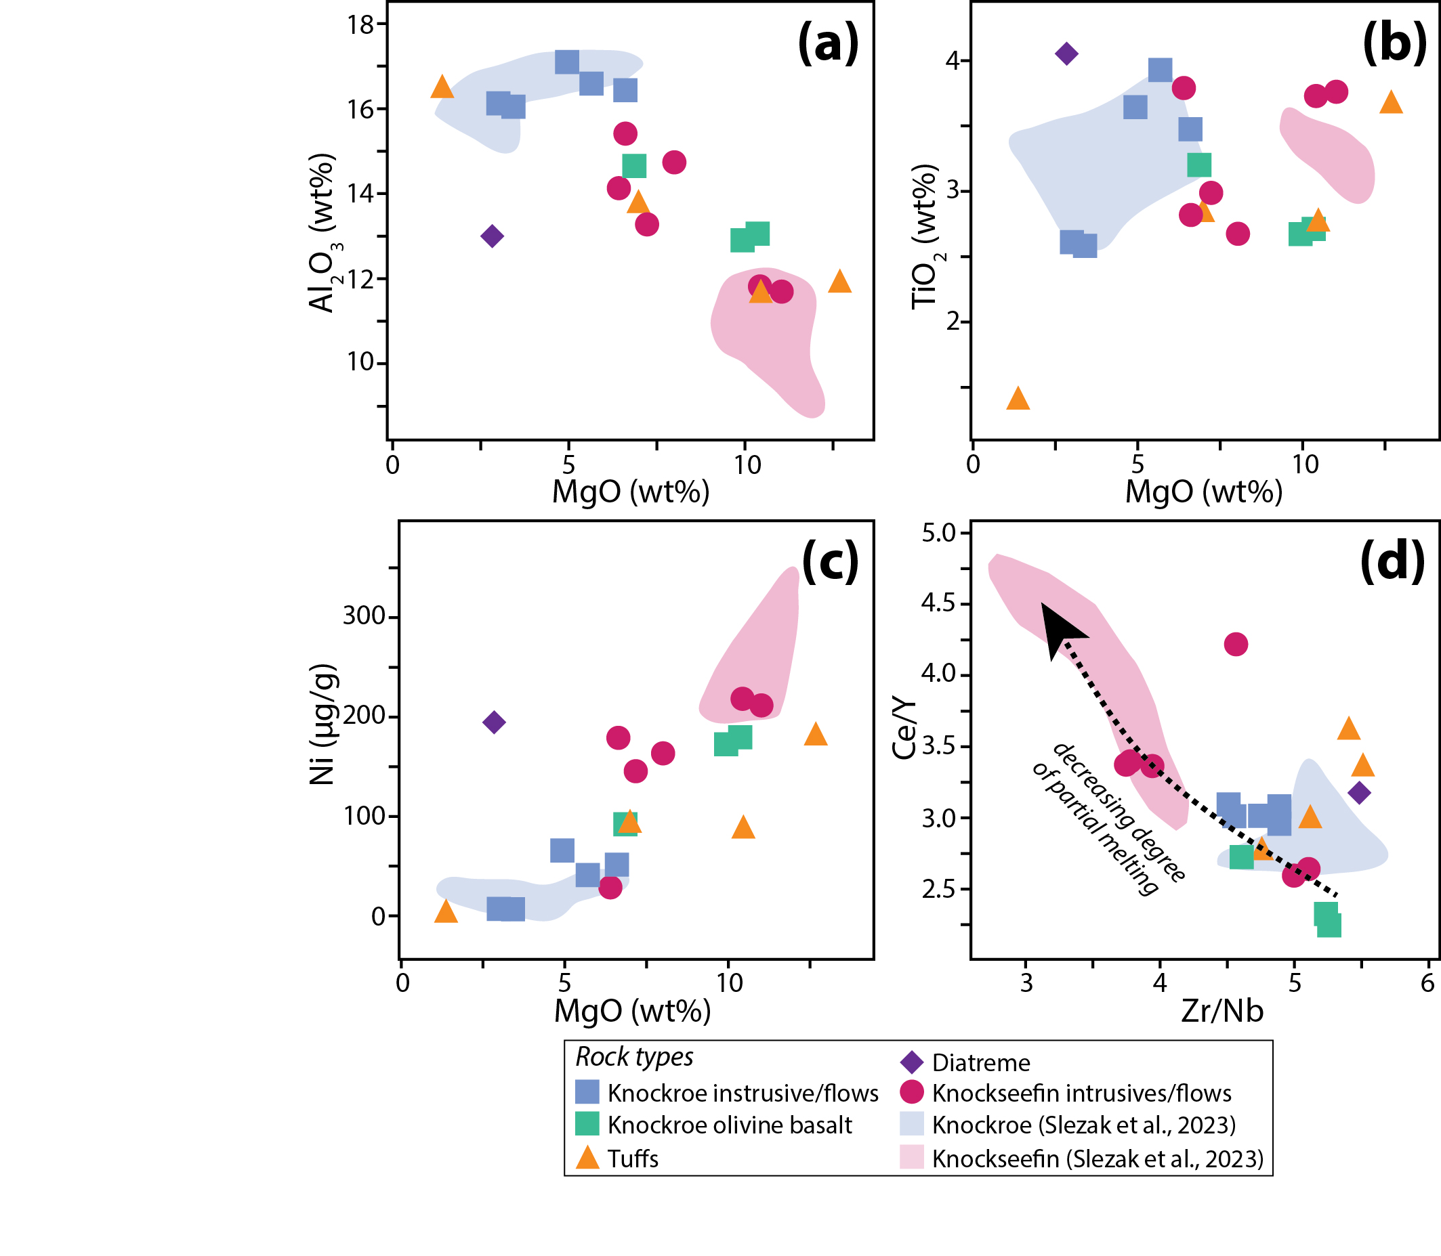
3. LIS bulk rock geochemistry
17

Slide 18
3.LIS models: volcanic successions
18
(Modified from Strogen 1983)

Slide 19
3. LIS models: volcanic successions
19
(Modified from Strogen 1983)

Slide 20
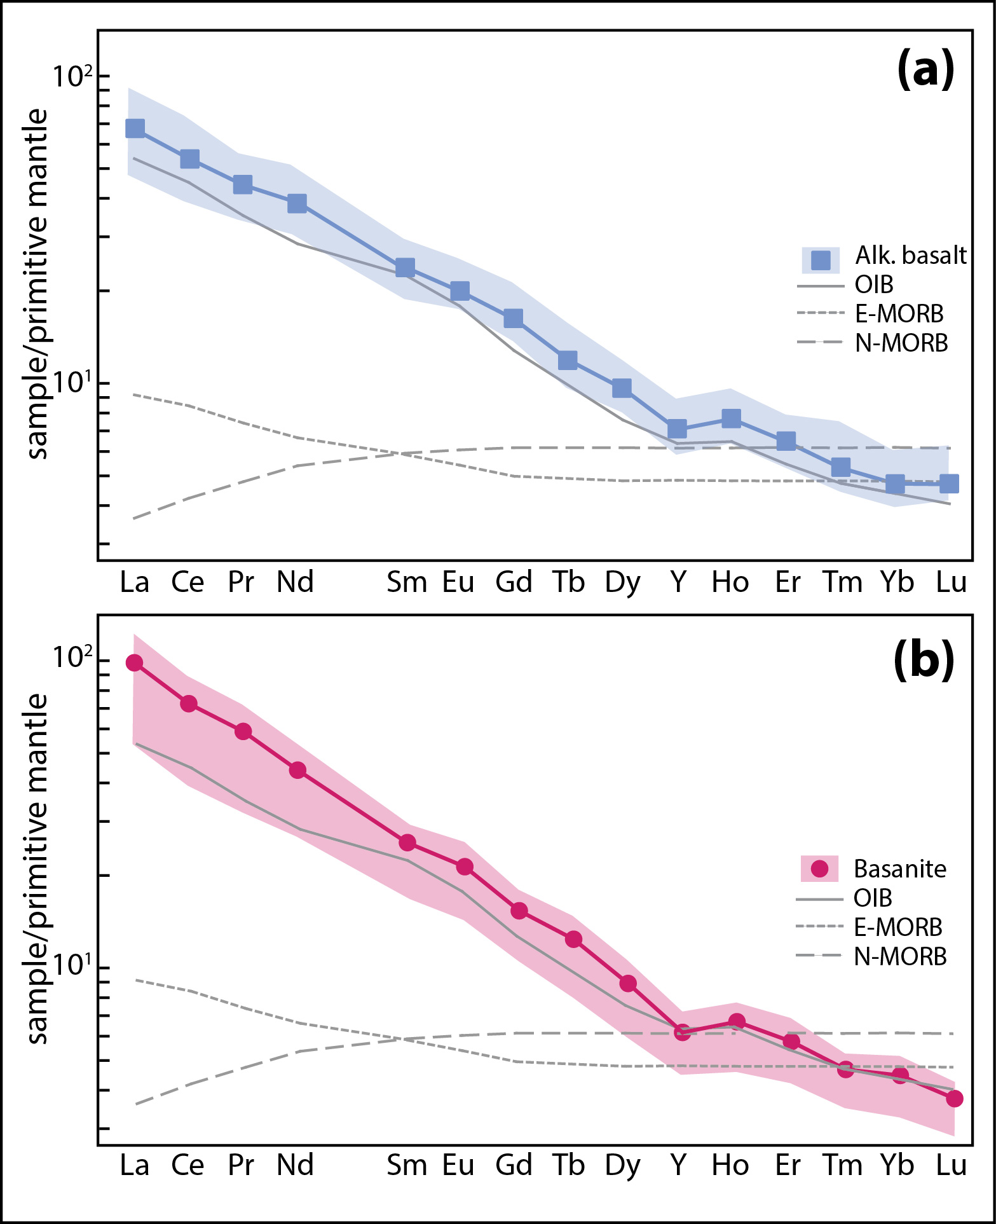
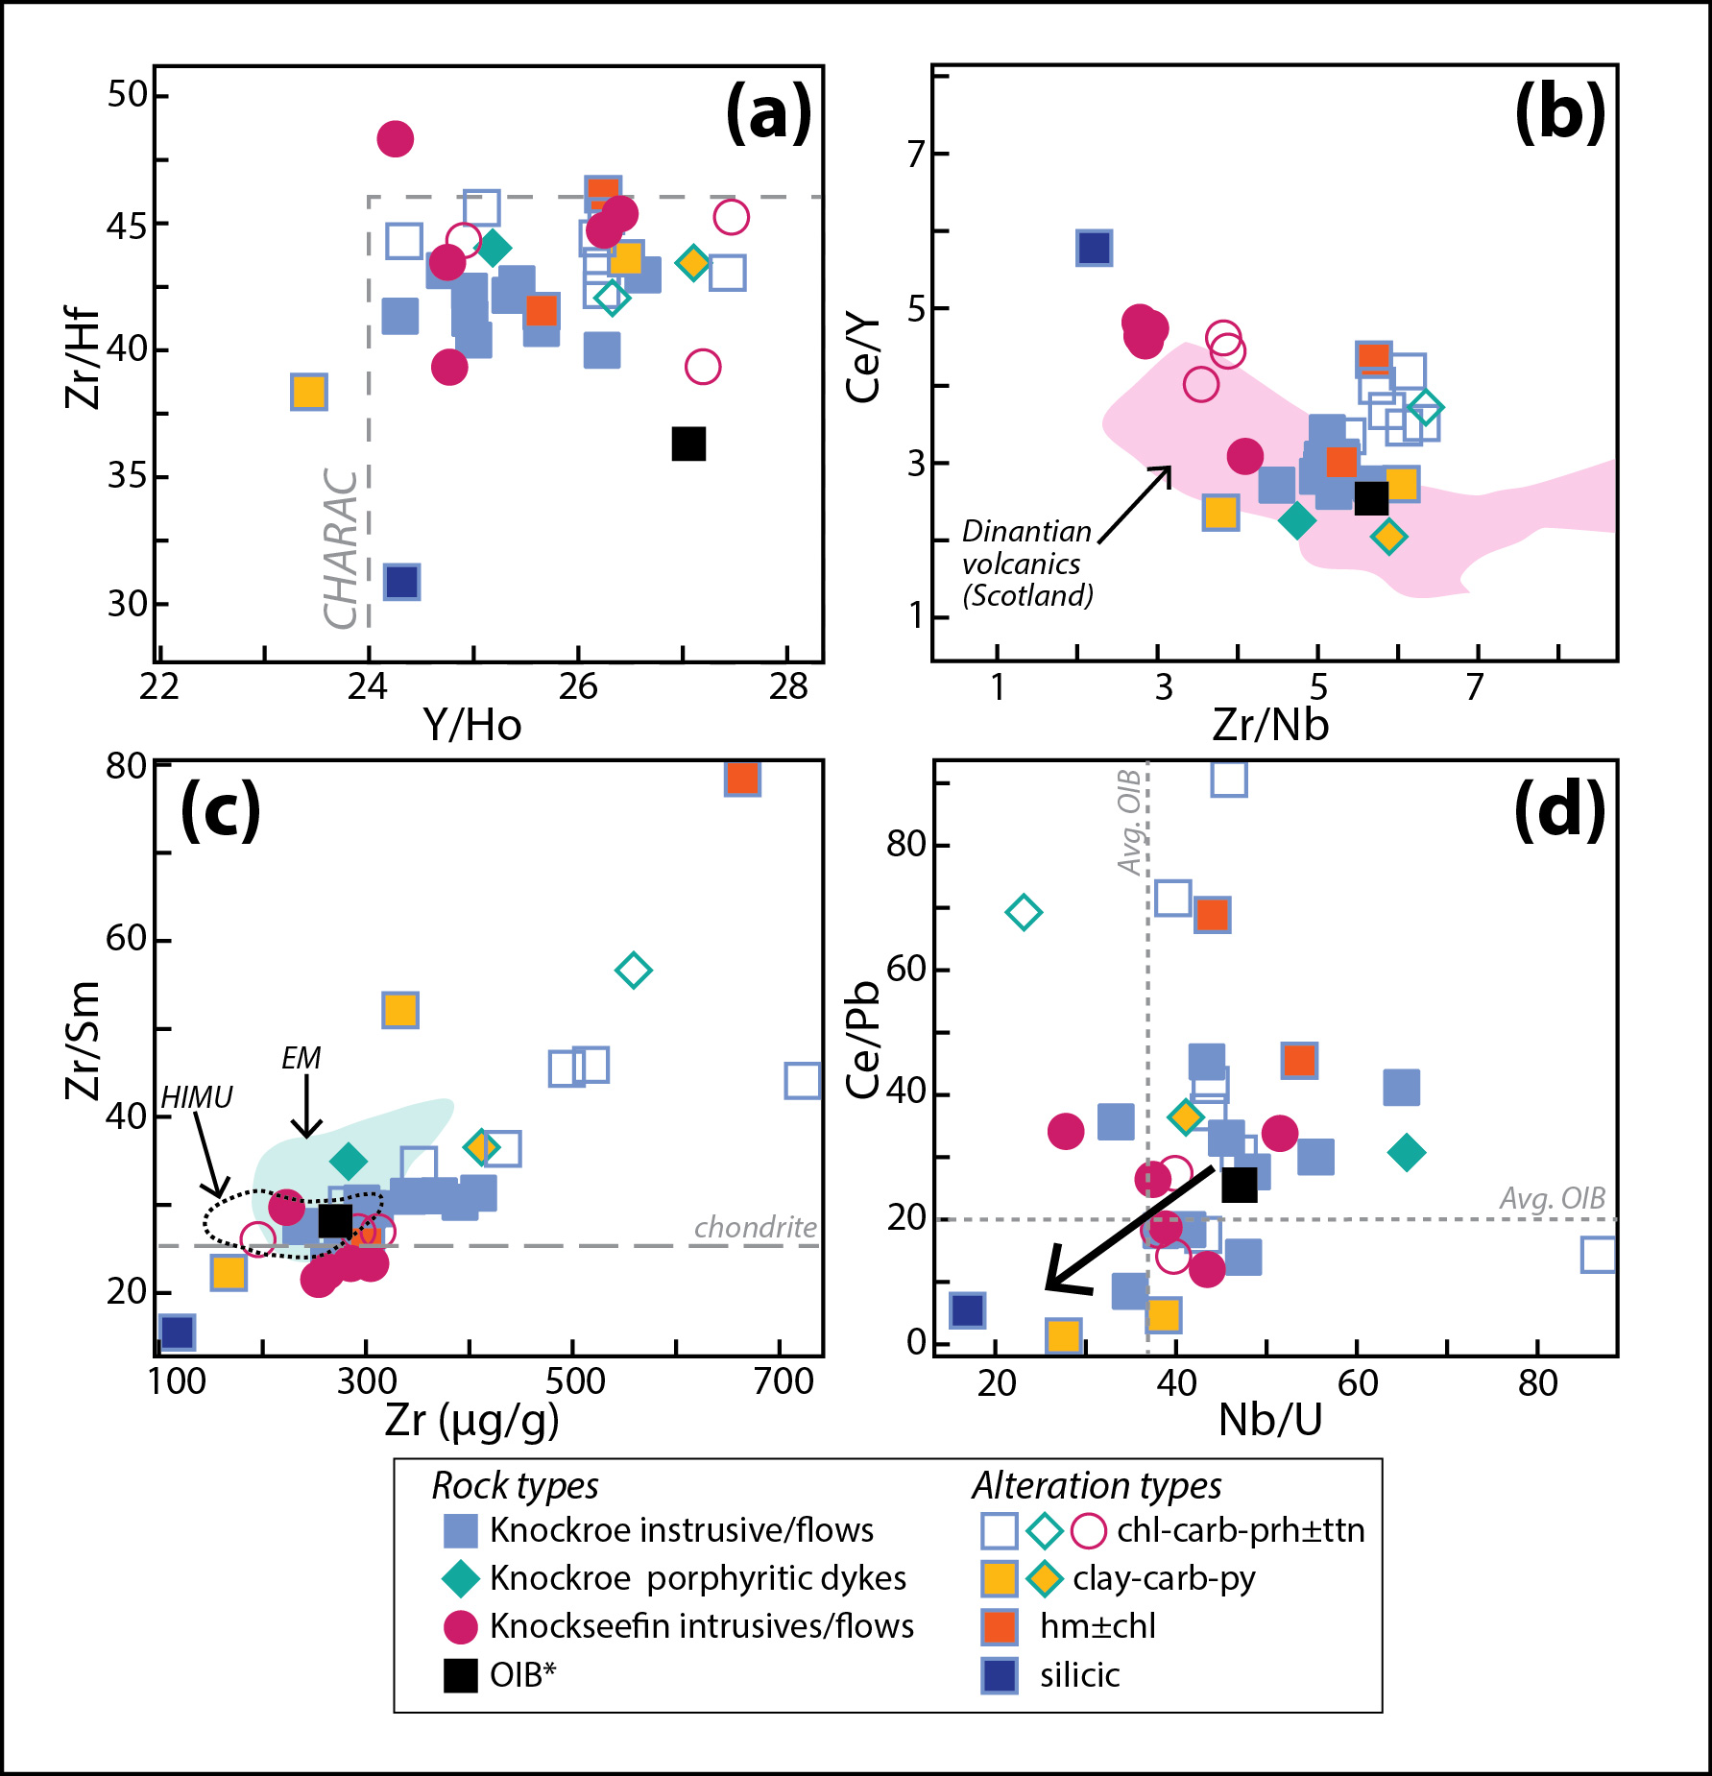
4. LIS sources/affinities
20
(Slezak et al. 2023)

Slide 21
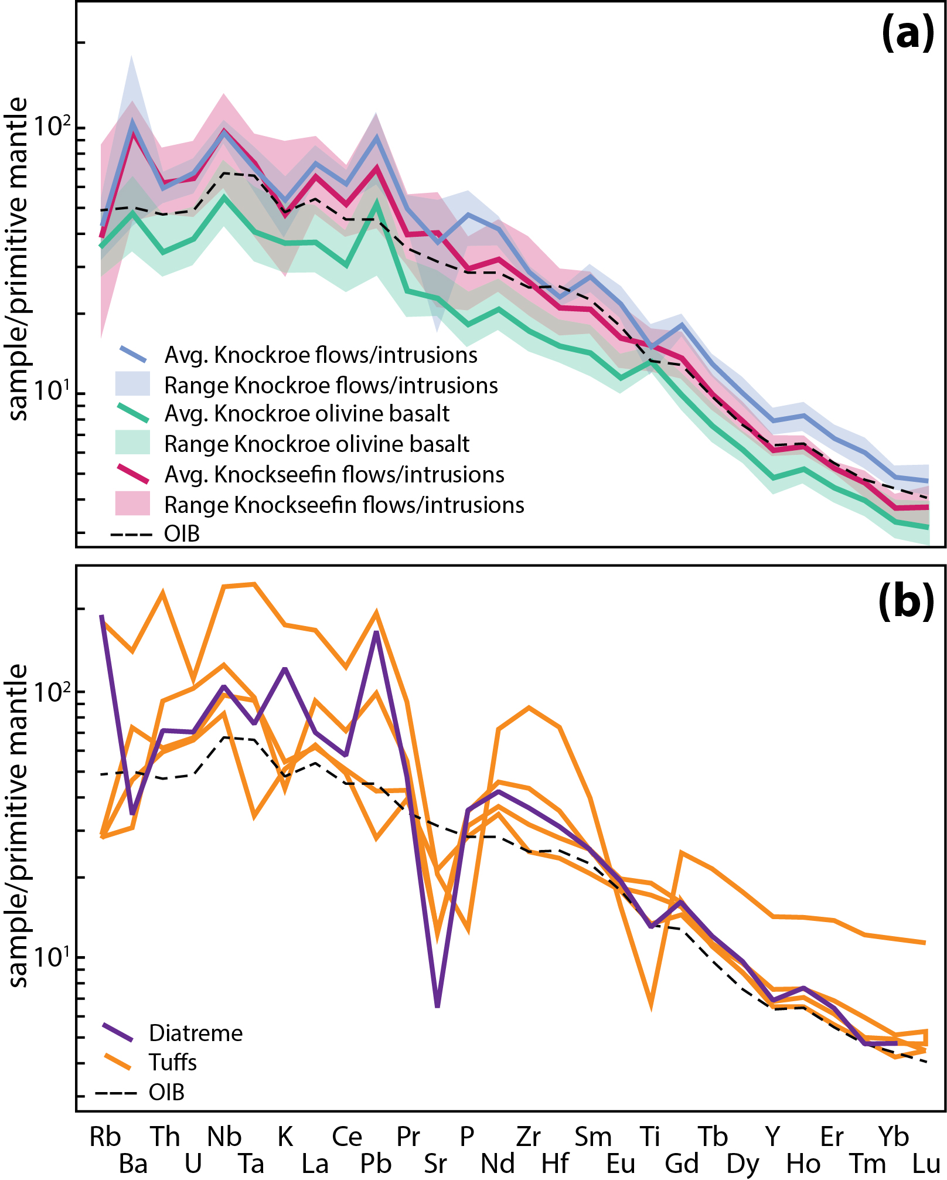
4. LIS sources/affinities
21

Slide 22
4. Mantle origin takeaways
22
Least-altered Tb/Yb_{cn} = 2.2–2.9
Garnet may have been significant mantle component, hinting at a relatively deep source (Wang et al., 2002)
Using model from Lee et al. (2009), estimated formation ~4-5 GPa and ~1500°C

Slide 23
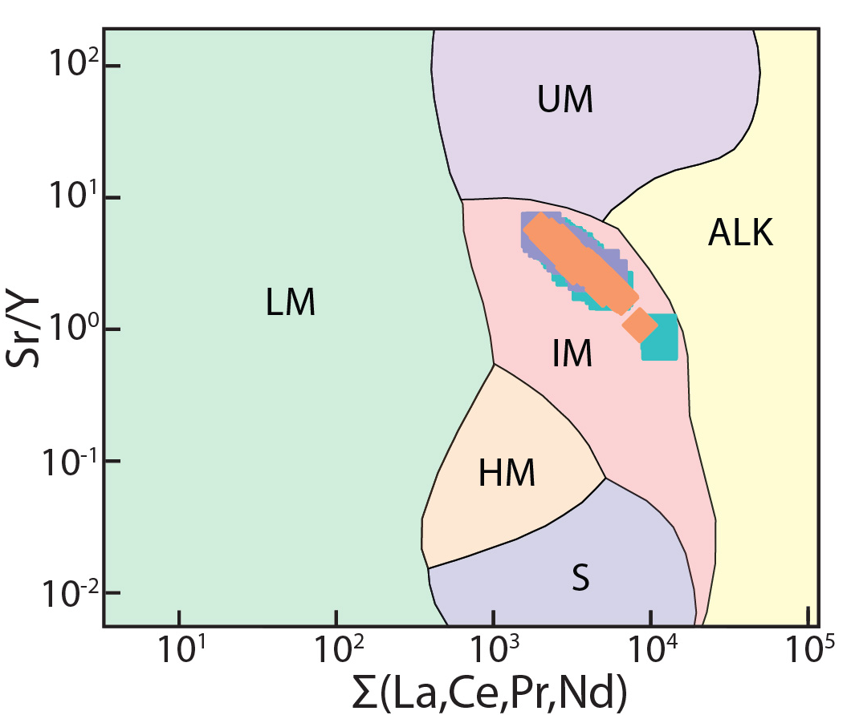
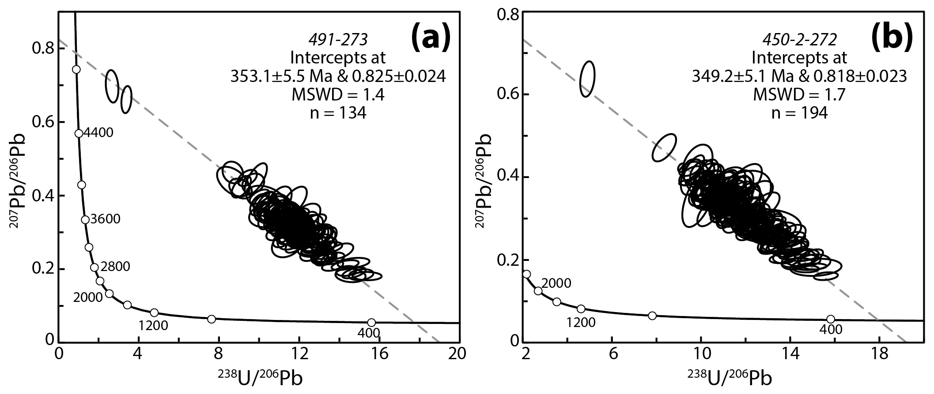
5. LIS apatite dates
23
(Slezak et al. 2023)

Slide 24
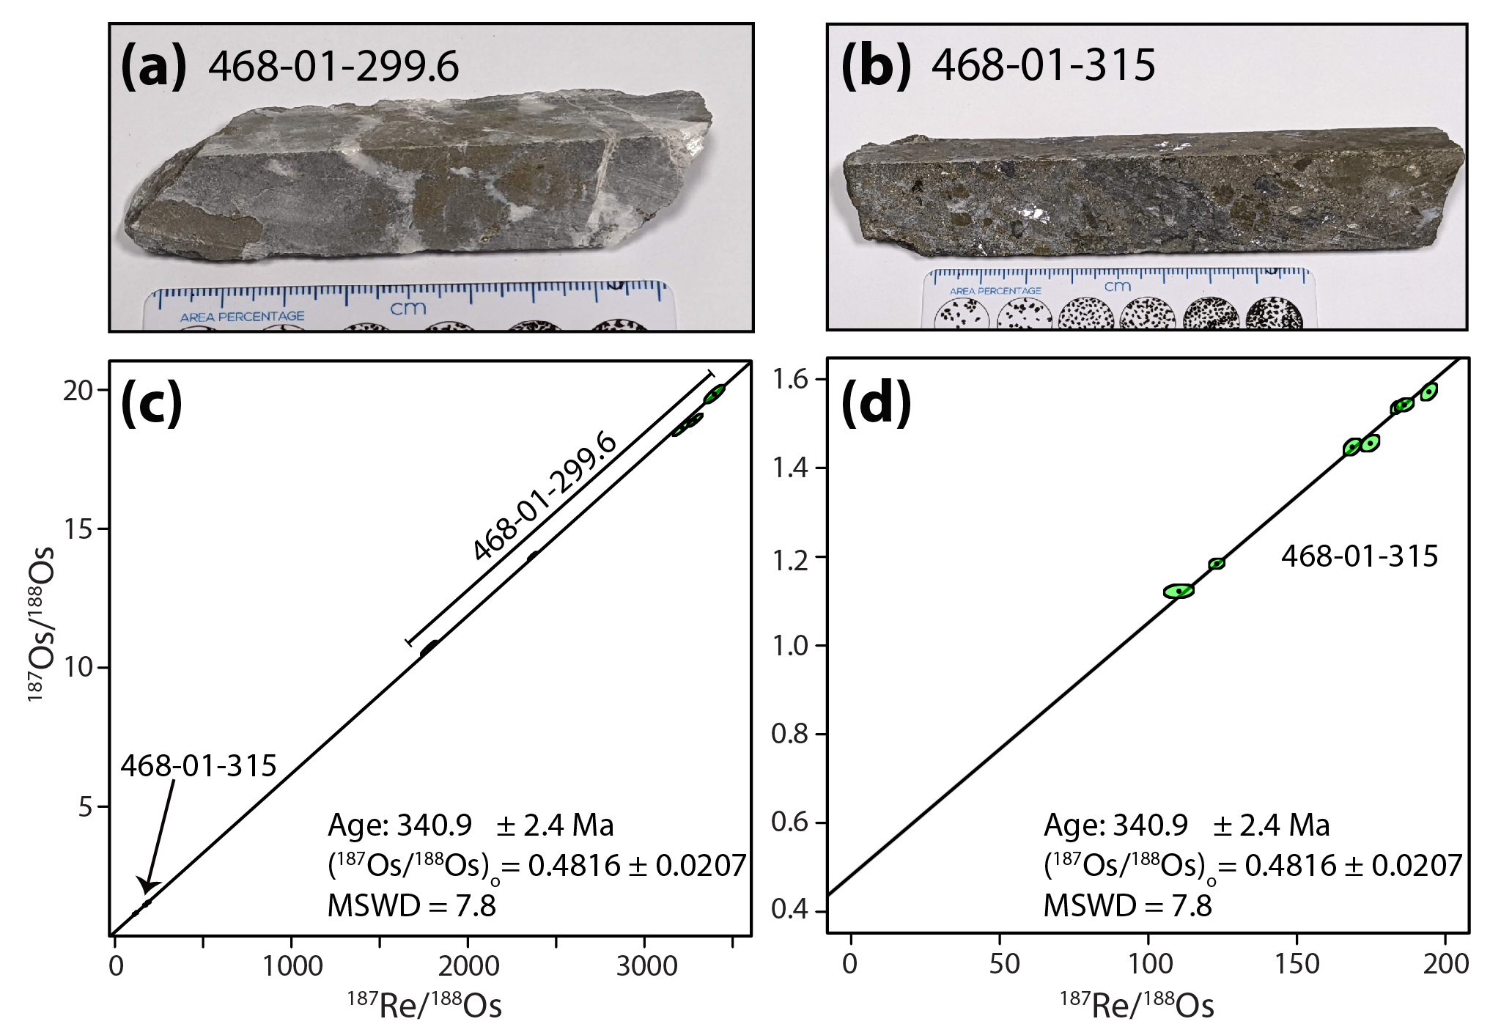
5. Re–Os (isochron using py, sp, gn)
24

Slide 25
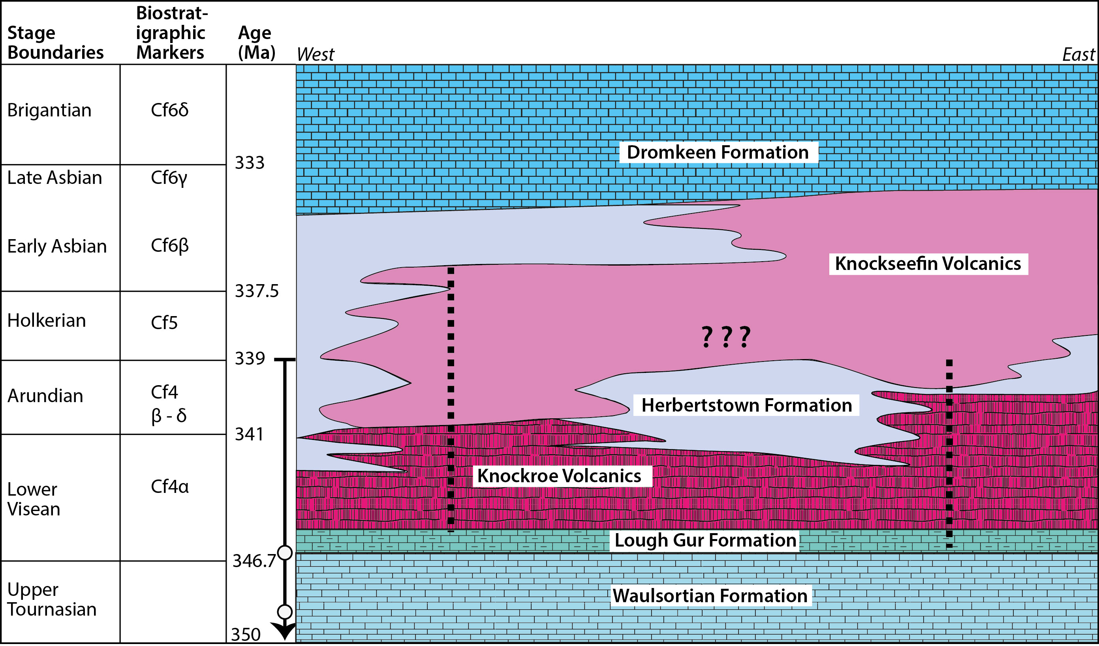
5. Biostratigraphy
25
TC-2531-1
GC-2529-491
(Modified from Somerville et al. 1992)

Slide 26
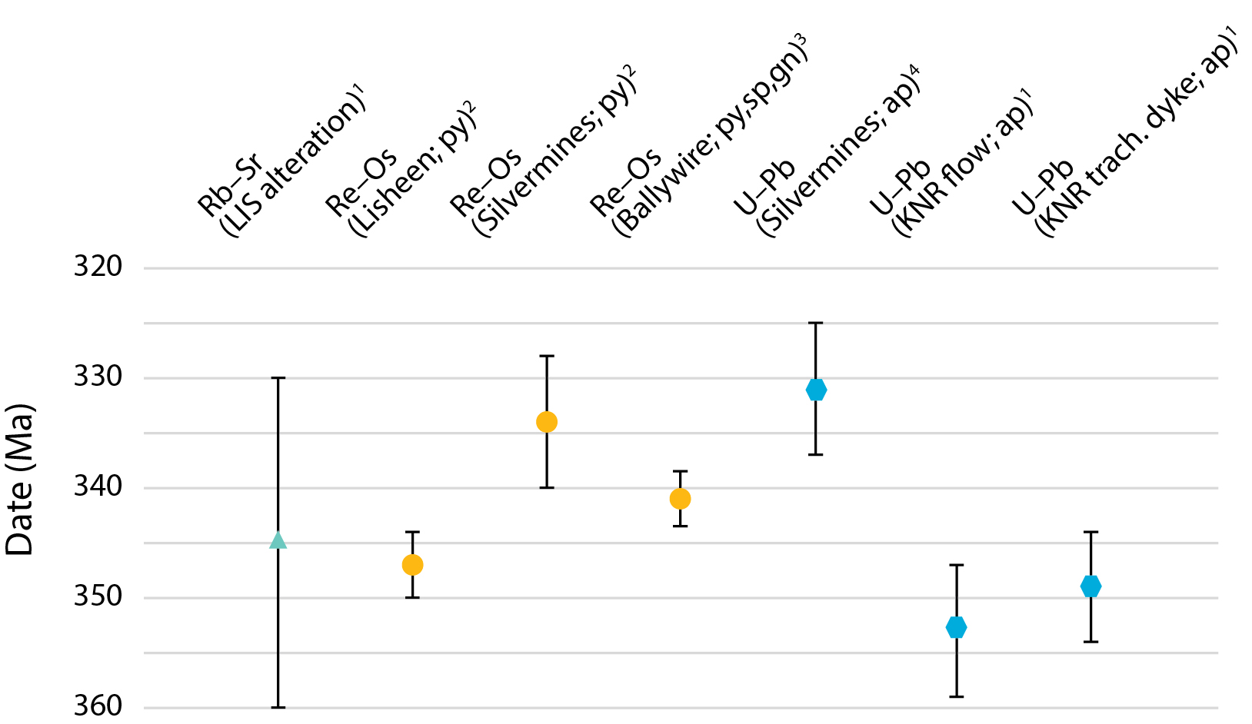
5. Significance of the dates
26
(¹Slezak et al. 2023; ²Hnatyshin et al. 2015; ³This study; ⁴Vafeas et al. 2023)

Slide 27
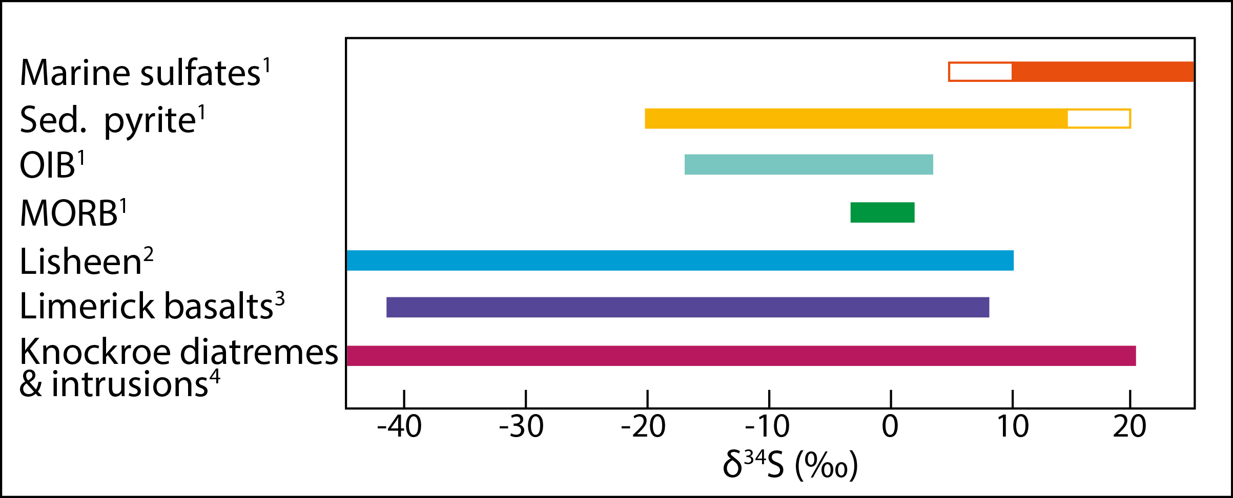
5. Stable isotopes (δ³⁴S)
27

Slide 28
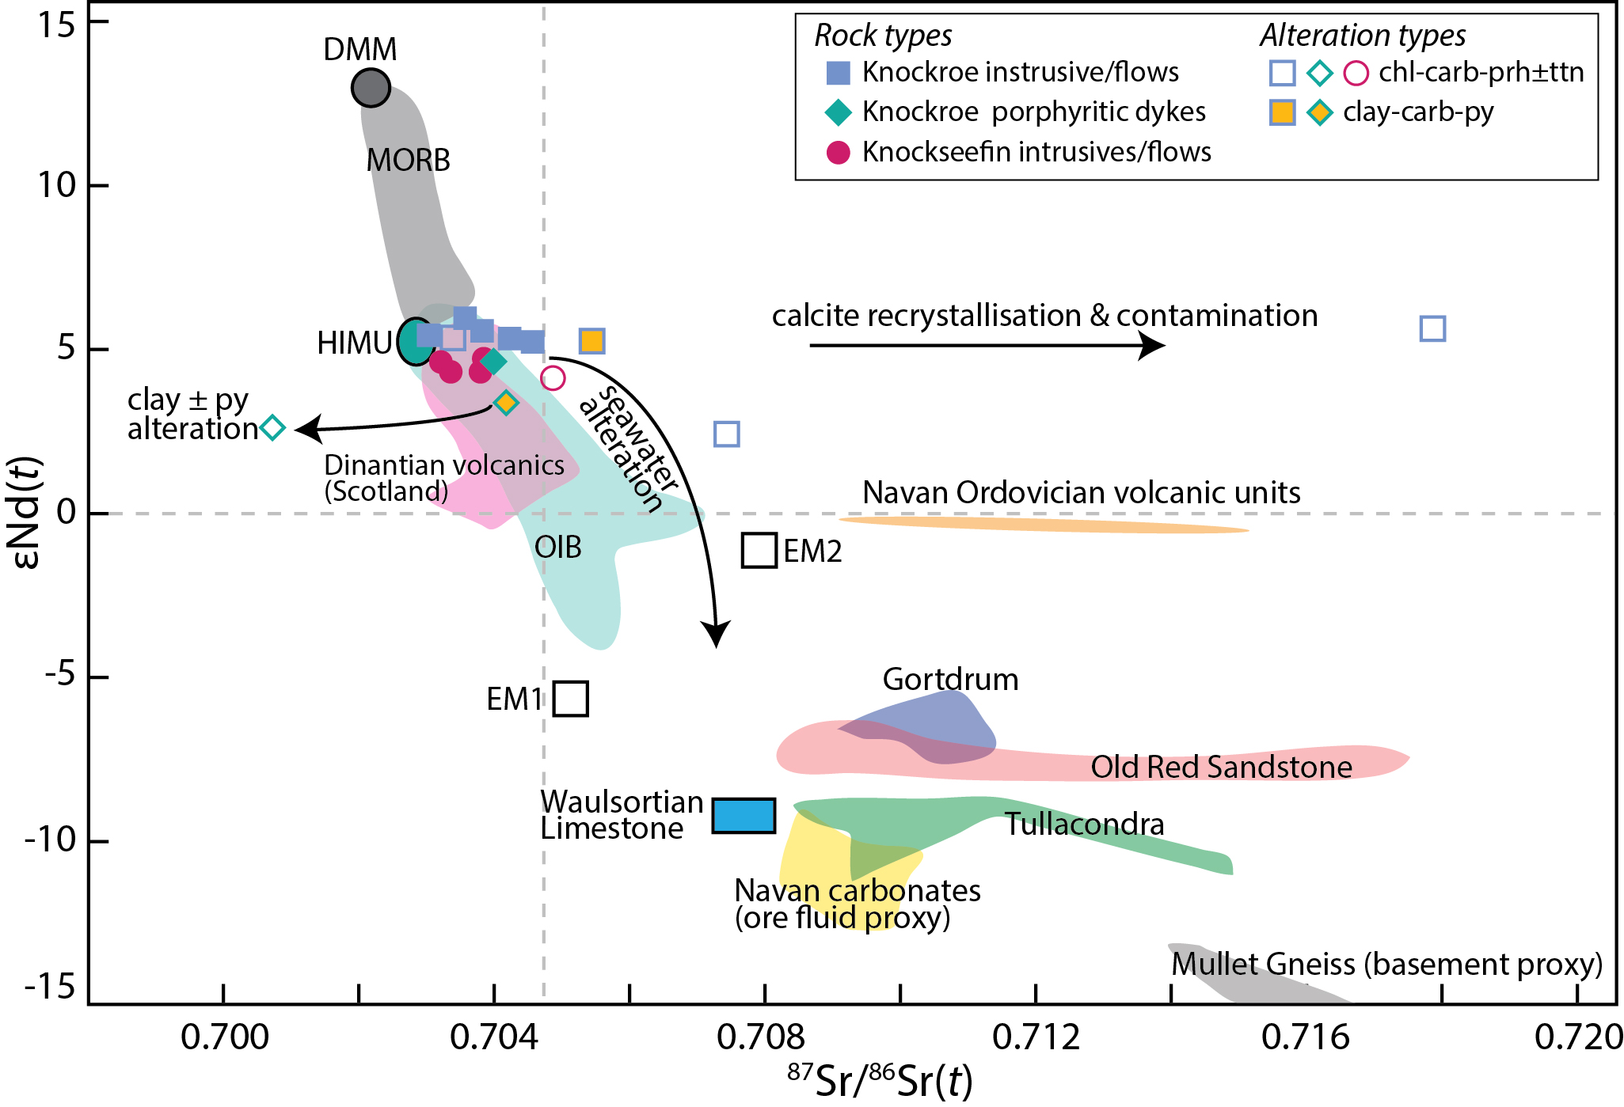
5. Radiogenic isotopes
28
¹⁸⁷Os/¹⁸⁸Os = 0.4816 ±0.0207
*Crustal values* (mantle ~0.2)
³He/⁴He = 0.15 – 0.2 R_{a} in ore fluids
(Crust = 0.01 and mantle = ~6 – 8 R_{a})
Waulsortian, Navan and MG values from Walshaw et al. (2006); ORS, Gortdrum and Tullacondra from Cordeiro et al. (2023); He isotopes from Davidheiser-Kroll et al. (2014)
Notes:
Add seawater alteration bit here.

Slide 29
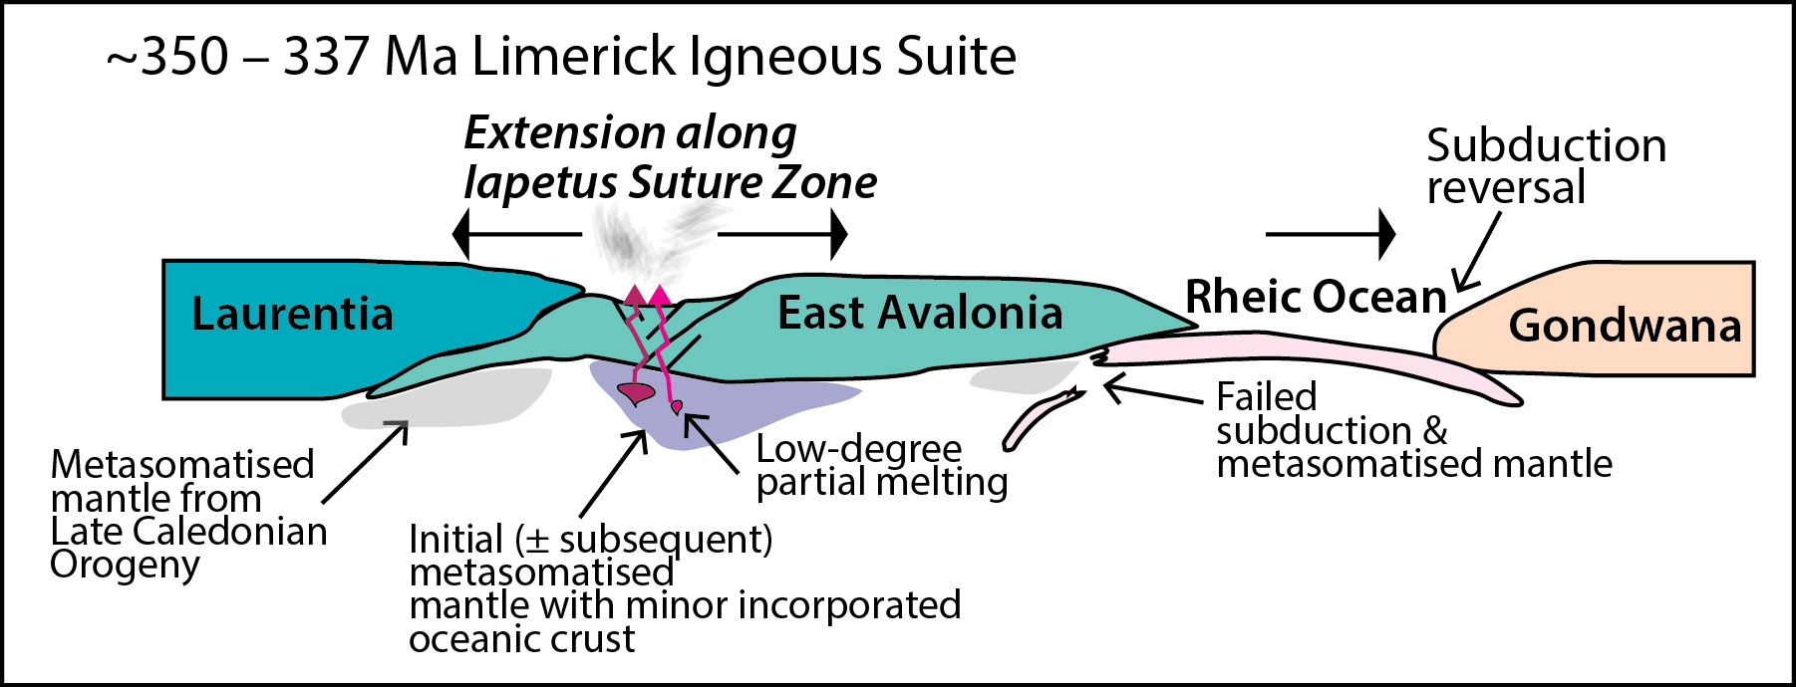
6. Tectonic context & implications
29
(Slezak et al. 2023)
Notes:
Lots of talk about heat, but no one explains why

Slide 30
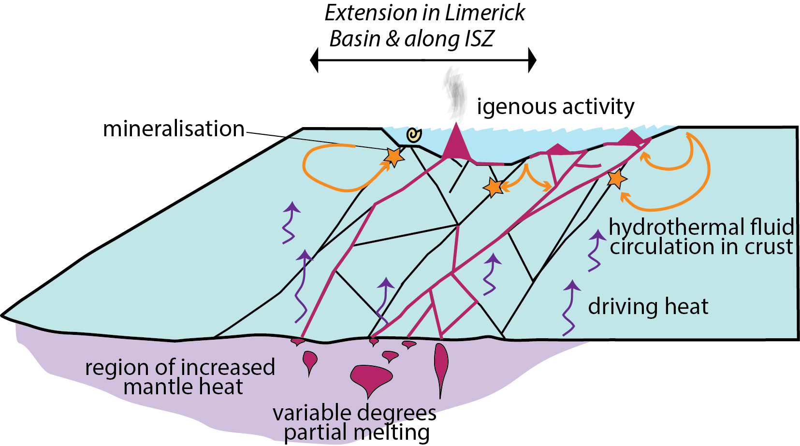
6. Limerick genetic model
30
Notes:
Be sure to emphasise that igneous stuff is clogging the faults

Slide 31
Conclusions
LIS comprises two magmatic trends:
Knockroe: Alkali basalts to trachytes
Knockseefin: Alkali basalts to basanites
Units distinguishable by Ni-Cr-Cu (±Co)
Not a base metal source
Evidence of mantle heat
Local heat source likely facilitating hydrothermalism but potentially hindering fluid flow

Slide 32
Thank you!
32
This presentation has emanated from research supported by Science Foundation Ireland Grant Number 16/RP/3849 and in part from Irish Research Council award GOIPD/2022/897

Slide 33
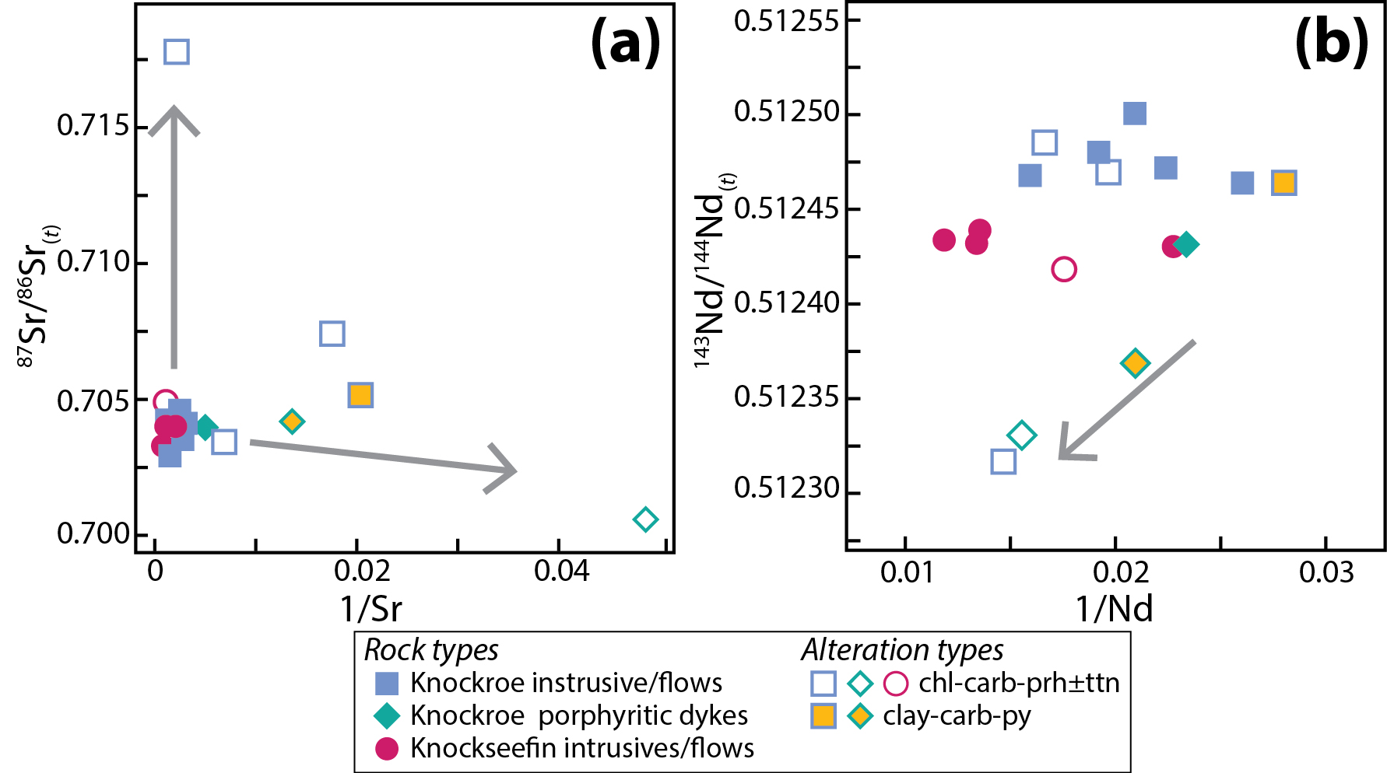

Slide 34
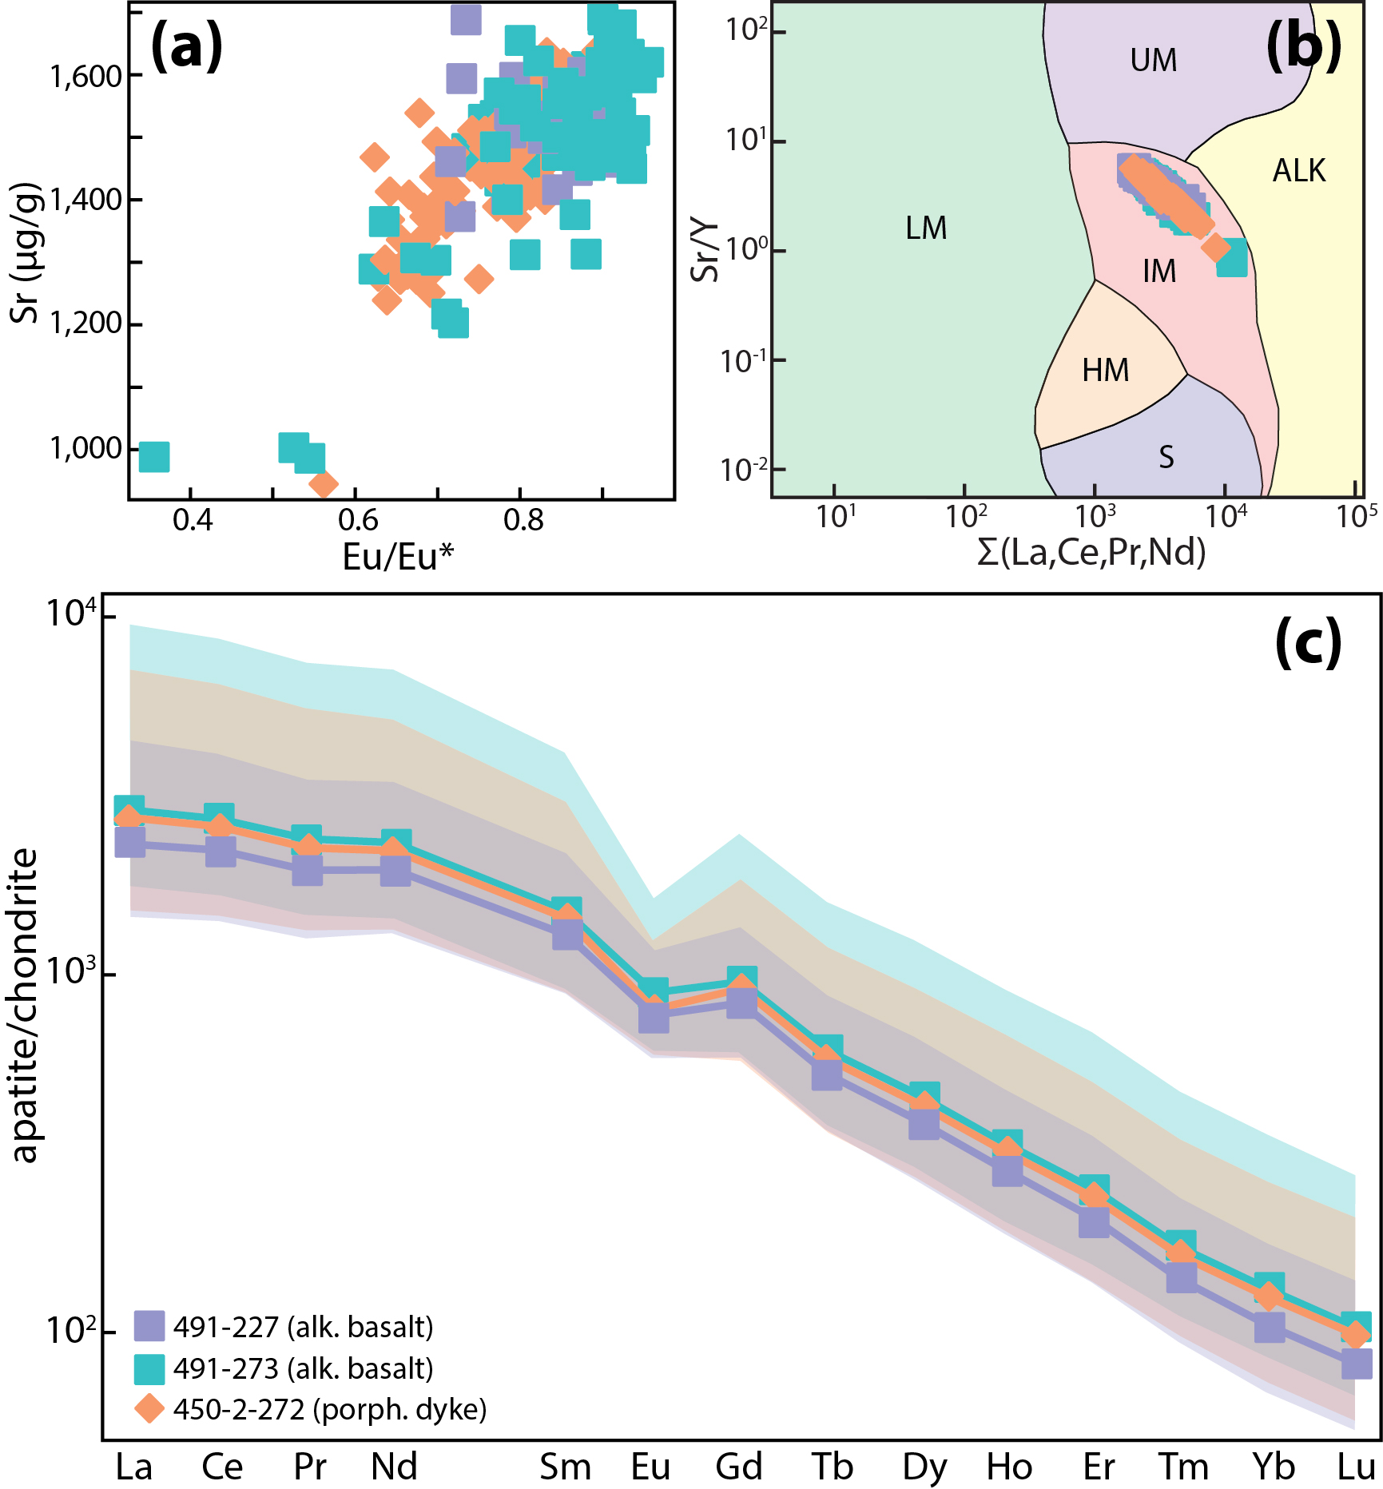

Slide 35
