Slide 1
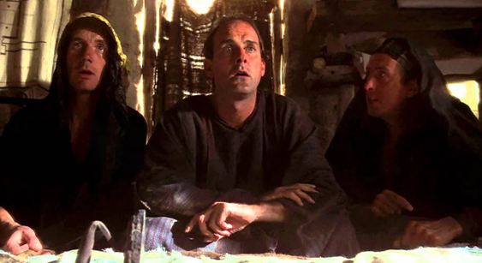
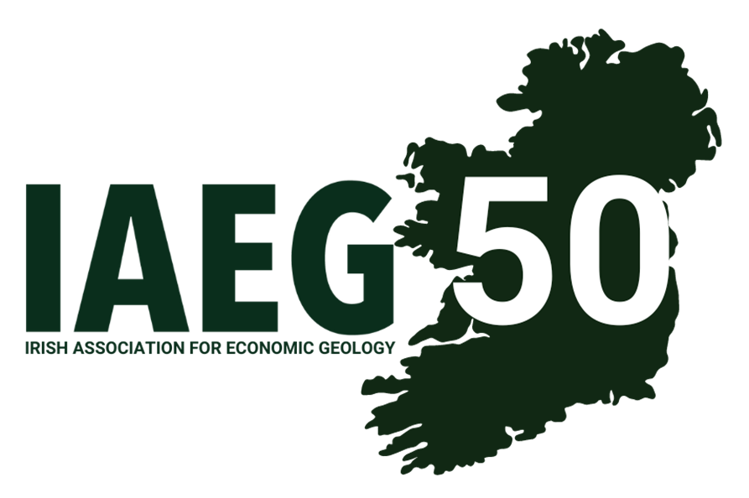
“What has Zinc ever done for us?” A geologist’s assessment of zinc’s contribution to the Irish economy
EurGeol Paul Mc Dermott PGeo
Geoscience Regulation Office (DECC)
paul.mcdermott@decc.gov.ie
Notes:
I would like to start by thanking the IAEG for inviting me to speak at the conference
And to offer them my congratulations on being 50
It is a great achievement and a testament to the continuing commitment of their members
Ok - Let’s start with a quick demonstration of the influence of zinc on the great and good of Irish Geology (yourselves)
Please raise your hand if you currently work in zinc exploration or mining in Ireland - Pause
And now, those who have at some time in their pass, worked in the Irish zinc ore-fields?
Nothing like preaching to the converted
Ok, let’s put the economics into the Irish Association of Economic Geologists
NEXT SLIDE

Slide 2
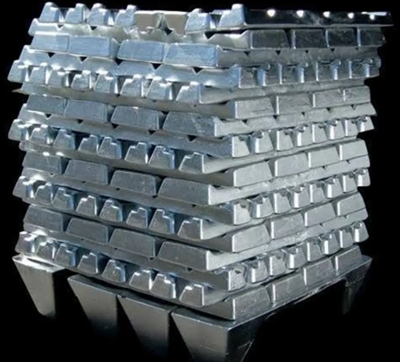
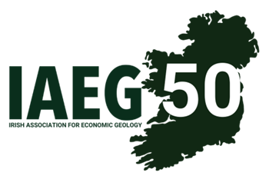
Ireland and Zinc
Most zinc discovered per square kilometre (Singer 1995)
9.5% of zinc mine output in Europe (2022)
Notes:
So, what has zinc ever done for Ireland
Back in 1995, Ireland was ranked as having the most zinc discovered per square kilometre than anywhere else in the world.
This included discoveries like Abbeytown, Tynagh, Silvermines, Galmoy, Lisheen and the big dog Tara Mines
NEXT SLIDE

Slide 3
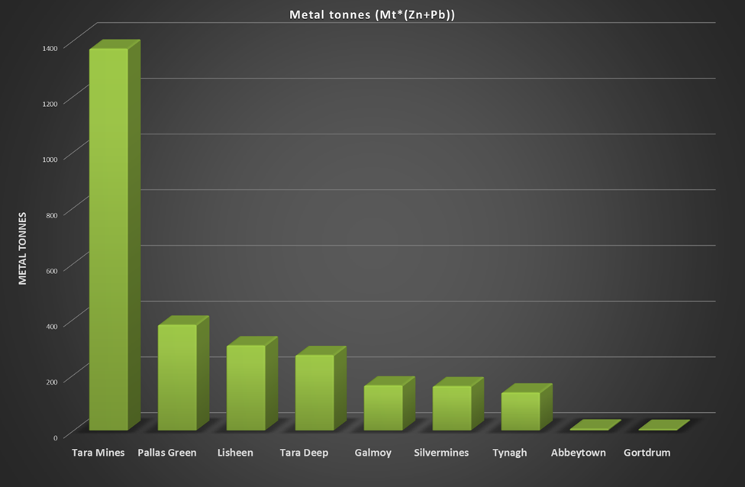
Pallas Green 45.1 Mt @ 7.2% Zn and 1.2% Pb
Tara Deep 27.0 Mt @ 8.4% Zn and 1.6% Pb
Notes:
Since then, we have added a number of significant discoveries, in particular Pallas Green and Tara Deep
If you look at the graph you will see on a metal tonnes basis Pallas Green is ranked 2nd and Tara Deep 4th of the major discoveries in Ireland
And anyone following the exploration companies on social media, you will see companies are continuing to hit some interesting intersections
It is this potential, more than any other metal, that has attracted global and indigenous prospectors and investors to Ireland.
Allowing us to establish and maintain an exploration and mining infrastructure within the country.
NEXT SLIDE

Slide 4
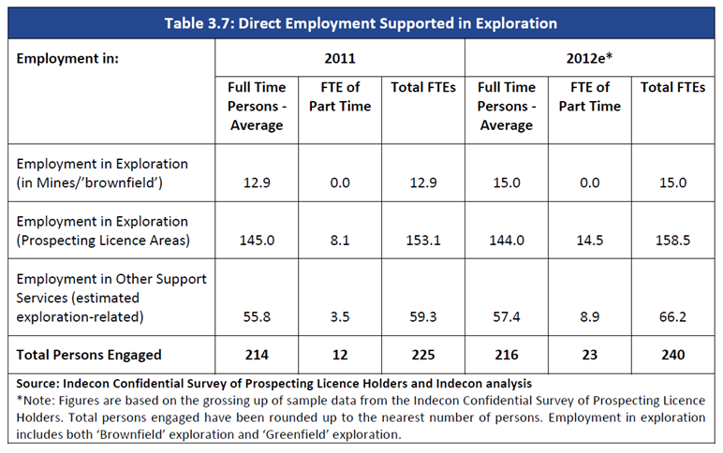
Exploration and Zinc
Indecon report of 2013
240 employed in 2012
Wages of approximately €4.3m
And €23.7m in Irish produced non-labour inputs
Notes:
Looking at the Exploration Sector
The Indecon report of 2013 gave us a snapshot into the economics of the exploration sector
Which employed approximately 240 in 2012
contributing approximately €4.3m in wages
And €23.7m in Irish produced non-labour inputs
NEXT SLIDE

Slide 5
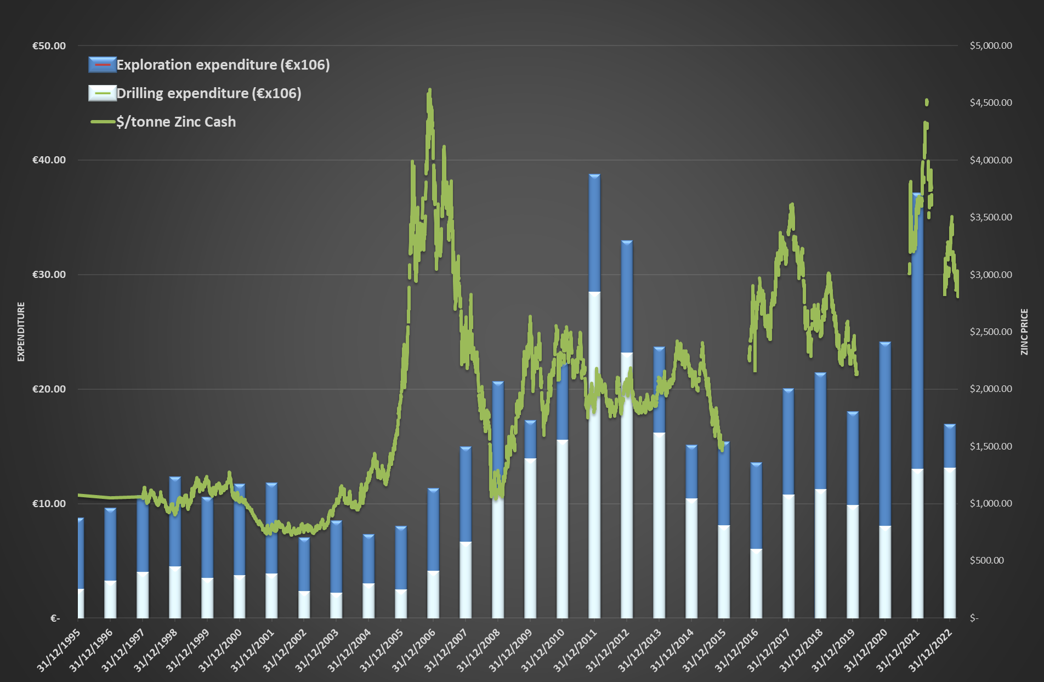
Notes:
For a boarder view we can use data from the much-loved Geoscience Regulation Office and look at the exploration spend in Ireland from 1995 to 2022.
What the graph shows is a doubling of expenditure over the period, with high spending outlier years including 2011 and 2012
Expenditure has gone from averaging just under €10 million per year in the latter half of the 1990s to averaging over €23 million since 2010
It should be noted that the expenditure here does not account for total spend by exploration companies as the GSRO only considers expenses incurred in a technical field programme
Ok, so the exploration expenditure has doubled over last few decades but what is the influence of zinc on this?
Excluding the zinc price spike of 2006 / 2007, we can see a correlation between the increase in the zinc price over the last 25 years, and exploration expenditure in Ireland.
And if we also look at the influence of the zinc price on the number of prospecting licences held - NEXT SLIDE

Slide 6
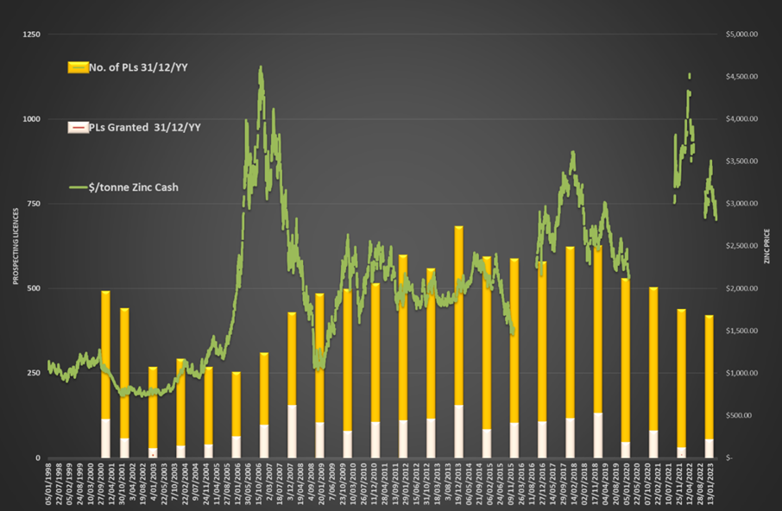
Notes:
We see a similar trend,
Both the zinc price and the number of prospecting licences held correlates reasonably well up to 2020.
However, from 2020 onwards we start to see a possible decoupling between the number of licences held and the zinc price.
It is probably a little early to say if this is a trend or a temporary situation,
NEXT SLIDE

Slide 7
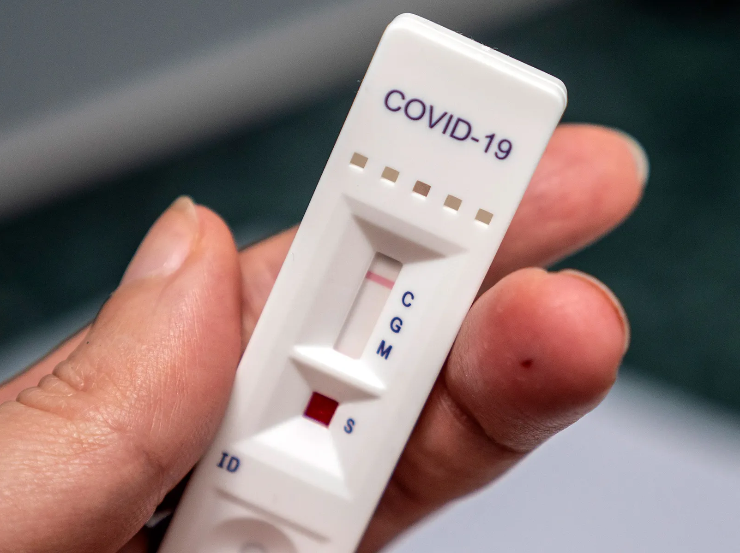
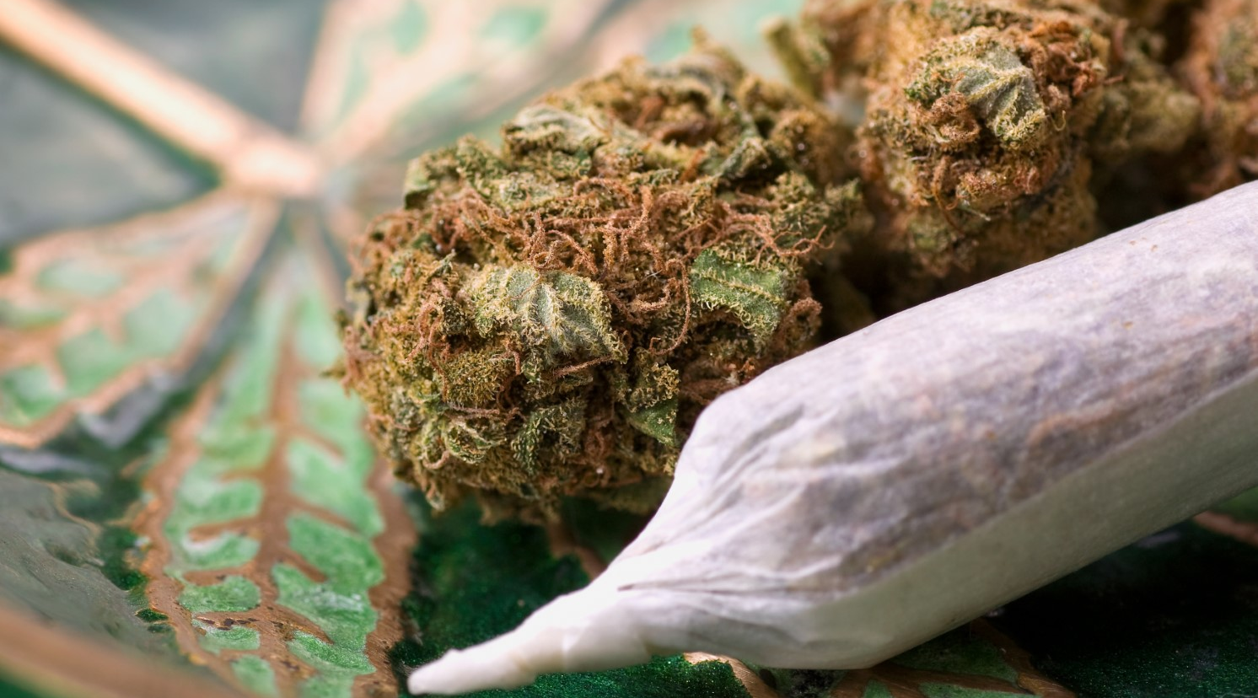
Notes:
Associated with external factors like investors moving into marijuana or an effect of the Covid pandemic.
NEXT SLIDE

Slide 8
Notes:
However, what both graphs indicate is the influence of the zinc price on
the overall exploration spend within Ireland and
the number of prospecting licences held.
illustrating that zinc is central to Irish exploration activity
NEXT SLIDE

Slide 9
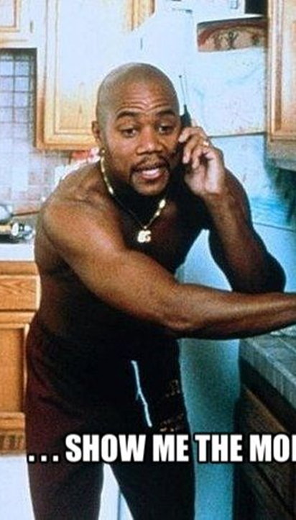
Mining and Zinc
“Show me the Money”
Notes:
We all love exploration but when it comes to the economics - MINING is MONEY
We switch from talking about millions of Euro to talking about billions,
And this is nicely illustrated from the DECC’s AECOM’ report on Galmoy and Lisheen
NEXT SLIDE

Slide 10
AECOM Report
Social, environmental and economic effects of Galmoy and Lisheen Mines
Considered the baseline, construction, production, closure and rehabilitation stages
Study was framed using a ‘Capitals’ approach
Notes:
The report was a detailed independent look at the full mine cycle of both Galmoy and Lisheen, from construction to closure
Both mines were the first in Ireland to be opened, operated, and closed under a modern regulatory regime.
The report used a capitals approach to assess the social, environmental, and economic effects of each mine and is publicly available to download for from gov.ie
For this talk we have focused on the economics, however the three effects are often interconnected, in particular the social and economic effects.
NEXT SLIDE

Slide 11
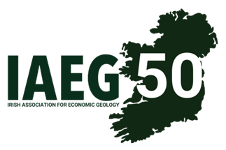
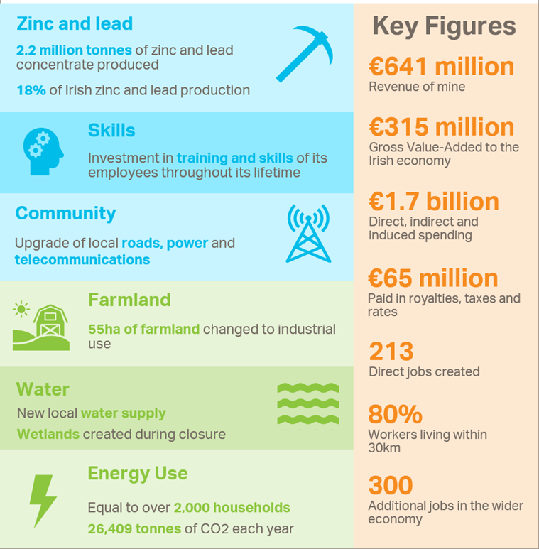
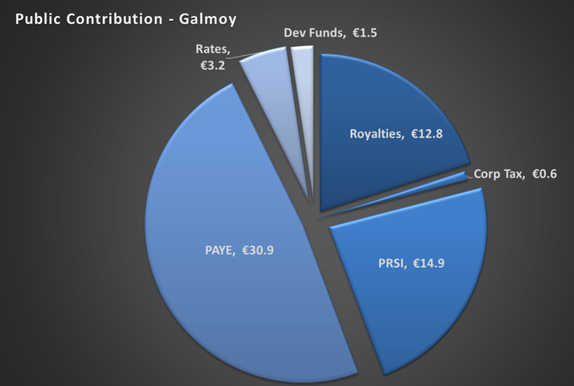
Galmoy Mine
An average of 213 direct employees
80% of whom lived within 30km of the mine
Paid an estimated €65 m in royalties, taxes and rates over life of mine
And had a total spending, including direct, indirect and induced of €1.7 billion
Notes:
Some examples of the economic benefits to the community and State from Galmoy were
an average of over 200 direct employees; 80 per cent of whom lived within 30km of the mine.
an estimated €65 m paid in royalties, taxes and rates over the life of the mine
And had a total spending, including direct, indirect and induced of €1.7 billion

Slide 12
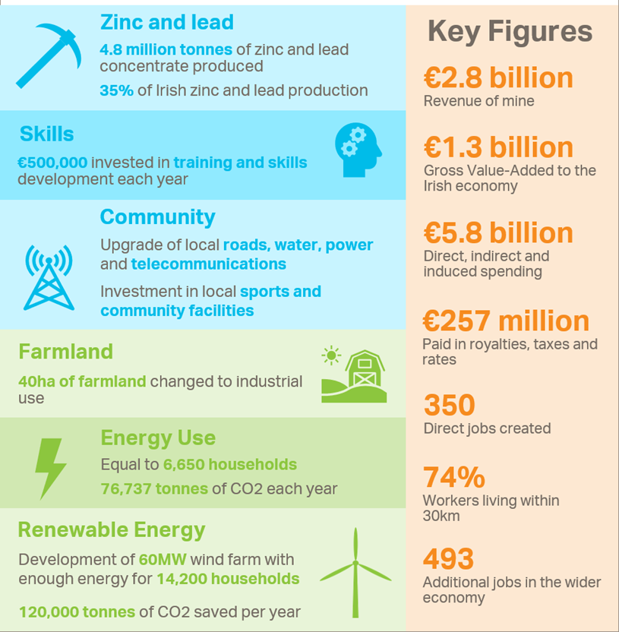
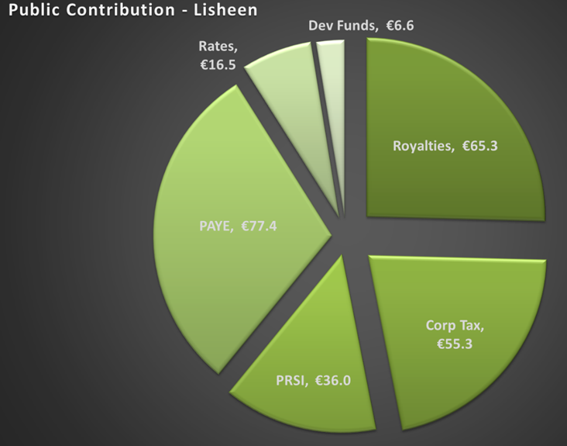
Lisheen Mine
An average of 350 direct employees
74% of whom lived within 30km of the mine
Paid an estimated €257 m in royalties, taxes and rates
And had a total spending, including direct, indirect and induced of €5.8 billion
Notes:
At Lisheen
There was an average of 350 people employed, with 74 per cent living within 30km of the mine.
They paid an estimated €257 m in royalties, taxes and rates over the life of mine
And had a total spending of €5.8 billion
NEXT SLIDE

Slide 13
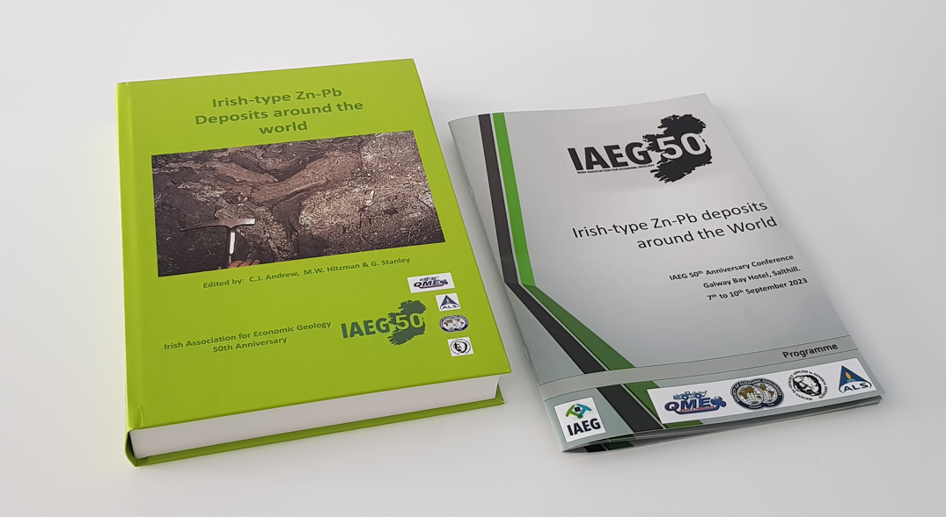
Notes:
Additional information and a breakdown of the economics is available in the new Green volume or from the AECOM Report itself
Just google – AECOM, Galmoy and Lisheen and the report should come up
NEXT SLIDE

Slide 14
Tynagh Mine
OMAC, now ALS Global Loughrea
40 years in business in 2020
Approx. 200 staff.
Irish drilling
55 years and
employs over 55 people
Priority Drilling
since 1954,
employing over 65
https://thewildgeese.irish/profiles/blogs/gold-in-them-there-hills-tynagh-county-galway-ireland
Notes:
It is not just Galmoy and Lisheen that have left a positive legacy
For example, If you look at Tynagh which closed in 1982, a number of important Geoscience companies developed in its ecosystem
Including
OMAC, now ALS Global Loughrea, which celebrated over 40 years in business in 2020 and is one of the major employers in Loughrea Co Galway with about 200 staff.
Irish drilling has been in business for over 55 years and employs over 55 people and
Priority Drilling has been providing drilling services since 1954, employing over 65 people
That is over 300 jobs in rural East Galway since the 1950s.
It should be noted that not all of the legacies from Tynagh has been positive, and there remains a number of environmental issues associated with the former mine.
NEXT SLIDE

Slide 15
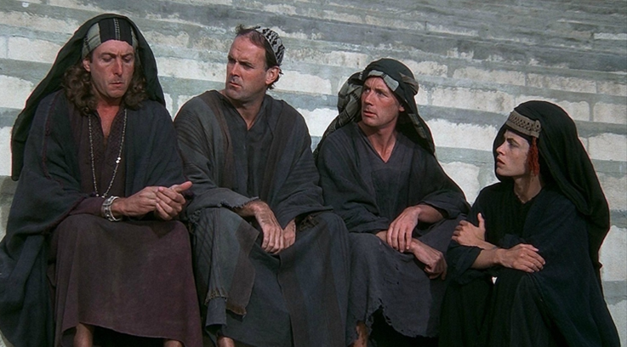
“Apart from the sanitation, the medicine, education, wine, public order, irrigation, roads, the fresh-water system, and public health, what have the Romans ever done for us?”
Notes:
Hopefully, I have showed you that zinc has had a positive economic impact in Ireland and its mines are strong economic drivers in their local communities
It is an important employer in the communities it works in and supports an important skill set in the country.
However, we are still on the bottom rung of the ladder. We are only an exporter of zinc concentrate and maybe it is time for us to consider adding addition value to our zinc
The world is going through fundamental change, and this is an opportunity for Ireland to be more than just an exporter of zinc concentrate.
Over the next decade Ireland plans, not just to become self-sufficient in energy, but to have a surplus of renewable green energy
And this surplus of cheap green energy is an opportunity
NEXT SLIDE

Slide 16
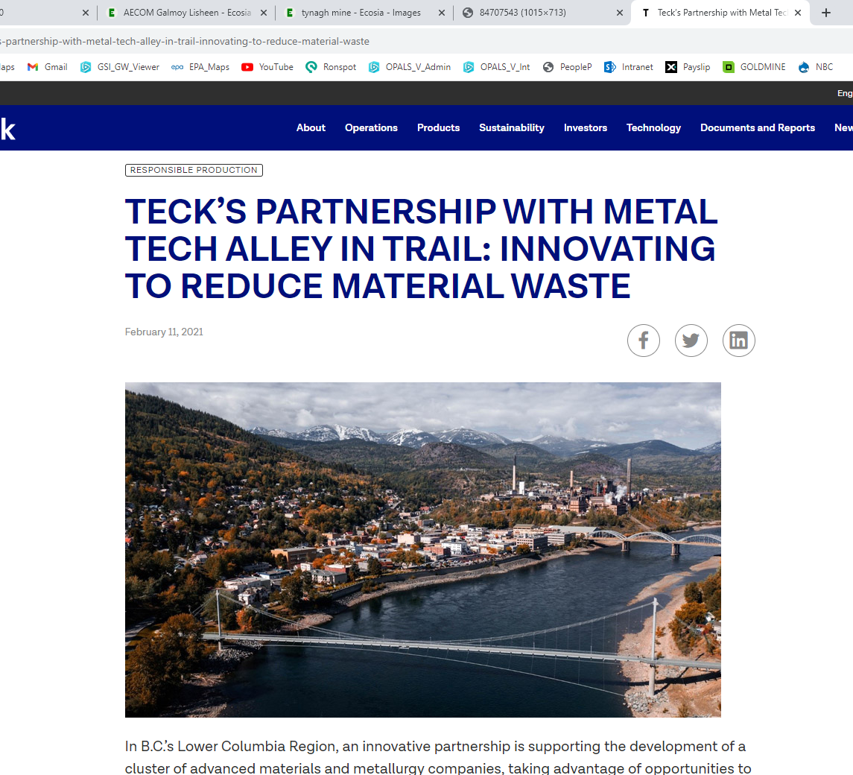
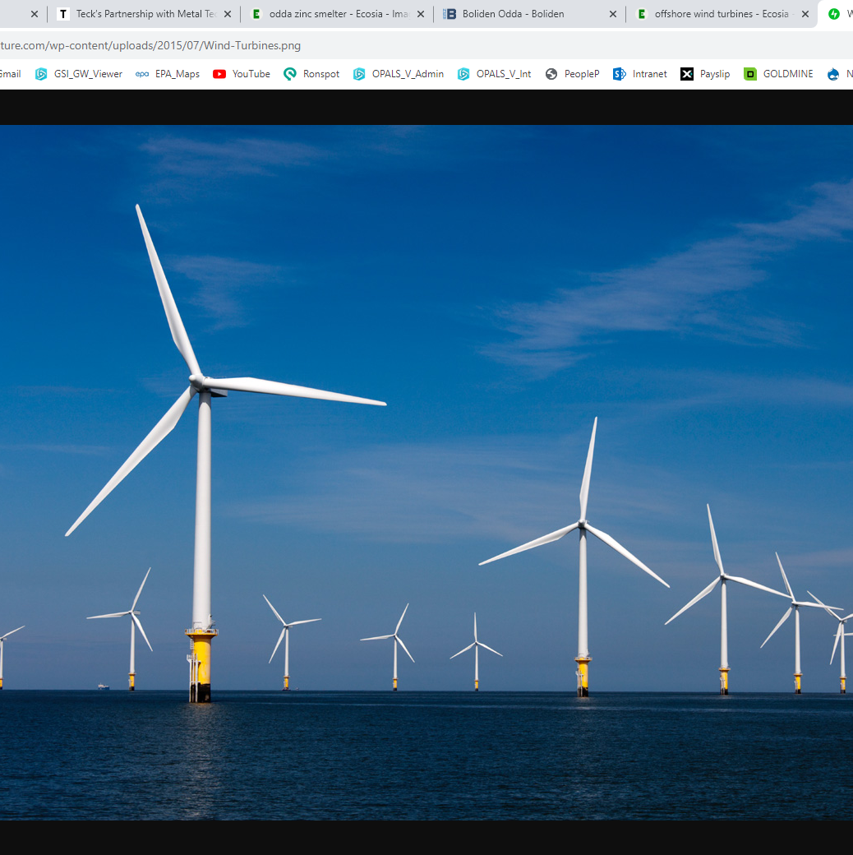
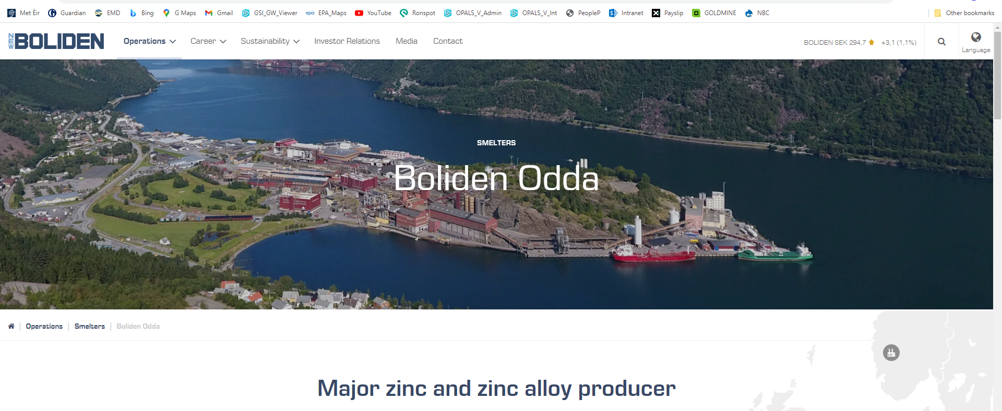
From mine
– to product
– to recycle
Notes:
An opportunity for Ireland to become a producer of low carbon refined zinc?
A low carbon smelter using power from our offshore wind and green hydrogen, similar to the Boliden zinc smelter in Odda Norway
Or can we think bigger and follow the example of Teck’s partnership with Metal Tech Alley, in British Columbia in Canada
Where they are developing a cluster of advanced materials and metallurgy companies.
So why not build the capacity within clusters to mine, smelt and build value added products from Ireland’s zinc
Examples are already available within the EU where lithium clusters have come together to produce lithium batteries from EU mined lithium
Ambitious, nuts, not going to happen?
Well, I will leave you with this thought - NEXT SLIDE

Slide 17
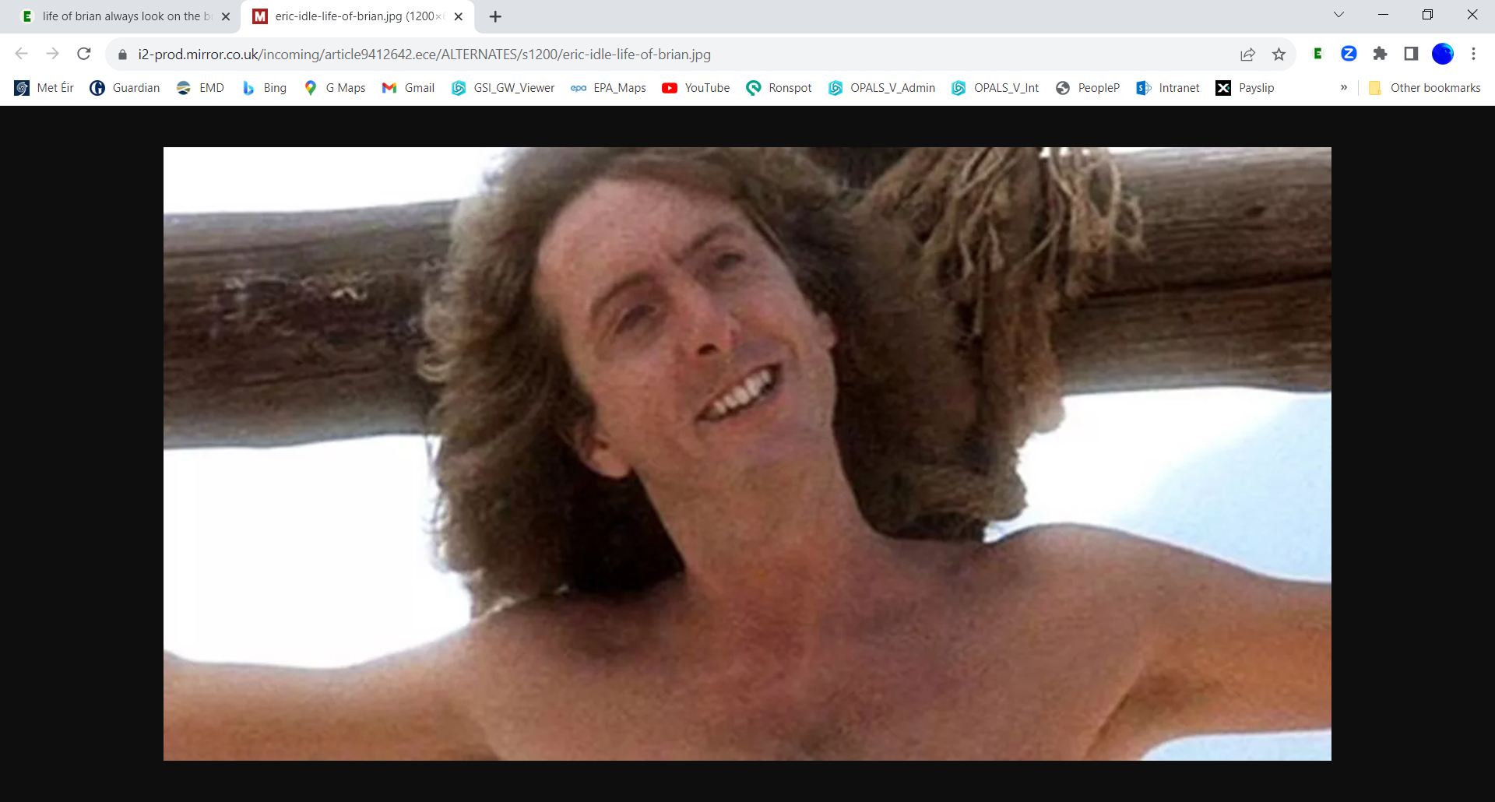
“Always look on the bright side of life”
EurGeol Paul Mc Dermott PGeo
Geoscience Regulation Office (DECC)
paul.mcdermott@decc.gov.ie
Notes:
Always look on the bright side of life
Thank you

