Slide 1
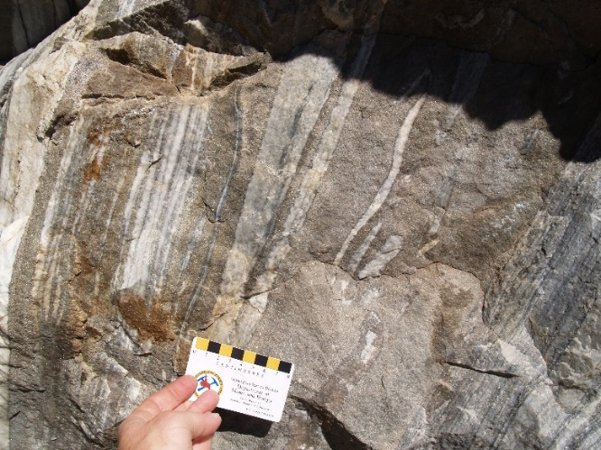
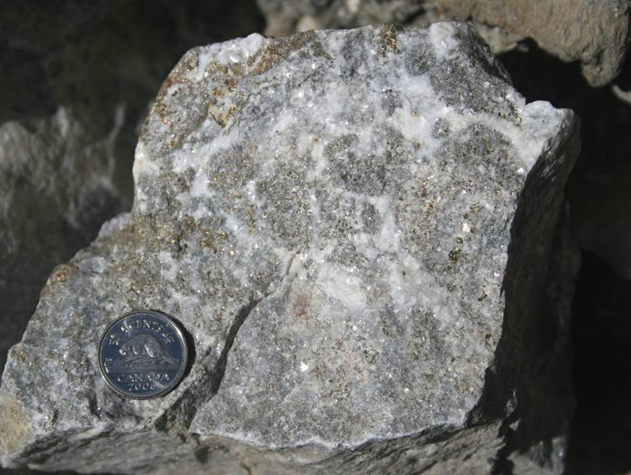
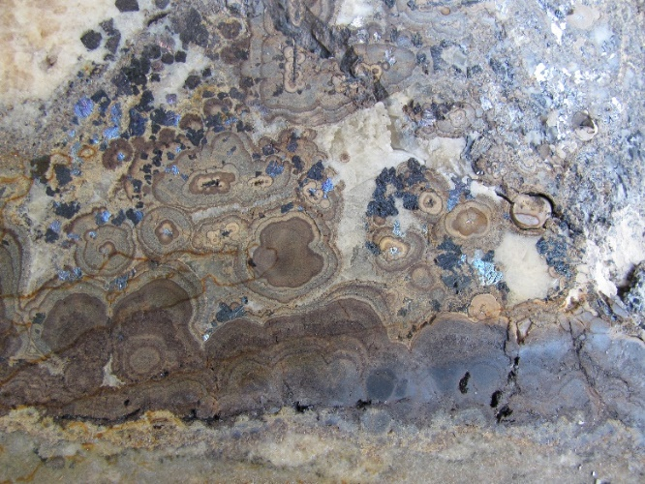



Mineralogical and chemical characterization of Mississippi Valley–type mineralization in Western Canada: Implications for ore-forming processes
Daniel J. Kontak and Zach Waller
1Harquail School of Earth Sciences, Laurentian University, Sudbury, Canada
Suzanne Paradis
Geological Survey of Canada, Sidney, British Columbia, Canada
Mostafa Fayek
Department of Geological Sciences, University of Manitoba, Winnipeg, Canada
Notes:
Summarize from Leach et al. papers

Slide 2
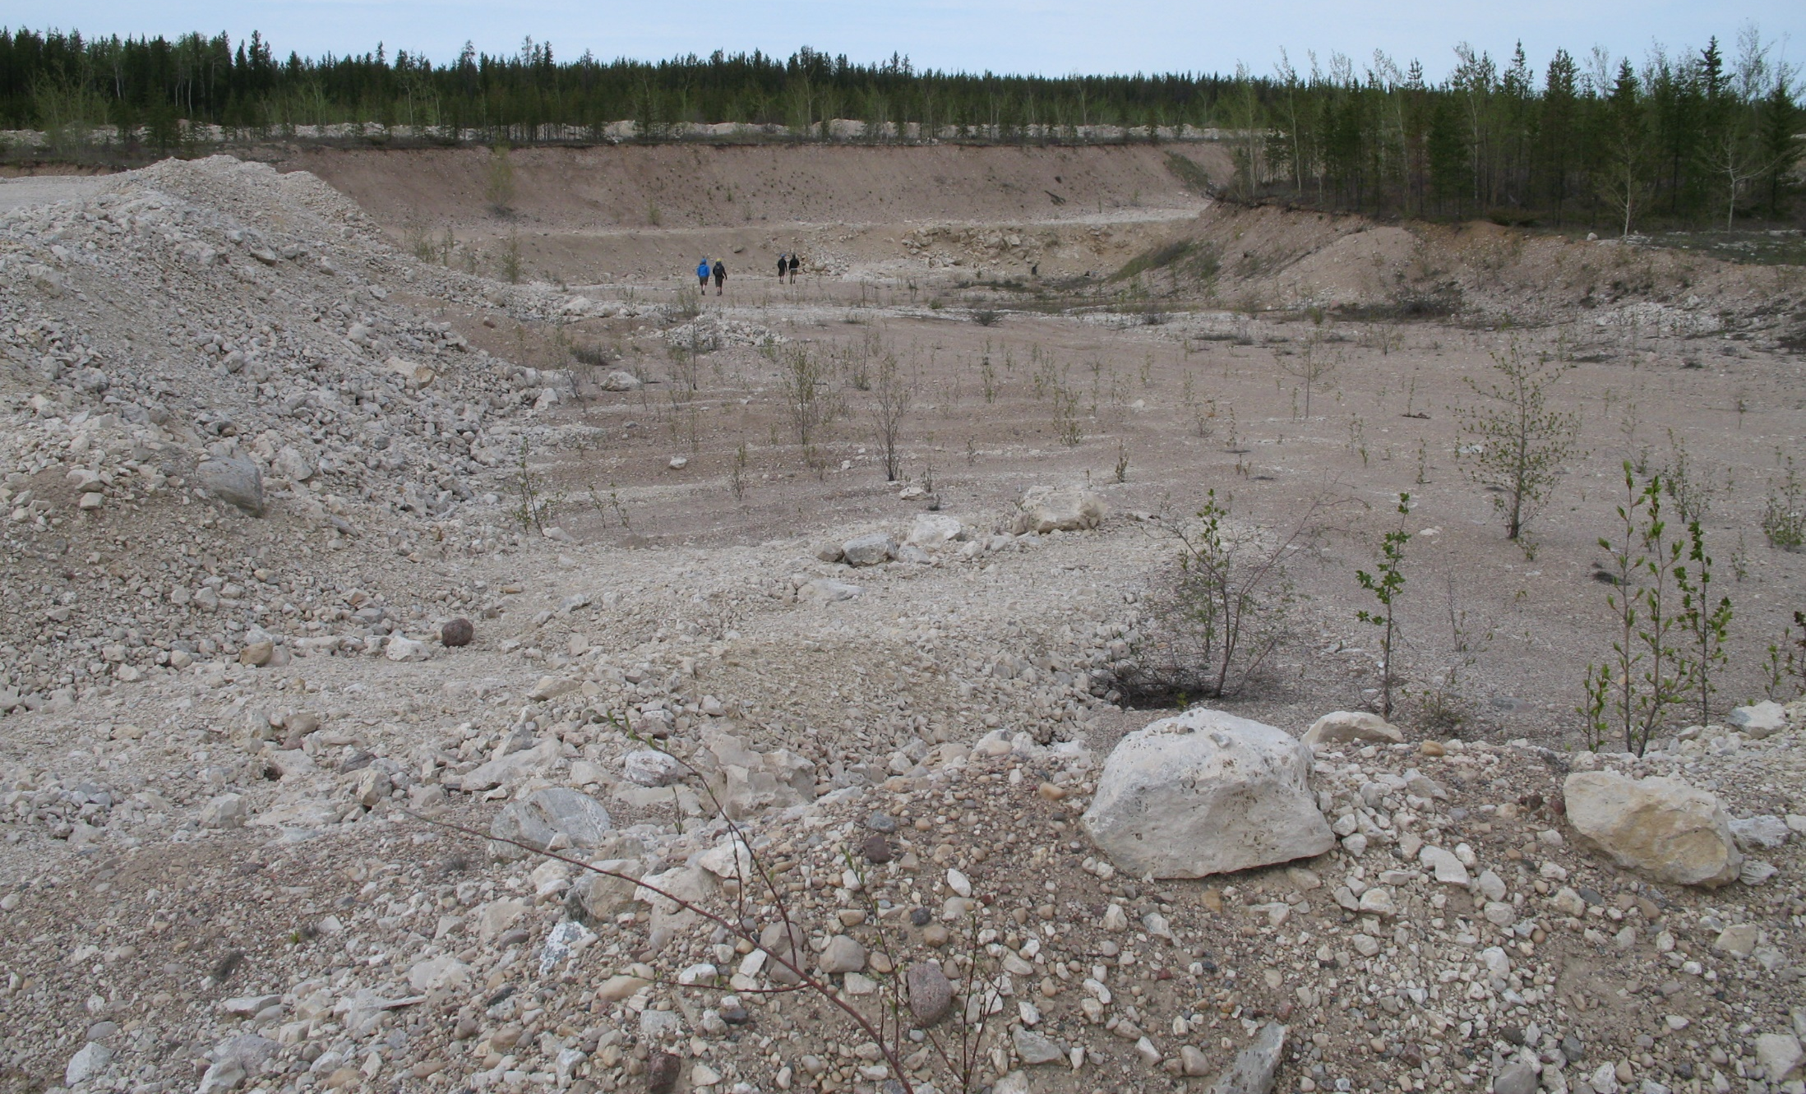
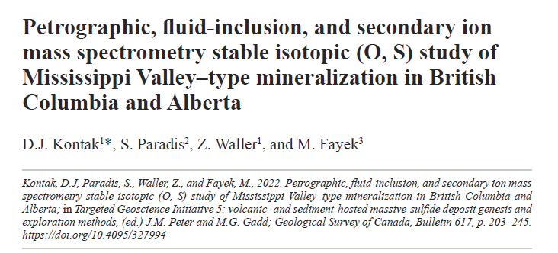
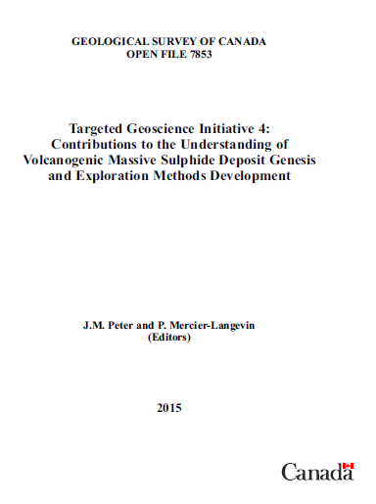
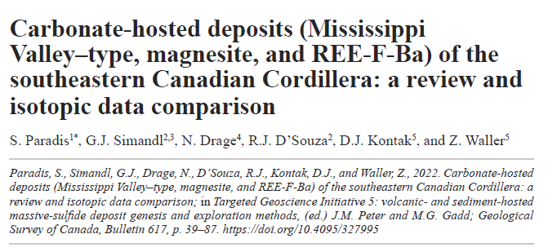
Cautionary Statement

Slide 3
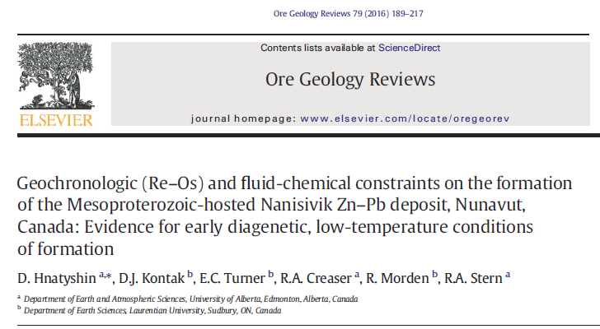
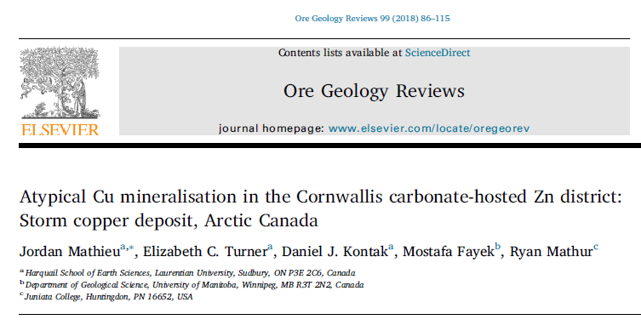
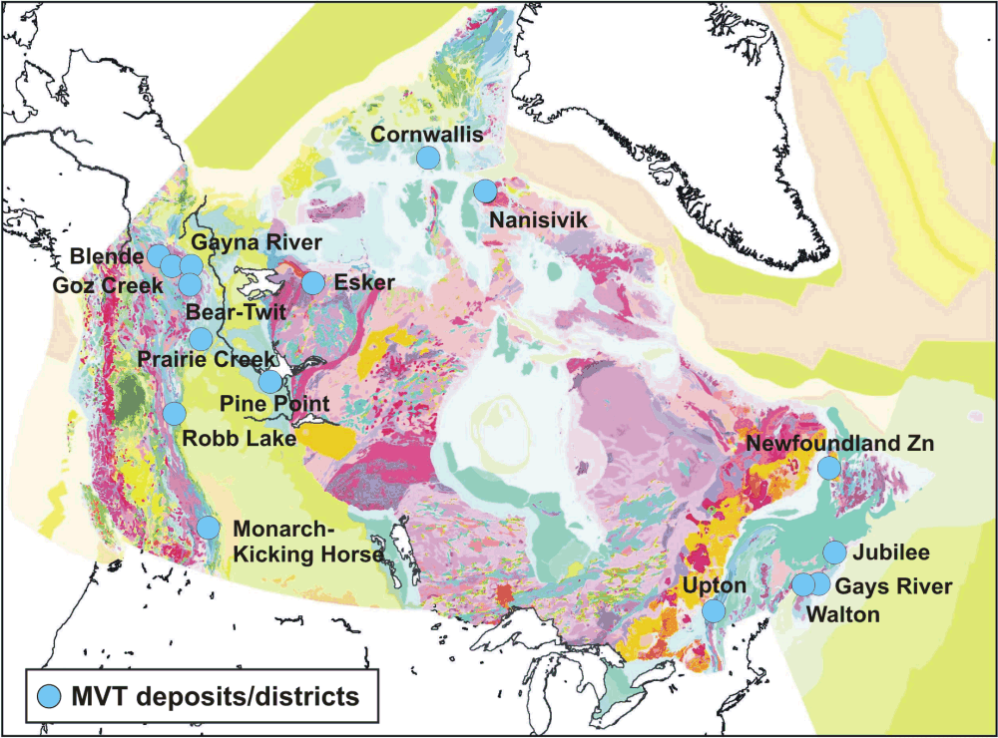
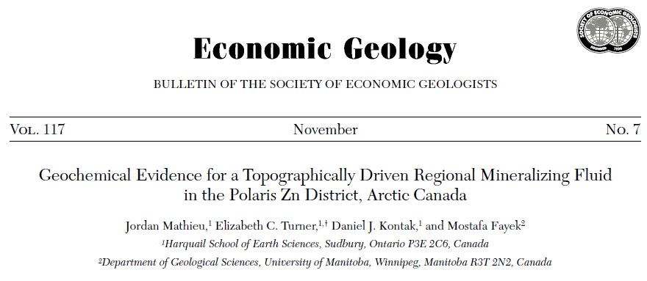
Regional Geological Setting
low value of Zn/km²!
Storm
This talk
Conliffe et al.
Paradis et al. 2007

Slide 4
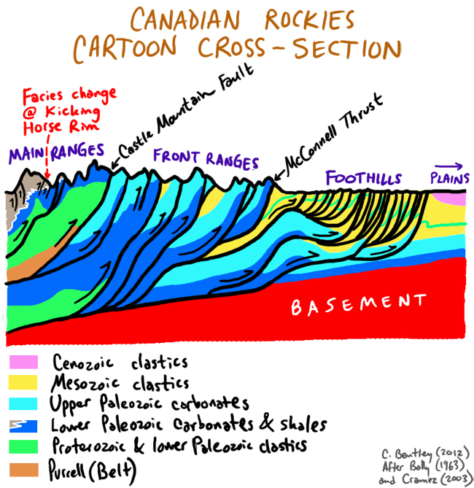
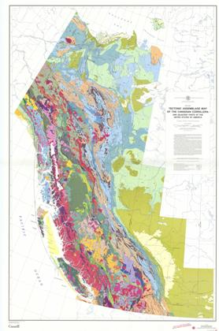
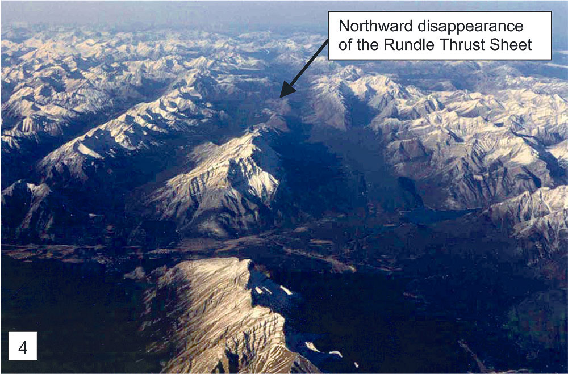
Regional Setting: Cross Section of the Rocky Mountains/Canadian Cordillera
Collage of numerous off-board terranes and numerous arcs/subduction zones, etc.
Univ. of Alberta
C. Bentley, Piedmont College, Virginia

Slide 5
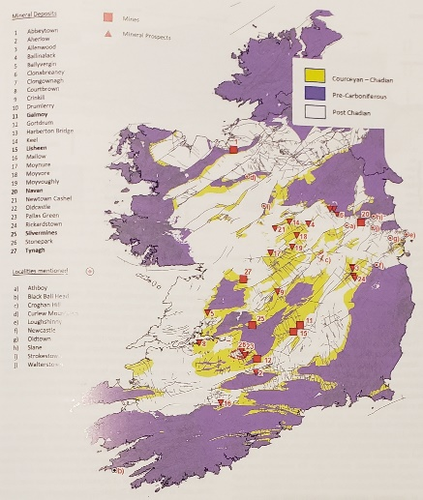
Introduction: Regional Setting
Numerous Sedex (= CHSD) and MVT Zn-Pb deposits throughout the Cordillera
from Paradis et al. 2022

Slide 6

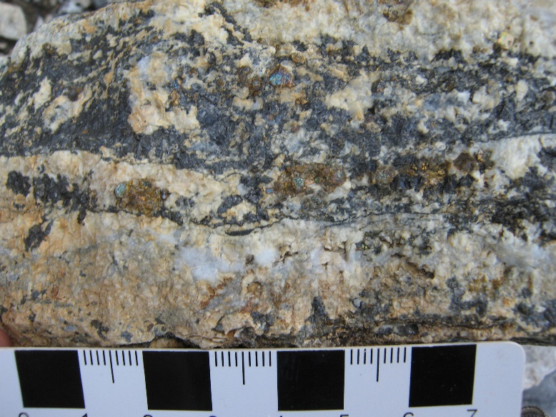

Introduction: Intent of this Study
Are there common and relevant features among MVT deposits in regional districts important in regard to their genesis/exploration/etc.?
What causes/localises such styles of mineralization in MVT-type settings?
Is variation in paragenesis, mineralogy, alteration, T°C, fluid chemistry (δ³⁴S_{H2S}, δ¹⁸O_{H2O}) important?
Address this using archived samples from MVT deposits across the Canadian Cordillera
Reeves-MacDonald
Abbott-Wagner
Kicking Horse
Pine Point

Slide 7
Regional Geological Setting
RMFTB = Rocky Mtn Fold and Thrut Belt, WCSB = Western Canadain Sedimentary Basin, KArc = Kootney Arc
RMFTB
RMFTB
KArc
WCSB
from Paradis et al. 2022

Slide 8
Regional Geological Setting
Part of long lived, Neoproterozoic (1) Windemere SGp (Sullivan) to Mesozoic (Red Dog) basin evolution off margin of the Precambrian Canadian Shield (Laurentia)
Basinal sediments (2) and platformal carbonates (3a,b)
Deep-water basins host SEDEX deposits (e.g., Sullivan, Howards Pass, Red Dog) and platformal carbonate sequences host MVT deposits (e.g., Pine Point)
Accretion of many allochthonous terranes with related deformation (KArc)
Regionally extensive oil/gas reservoirs – see Pine Point district in WCSB (4)
❸
❷
❸
❹
❸
❹
❶
Paradis et al. 2022

Slide 9
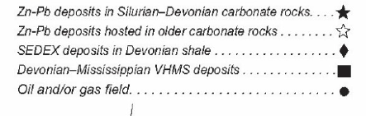
Regional Geological Setting
Some important geological features:
Limit of Cordilleran deformation
Western edge of N American craton
Shale outline/western edge of Paleozoic carbonates
McDonald-Hay River Fault/Great Slave SZ
❶
❷
❸
❹
Note 1st order structural control to MVT deposits
Deposits part of passive margin basin development

Slide 10
Sampling Sites
1. Kootenay Arc:
highly deformed and metamorphosed due to accretionary tectonics
2. Rocky Mountain Fold and Thrust Belt
moderate deformation better preservation
3. Western Canadian Sedimentary Basin
well preserved
❷
❶
❷
❶
❸
Deposits Zn>Pb
Small <1 Mt to large (10 Mt)
Most have not been explored in modern context (e.g., geophysics, deep drilling)
from Paradis et al. 2022
Notes:
Summary of the sites with the tonnage, ore types, ages of host, timing of mineralization

Slide 11
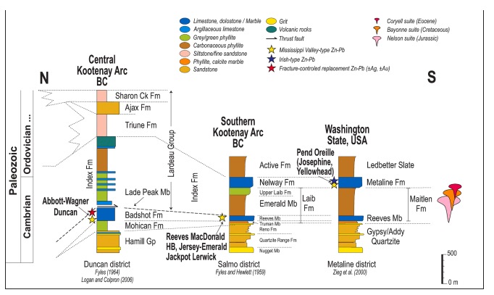
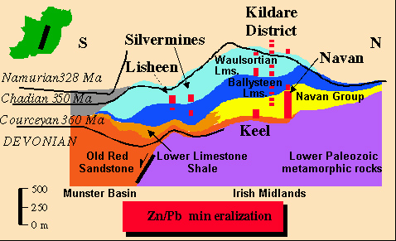
Regional Geological Setting: Mineralized Horizons
Many carbonate horizons present in local/regional stratigraphy sections
Thus, Zn-Pb mineralization NOT at one preferred horizon
E.g., Stratigraphy of southern BC/USA – many carbonate horizons....as seen in Ireland and elsewhere
from Paradis et al. 2023

Slide 12
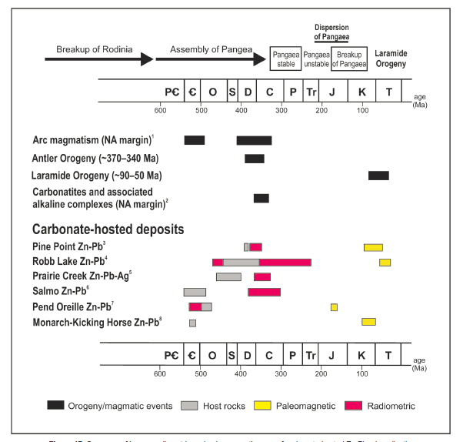
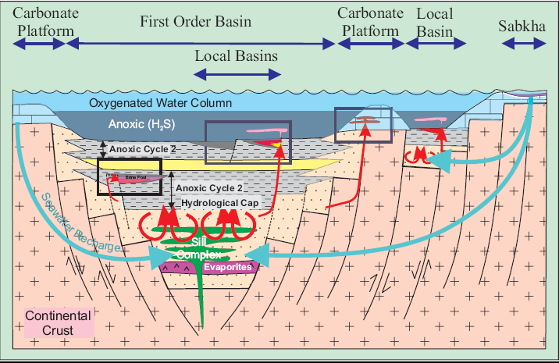
Timing/age of Mineralization and Related Model(s)
Relative/absolute ages important for Sedex vs MVT vs IT deposit
Few absolute age constraints...challenging (!)
Mineralization variable and suggest prolonged period of ingress of mineralizing fluids
MVY deposits in many carbonate horizons and fluids part of ongoing basin evolution (= Sedex formation)
Paradis et al. 2022
Goodfellow 2007

Slide 13
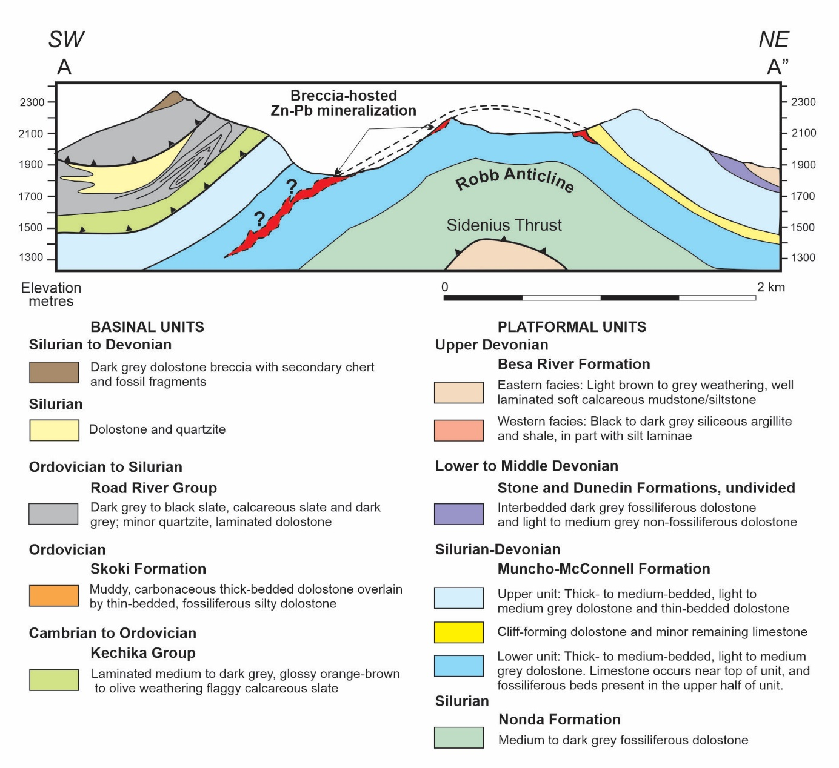
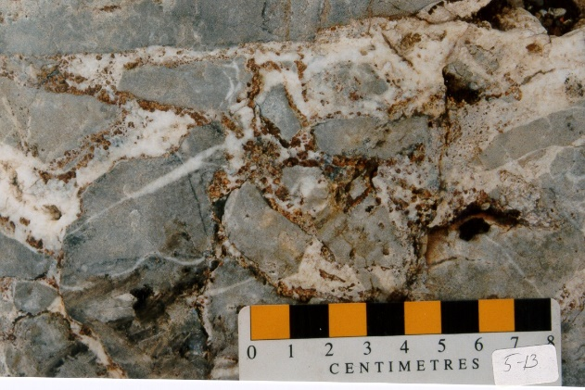
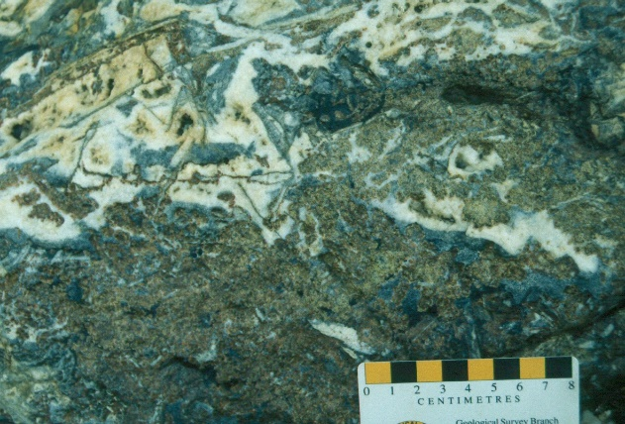
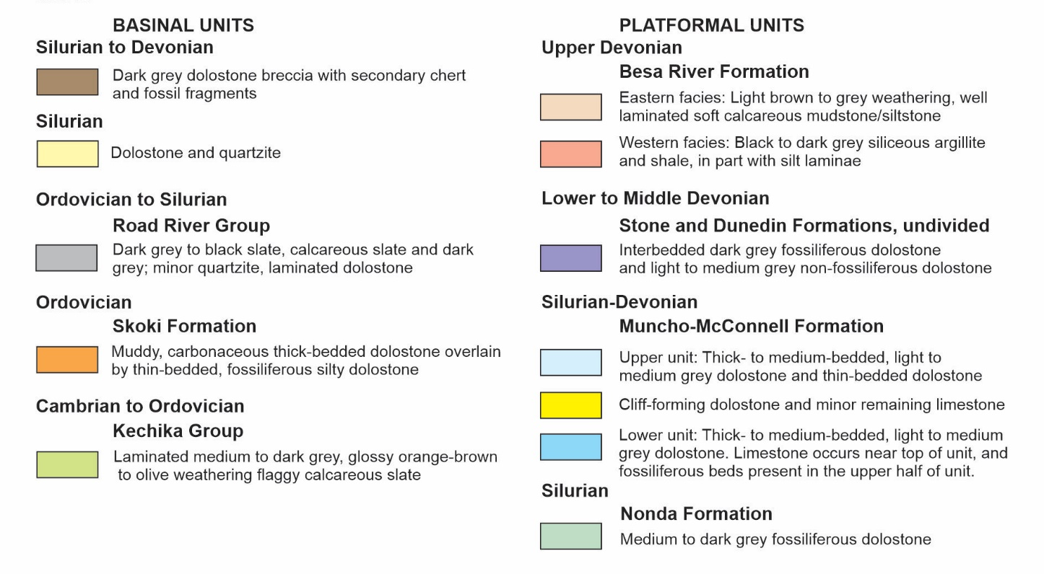
MVT Settings: Robb Lake Deposit (RMFTB)
SW
NE
Deep basinal units
Platformal carbonates

Slide 14
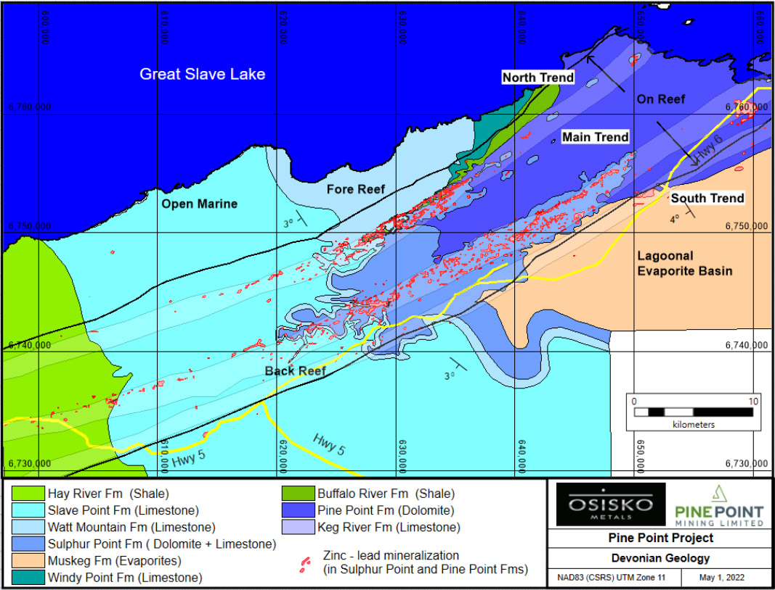
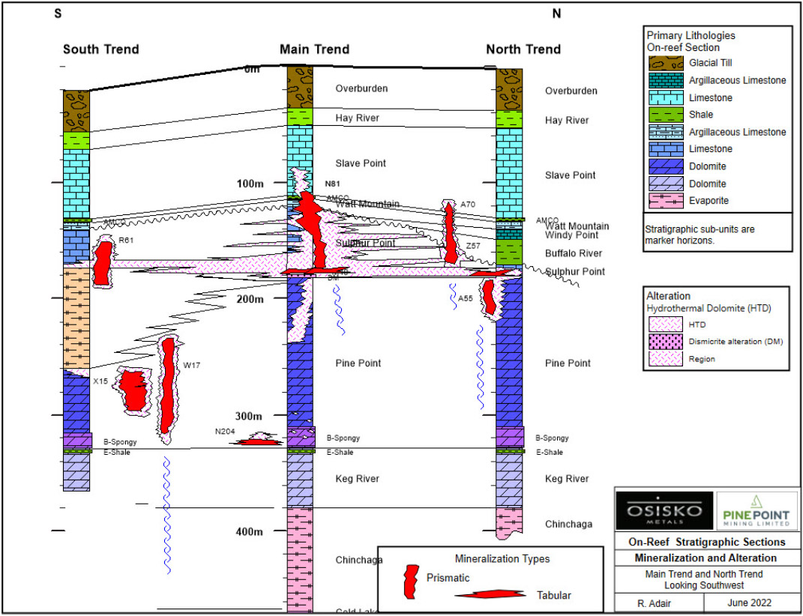
MVT Settings: Pine Point Deposit
≈100 ore bodies (0.1-xMt) of tabular and prismatic geometry; ca. 69 Mt 10% Zn + 3% Pb
Sulfides occlude open space via dissolution with related textures
Great Slave Shear Zone
Sh
Lmst
Lmst
Evp
2022 PEA for Zn and Pb ($1.37/lb and $0.97/lb respectively) → 15.7 Mt @ 5.5% Zn eq. in indicated + 47.2 Mt @ 5.94% Zn eq. inferred.
Dolm

Slide 15
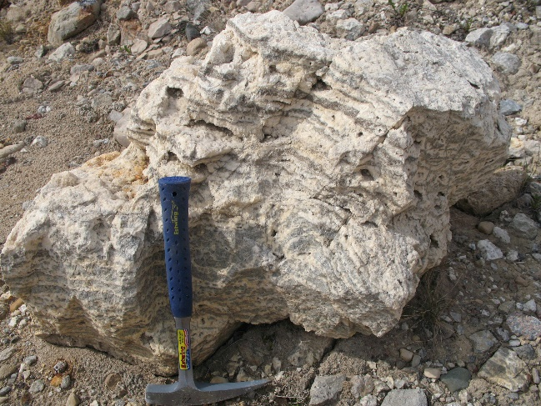
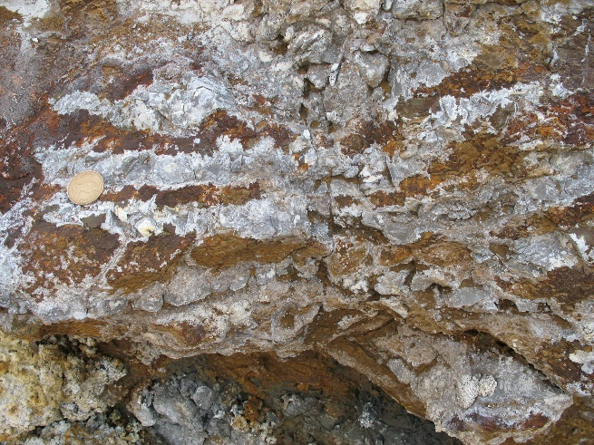
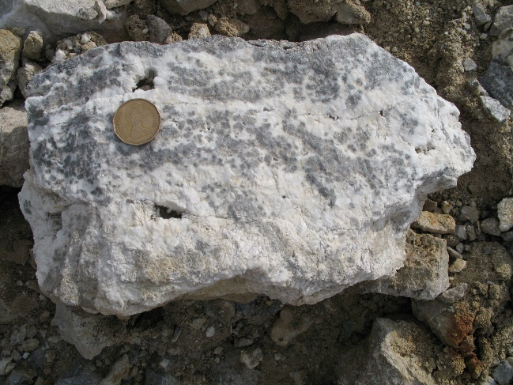
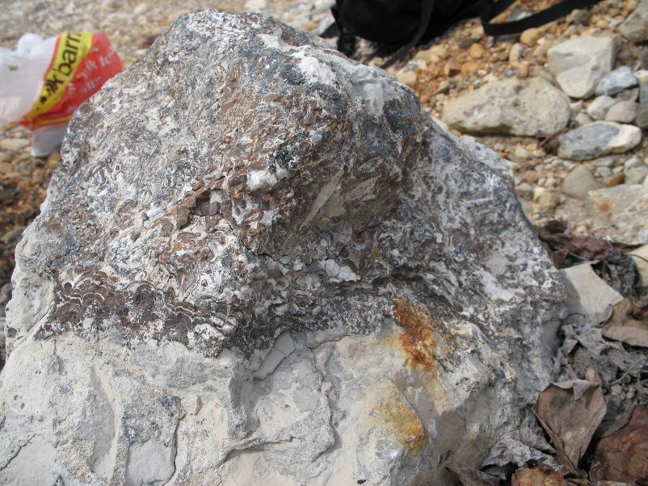
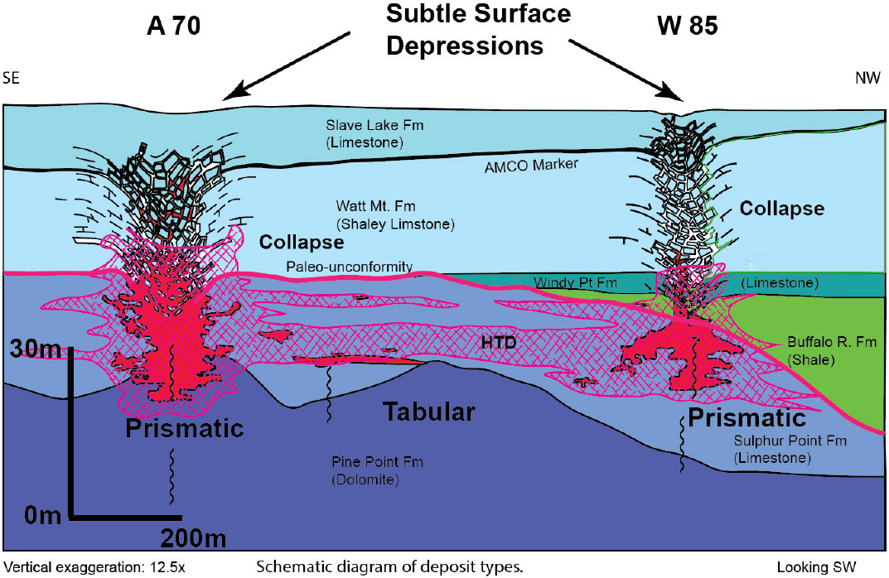
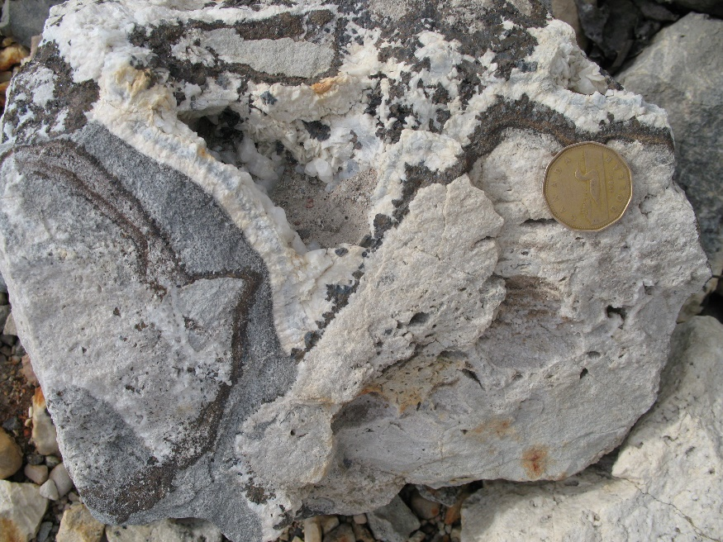
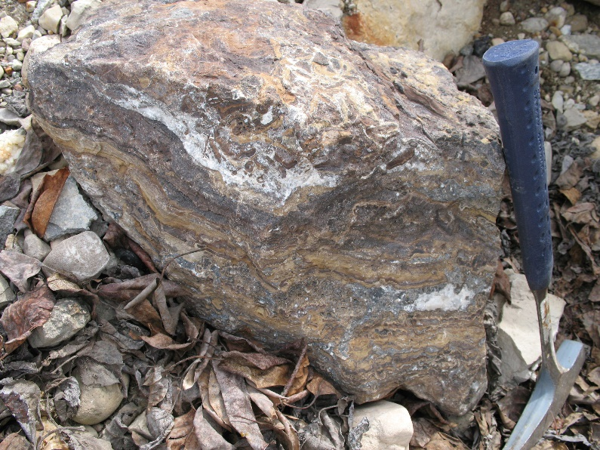
MVT Settings: Pine Point Deposit

Slide 16
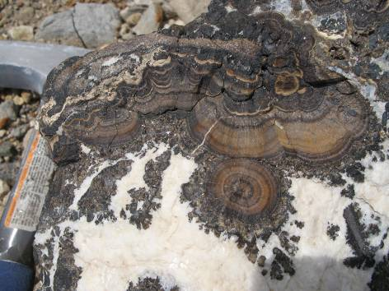
Features to be Assessed in Sites
Pine Point, Western Canadian Sedimentary Basin
Mineral paragenesis
Diagenesis/cementation
Sphalerite (habit, texture, chemistry)
Presence of petroleum/bitumen
Breccias
T of ore formation via FIs
Fluid reservoirs - δ¹⁸O and δ¹⁸S

Slide 17
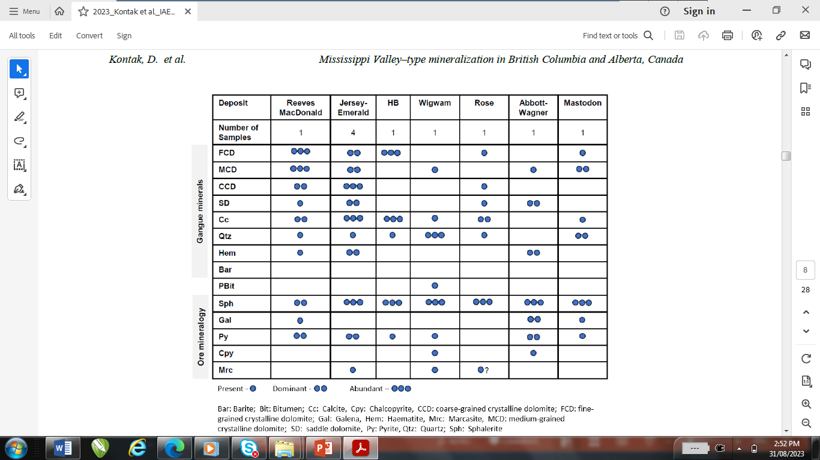
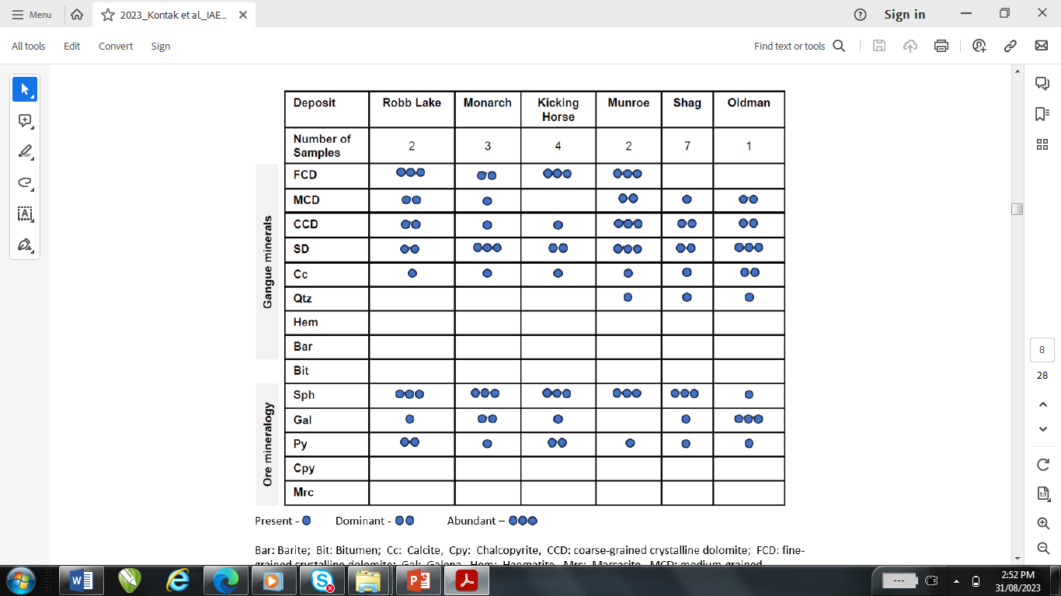
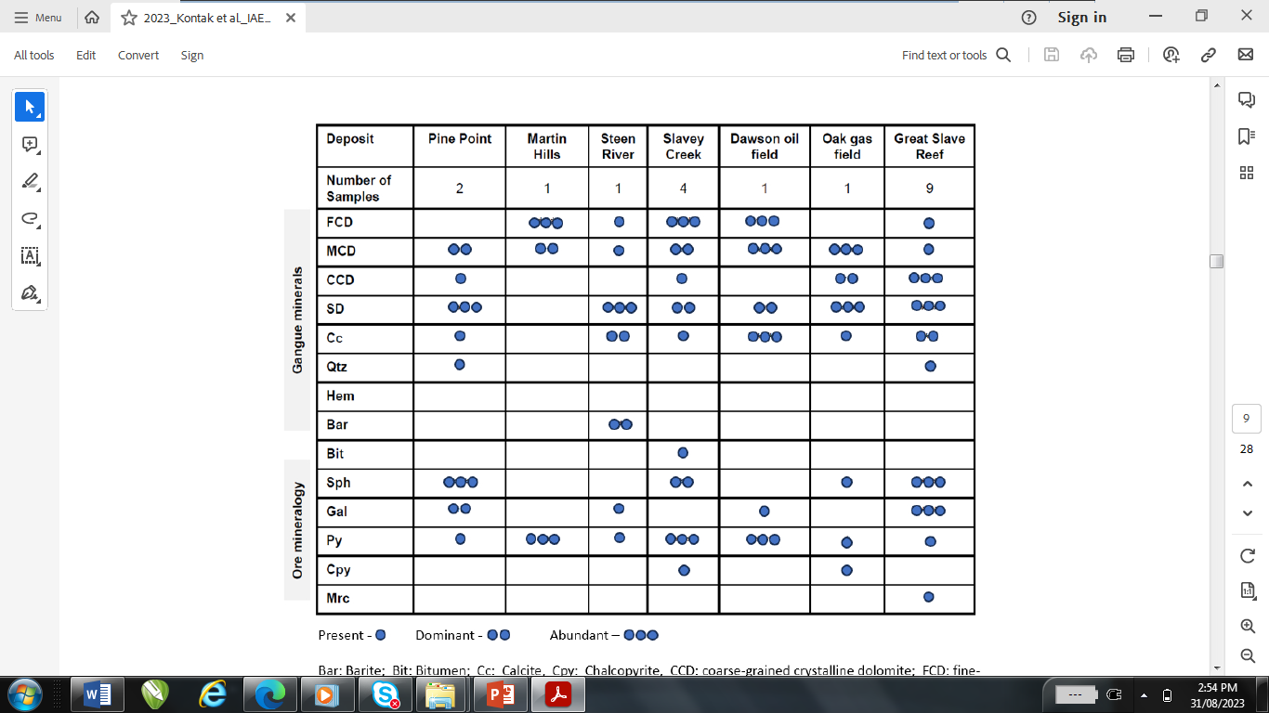
Results: Mineralogy and Paragenesis
Kootenay Arc
Rocky Mountain Fold and
Thrust Belt
Western Canadian Sedimentary
Basin
x
x
x
x
x
x
x
x
x
x
x
x
x
x
x
x
x
x
x
x
AW anomalous Cu rich – see sph chemistry
Present Dominant Abundant

Slide 18
Results: Mineralogy and Paragenesis
Kootenay Arc
Rockly Mtn Fold and Thrust Belt
Western Canadian
Sedimentary Basin
Event Pre-Ore Ore-Stage Post-ore
Marine cementation
Brecciation
F/MGCD
CGCD
SD
Sphalerite
Galena
Pyrite
Chalcopyrite
Generally very similar paragenesis for the 3 districts and many deposits studies...reflects a repeated process in time and space and suggests a common model

Slide 19
Results: Carbonate Cementation, Chemistry, and CL
Carbonate cementation paragenesis:
Lmst → FCD → MCD → CCD → SD → late Cc
MCD
Sph
FCD
Sph
MCD
Sph
CCD
FCD
FCD
FCD
2 mm
2 mm

Slide 20
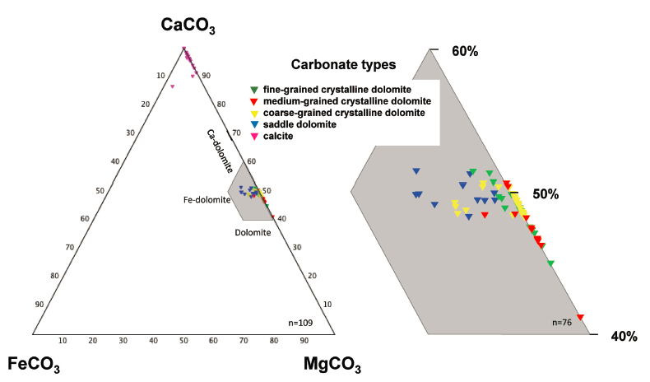
Results: Carbonate Cementation, Chemistry, and CL
General trend of increasing Fe (also Zn as micro-inclusions) in carbonates from early FG dolomites through coarsening to saddle-type dolomite
Late-stage post-ore calcite Fe-poor
Does carbonate chemistry trace an evolving fluid?
Can see this easier, quicker and more comprehensive with CL!
ore stage

Slide 21
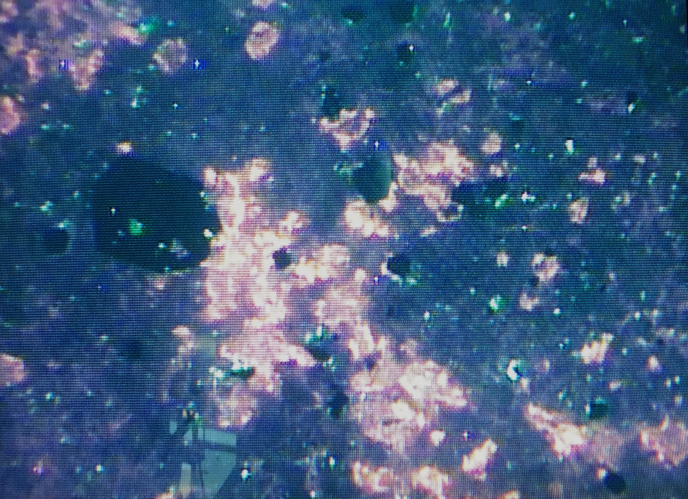
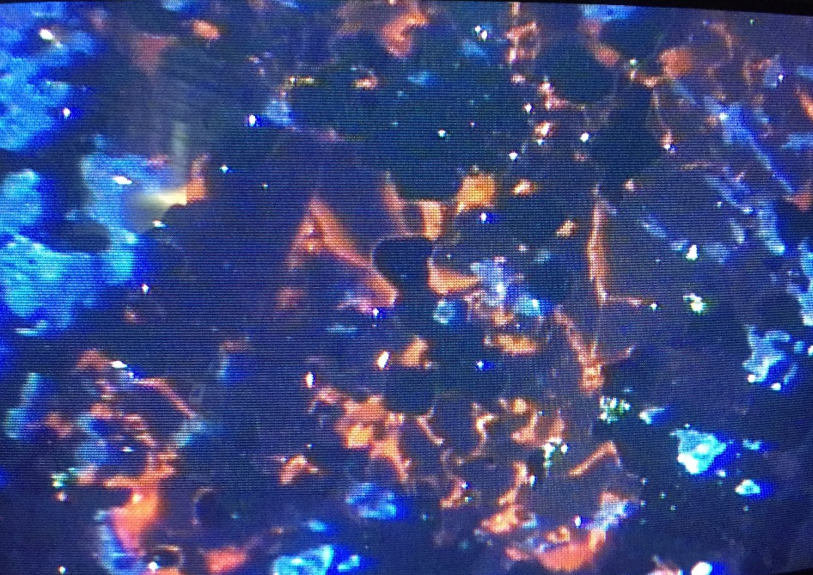
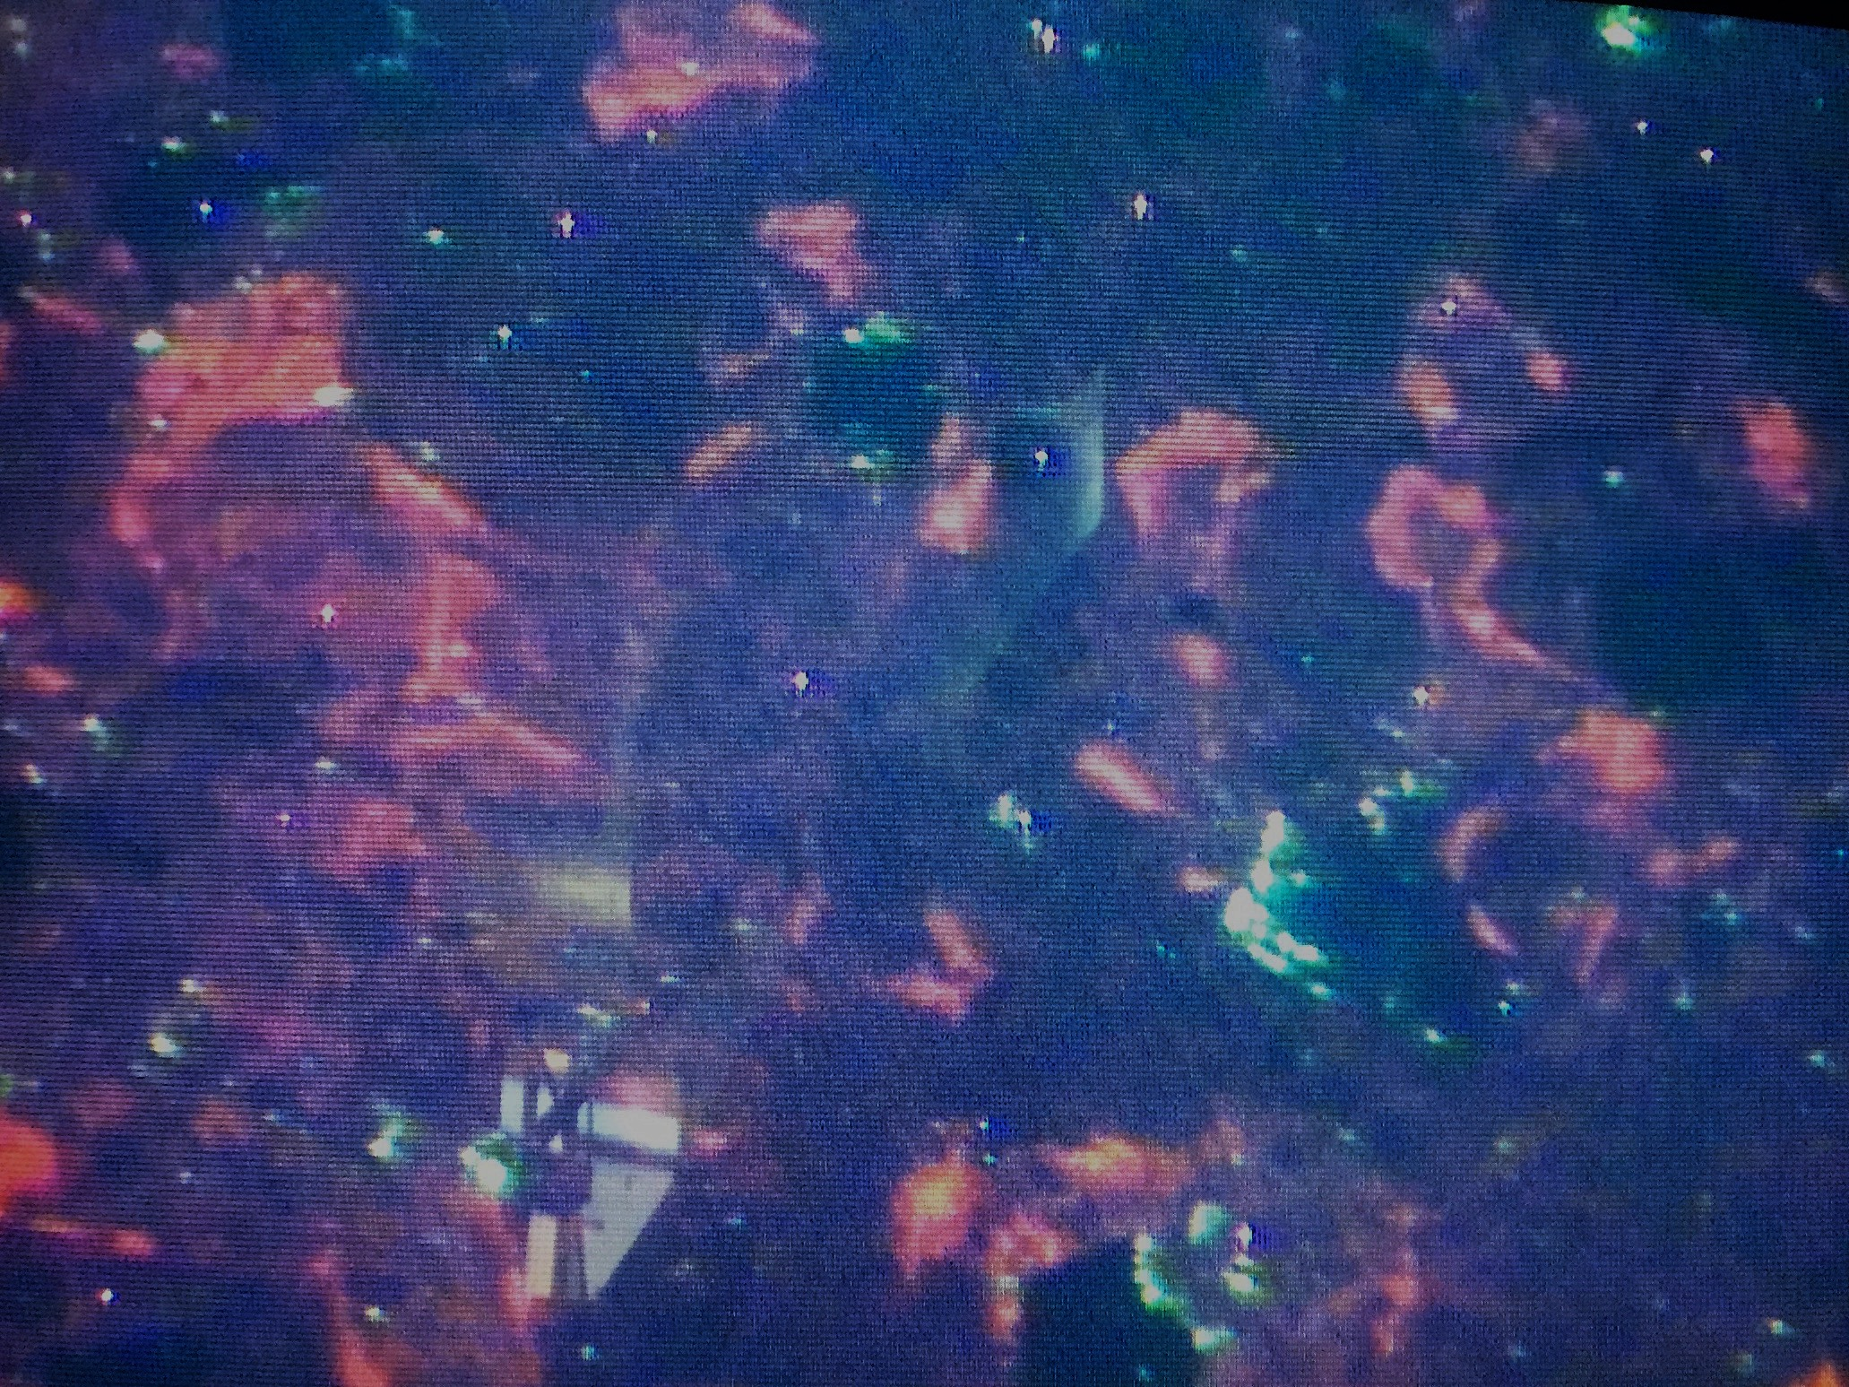
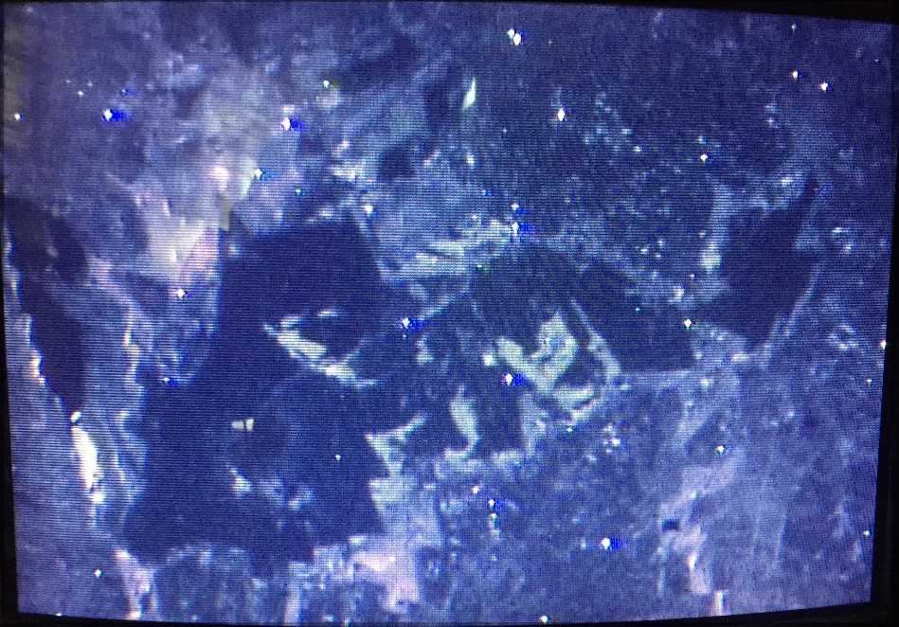
Results: Carbonate Cementation, Chemistry, and CL
CL is a measure of variable luminescence due to the presence of activators (often TMs as Fe, Mn, Al, Ti)
Trend of CL dark to CL brighter (orange, reds) from FCD to MCD to CCD to SD
Sph(-Gal) with the MCD and CCD.... suggests Fe-Mn addition is syn-mineralization and reflect different fluid vs marine cementation
Post-ore calcite (Cc) is CL dark...depleted in Fe-Mn
SD
Sph
CCD
FCD
4 mm
4 mm
F/MCD
FCD
SD
Cc
Sph
M/CCD
4 mm
2 mm

Slide 22
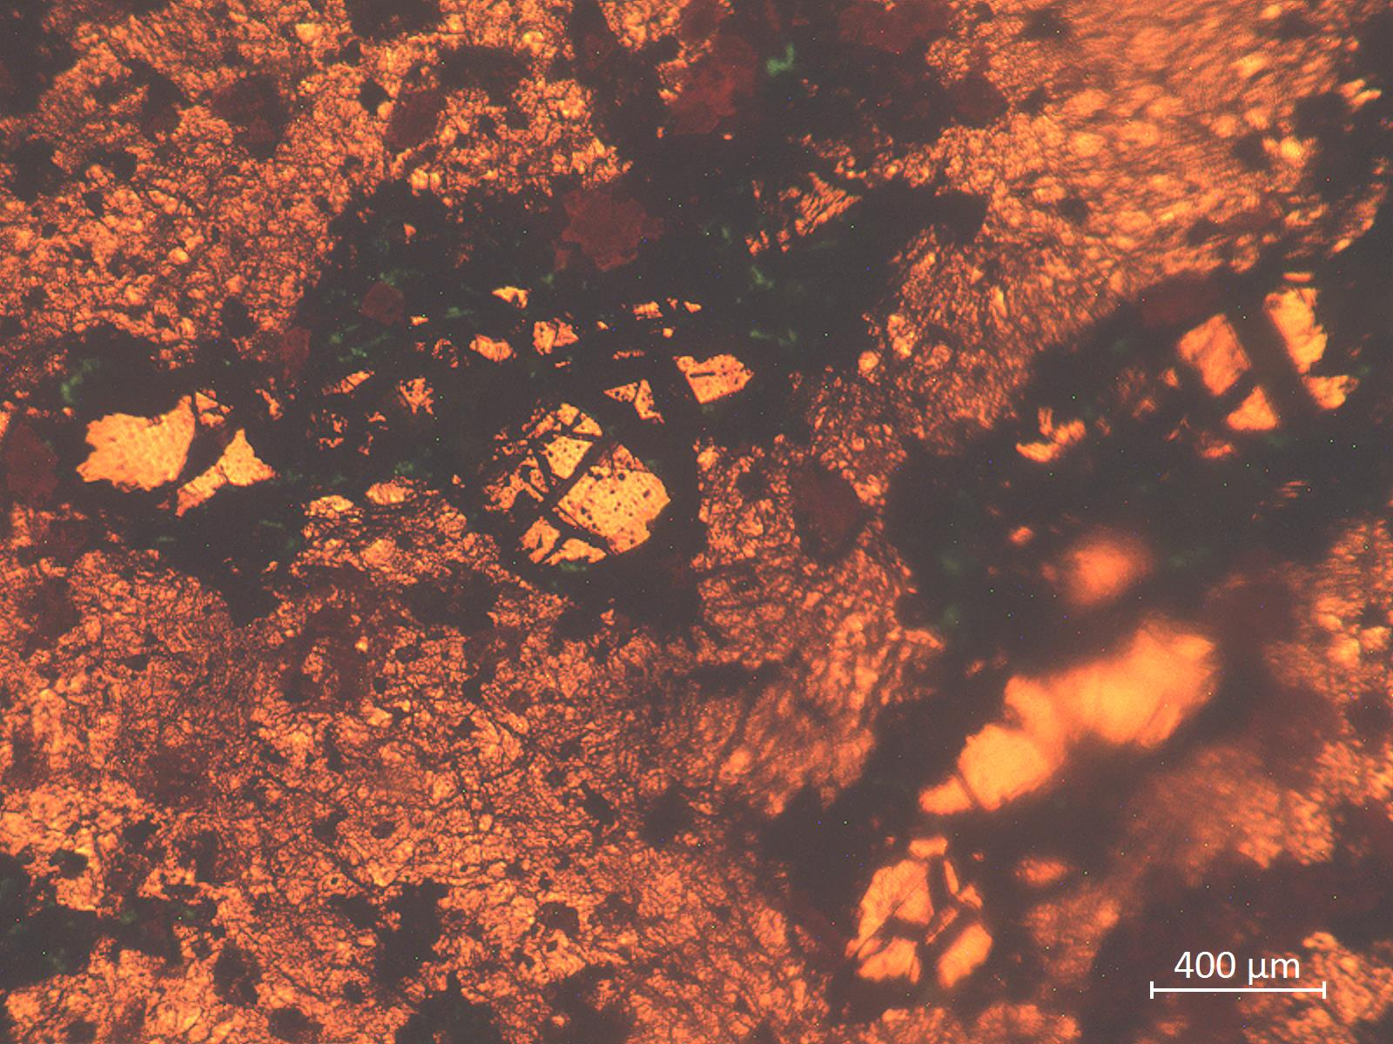
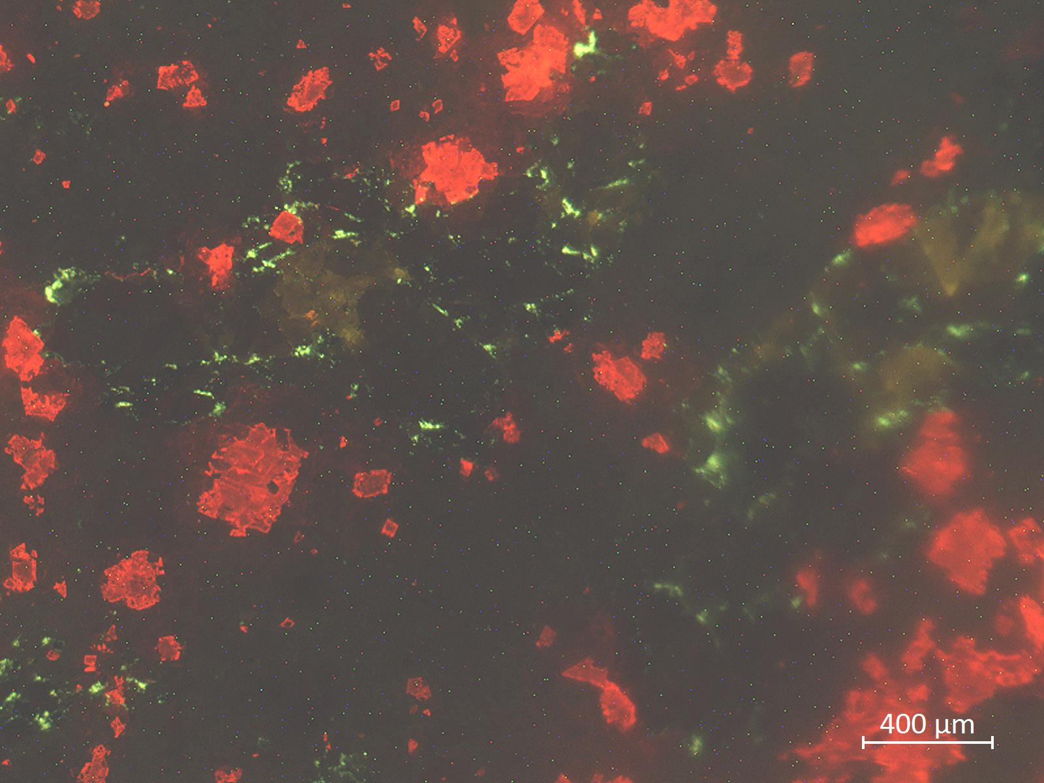
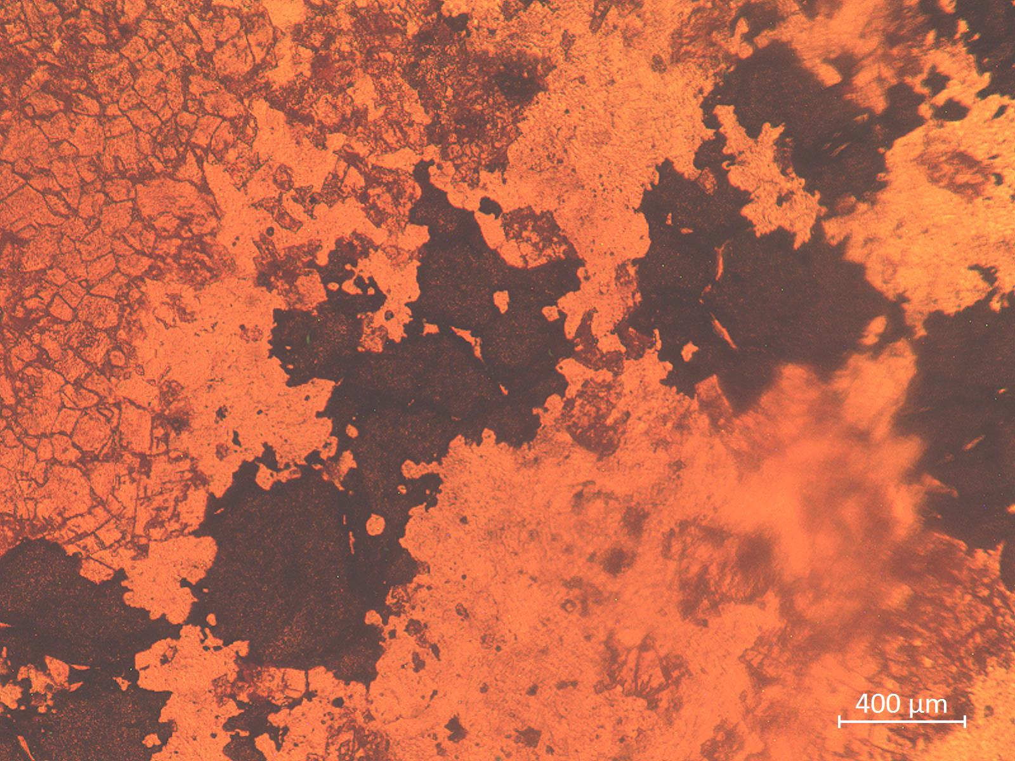
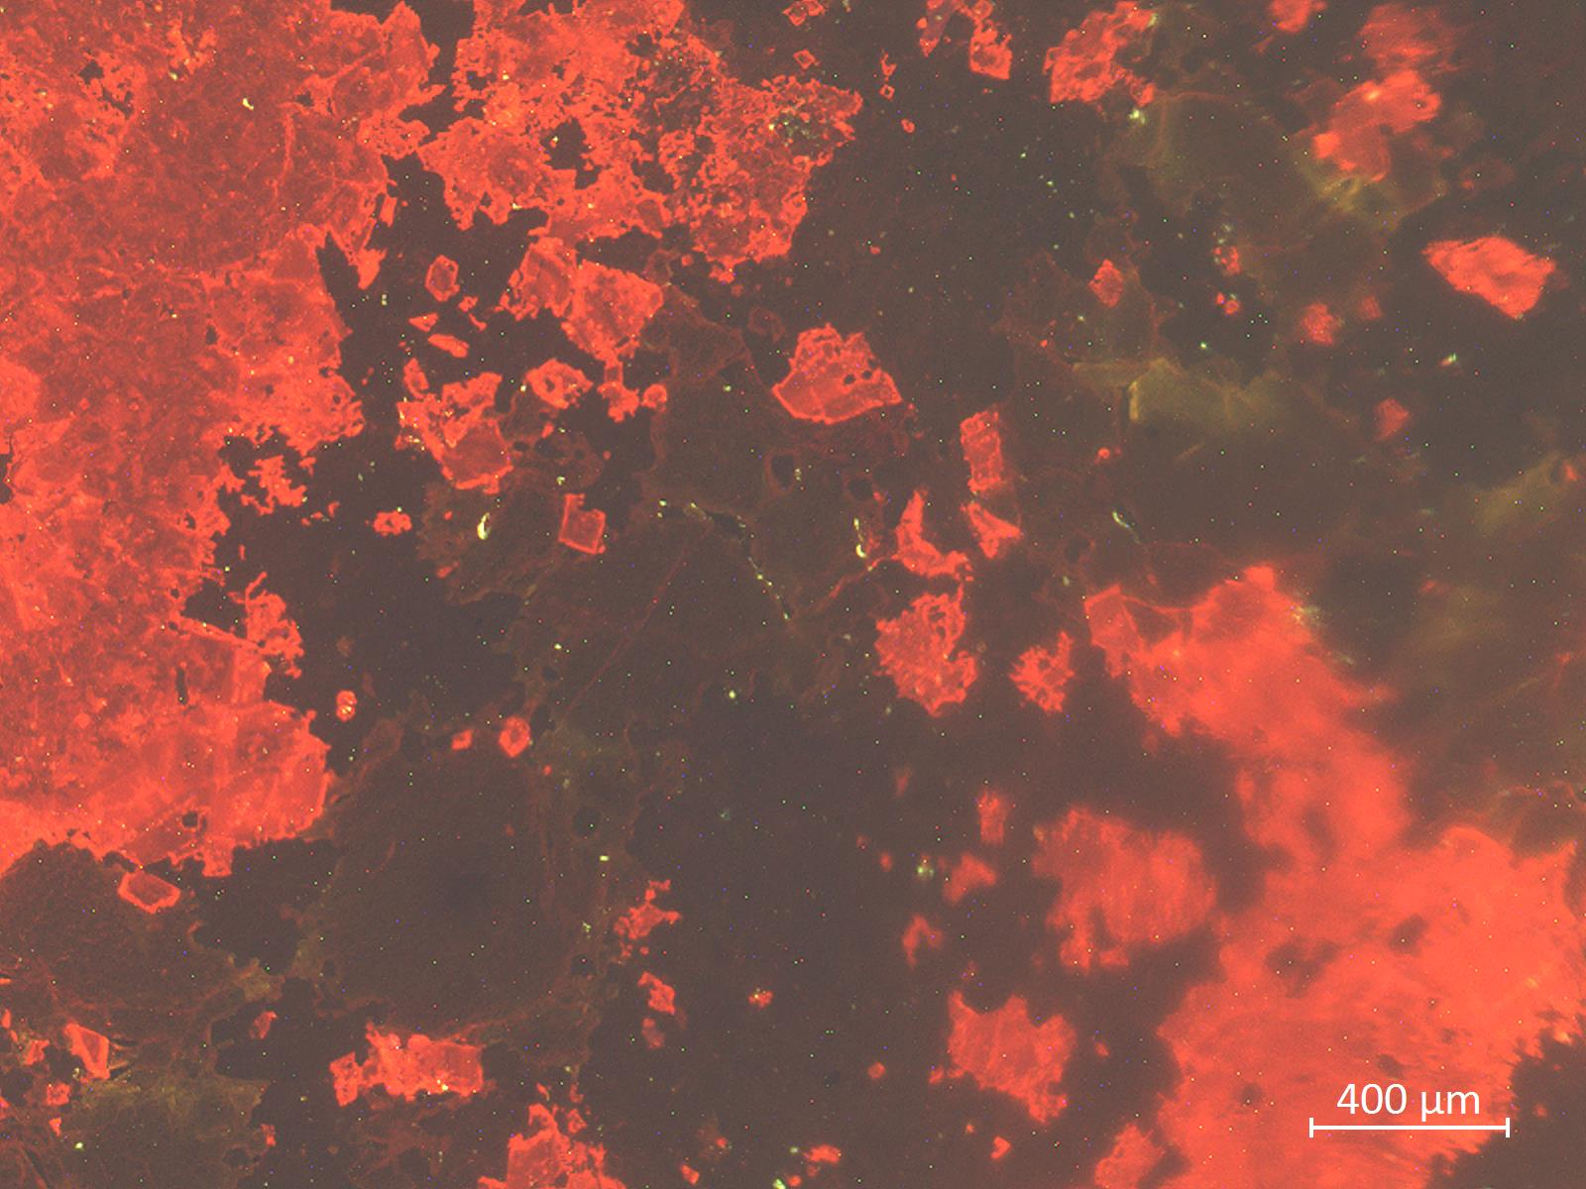
Results: Carbonate Cementation, Chemistry, and CL
PPL
CN
Sph
Need in situ TE chemistry and isotopes to trace fluid ingress
PPL
CN

Slide 23
Results: Mineralogy and Paragenesis
Kootenay Arc
Rockly Mtn Fold and Thrust Belt
Western Canadian
Sedimentary Basin
Event Pre-Ore Ore-Stage Post-ore
Marine cementation
Brecciation
F/MGCD
CGCD
SD
Sphalerite
Galena
Pyrite
Chalcopyrite
Generally very similar paragenesis for the 3 districts and many deposits studies...reflects a repeated process in time and space and suggests a common model

Slide 24
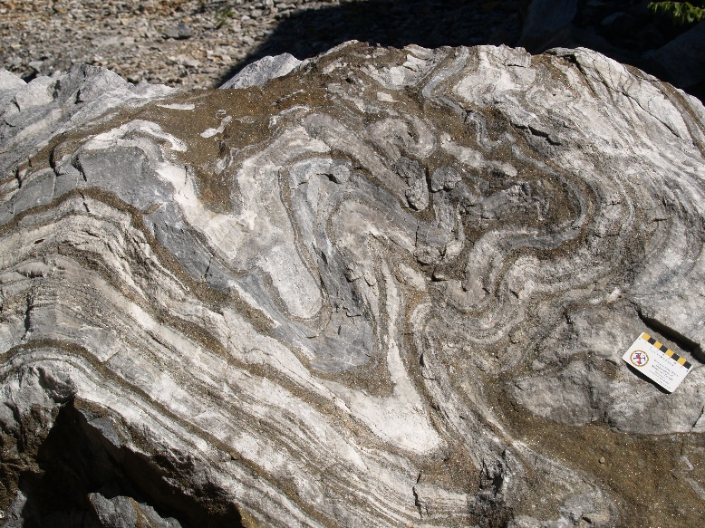
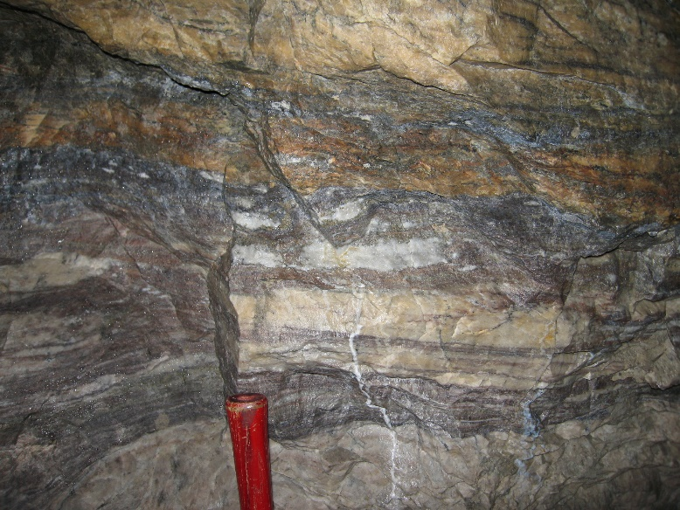
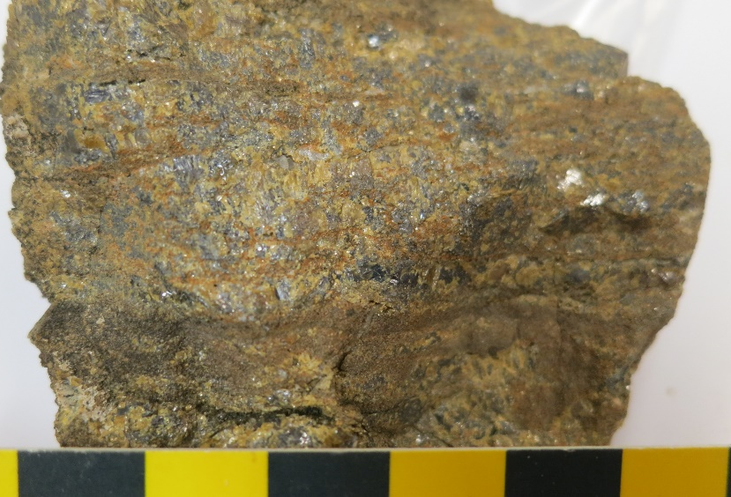

Results: Mineralogy and Paragenesis – Sphalerite(-Galena)
Kootenay Arc setting mineralization is replacement-type and deformed/recrystallized, but replacement textures still preserved (?)
Reeves-MacDonald
Reeves-MacDonald
Jersey
Mastodon
Abbott-Wagner
HB

Slide 25



Results: Mineralogy and Paragenesis – Sphalerite(-Galena0
RMTFB and WCSB setting mineralization less and/or more commonly undeformed, more open-space type textures
Kicking Horse
Kicking Horse
Pine Point
Robb lake
Robb lake

Slide 26
Results: Mineralogy and Paragenesis – Sphalerite(-Galena)
Many textural varieties of low-Fe sphalerite
Mixed habits/overgrowths
Pale yellow/orange brown to clear
Where zoned, brownish to paler (always)
Layered, granular, massive, isolated grains
Tartan-like twinning/strain
Unusual textures (dendritic gal)
2 mm
1 mm
CCD
1 mm
1 mm

Slide 27


Results: Mineralogy and Paragenesis – Sphalerite(-Galena0
Many textural varieties of low-Fe sphalerite
Mixed habits/overgrowths
Pale yellow/orange brown to clear
Where zoned, brownish to paler (always)
Layered, granular, massive, isolated grains
Tartan-like twinning
Unusual textures (dendritic gal)
MCD
SPH
0.5 mm
2 mm
2 mm
1 mm

Slide 28
Results: Mineralogy and Paragenesis – Sphalerite(-Galena)
Many textural varieties of low-Fe sphalerite
Mixed habits/overgrowths
Pale yellow/orange brown to clear
Where zoned, brownish to paler (always)
Layered, granular, massive, isolated grains
Tartan-like twinning
Unusual textures (dendritic gal)
2 mm
2 mm
1 mm
0.5 mm

Slide 29
Results: Liquid Petroleum in Pine Pont Sphalerite
Also see Szmihelsky et al. (2020 Geology)....petroleum initiates rapid sulfide precipitation via sulphate reduction
2 mm
1 mm
2 mm
Images in PPL and SW IR light – spent and active petroleum

Slide 30


Results: Mineralogy and Paragenesis – Sphalerite(-Galena)
TEs can be used discriminate deposits such as Abbot Wagner from other settings in Kootenay Arc
KArc deposits
AW

Slide 31



Results: Breccia Textures
Kootenay Arc
Rocky Mountain Fold and
Thrust Belt
Western Canadian Sedimentary
Basin
Present Dominant Abundant

Slide 32
Results: Breccia Textures
Kootenay Arc
Rocky Mountain Fold and
Thrust Belt
Western Canadian Sedimentary
Basin
Present Dominant Abundant

Slide 33

Results: Fluid Inclusions – Previous Work
Old data did not follow FIA protocol – how reliable (?)
Poor classification as P, PS, S types – what is timing of fluid(s)
Large ranges for Th values (40-65°C) for single groups of FIs – suggest post-entrapment issues (?)...Th likely <100°C
Large range for salinities of <1 to 35 wt. %eq. NaCl) – thus different fluids

Slide 34



Results: Fluid Inclusions – FIA Approach
Creede LS epithermal deposit (USA)
Convention
Cave-in-Rock Fluorite MVT deposit
Th values = x ± 1-2°C
FIA approach

Slide 35

Results: Fluid Inclusions

Slide 36


Results: Fluid Inclusion Data or Sphalerite using FIA Approach
Th values from L:V ratios or density
Sphalerite-hosted FI data
PP
PP ore fluid –
metal rich
Large range in Th for sphalerite-hosted FIs
Large range in salinity for sphalerite-hosted FIs
No single fluid-type implicated in mineralization...mixing of two (?) end members (but more work needed)
But see Szmihelsky et al. (2020)
from Kontak et al. 2022

Slide 37

Results: in situ SIMS S Isotopes
In situ SIMS δ³⁴S analysis
Additional data confirm earlier work of Paradis et al. (2022) and extend data base (see data)
No extreme variations on the microscale (as noted in other settings)
Suggests evaporitic S source
Sulfate reduction via TSR processes vs BSR
PP
RL
RMD
Paradis et al. 2022

Slide 38

Results: In situ SIMS O Isotopes
Use P-corrected Th data with δ¹⁸O_{carb} (to infer δ¹⁸O_{H2O}
δ¹⁸O_{carb} (old and new data) records equilibration of host carbonate rocks:
FCD carbonate with SW
dolomite cements (MCD to SD) with fluid in thermal and chemical with basinal sediments
late calcite with meteoric fluid

Slide 39
Summary and Conclusions
Study of >20 carbonate-hosted MVT settings across western Canada consistent with MVT features, hence a distant Irish relative but DO NOT disown as many processes are still the same (see below)!
Deposits have similar mineral paragenesis: 1) dolomite cementation (with Fe/Mn enrichment); 2) mineralization; 3) post-ore calcite
Mineralization of Zn > Pb [where Cu present possibly of different (?)] as replacement/cavity fill (dissolution features) with similar ore textures
S is evaporitic; H₂S via open/closed system reduction by TSR > BSR (but Boyce et al. approach needed)
δ¹⁸O_{carb} records change in fluid from marine to crustal/thermally-equilibrated to meteoric (as in many other studies)
FIs indicate two end-member fluids....but implications/relevance TBD
Implications of Pine Point – does its size reflect an efficiency/process not seen elsewhere or simply longer/bigger fluid flux?

