Slide 1
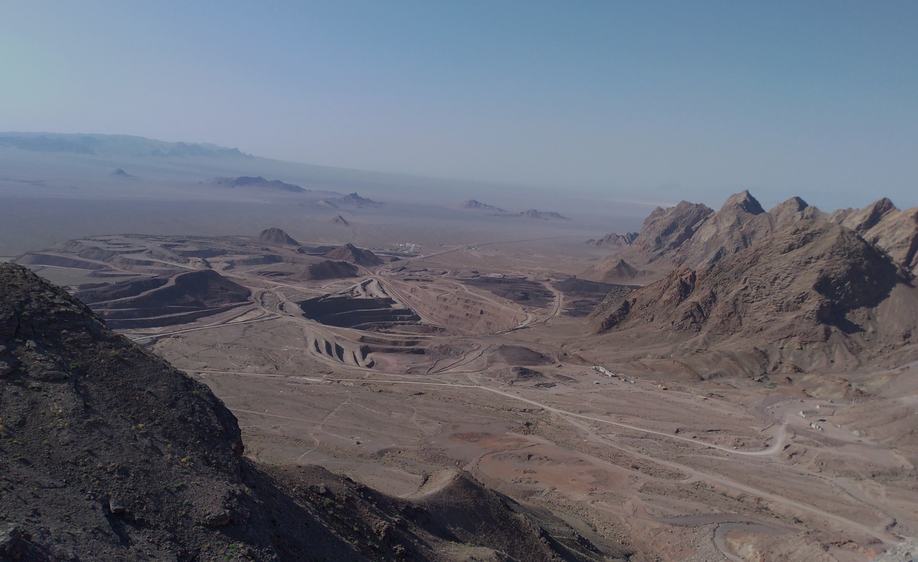
Irish-type Zn-Pb deposits around the world - 2023
Carbonate -Hosted Zn-Pb-Cu-Ba (-Ag) mineralization in Mehdiabad deposit: new insights, new discoveries
Ghazaleh Khan Mohammadi, Abdorrahman Rajabi*, Shojaedin Niroomand, Pouria Mahmoodi, Carles Canet, Pura Alfonso
Mehdiabad Mining Camp
Yazd, Iran - 2019
* e-mail: rahman.rajabi@ut.ac.ir
Notes:
Hello again. Due to the absence of Miss Khanmohammadi at this conference, I present the paper on behalf her.
Khan Mohammadi is an MSc student in Economic Geology at the University of Tehran.
We are going to talk to you about the world's largest carbonate-hosted lead-zinc deposits.

Slide 2
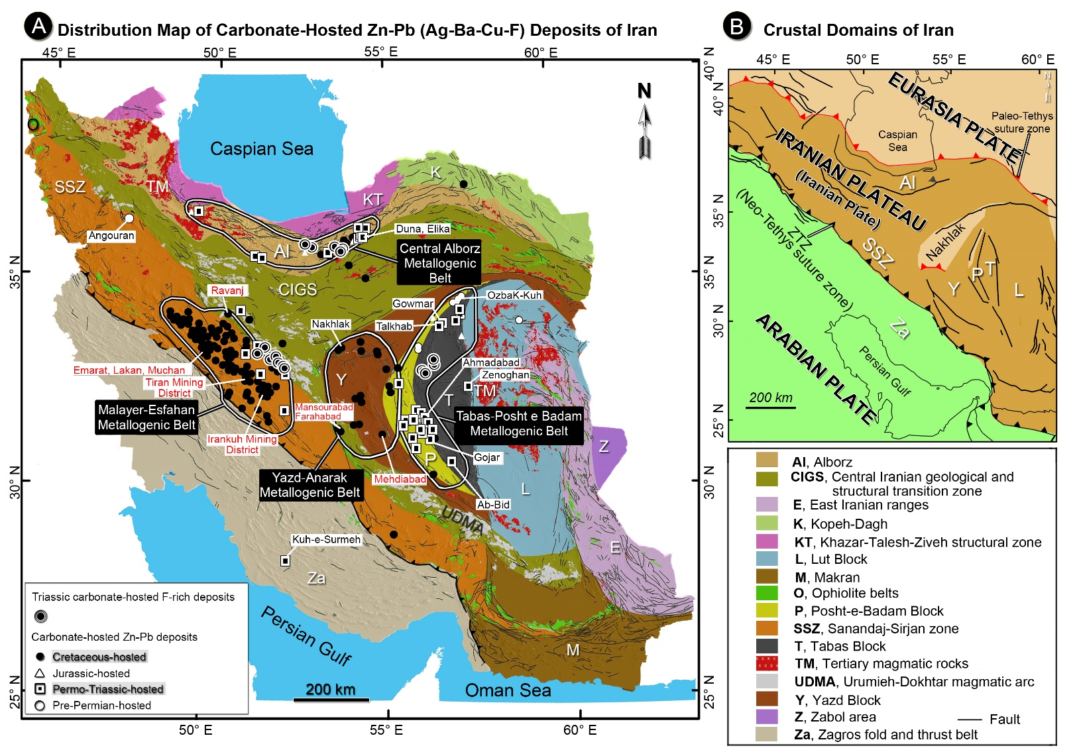
Irish-type Zn-Pb deposits around the world - 2023
Distribution of the CH Zn-Pb ore deposits
A) Simplified tectonic map of Iran (Aghanabati, 1998) and distribution map of carbonate‐hosted (MVT and Irish-type) Zn‐Pb and F‐rich deposits according to the age of host rocks in the Central Alborz, Tabas‐Posht e Badam, Malayer‐Esfahan, and Yazd‐Anarak metallogenic belts (Rajabi et al., 2012a; 2019a; 2022). Major Irish-type deposits are indicated with red font. B) Simplified terrane map of the western Tethysides, and crustal domains of Iran (Rajabi et al., 2019a).
2
Notes:
This map, again, shows the distribution of carbonate‐hosted Zn‐Pb deposits in Iran. There are four major metallogenic belts that host these deposits, including the Central Alborz, Tabas‐Posht e Badam, Malayer‐Esfahan, and Yazd‐Anarak metallogenic belts.
Mehdiabad is here, in the Yazd-Anarak metallogenic belt.

Slide 3
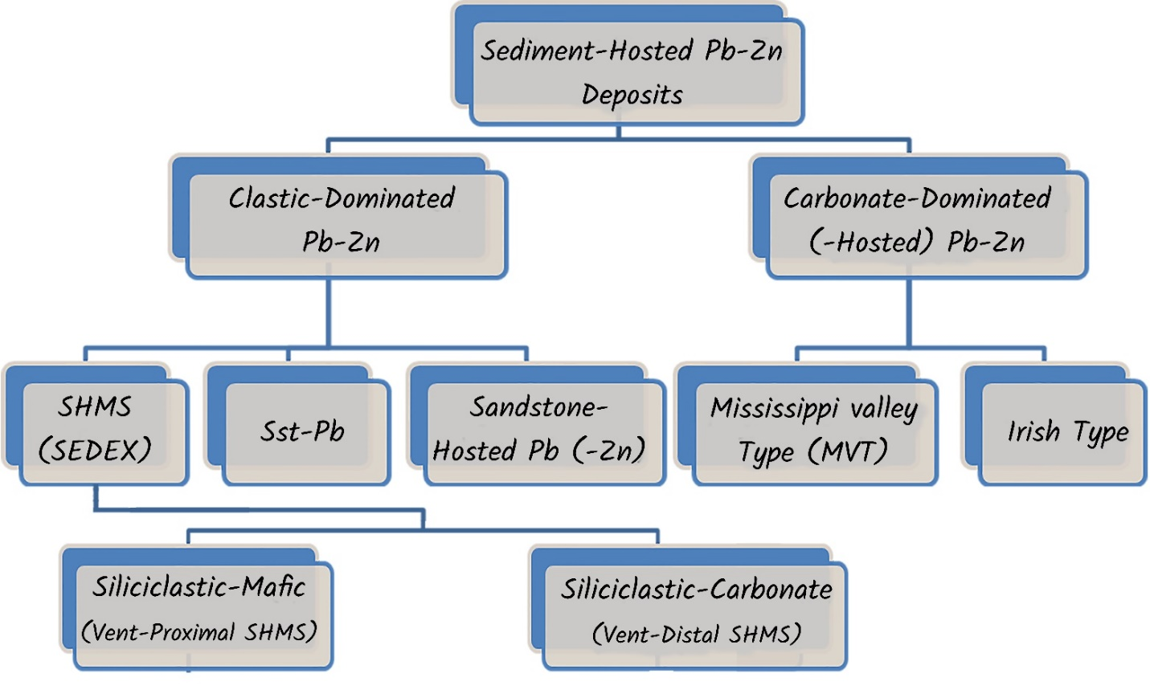
Irish-type Zn-Pb deposits around the world - 2023
Types of the SH Zn-Pb ore deposits
Leach et al. (2010)
Leach et al. (2005)
Houston et al. (2015)
(Goodfellow, 2004)
SEDEX
MVT
Irish-Type
Suggested Model for Mehdiabad
Maghfouri et al. (2019)
Leach et al. (2005 )
Liu et al. (2023)
Burton (2003)
Rajabi et al. (2012)
Rajabi (2022)
Ghasemi (2006)
3
Notes:
This chart shows different kinds of sediment-hosted zinc-lead deposit classifications, including the clastic-dominated and Carbonate-dominated deposits. The common method is the genetic classification suggested by Leach et al. (2005). We also prefer to use genetic classification of these deposits that mainly includes Shale-Hosted massive sulphide, the Irish-type and MVT deposits. Other groups are not very extensive.
Many authors worked on Mehdiabad deposit and suggested different genetic models, from Sdex to MVT and Irish-type.

Slide 4
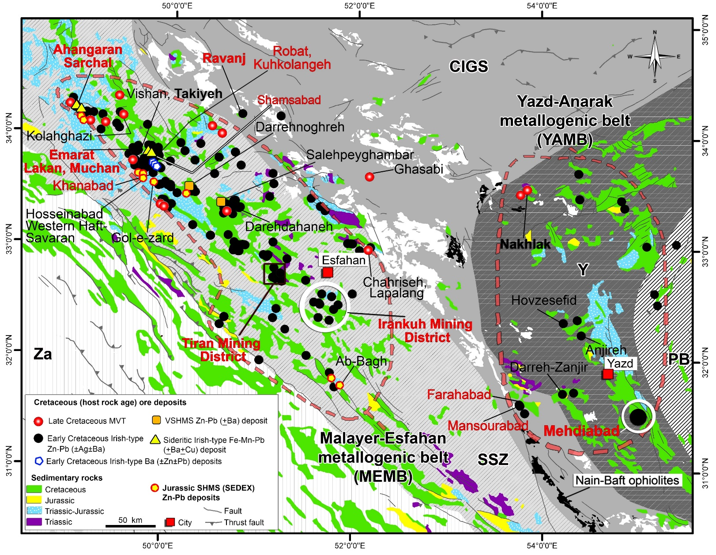
Irish-type Zn-Pb deposits around the world - 2023
The Cretaceous Metallogenic Belt
Distribution map of Irish-type, SHMS (SEDEX) and VSHMS deposits in the Malayer-Esfahan and Yazd-Anarak metallogenic belts of Iran (after Rajabi et al., 2012). These deposits occur on both sides of the Nain-Baft back-arc basin, characterized by ophiolites.
4
Notes:
The Yazd-Anarak metallogenic belt (YAMB) in Central Iran hosts several carbonate-hosted Zn–Pb deposits, including Irish-type mineralizations (e.g., Mehdiabad, Mansourabad, and Farahabad) and structural control Mississippi Valley-type, MVT, (e.g., Nakhlak and Darreh-Zanjir)
The most similar deposits to Mehdiabad are the Farahabad and Mansourabad deposits southwest of Mehdiabad.

Slide 5
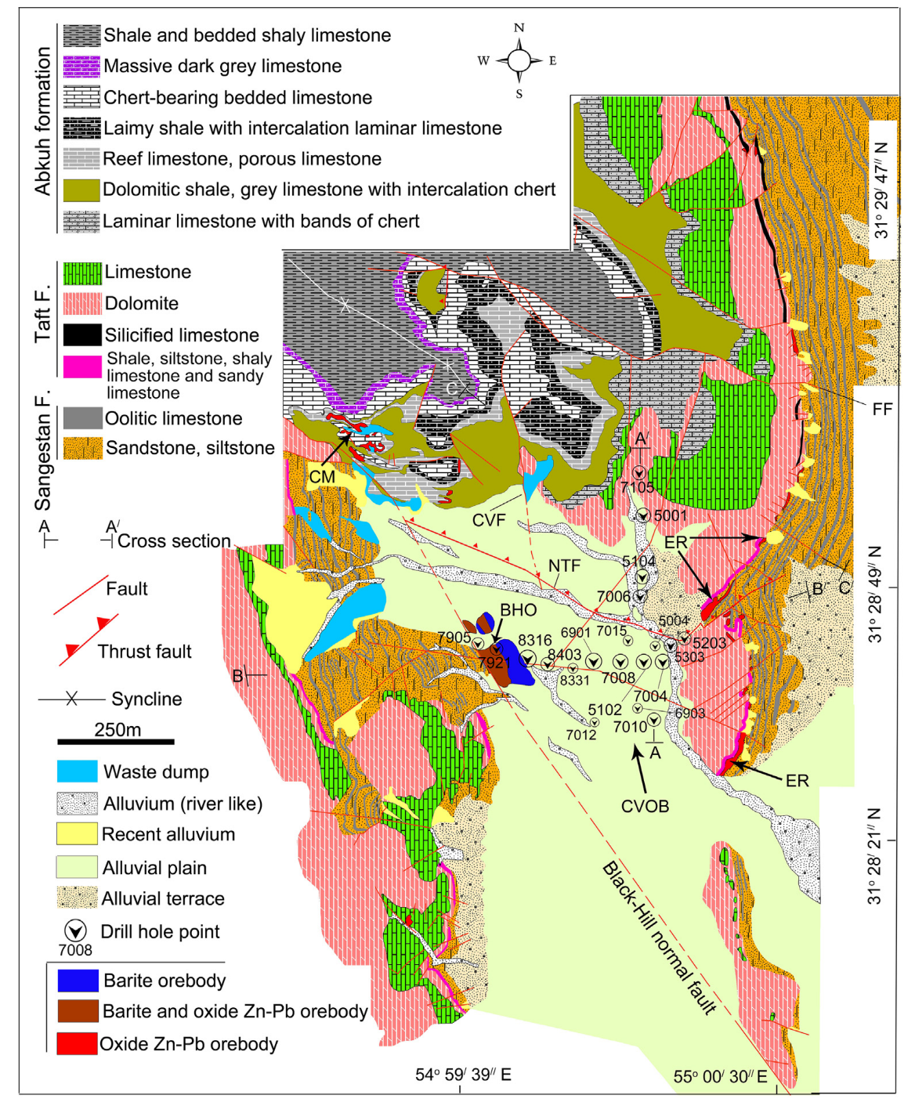
Irish-type Zn-Pb deposits around the world - 2023
Mehdiabad Zn-Pb-Ba-Cu (+Fe+Mn) deposit
Mehdiabad Zn-Pb-Ba-Cu (+Fe+Mn) deposit
Mehdiabad deposit:
Recent exploration revealed the total geological resource of this deposit of about 630 Mt at 4.2% Zn, 1.2% Pb, 5% Cu and 51 g/t Ag, along with tens of Mt of barite.
Geological map of the Mehdiabad deposit showing the location of the barite deposit in the east of the Black-Hill Fault and of the oxide Zn-Pb orebody in the northeast of the map. CVF: Central Valley fault; NTF: North Thrust fault; FF: Fourozandeh fault; BHO: Black-Hill ore; CVOB: Central Valley orebody; ER: East Ridge; CM: Calamine Mine (Maghfouri et al., 2019).
5
Notes:
Let’s have a look again at the geological map of the Mehdiabad deposit. Here is the Sangestan formation, on the right and the Taft formation, on the top. Here is the Black-hill fault. The mineralization occurs on the right-hand hanging wall of this fault. You see a small outcrop of mineralization here.
Here in the northwest, you see the Abkuh calamine ore.

Slide 6
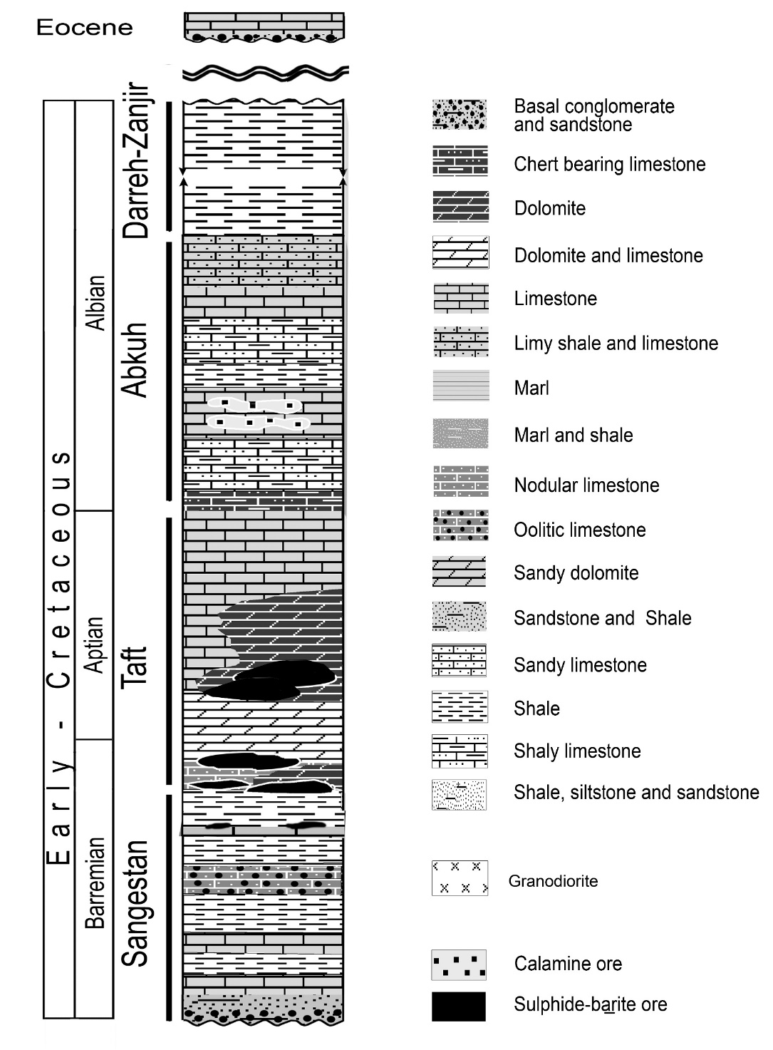
Irish-type Zn-Pb deposits around the world - 2023
Mehdiabad Zn-Pb-Ba-Cu (+Fe+Mn) deposit
Generalized lithostratigraphic columnar sections of Mehdiabad deposit (Modified after Rajabi et al., 2012; Khanmohammadi et al., 2023).
6
Notes:
In the Taft formation, we have the main orebodies of Mehdiabad, and here is the Calamine ore in Abkuh Formation.

Slide 7
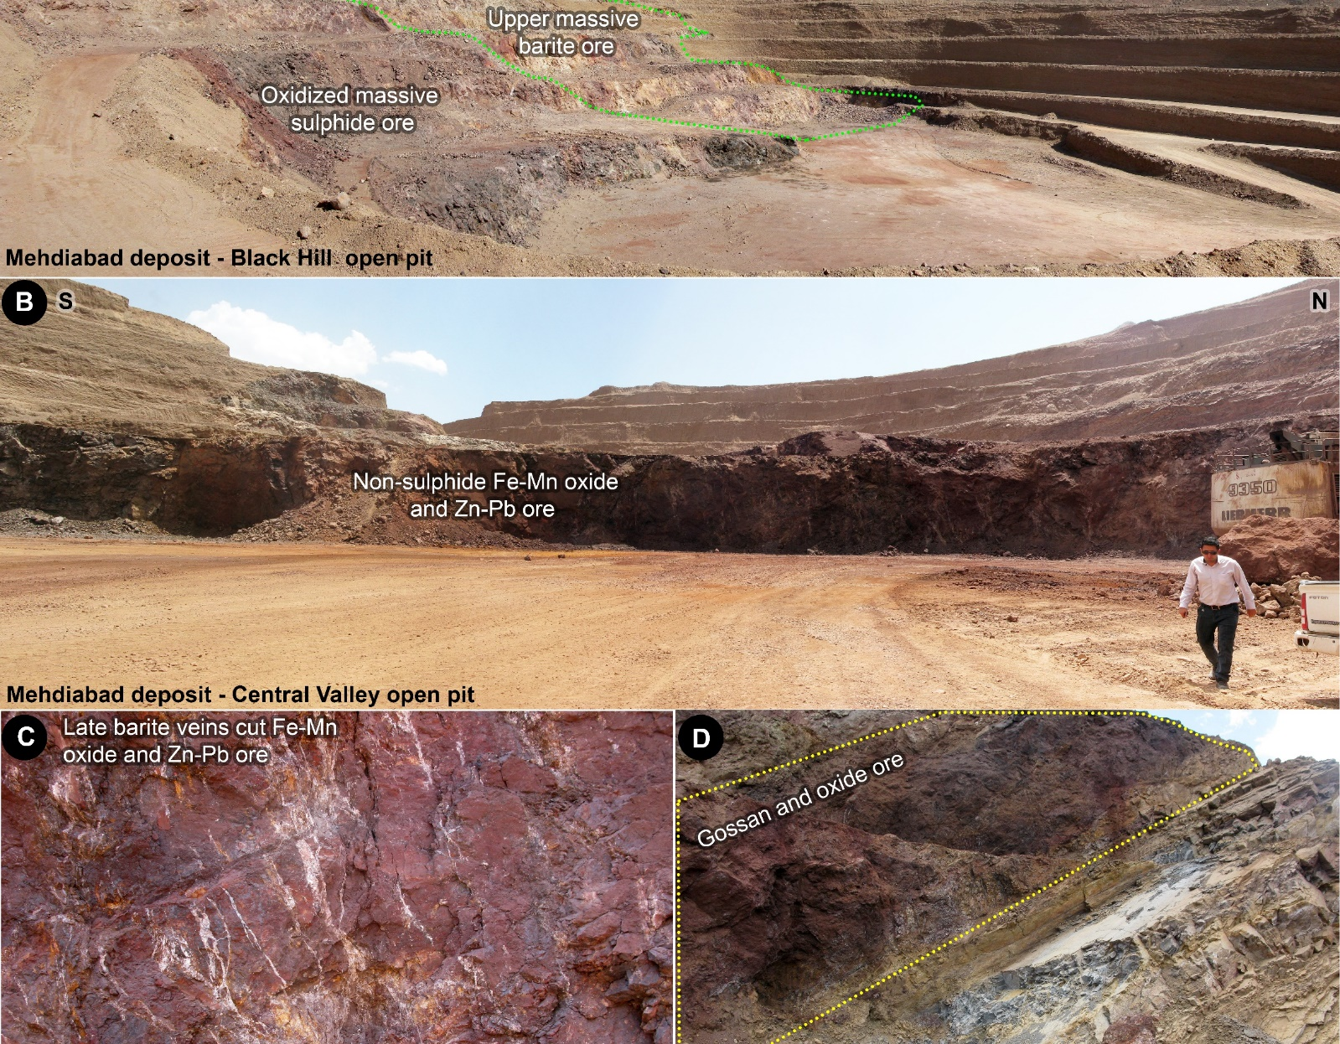
Irish-type Zn-Pb deposits around the world - 2023
Mehdiabad Zn-Pb-Ba-Cu (+Fe+Mn) deposit
Outcrop views from Black Hill open pit and Calamine ore (A), Central Valley (B) and East Ridge (D) open pits in Mehdiabad giant deposit, representing oxidized massive ore, upper massive barite, non-sulphide Fe-Mn oxide and Zn-Pb ore, and late barite veins (C).
7
Notes:
The lower and main horizon of the mineralization in Mehdiabad deposit is composed of three parts: the Mountain/Black Hill orebody, the Central Valley orebody, and the East Ridge, hosted in the Taft Formation. The second ore horizon is only observed at the Calamine Mine and is hosted in the Abkuh Formation.
Here you see the upper massive barite ore, oxidized massive sulfide and barite, the non-sulphide zinc-lead ore associated with Fe – Mn oxide.
At the bottom, here we have late barite veins that cut oxide ore. On the right, there is an outcrop of the East Ridge oxide ore.

Slide 8
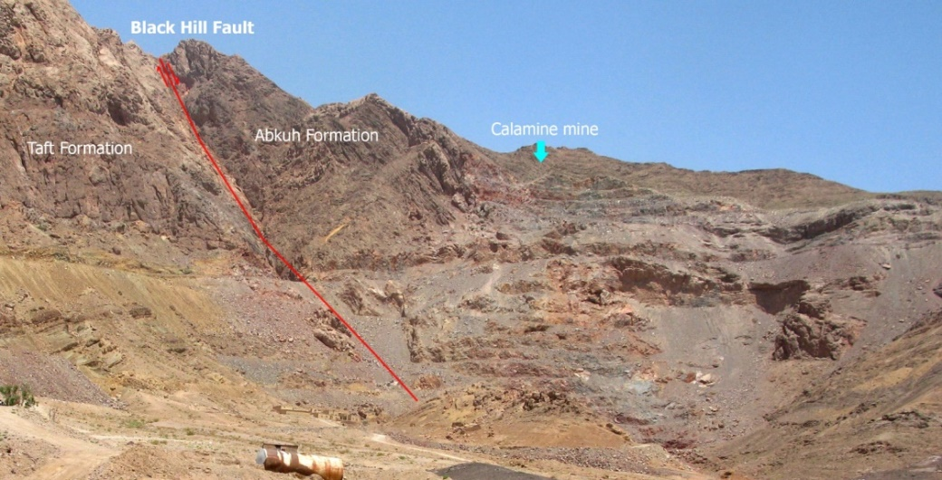
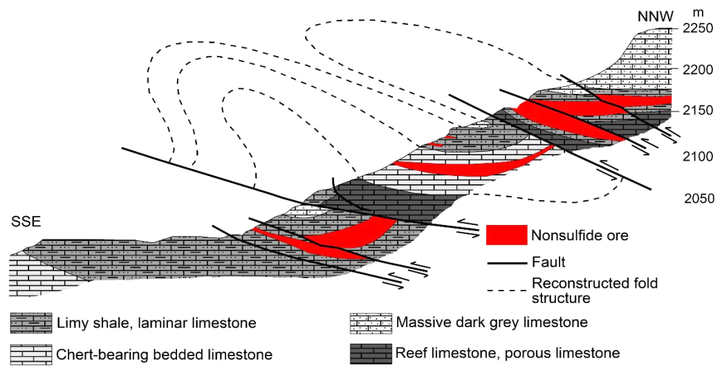
Irish-type Zn-Pb deposits around the world - 2023
Mehdiabad Zn-Pb-Ba-Cu (+Fe+Mn) deposit
After Nisratian (1990) and Maghfouri et al. (2019)
8
Notes:
Here we see a general view of the Calamine ore in the Abkuh Formation, on the right hangingwall of the Black Hill normal Fault. And a geological cross-section of this part of the deposit.

Slide 9
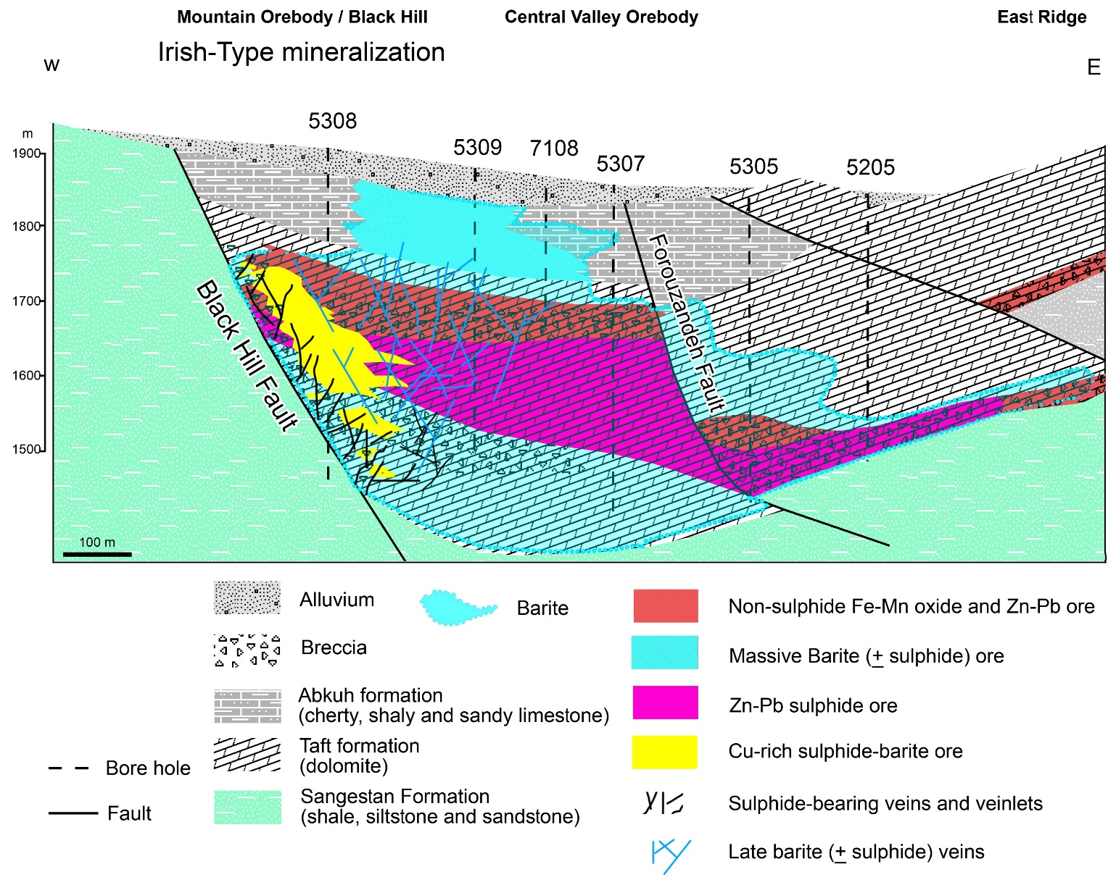
Irish-type Zn-Pb deposits around the world - 2023
Mehdiabad Zn-Pb-Ba-Cu (+Fe+Mn) deposit
Schematic cross-section of the Mehdiabad deposit (Khanmohammadi et al., 2023; modified after Reichert, 2007; Rajabi et al., 2012; Lui et al., 2023).
9
Notes:
Here is the cross-section of the Mehdiabad deposit.
The main three parts of the deposit are the Mountain/Black Hill orebody, the Central Valley orebody, and the East Ridge.
Black Hill orebody consists of a feeder zone, copper-rich sulphide-barite ore, zinc-lead sulfide ore, non-sulphide orebody, and massive barite at the top.
Based on the orebody geology, mineralogy, and ore textures and fabrics, the orebodies in the Mehdiabad deposits can be divided into different ore zones, including the feeder zone, massive ore (including sulphide-oxide parts), massive barite ore, and copper-rich sulphide-barite ore.
The major features of this deposit are the barite sheath around the sulphide mineralization, and also the presence of high-grade copper mineralization near the Black Hill fault.

Slide 10
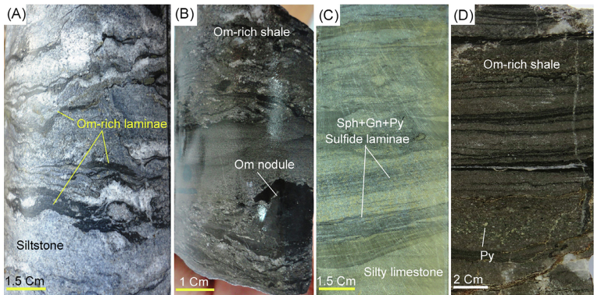
Irish-type Zn-Pb deposits around the world - 2023
Mehdiabad Zn-Pb-Ba-Cu (+Fe+Mn) deposit
The first stage of mineralization in Mehdabad indicated with fine-grained sulphides and barite
10
Notes:
mineralogical studies of the ore outcrops in new mining activities reveal several ore stages in this deposit.
The first stage of mineralization is characterized by minor sulphides, including framboidal pyrite and fine-grained barite, and minor sphalerite and galena.

Slide 11
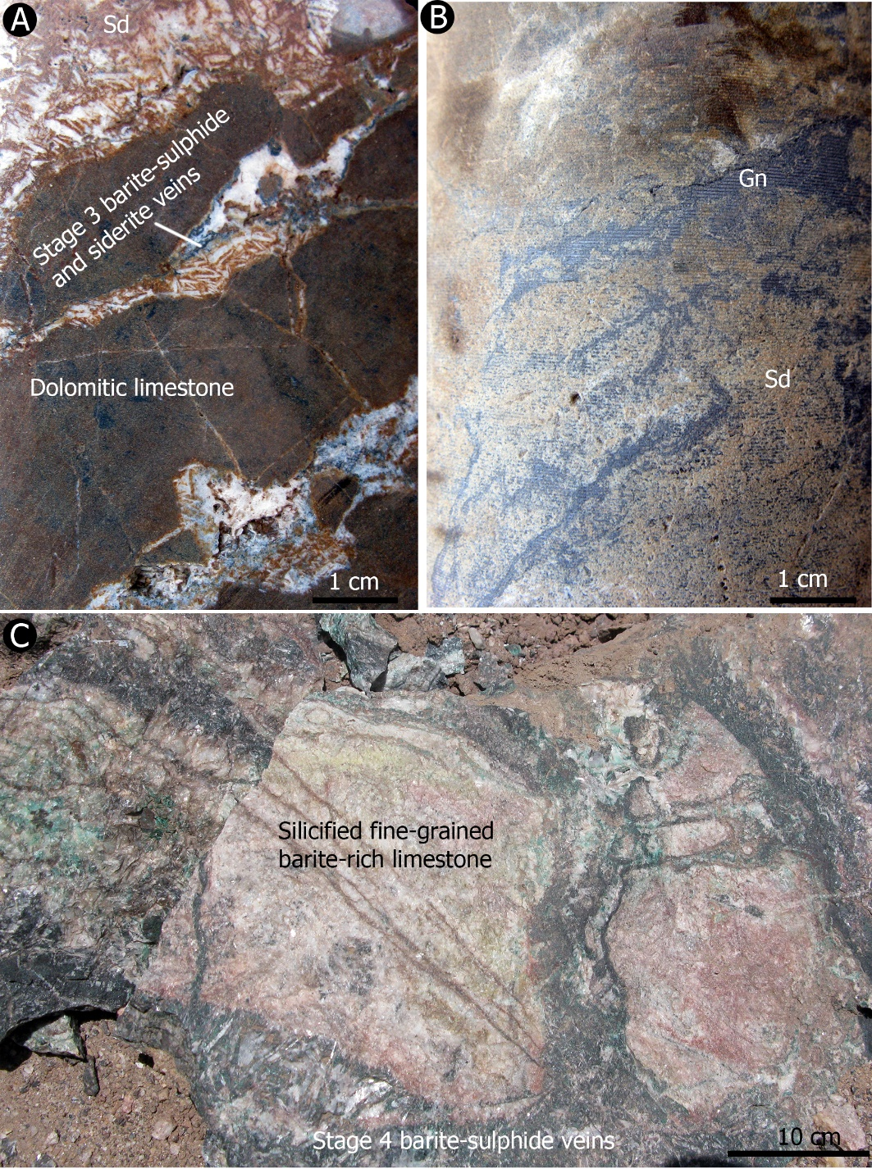
Irish-type Zn-Pb deposits around the world - 2023
Mehdiabad Zn-Pb-Ba-Cu (+Fe+Mn) deposit
Complex veins and veinlets of sulphides and barite in the feeder zone of the Mehdiabad deposit. Gn: galena, Ba: barite,
11
Notes:
The second stage includes the pre-sulphide, massive fine-grained barite (C).
The third stage consists of siderite with coarse-grained barites (A, B). These minerals occur mainly as veins, crosscut and replace previous orebodies and carbonate host rocks.
In some parts of the mine, this barite is associated with galena, sphalerite, chalcopyrite, colloform pyrite, and siderite, which developed as zebra texture.
Stage 4 of mineralization includes stockwork veins and veinlets composed mainly of quartz, sphalerite, galena, chalcopyrite, bornite, and pyrite. These veins crosscut the previous barite, sulphides and carbonates. Chalcopyrite is observed as a replacement in barite and pyrite (5C), in the feeder zone and the massive ore.

Slide 12
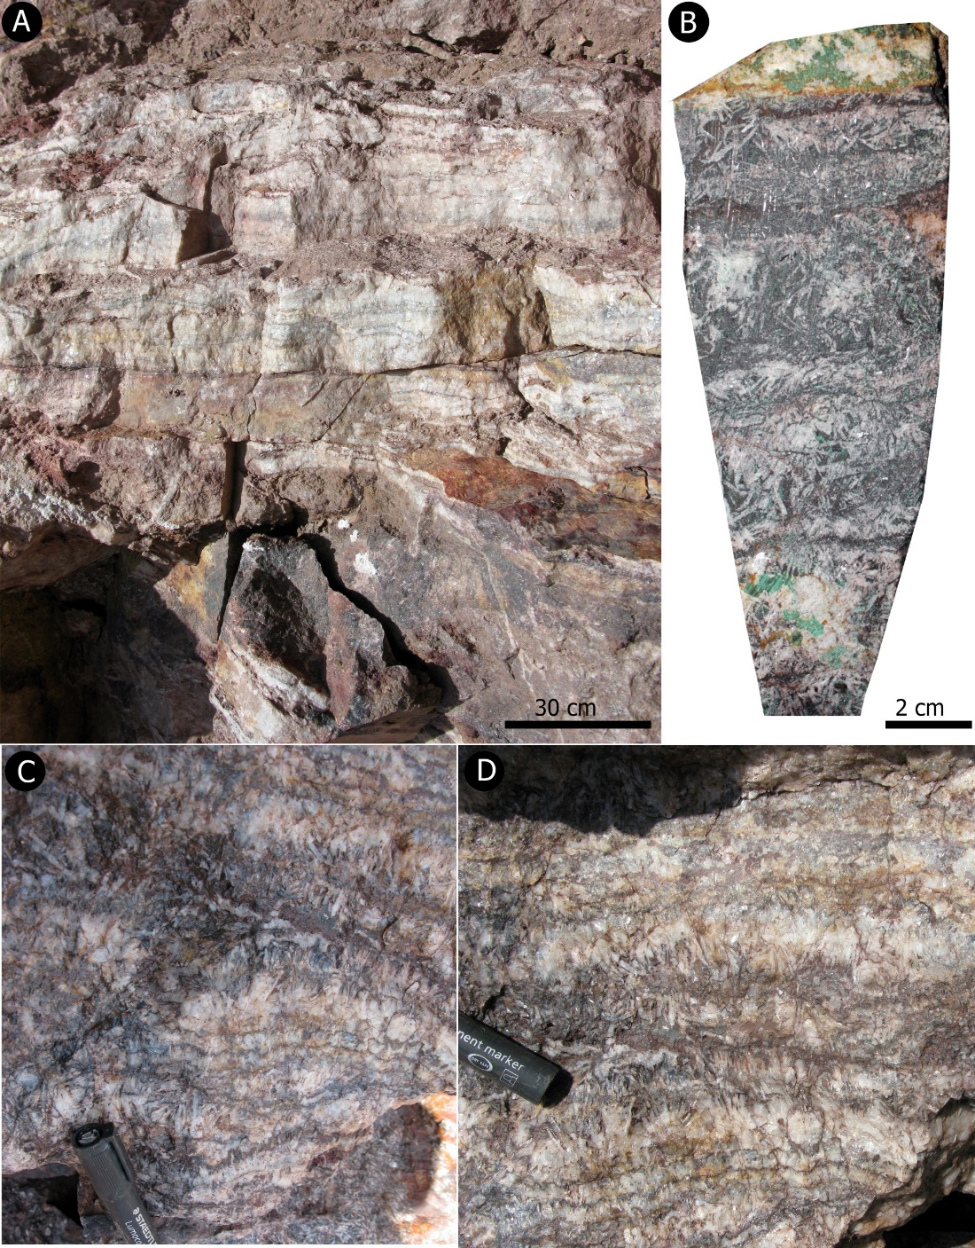
Irish-type Zn-Pb deposits around the world - 2023
Mehdiabad Zn-Pb-Ba-Cu (+Fe+Mn) deposit
Crustiform banded barite (A) and zebra texture (B-D) from the Mehdiabad deposit consisting of interlayered barite and altered sulphides.
10
Notes:
Stage 5 is characterized by white barites, followed by the massive sulphide replacement, with abundant sphalerite and galena. These sulphides replace the former barite crystals and other sulphides. The last stage forms the late massive barite at the upper part of the deposit, which is characterized by the widespread zebra texture at the upper part, and a barite vein network, interrupting the orebodies at the bottom.

Slide 13
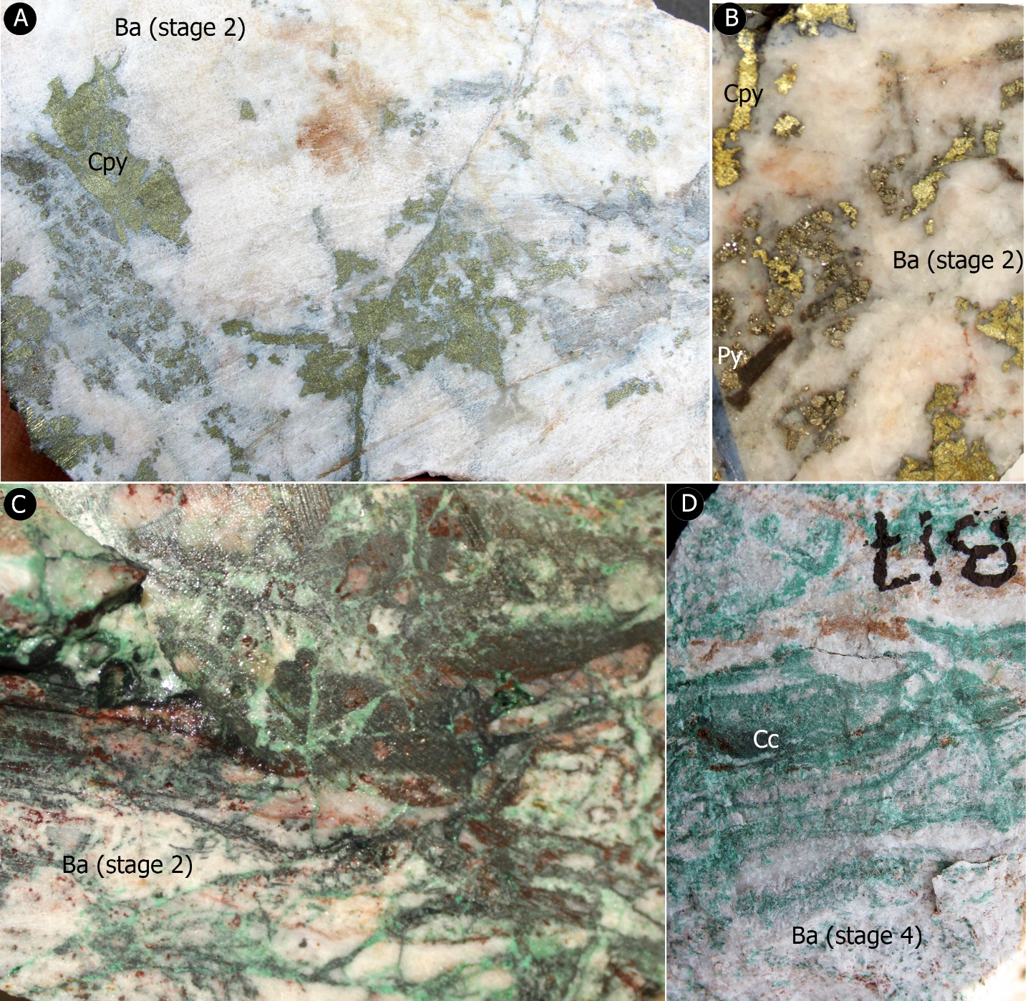
Irish-type Zn-Pb deposits around the world - 2023
Mehdiabad Zn-Pb-Ba-Cu (+Fe+Mn) deposit
Hand specimen samples of copper mineralization in copper-rich sulphide-barite ore of the Mehdiabad deposit illustrate the replacement of barite with sulphides. Cpy: chalcopyrite, Py: pyrite, Gn: galena, Cc: Chalcocite, Ba: barite.
11
Notes:
Besides the Zn-pb sulphide mineralization, the copper-rich sulphide-barite zone is one of the most critical orebodies that contains more than 50 Mt copper ore and developed near the Black Hill fault. This ore zone includes chalcopyrite, bornite, chalcocite, covellite, minor sphalerite, and galena, replacing coarse-grained pyrite and barite.
Here you see a replacement of barite with copper sulfides.

Slide 14
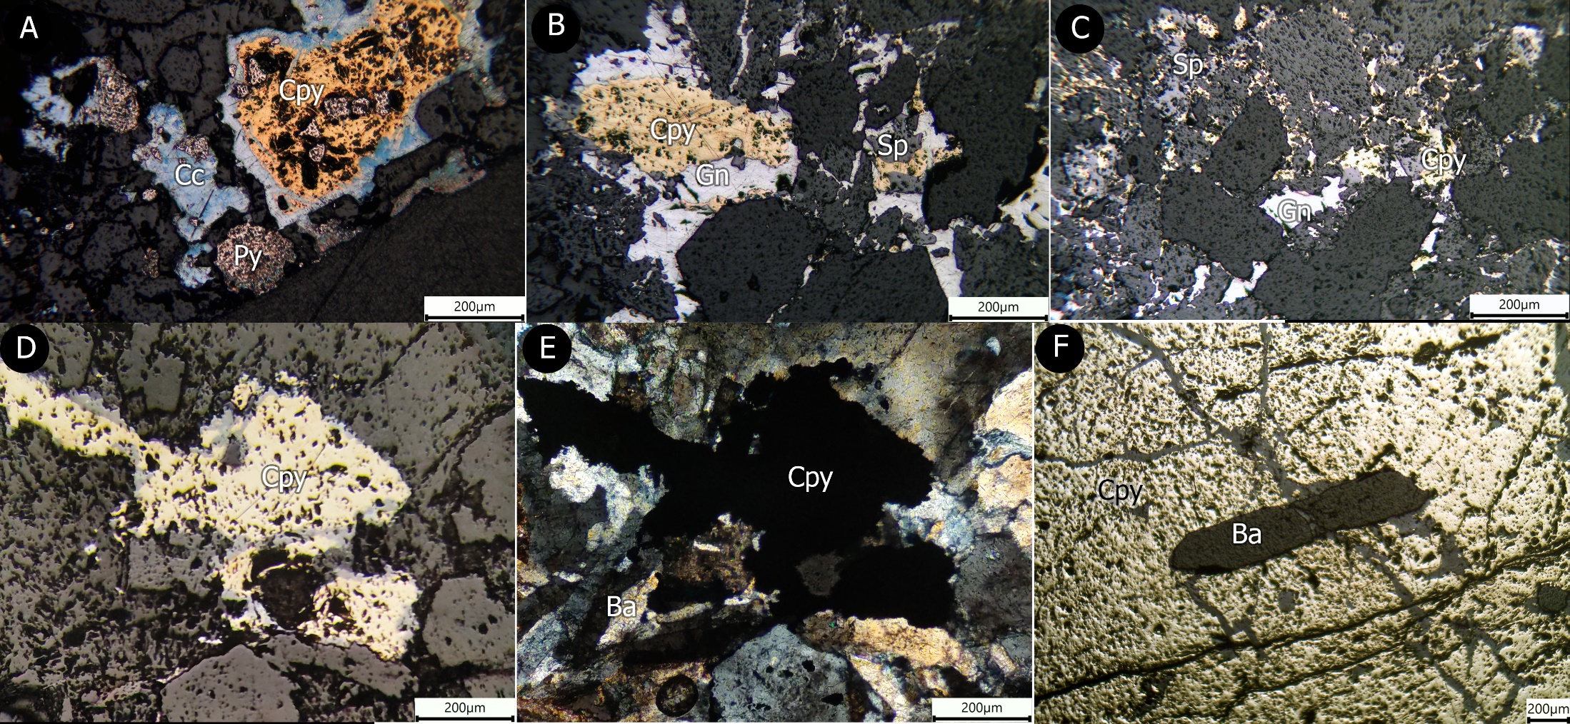
Irish-type Zn-Pb deposits around the world - 2023
Mehdiabad Zn-Pb-Ba-Cu (+Fe+Mn) deposit
Photomicrographs of sulphides and barite replacement textures in Mehdiabad deposit. A-C) Replacement of pyrite (Py) with chalcopyrite (Cpy), galena (Gn) and sphalerite (Sp). Galena and sphalerite also replace chalcopyrite. D-F) Replacement of barite with chalcopyrite.
12
Notes:
This slide shows photomicrographs of sulphides and barite replacement textures in the Mehdiabad deposit. A to C) Replacement of pyrite with chalcopyrite, galena and sphalerite. Galena and sphalerite also replace chalcopyrite. D to F represent the replacement of barite with chalcopyrite.

Slide 15
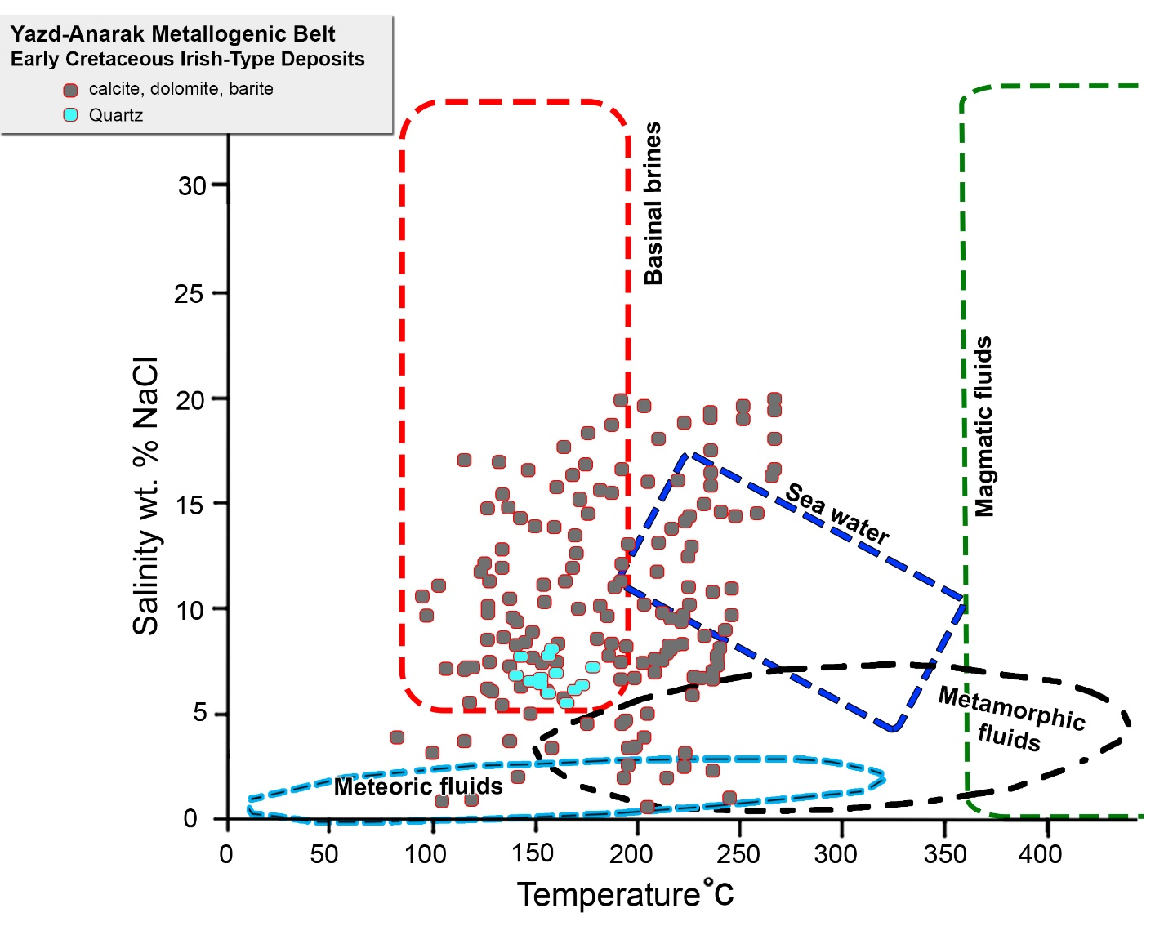
Irish-type Zn-Pb deposits around the world - 2023
Mehdiabad Zn-Pb-Ba-Cu (+Fe+Mn) deposit
Summary of published fluid inclusion homogenization temperature–salinity pairs from Mehdiabad deposit (modified after Rajabi et al., 2019b, 2023; Data from Maghfouri, 2007; Lui et al., 2023).
14
Notes:
let’s have a look at fluid inclusion studies in Mehdiabad.
It shows high homogenization temperatures for ore fluids and is more compatible with Irish-type deposits. Also, fluid inclusions represent basinal brine and seawater sources for ore fluids.

Slide 16
Irish-type Zn-Pb deposits around the world - 2023
Summary and Conclusion
Consideration of the geologic characteristics of this deposit leads to a recognition of the following features:
The Mehdiabad deposit formed in an extensional environment that is related to the Naein-Baft back-arc basin undergoing active extensional faulting and subsidence.
The sulphide and barite mineralizations are controlled with syn-sedimentary normal Black Hill fault that may act as feeder zones and conduits for ore fluids and generated debris flow breccias.
The deposit is stratabound and comprises a wedge-shaped sulphide-barite orebody.
Orebodies represent complex textures of sulphides and barite, such as brecciated, replacement, colloform, zebra, banded replacement, and very minor laminated.
Alteration consists mainly of dolomitization and Silicification. Fe-dolomite and siderite are common.
Barite is an important gangue mineral, replaced by coarse-grained pyrite, chalcopyrite, galena and sphalerite. Laminated sulphides are minor, and there is no evidence of exhalation in the formation of orebodies.
Temperatures of ore deposition are typically 80° to about 250°C (majority 120°-230°C), and salinities range from 1 to 20 wt% NaCl equiv., with the majority falling between 5 and 17 wt%.
These features are similar to those in other Irish-type and some barite-replacement sediment-hosted Zn-Pb (e.g., Red Dog) deposits worldwide, suggesting that diagenetic and replacement processes in carbonate rocks formed the Mehdiabad deposit.
15
Notes:
In conclusion, let me sum up the main points:
The Mehdiabad formed in an extensional environment.
The sulphide and barite mineralizations are controlled with syn-sedimentary normal Black Hill fault.
The deposit is stratabound and comprises a wedge-shaped sulphide-barite orebody.
Orebodies represent complex textures of sulphides and barite, such as brecciated, replacement, colloform, zebra, banded replacement, and very minor lamina.
Alteration consists mainly of dolomitization and Silicification. Fe-dolomite and siderite are common.
Barite is an important gangue mineral, replaced by coarse-grained pyrite, chalcopyrite, galena and sphalerite.
Laminated sulphides are minor, and there is no evidence of exhalation in the formation of orebodies.
Temperatures of ore deposition are typically similar to those in other Irish-type and some barite-replacement sediment-hosted Zn-Pb deposits worldwide, suggesting that diagenetic and replacement processes in carbonate rocks formed the Mehdiabad deposit.

Slide 17
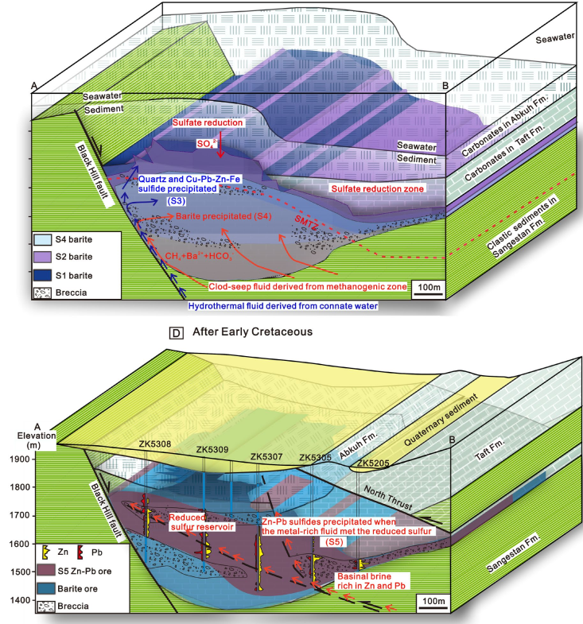
Irish-type Zn-Pb deposits around the world - 2023
So, Is the Mehdiabad, as an Irish-type deposit, fraternal twin to Red Dog or distant cousins?
Dr. Gleeson and Magnall answer us.
Kelley et al. (2004)
Liu et al. (2023)
Notes:
So, Is the Mehdiabad, as an Irish-type deposit, fraternal twin to Red Dog or distant cousins?
Dr Gleeson and Magnall answer us.

Slide 18
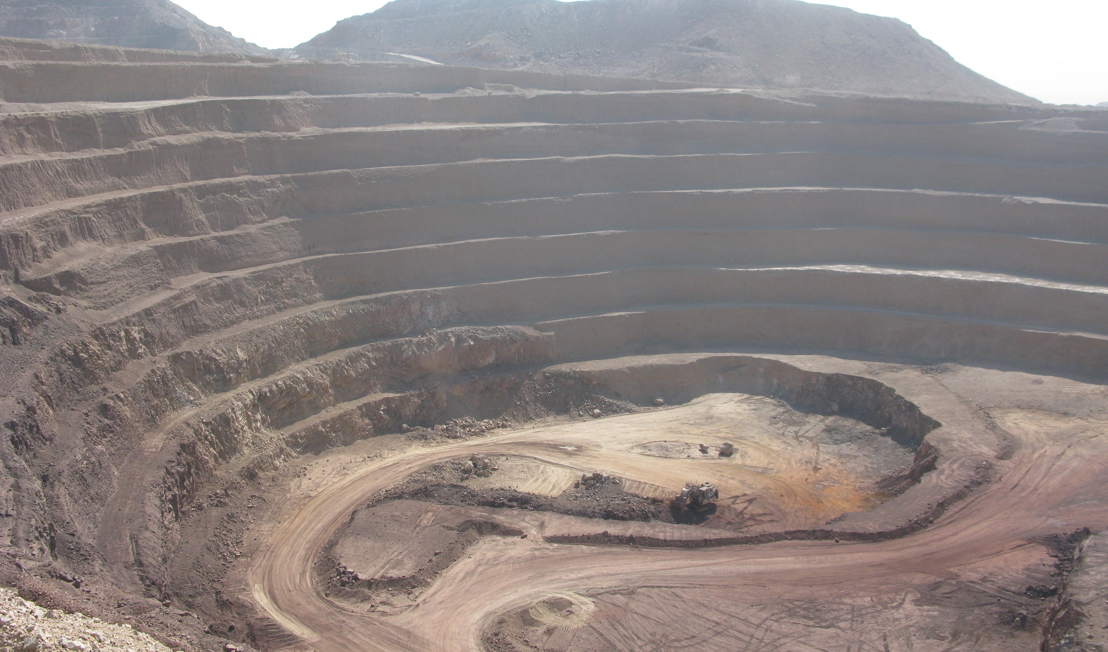
Irish-type Zn-Pb deposits around the world - 2023
rahman.rajabi@ut.ac.ir
abdorrahmanrajabi.ut@gmail.com
16
Notes:
There are many ambiguities about the Mehdiabad deposit, which we hope Miss Khan Mohammadi will answer in her research.
Thank you for listening.
I’ll gladly answer any of your questions at the end if I can.

Slide 19
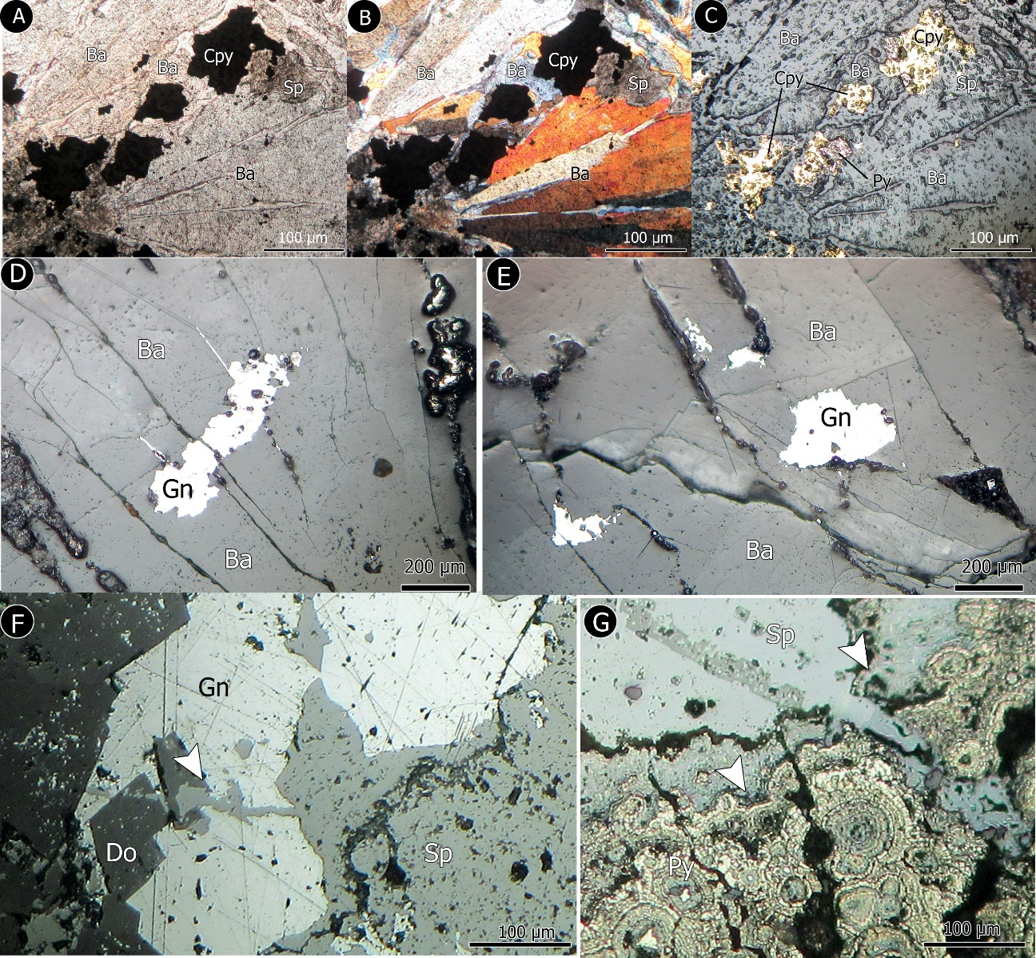
Irish-type Zn-Pb deposits around the world - 2023
Mehdiabad Zn-Pb-Ba-Cu (+Fe+Mn) deposit
Photomicrographs of replacement textures of sulphides and barite in the Mehdiabad deposit. A-C) Replacement of barite with pyrite (Py), chalcopyrite (Cpy) and sphalerite (Sp). D, E) Replacement of barite with galena (Gn). F, G) Replacement of dolomite (Do), galena and pyrite with sphalerite.
13
Notes:
I am ignoring this slide, you have seen that before.

Slide 20
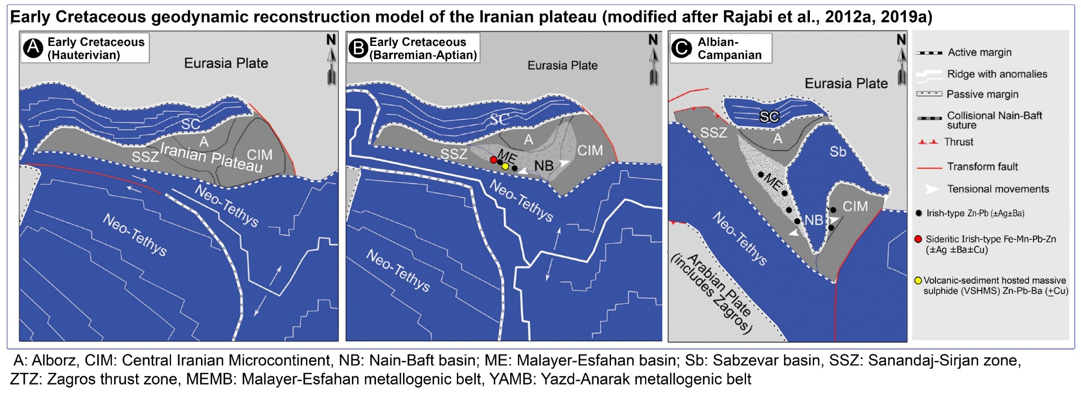
Irish-type Zn-Pb deposits around the world - 2023
Spatial distribution of deposits and their relation to the tectonic environment
A-C) Geodynamic reconstruction model of the Iranian plateau (dark grey) from the Early to Late Cretaceous (modified after Rajabi et al., 2012a) and Zn-Pb (Ag ± Cu ± Ba) mineralizations around the Nain-Baft suture zone. (modified after Rajabi et al., 2012a, 2019a).
33
Notes:
However, some authors suggest an orogenic MVT model for the Early Cretaceous deposits of Iran, but it can not explain all geological and geochemical aspects of these deposits.
The Early Cretaceous Irish-Type deposits of Iran occur around the Nain-Baft suture zone, far from the Zagros collisional thrust zone.
Recent evidence of the Nain-Baft ophiolites shows that the suture between the Sanandaj-Sirjan zone and Central Iran is in fact a major structure resulting from a series of back-arc basins.
Following the subduction of Neo-Tethyan oceanic crust beneath the southern margin of the Iran plateau in the Early Cretaceous, the Nain-Baft back-arc basin began opening.
We suggest that the extensional back-arc environment between the Sanandaj-Sirjan zone and Central Iran in Early Cretaceous time created favourable conditions for the formation of VHMS ore deposits within the riftogenic sequence and Irish-type deposits in the passive marginal carbonate platforms on both edges of the basin.

