Slide 1
Dr Aileen Doran
Postdoctoral researcher with iCRAG at UCD
Hydrothermal carbonates in the Irish Zn-Pb ore field: tracking fluid sources, mixing, and temperatures
IAEG 50, September 9th, 2023

Slide 2
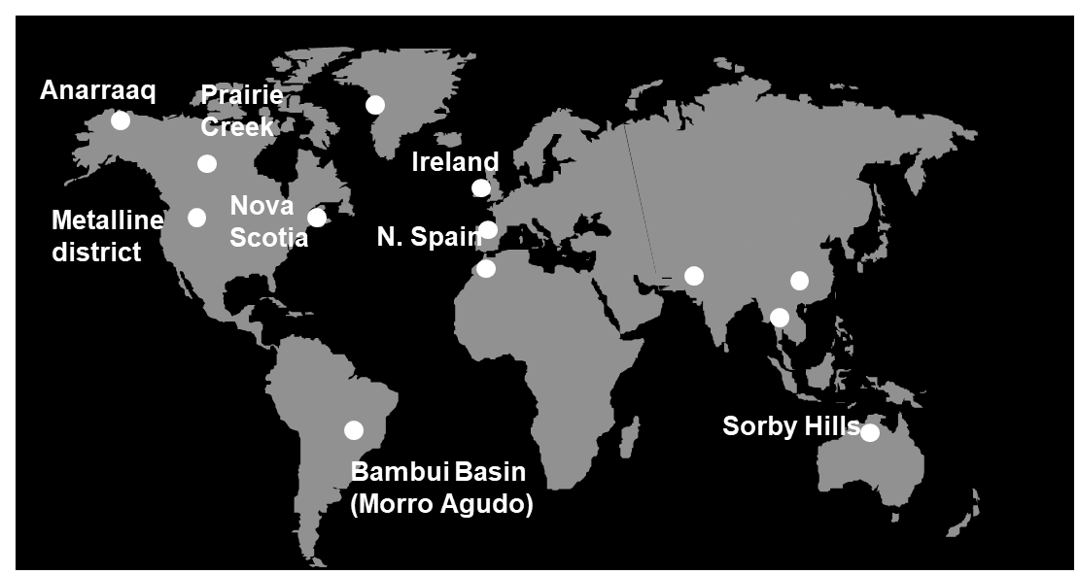
Zn-Pb in Ireland and global impacts
Zinc is crucial to achieving many sustainable development goals (SDG’s; used in infrastructure, green technologies, etc.)
Irish Zn-Pb are world-class (less unwanted phases, less energy intensive to process), supplying much of Europe's Zn needs
Exploration active in Ireland, with several potential projects in the southern Irish ore field
source: Dr Koen Torremans
Similar deposits globally – many put in ‘Irish type’ category (Hitzman & Large 1986), but still many more to be identified (esp. in Canada)
Ireland is in a position to become the leader in refining our understanding, developing models and testing vectors

Slide 3
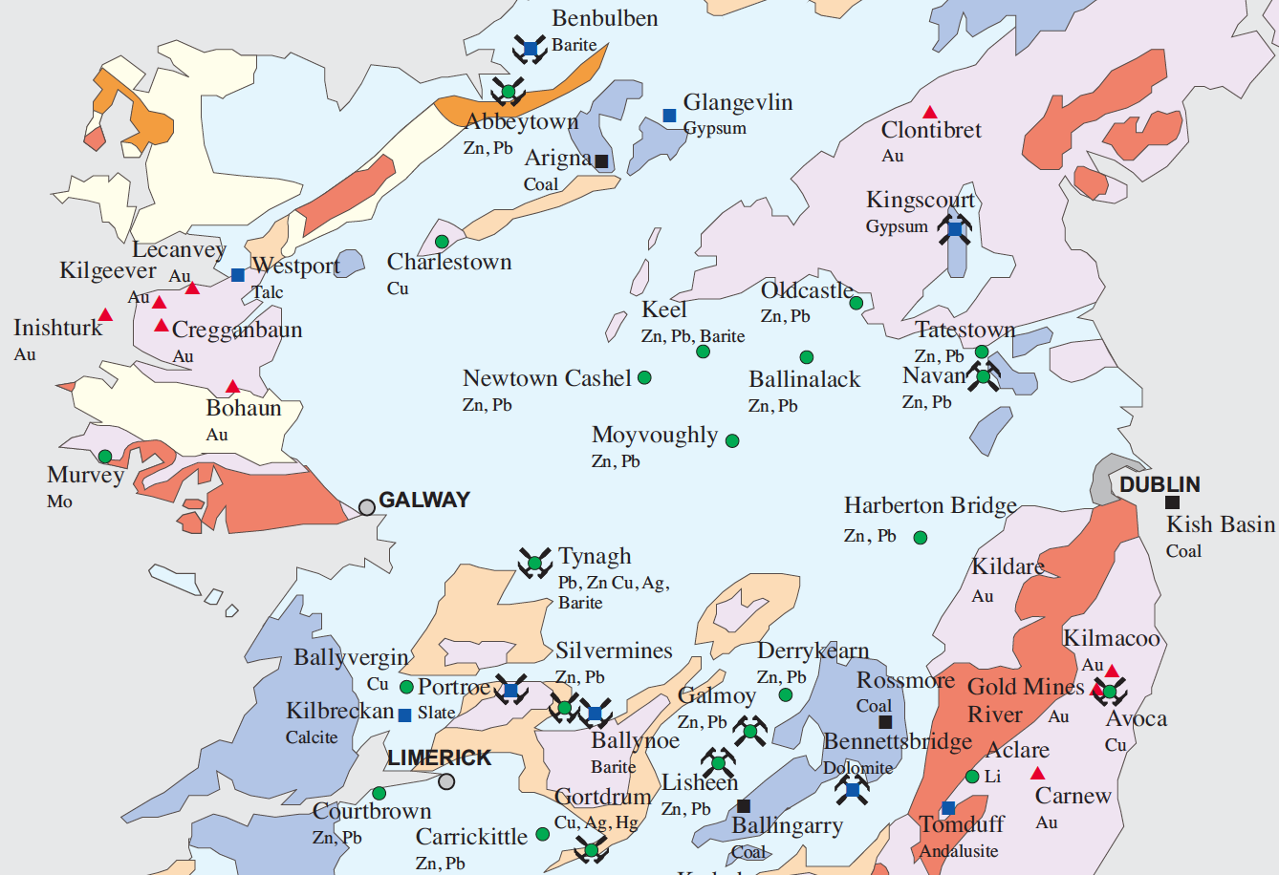
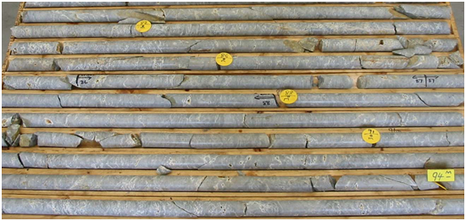
Southern Irish ore field: Geology overview
Blue: Lower Carboniferous (Mississippian) marine carbonate succession (host rocks)
Waulsortian Limestone Fm = southern Irish Zn-Pb ore field
Lower Paleozoic basement (metal source)
Dolomitized on regional scale – Rathdowney Trend
Five carbonate-hosted Zn-Pb orebodies mined in last 50 years and over 20 sub-economic prospects discovered
15 deposits with >1Mt Zn-Pb
Exploration moving to deeper levels – so need refined tools to help vector to new mineralization - new thinking & tools
Stonepark; Pallas Green
Geology adapted from Geological Survey Ireland, 1:150,000 Bedrock Series; Map produced by the Exploration and Mining Division, Department of Communications, Climate Action and Environment
Notes:
new thinking and tools are required.

Slide 4
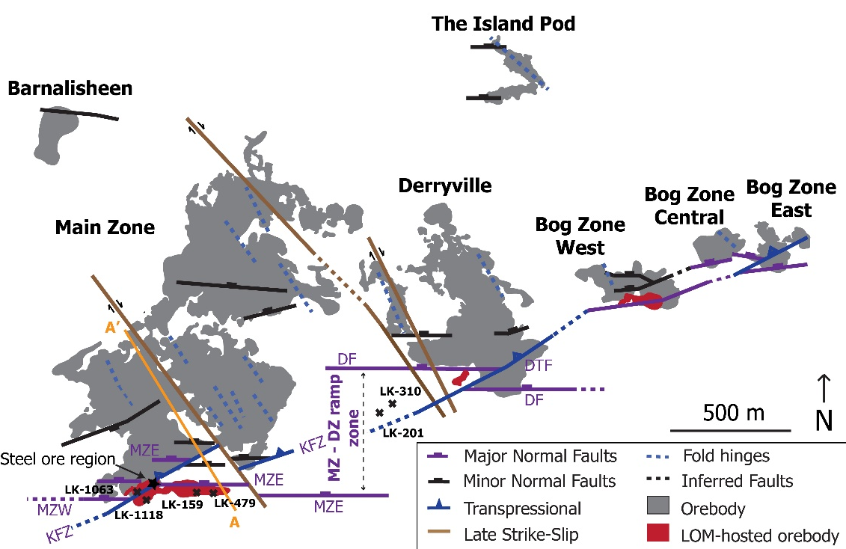
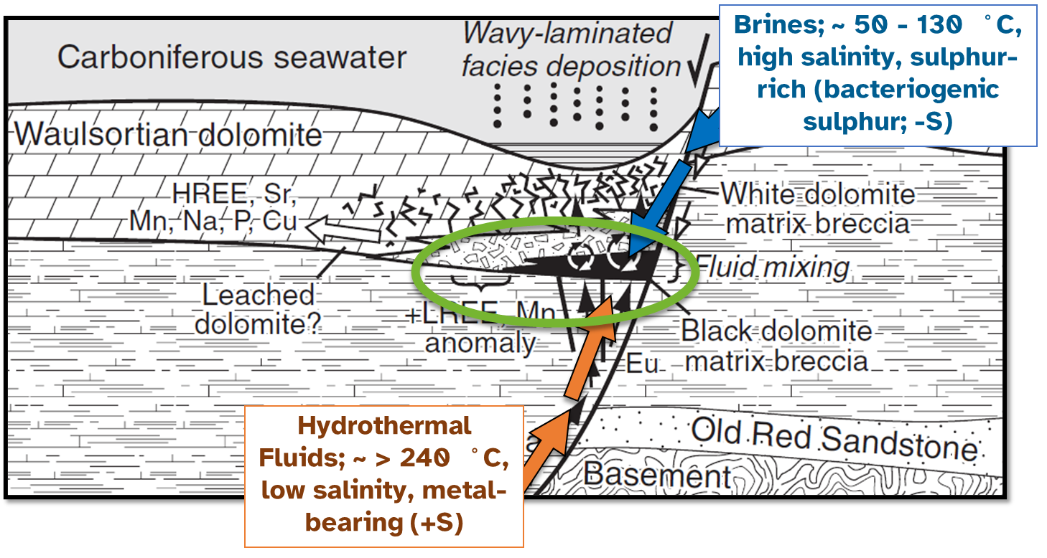
Lisheen deposit
Adapted from Torremans et al. (2018), Kyne et al. (2019), Doran (2021)
Operational for over 15 years, closing in 2015
Strongly controlled by an extensional, left-stepping, ramp-relay fault array
Normal faults act as fluid conduit for dual fluid sources
Dual fluid source, mixing
Pyrite, sphalerite, galena, barite, sulfosalts, chalcopyrite, Ni-As-sulfides
Mineralization typically at base of Waulsortian, with several carbonate (dolomite/calcite) phases associated with ore formation
Carbonate dissolution crucial in formation of deposits (space generation and compositional effects)
Adapted from Wilkinson, 2010
Notes:
Case example

Slide 5
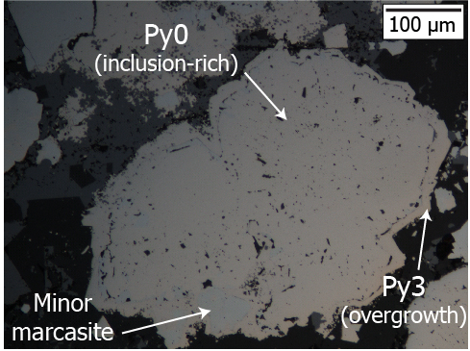
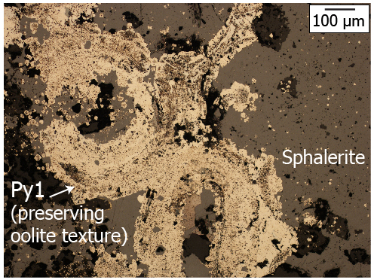
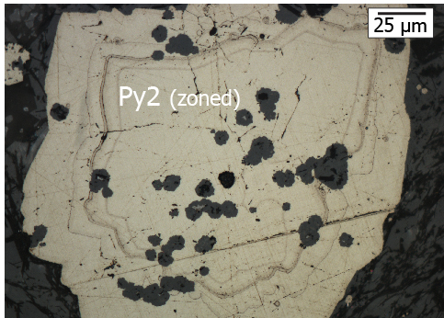
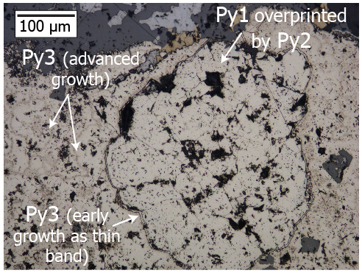
Lisheen sulfides: early ore phases
Early Fe-dominated event: multiple phases of hydrothermal pyrites, with increasing textural & geochemical complexity with time
Episodic hydrothermal fluid flow - Record the ‘ramping’ up of the system as hydrothermal influxes continued; before massive Zn-Pb
S isotopes: additional impact from replacement of diagenetic pyrite (S recycling; Doran et al., 2022; Doran et al., in prep.)
Pyrite also a vector to mineralization (As-Tl spatial trends; Doran et al., 2022)? (Dr Claire Geel’s poster!)
But what about outside of the sulphides?
Doran (2021); Doran et al. (2022)

Slide 6
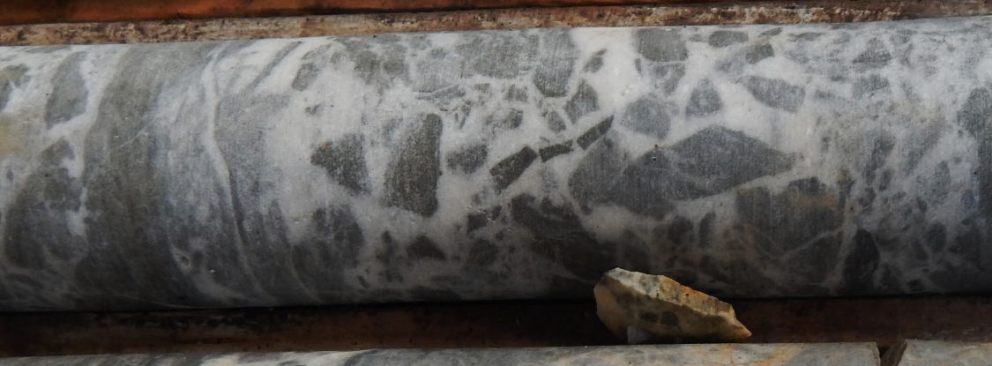
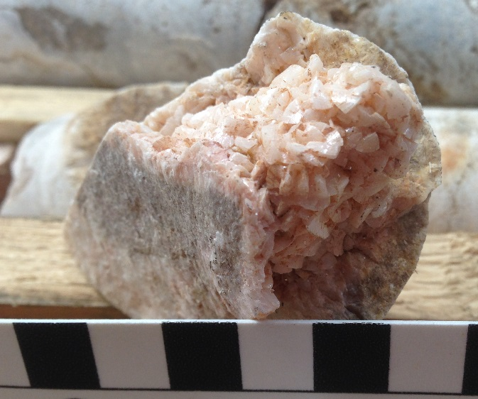
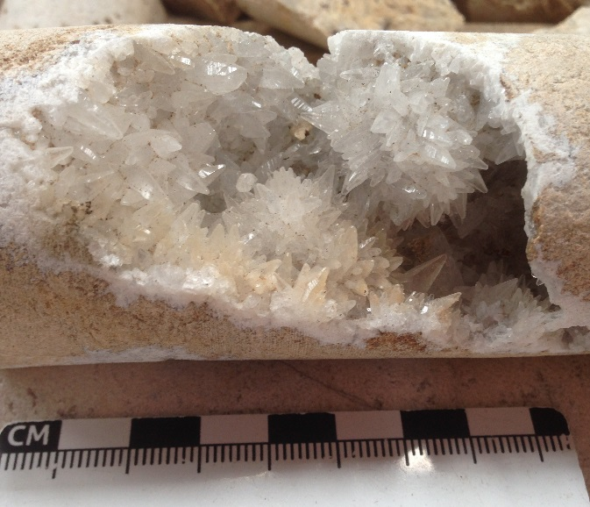
Carbonates associated with mineralization
In paragenetic order:
Waulsortian limestone
Dol1: Regional dolostone (a. fine, grey & b. coase, white)
Dol2: Black matrix breccia (halo around ore)
Dol3: White matrix breccia (broader distribution)
Dol4: White, coarse dolomite (veins)
Dol5: Pink dolomite phase, often saddle
Cal4: White calcite (veins)
Cal6/7: White to yellow calcite (coarse)
WMB with regional dol. clasts
BMB with regional dol. clasts
Pink dolomite
Late carbonate
*CL images (taken at Imperial College London) with C. John
Drill core images courtesy of Dr Steve Hollis
Doran, 2021
Notes:
What about the carbonates?
Summarized overview of carbonate phases discussed in this talk.
Figure 6.3 Representative images of (a) undolomitised Waulsortian Limestone Formation (WLF) (CL image), (b) white matrix breccia (Dol3) with regional dolomite clasts (photo of core sample), and (c) Dol3 with regional dolomite clasts (CL image). In both (b) and (c) the regional dolomite clasts are primarily composed of fine-grained, grey Dol1a, with minor amounts of coarse-grained, white Dol1b also present. (d) Idealized cross-section showing the occurrences of black matrix breccia/rock matrix breccias (Dol2) relative to massive sulphide mineralisation, in the hanging wall of a normal fault (x2.5 vertical exaggeration). White matrix breccia (Dol3) typically forms in the overlying Waulsortian Limestone Formation, which is generally dolomitised in the Rathdowney Trend. Image modified from Wilkinson et al. (2011). While white matrix dolomites are often best developed around Dol2/sulphide mineralisation, they extend much more widely throughout the regionally dolomitised WLF at Lisheen and Galmoy.

Slide 7
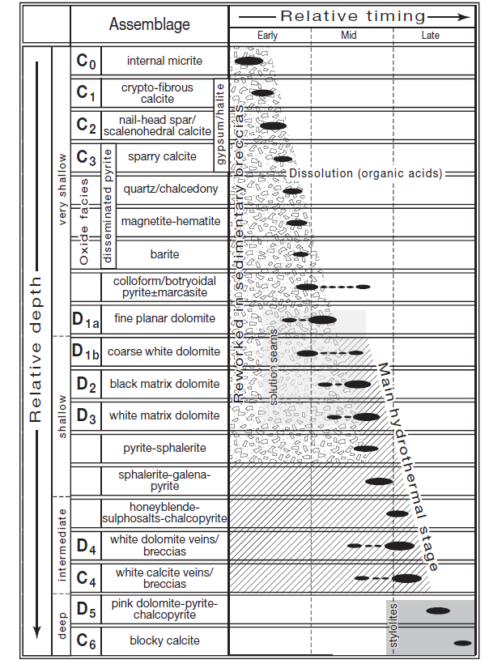
Carbonate classification scheme
Wilkinson (2010) carbonate classification scheme for Irish midlands
Why carbonates?
Carbonates often associated with ore systems, globally
Irish systems: carbonates closely associated with mineralization (pre, main and post-ore phases)
Temperature & isotopic (C-O) studies help to improve understanding of fluid processes (including sources, mixing, ore formation)
Potential for vector development – large haloes around ore deposits – targets for exploration?

Slide 8
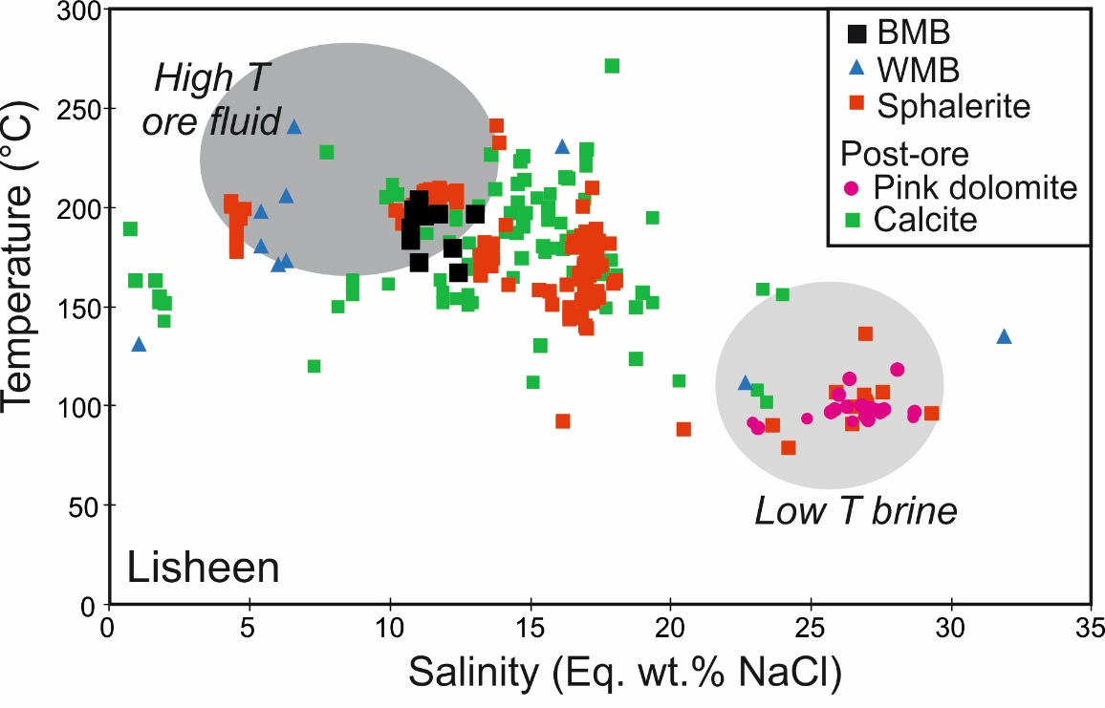
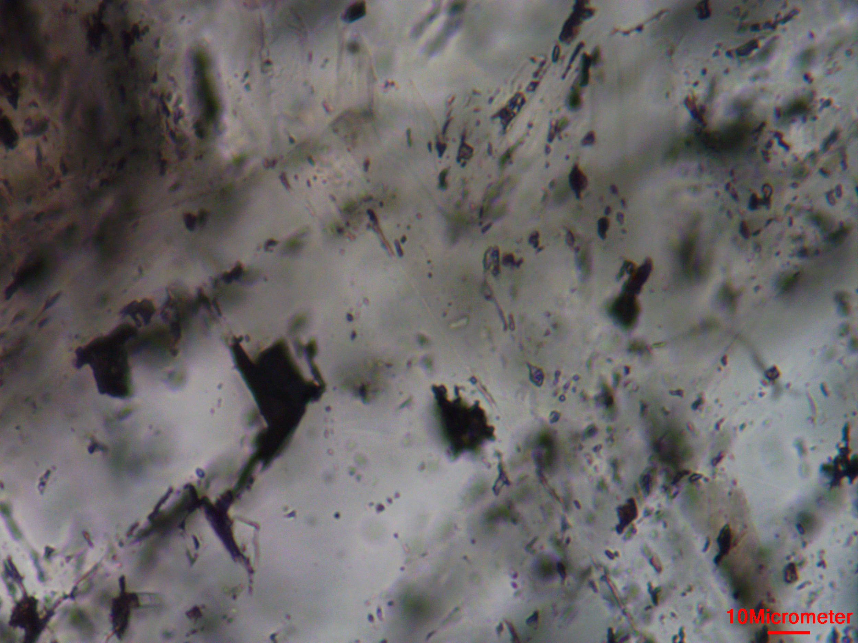
Existing temperature constraints
Wealth of existing fluid inclusion data, fundamental in identifying two fluid sources (Wilkinson, 2010).
Number of key phases are under-represented:
Various types of regional dolomite rarely have inclusions
Only 1 BMB (Dol2) sample has yielded fluid inclusions in Ireland (Wilkinson & Earls, 2000) – not from an orebody
WMBs (Dol3) often contain fluid inclusions too small for reliable analysis (<5 µm) (most Lisheen from one hole)
Ore-stage carbonates
Carbonate-hosted fluid inclusions are susceptible to post-entrapment modification - especially compared to quartz.
Examples of fluid inclusions from Navan.
Average size ~5 µm.
Slide source: Dr Steve Hollis

Slide 9
Challenges with traditional methods
Fluid inclusion studies
Fluid inclusions; often too small, deformed, ruptured or absent for reliable analysis
Traditional δ¹⁸O isotopic analysis
Bulk carbonate δ¹⁸O isotopic values vary according to temperature and fluid isotopic composition
Fluid δ¹⁸O isotope values are often inferred, leading to uncertainties with the fluid δ¹⁸O-based thermometer model
For fluid δ¹⁸O isotope values to be determined, accurate temperature constraints are required for each sample with matched carbonate isotope values
δ¹⁸O temperatures cannot be assumed where there are large intra-sample variations (e.g. WMBs)
Clumped isotope analysis provides carbonate δ¹³C, δ¹⁸O and temperature allowing fluid compositions to be directly calculated*
Examples of fluid inclusions from Navan.
Average size ~5 µm.
Source: Dr Steve Hollis

Slide 10
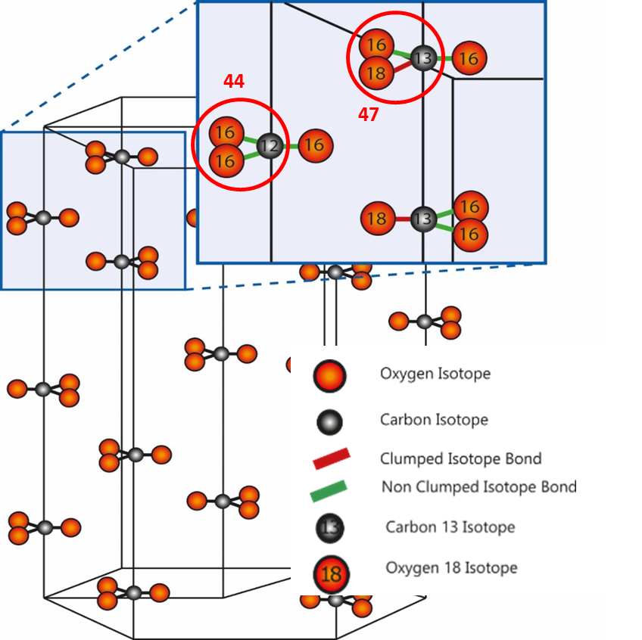
Potential solutions
Clumped isotopes: What are they? (geothermometer)
Traditional application to low T environments
Technique depends on ordering of heavy isotopes
Degree of bonding or ‘clumping’ of heavy isotopes in carbonate minerals is temperature dependent
At very high temperatures, heavy isotopes like ¹³C and ¹⁸O will be distributed more or less randomly.
The colder it gets, the more heavy isotopes tend to huddle together in clumps.
Adapted from https://dinotopes.wordpress.com/
Notes:
errors at hydrothermal temperatures better than ±12˚C.
Clumped isotope analysis provides both carbonate δ13C, δ18O and temperature allowing fluid compositions to be directly calculated

Slide 11
Potential solutions
Clumped isotopes.
What are they?
Technique depends on ordering of heavy isotopes
Degree of bonding or ‘clumping’ of heavy isotopes in carbonate minerals is temperature dependent
Independent of fluid isotope composition and carbonate mineral chemistry, no need for fluid inclusions to get temperatures (!)
React carbonates powder with phosphoric acid at a set temperature
Allows fluid compositions (fluid δ¹⁸O) to be directly calculated (over modelled)
Clumped O-C isotope analysis results in both carbonate δ¹³C, δ¹⁸O and temperature - provides an independent measure of carbonate crystallization temperatures
New insights into fluids involved in ore formation, helping to generate new models
Challenges of sulphides – ongoing work (Missing BMB)
Applied to any carbonate phase; providing independent measure of carbonate crystallization temperatures
Notes:
errors at hydrothermal temperatures better than ±12˚C.
*Filling the gaps in our carbonate system evolution, gaining new insights from carbonate that were inaccessible before.

Slide 12
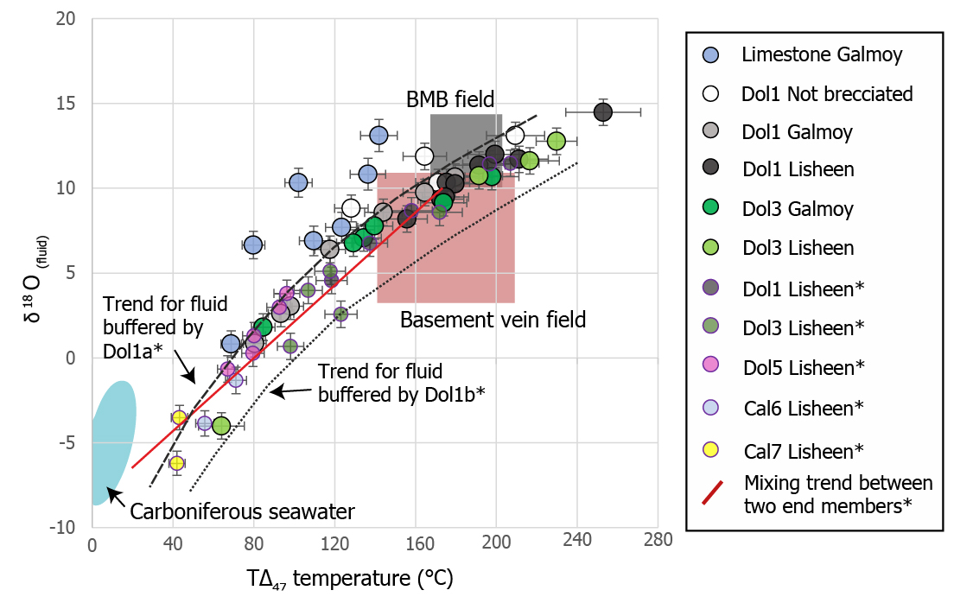
Clumped isotope studies of the Irish ore field
Initial studies by Dr Steve Hollis (matched T from clumped and fluid inclusions)
Galmoy & Lisheen
Two end-member trends: hydrothermal and marine sources
Curved nature: Fluid δ¹⁸O values suggest buffering by dissolution of regional dolostone (Dol1)
Limestone reset, shifted towards basement
Overall trend towards fluids equilibrated with basement buffered by regional dolostone (before)
& return to seawater composition for post-ore phases
Regional dolomite
Regional dolomite
WMB
WMB
Regional dolomite
WMB
Post-ore pink dolomite
Late white calcite
Late yellow calcite
Data from Hollis et al. (in review); Doran (2021); Everett et al. (1999); Hollis et al. (in review).
Notes:
Steve's study: comparison of clumped temperatures with fluid inclusion data to test the accuracy of the technique. Focused on broader area. This study focused in on Lisheen and Galmoy…
Nice review: http://www.carbonateresearch.com/clumped_isotope

Slide 13
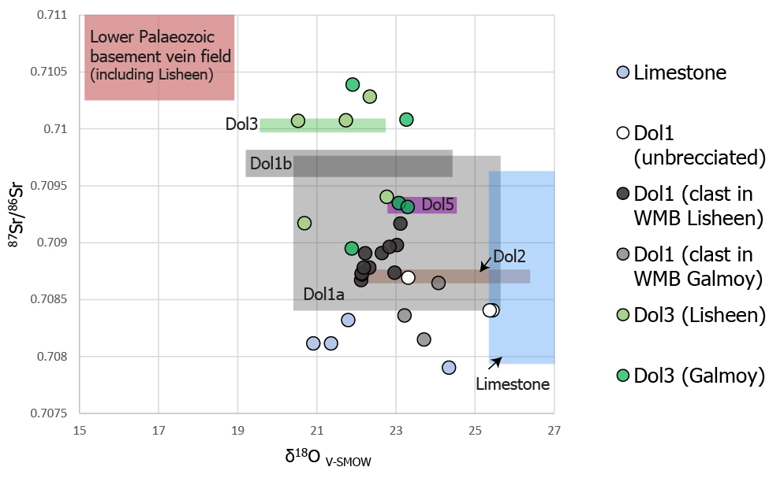
Combined with Strontium (⁸⁷Sr/⁸⁶Sr ratios) isotope analysis (sources)
Limestone ⁸⁷Sr/⁸⁶Sr ratios in line with those expected from Carboniferous seawater (partial resetting)
δ¹⁸O_{V-SMOW} values overlap later hydrothermal samples (& last slide)
Overall trend towards hydrothermal fluids, equilibrated with basement (WMB -> basement) (& again seeing return to seawater)
Regional dolomite
Regional dolomite
Regional dolomite
WMB
WMB
Data from Doran (2021); Turner (2019; unpublished PhD thesis); Everett et al. (1999); Douthit et al. (1993), Hollis et al. (in review)
Notes:
Figure 6.4 δ¹⁸O_{V-SMOW} vs δ¹³C_{V-PDB}, for carbonates at the Lisheen and Galmoy deposits. Shaded areas represent data from Douthit et al. (1993), Hitzman and Beaty (1996), Hitzman et al. (1998), Eyre (1998), Everett et al. (1999), Everett (2000), Wright (2001), Gregg et al. (2001) Wright et al. (2004), Wilkinson et al. (2005b) and Hollis et al. (in review). The data range for undolomitized limestone includes samples distal to known Zn-Pb mineralisation, which have similar isotopic values.
Figure 6.5 δ¹⁸O_{fluid} vs TΔ₄₇ temperature (°C) data from carbonates at the Lisheen and Galmoy deposits. Included data marked by * denotes data from Hollis et al. (in review), while the shaded boxes represent data from Everett et al. (1999) and Hollis et al. (in review). δ¹⁸O_{fluid} values from previously published data (defined by shaded boxes) were modelled based on fluid inclusion analysis in these studies. The buffering curves from Hollis et al. (in review) represent mean Dol1a and Dol1b compositions, but overall, these two phases overlap significantly.
Figure 6.6 δ¹⁸O_{V-SMOW} vs ⁸⁷Sr/⁸⁶Sr ratios from the Lisheen and Galmoy deposits. Coloured boxes represent data from Everett et al. (1999), Douthit et al. (1993), Hollis et al. (in review) and Turner (2019). ⁸⁷Sr/⁸⁶Sr ratios for Dol2 and Dol3, taken from Turner (2019), have been vertically exaggerated on the plot.

Slide 14
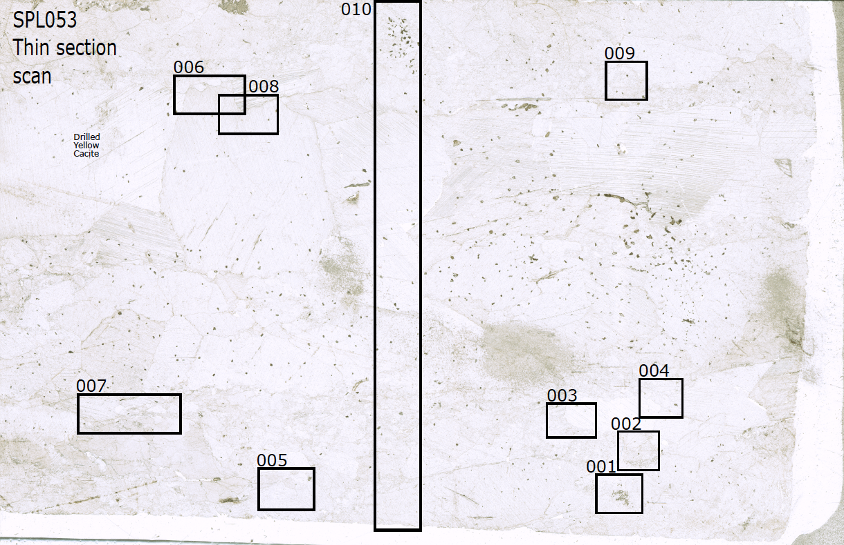
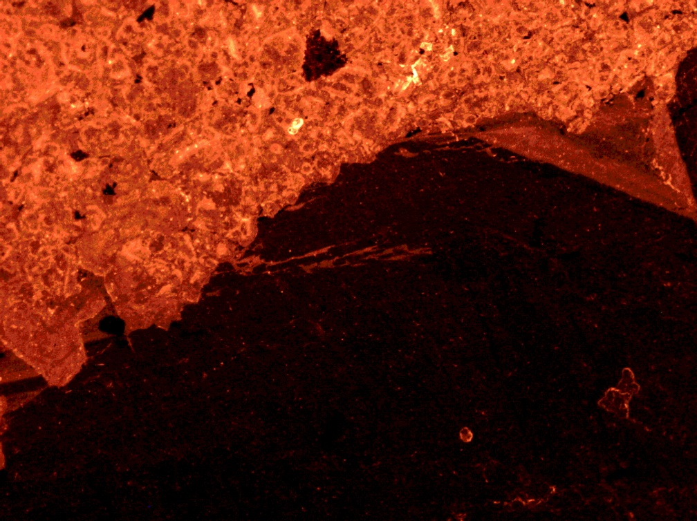
Thin section scale: recording multiple phases
We are able to characterize multiple phases in a thin section; example SPL53 (Island Pod)
Regional dolomite (D1a+b)
WMB (D3)
WMB dolomite
98°C (UEA) / 96°C (UoB)
Pink Dolomite (D5)
Regional dolomite clast 163°C
SPL053 – site 3
Late White calcite 63°C
Pink dolomite 82°C
V. Late yellow calcite 42°C
Slide source: Dr Steve Hollis
Notes:
Entire history of cb evolution on one slide

Slide 15
Conclusion & potential applications
Fluids & Resetting
Overall: early carbonate phases are part of a multi-stage, hydrothermal continuum, with buffering and modification from mixing and dissolution of host rocks (which were crucial processes in creating space for later sulphides)
Understanding of isotopic resetting (limestone) – current area of discussion in Cb world. Multiple isotope methods needed to understand modification, mixing and sources?
Further testing required (distal, sulphide contaminated samples, etc.)
Vector/pathfinder to ore? Test spatial variations to identify any T trends to known mineralization (need to test distally) – hotter toward Zn-Pb? Match with methods more commonly used by industry
Still several challenges to overcome (contamination, preparation) but lots of potential to combine with other techniques (U-Pb dating, LA-ICP-MS) to gain refined understanding of early hydrothermal systems
Moving forward..
Regional dolomite
Regional dolomite
WMB
WMB
Regional dolomite
WMB
Post-ore pink dolomite
Late white calcite
Late yellow calcite
Doran (2021)
Notes:
This was really just a snapshot of Clumped isotopes and its application – paper one under review and should be out this year
Dol1b-3 are part of a hydrothermal continuum from fluids that become progressively closer to Lower Palaeozoic basement composition.
Dissolution of earlier formed carbonates and later fluid buffering likely affected their composition, leading to T_{Δ47} and isotope resetting of these earlier phases (e.g., WLF). Thus, calcite data is likely reset.
The formation of these pre-ore dolomites, which are typically spatially associated with fault networks at deposits, was crucial for facilitating later massive sulphide mineralisation in the southern Irish ore field.
Clumped isotope analysis is not currently possible on Dol2 due to presence of fine-grained sulphides throughout the breccia.

Slide 16
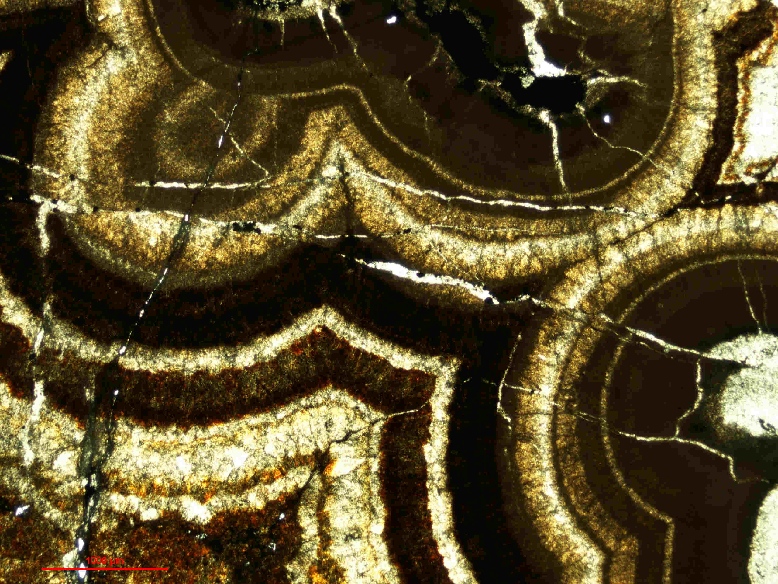
Thank you for listening
Articles (published/coming up)
Hollis et al. (in press). Tracking fluid temperature and δ18O in carbonate-hosted hydrothermal ore systems using clumped C-O isotopes. Economic Geology.
Doran et al. (in prep.), Zn-Pb-Cu-Ni mineralisation in the Lisduff Oolite Member at Lisheen, Ireland: Metal sources, replacement processes, δ34S isotopic recycling and hydrothermal fluid evolution. Ore Geology Reviews.
Doran et al. 2022, A distal, high-grade Irish-type orebody: petrographic, sulphur isotope, and sulphide chemistry of the Island Pod Zn-Pb orebody, Lisheen, Ireland. Economic Geology, v. 117, p. 305-326.
Doran 2022, “Tracking ore fluid evolution using clumped C–O isotopes”, available at: https://rdcu.be/cJs7B
Contact details
: aileen.doran@icrag-centre.org
: @aileendoran1
Micrograph of colloform sphalerite from the Irish base metal field
(SFI Photo of the year 2021)
The authors thank Vendata Resources and Zinc of Ireland for access to drill core and acknowledge support from…
This presentation has emanated from research supported in part by a research grant from Science Foundation Ireland (SFI) under Grant Number 13/RC/2092 and is co-funded under the European Regional Development Fund and by iCRAG industry partners.

Slide 17
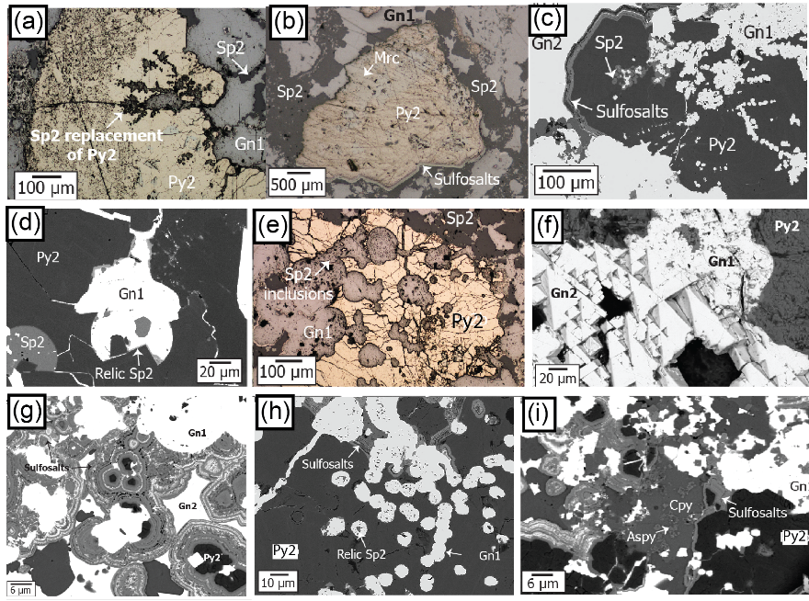
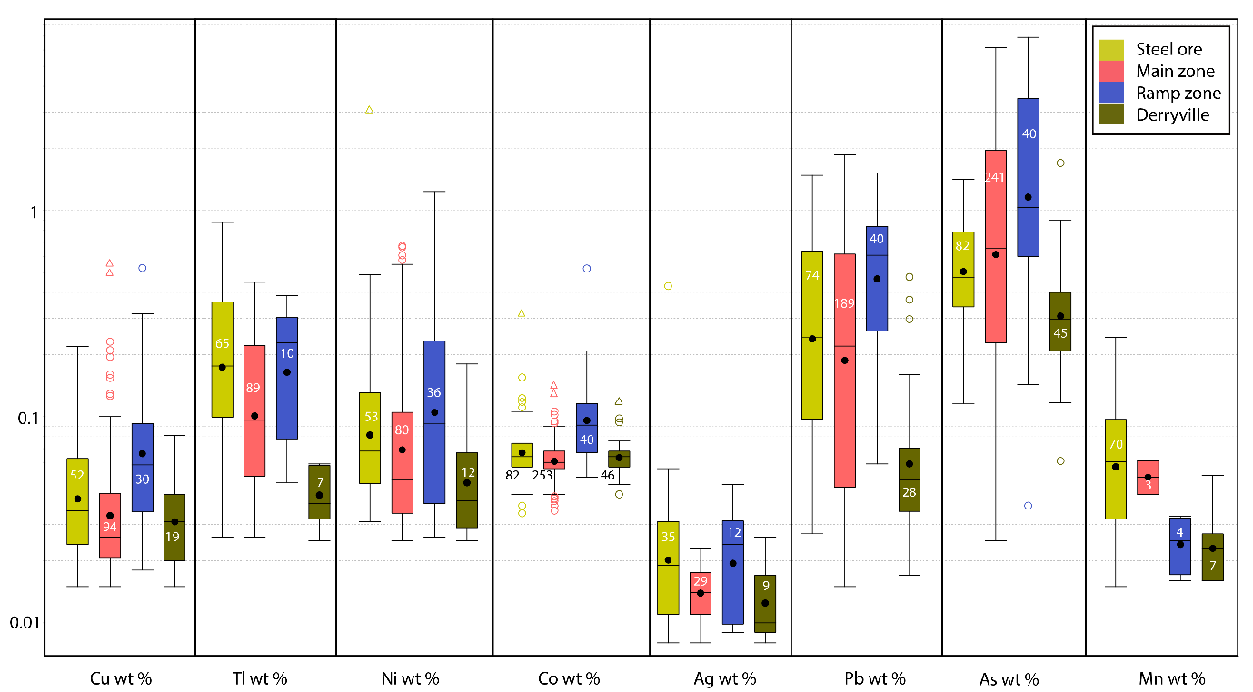
Doran et al. (in prep) - replacement features and impact on geochemistry
Figure 5. Key ore textures and sulphide phases from steel ore-hosted mineralisation.
Figure 7. Box plot of select elements from all pyrite phases, defined by location across LOM-hosted mineralization. (spatial trends)

Slide 18
Pyrite mineral chemistry: Orebody scale (Doran et al., 2022)
Ni/Cu distribution in pyrites not behaving as expected – sources?
As/Tl show spatial variability on deposit scale; vector?
How can this be applied to exploration? (multi-element/pXRF, etc.) – often pyrite only sulfide in drill core
Similar trends for Co and Ni
*hydrothermal pyrite
Pyrite TE’s differ from metal mobility maps – hydrothermal phases typically hosted by pyrite in distal zones
Adapted from Doran (2021) & Doran et al. (2022)
Notes:
Also IP hosts highest levels of Tl and As from whole study, associated with Py2.
Discuss trends overall, proximal to distal – show bivariate plot for steel ore? Interesting trends not in Py0 – in hydrothermal. So look closer at pyrite – will show clear evidence if hydrpthemral, with specific enrichments closer to feeders
Py2 and 3 nice – decrease in Ag, As, and Tl, but increase in Ni as you move away from orebody into halo – these pyrites are typically nicely zoned and can be identified easily under microscope.
The mineral chemistry analysis was carried out on all sulfide phases found within the IP. Sp summary, and gn. But, pyrite proved to hold a lot more information. ….. Summarize py data…. Found all these elements… but when we looked at the data in terms of spatial distribution, what came up was a distinct difference between the rebody and halpo in terms of As….
We can think about the data in 2 key ways, and compare the larger scale with the smaller. So if we start with the orebody scale. In this study we looked at paragenetically constrained pyrites , and whether or not//
The main result that popped up was ….
Average orebody concentrations of Co, As, Ni, Tl in pyrite almost double those for the halo
Sphalerite (except for Fe) and galena relatively “clean”
Pyrite reveals the most varied results (Fe, S, As, Co, Ni, Mn, Pb, Tl and Zn all detected)
Sphalerite and galena relatively “clean”
Pyrite revealed interesting variation
Then start bringing in these points

Slide 19
Ongoing work
This work builds on studies by past iCRAG researchers: new projects looking at potential vectors for use in exploration
LA-ICP-MS element maps and spots to explore variation, on grain and regional scale (moving away from just Lisheen)
Claire Geel (iCRAG, UCD)
Geochemical studies of pyrites(+marcasite) from across the Irish Zn-Pb ore field
Check out Claire’s poster !

Slide 20
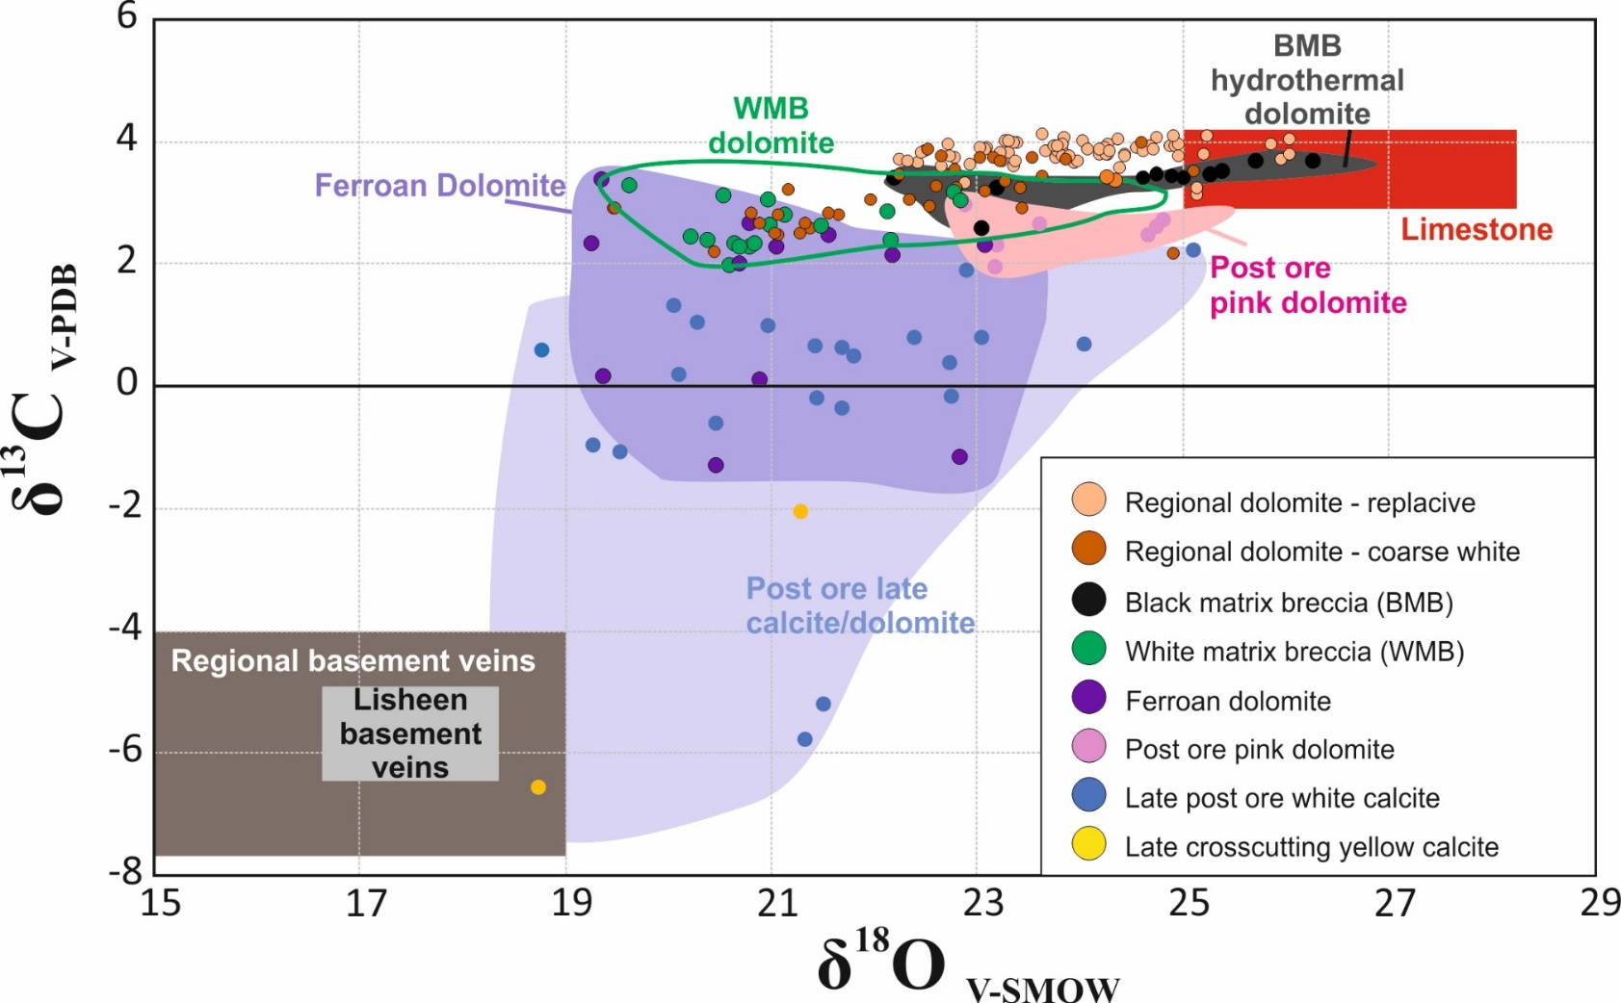
Standard carbonate δ¹³C and δ¹⁸O isotope data: Lisheen deposit
Each carbonate phase shows a large range in carbonate δ¹⁸O values with significant overlap.
Bulk carbonate δ¹⁸O varies according to temperature and fluid isotopic composition.
Bulk δ¹³C values buffered by Waulsortian limestones. Lower in basement veins and post-ore phases.
Data from Eyre (1998), Hitzman et al. (1998) & Hollis (unpublished)

Slide 21
Source of Metals
Stacey & Kramer (1975) growth curve
Deposit array with more radiogenic comps in the SE and least radiogenic in the NW.
Comparison with Low. Pal. basement shows matching geographic pattern.
Lower Palaeozoic Pb compositions modelled back to 350 Ma directly overlie deposit array – convincing evidence for direct derivation of Pb from local basement.
Modelled Pb modeled lead isotope composition of the Old Red Sandstone at 350 Ma is too radiogenic to have acted as main source of lead for the Irish ore field.
15.7
Deposit array (galena)
Southeast Ireland
0Ma
300Ma
15.6
500Ma
207
Pb
700Ma
204
Pb
15.5
Northwest Ireland
Lower Palaeozoic
wholerocks (present day)
17.4
17.8
18.2
18.6
19
206
Pb /
204
Pb
Dixon et al. (1990), O'Keeffe (1987)

Slide 22
Further evidence for fluid interactions and sources
Nd isotopes of hydrothermal carbonates from Navan deposit suggest that interaction fluids with crystalline basement occurred in this area (Walshaw et al., 2006)
Old Red Sandstone has been proposed as a source of metals in some models (e.g., Hitzman and Beaty, 1996; Lydon, 1986). Can be contributor, due to its clastic content that is basement derived, but contribution will be small (<10%, Wilkinson et al 2007).
Arc-derived Lower Palaeozoic greywackes are a good source rock. They can be easily leached of Pb, Zn, Cu, Ba, Ni, Co, Fe, Cd, As, Mn
Sr, C and O isotope data of hydrothermal carbonates in deposits fall in same trends as or continue trends of basement-hosted veins: Indicates use of similar fluid pathways, and elemental and isotopic exchange was happening.
Pb isotopes from Lisheen show differences between ore bodies at Lisheen, along with mapping basement affinities across Ireland (Hollis et al., in prep)
Chert oxygen isotope work – differentiating between O (and fluid) sources using cherts from across Irish ore field – pilot study by Evie Burton (UCD, iCRAG) – Links up with pyrite chemistry
Slide modified from: Dr Koen Torremans
Notes:
There is a huge amount of other past and current research that further help identify fluid sources and record their compositional evolution as they mix and begin precipitation of sulfide phases.
Just really wanted to highlight some of the other ongoing work, including Pb isotope work. Undertaken by Dr Hollis – regional and local scale.

Slide 23
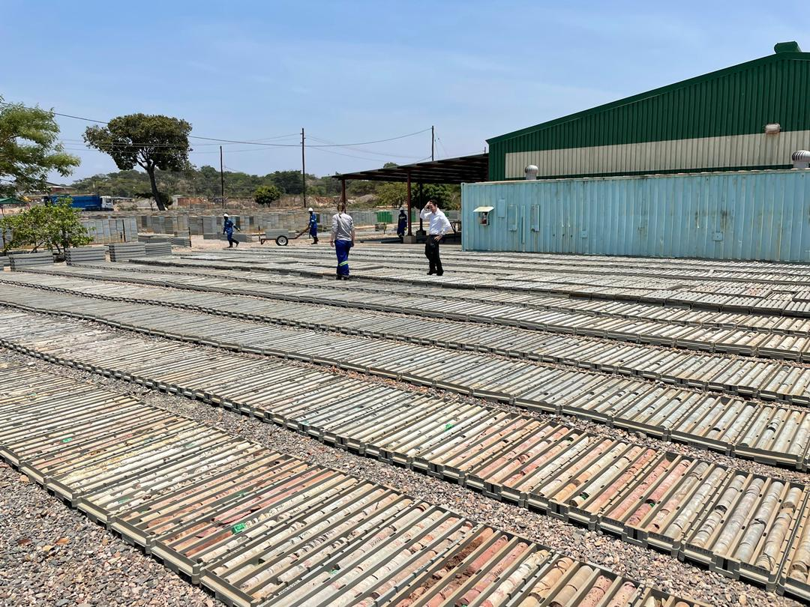
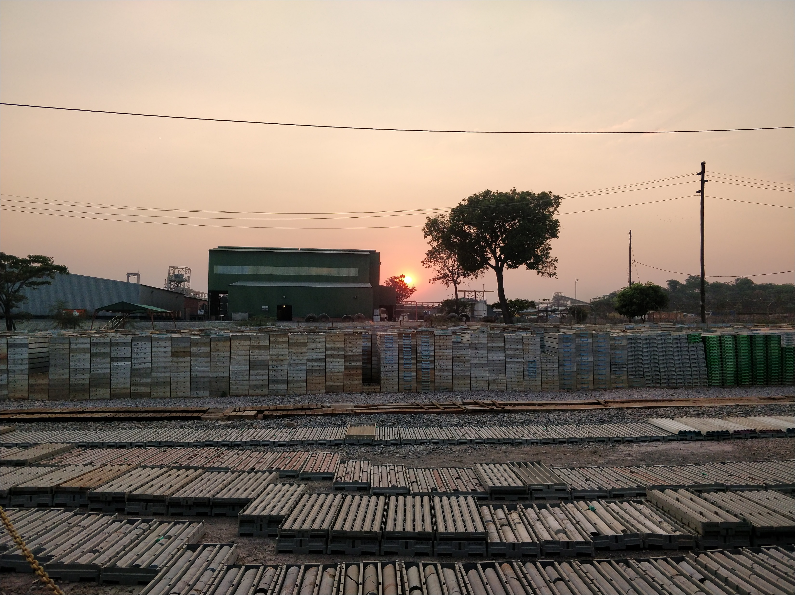
Current research
Project in Zambia, Africa – applying techniques and lessons from Irish work
Looking at cobalt-copper deposits
Get to look at ~2 km cores of rock that record the environment from up to ~900 mya
Record the influence of a suspected global glaciation event (snowball earth), can help with climate science studies
How did these rocks form? Are the features we see original or the result of intensive metamorphic/other alteration? Why is this important to understand? What are the challenges with this?
What environmental history have we lost since these rocks were deposited (e.g., massive salt dissolution)? How did the metals become so concentrated in this part of the world? How can we use this information to help find more of these crucial deposits? What minerals can be used to help us explore more effectively?
How can we ensure this is done sustainably and for the benefit of all?

Slide 24
Existing temperature constraints
Wealth of existing fluid inclusion data, fundamental in identifying two fluid sources (Wilkinson, 2010).
Number of key phases are under-represented:
Various types of regional dolomite rarely have inclusions.
Only 1 BMB sample has yielded fluid inclusions in Ireland (Wilkinson & Earls, 2000) – not from an orebody.
WMBs often contain fluid inclusions too small for reliable analysis (<5 µm). – all Lisheen data from one hole!
Ore-stage carbonates.
Carbonate-hosted fluid inclusions are susceptible to post-entrapment modification - especially compared to quartz.
Examples of fluid inclusions from Navan.
Average size ~5 µm.

Slide 25
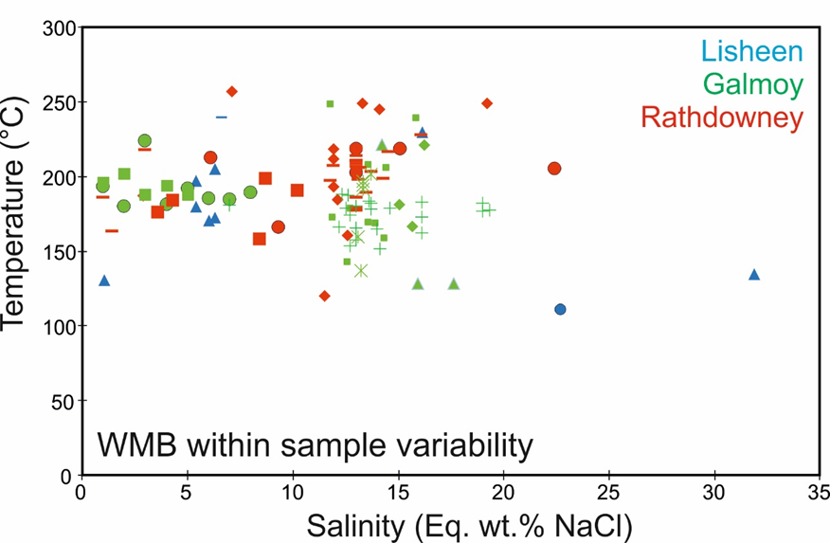
What temperature do we use if we want to calculate fluid δ¹⁸O?
For fluid δ¹⁸O be determined, accurate temperature constraints are required for each sample with matched carbonate δ¹⁸O.
Temperatures cannot be assumed where there are large intra-sample variations (e.g. WMBs) 🡪 leads to uncertainty of ~5‰ at high T
Clumped isotope analysis provides both carbonate δ¹³C, δ¹⁸O and temperature allowing fluid compositions to be directly calculated
Symbols reflect different samples
Data from: Eyre (1998), Wilkinson (2010)

Slide 26
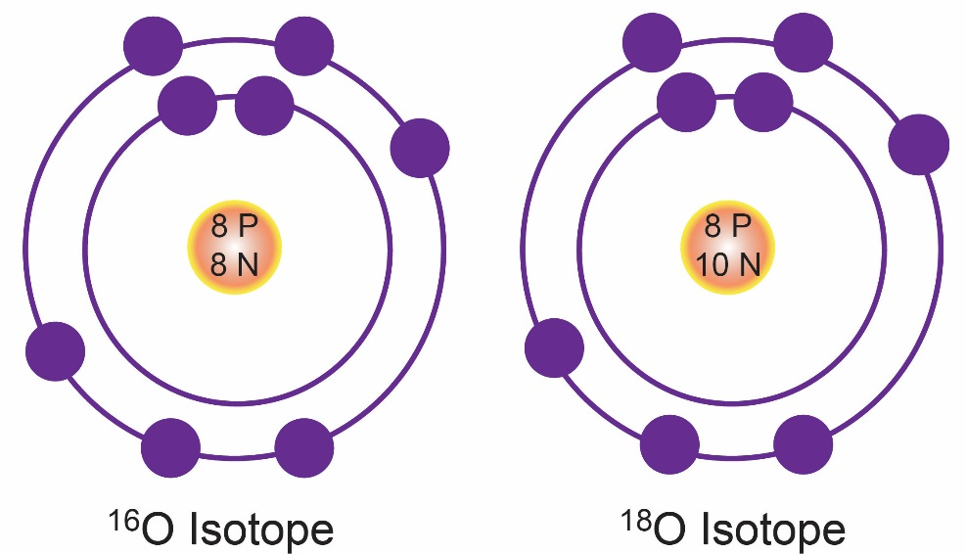
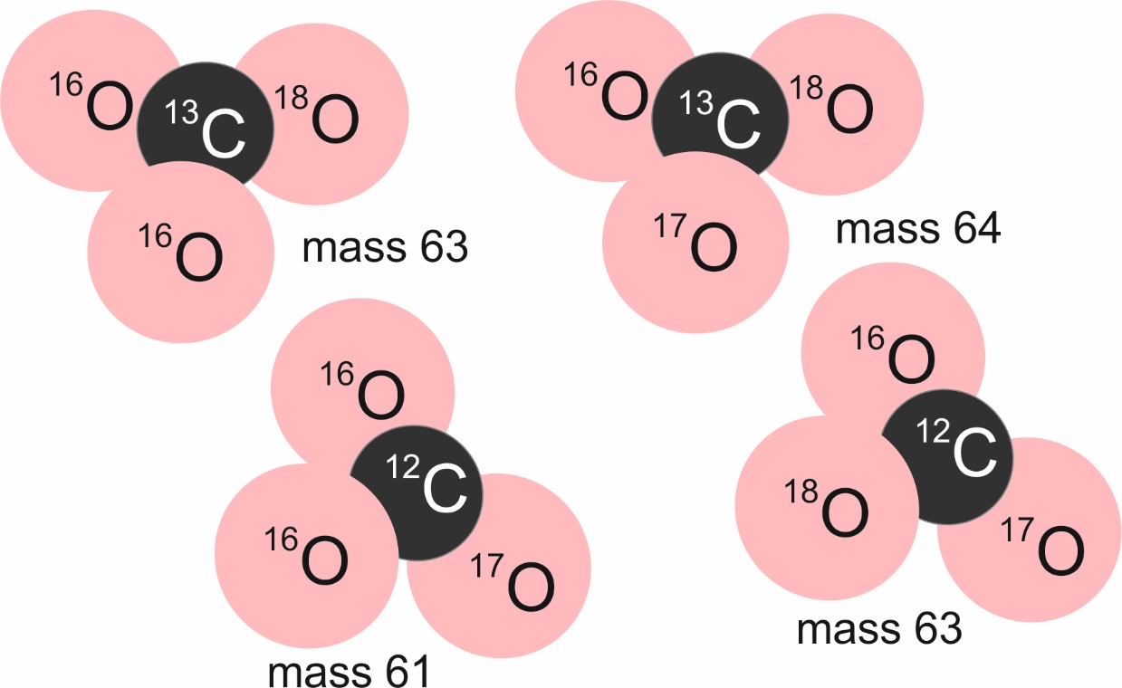
You have isotopes….
Same element, different mass
& isotopologues
Same CO₃ molecule,
different isotopic composition

Slide 27
What is a clumped isotope?
https://dinotopes.wordpress.com/
a multiply-substituted isotopologoue / or an isotopologoue with two or more rare isotopes
The degree of ‘clumping’ (heavy-heavy bonding) is an inverse function of temperature.
Example of carbon and oxygen:
At lower temperatures, clumping of these heavy isotopes is favoured as the vibrational energy for the heavy-heavy bond (¹³C-¹⁸O) is half that of the corresponding light-light bond (¹²C-¹⁶O).

Slide 28
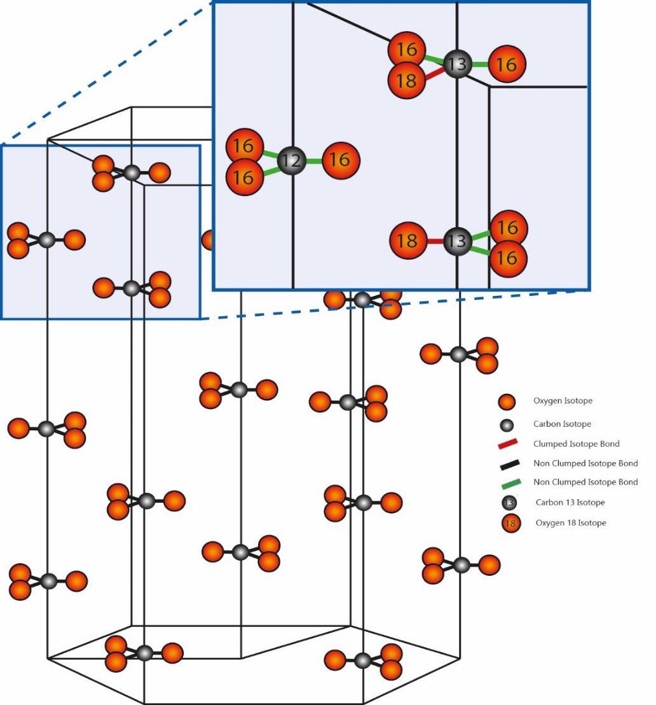
Clumped C-O isotope analysis – how does it work?
Technique relies on the ordering of isotopes of carbon (12,13) and oxygen (16,17,18) in the carbonate mineral lattice.
The heavy isotopes of carbon and oxygen (¹³C,¹⁸O) are now known to bond in carbonate minerals more frequently than expected by stochastic (i.e. random) distribution.
The extent of this “clumping” is temperature dependent, but crucially is independent of fluid isotope composition and carbonate mineral chemistry.
Isotopes move towards a more random (stochastic) distribution with increasing temperature.
We can’t measure solids, hence we react carbonates with phosphoric acid at a set temperature to produce CO₂.
44
47

