Slide 1
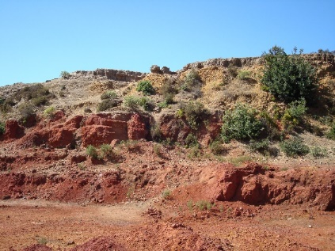






Irish-type deposits in Tunisia: a new perspective to assign the Pb-Zn deposits of the Nefza District
Sophie Decrée, A Van Ham-Meert, JM Baele, O Namur, E Deloule and C Marignac

Slide 2
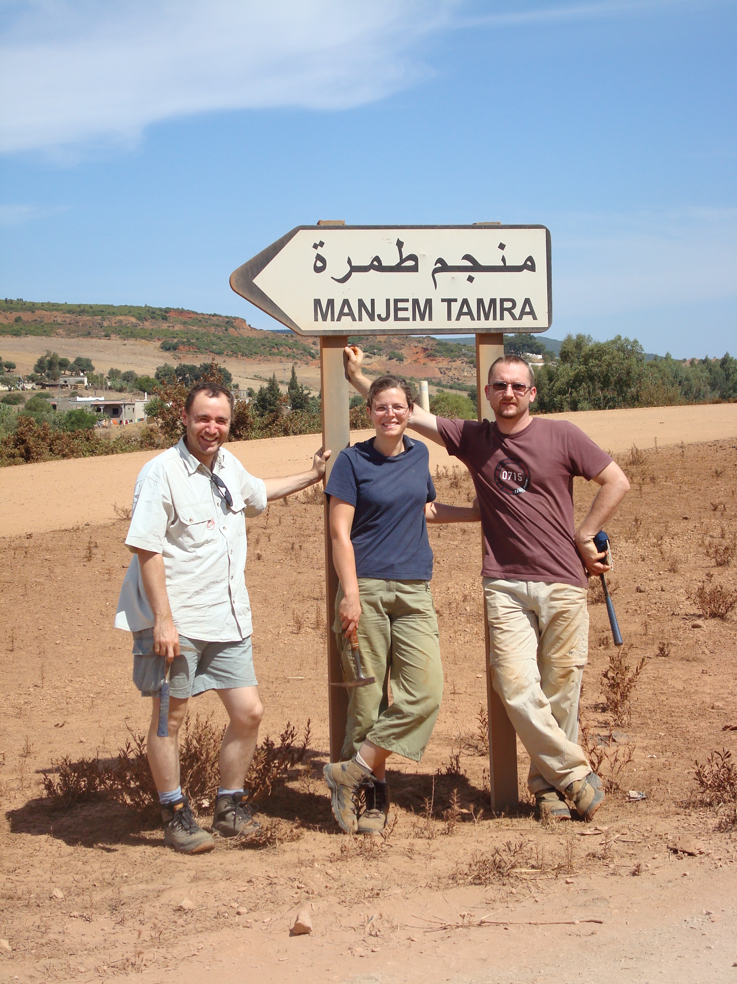
Mining district of Nefza (N. Tunisia)
Nefza
- Sidi Driss and Douahria Pb-Zn deposits in the Nefza mining district (polymetallic ore deposits and magmatic rocks)
- « SedEx-SHMS affinity » >< MVT further South
- 15 years after: thanks to IAEG, there is an opportunity to reconsider these deposits!
Decrée et al. 2016

Slide 3
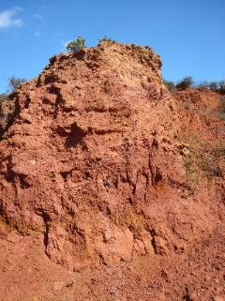
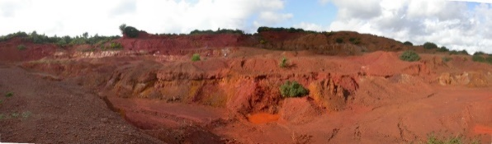
General setting: regional substratum and basins
Decrée et al. 2016
Bouaziz et al. 2002

Slide 4
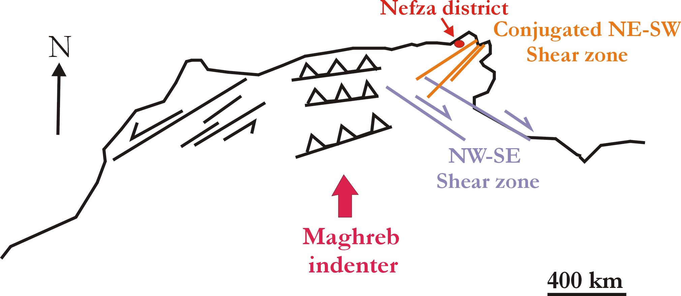
Regional structures, deposits and geochemical anomalies
- Structural lineaments inherited from the Variscan basement
- Control of the magmatic rocks emplacement en mineralizations (Pb-Zn (-Ag), Cu, Au, REE)
Bouaziz et al. 2002
Decrée et al. 2016
Piqué et al. 1998

Slide 5
Miocene magmatic activity in the Nefza
Jallouli & Mickus 1999
- Shear zones and associated lineaments inherited from the Variscan orogeny reactivated by transtensional processes during the Alpine orogeny
- magma ascent facilitated due to a thinner lower crust (10 km vs. 20 km in central Tunisia) and a more proximal Moho
- Gravimetric survey → shallow concealed igneous bodies
Jallouli et al. 2003

Slide 6
Miocene magmatic activity in the Nefza
Decrée et al. 2014
From the oldest to the most recent :
- granodiorite < differentiation of a metaluminous calc-alkaline magma
- rhyodacite < same magma with melted crust
- cordierite-bearing rhyodacite < highest crustal contribution
- late basalts, transitional between the calc-alkaline and alkaline series < enriched mantle source (lithosphere–asthenosphere boundary)

Slide 7
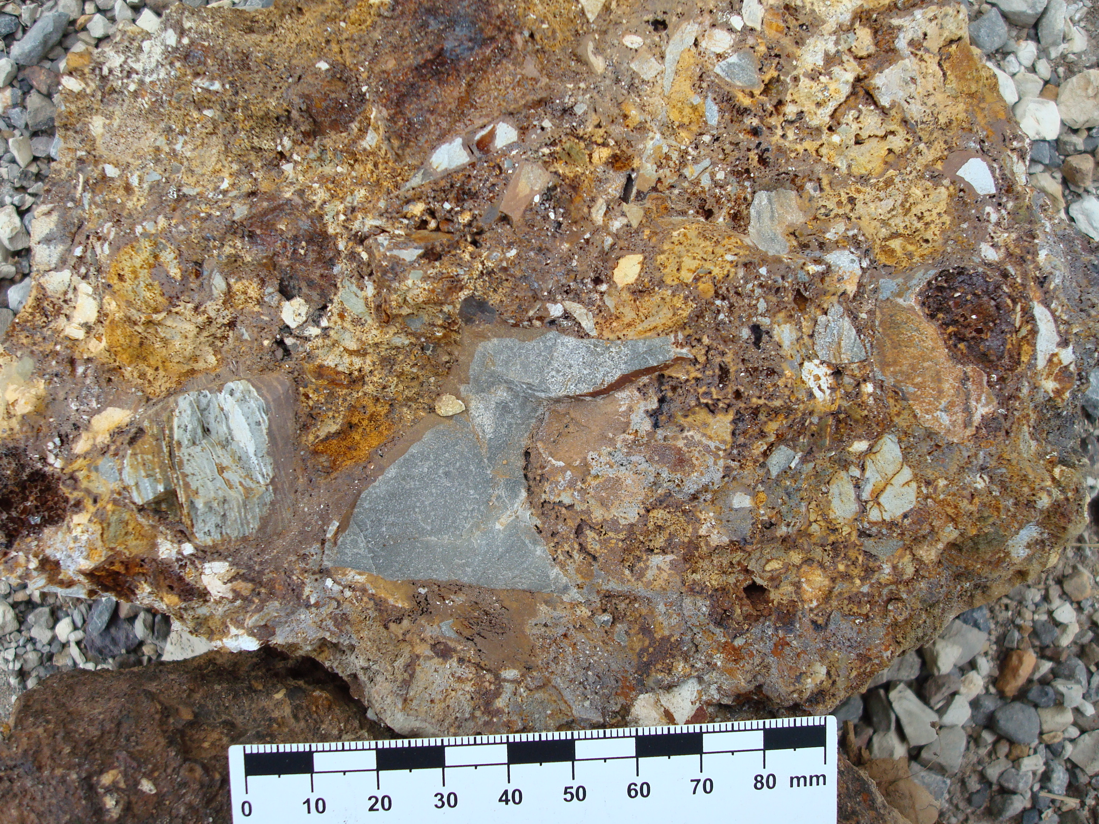
The Nefza mining district: polymetallic deposits
- Oued Belif IOCG: matrix-supported breccia (phreato-magmatic event) mineralized in Fe-REE-Cu(-Au) – Tortonian (9 Ma)
- Pb-Zn deposits of interest: Sidi Driss and Douaria – Messinian (~7-6 Ma)
- Fe oxides (+ Mn above Sidi Driss): mixed influence of hydrothermal fluid circulation and pedogenesis during the Pliocene (4.5-3.3 Ma)

Slide 8
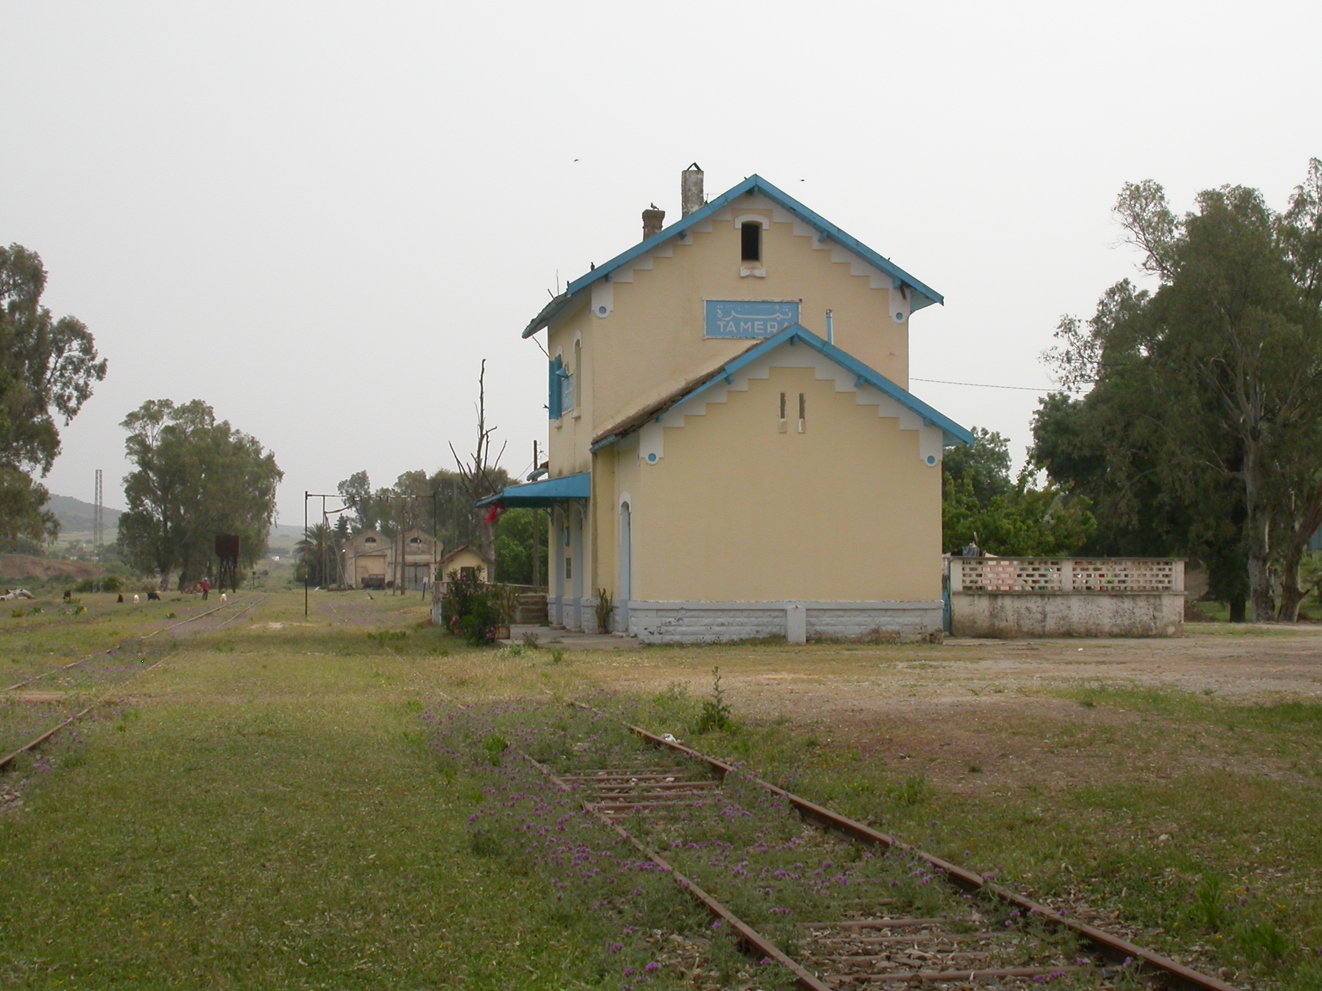
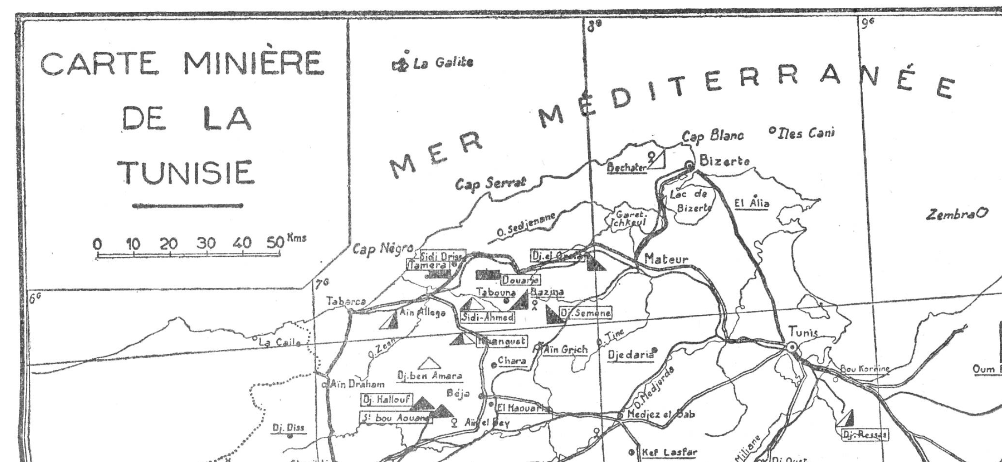
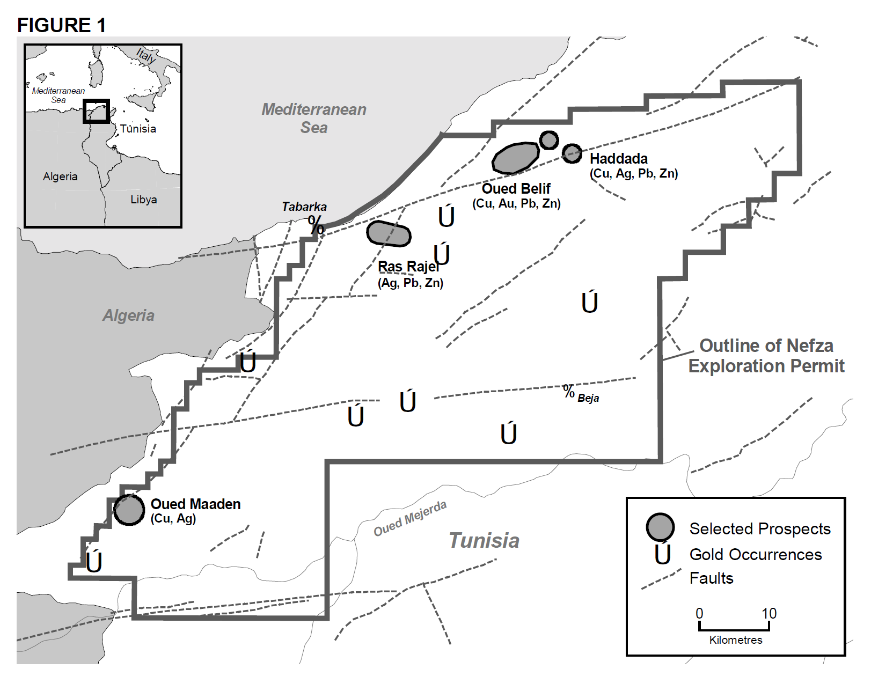
The Nefza mining district: polymetallic deposits
- Pb-Zn deposits of interest: Sidi Driss and Douaria
Gottis 1952
- Sidi Driss: discovered in 1902, closed in the 70’s
- Fe oxides (rich in As) send to the UK/US (1920-1950)
- New exploration permits (Albidon)
Albidon 2004

Slide 9
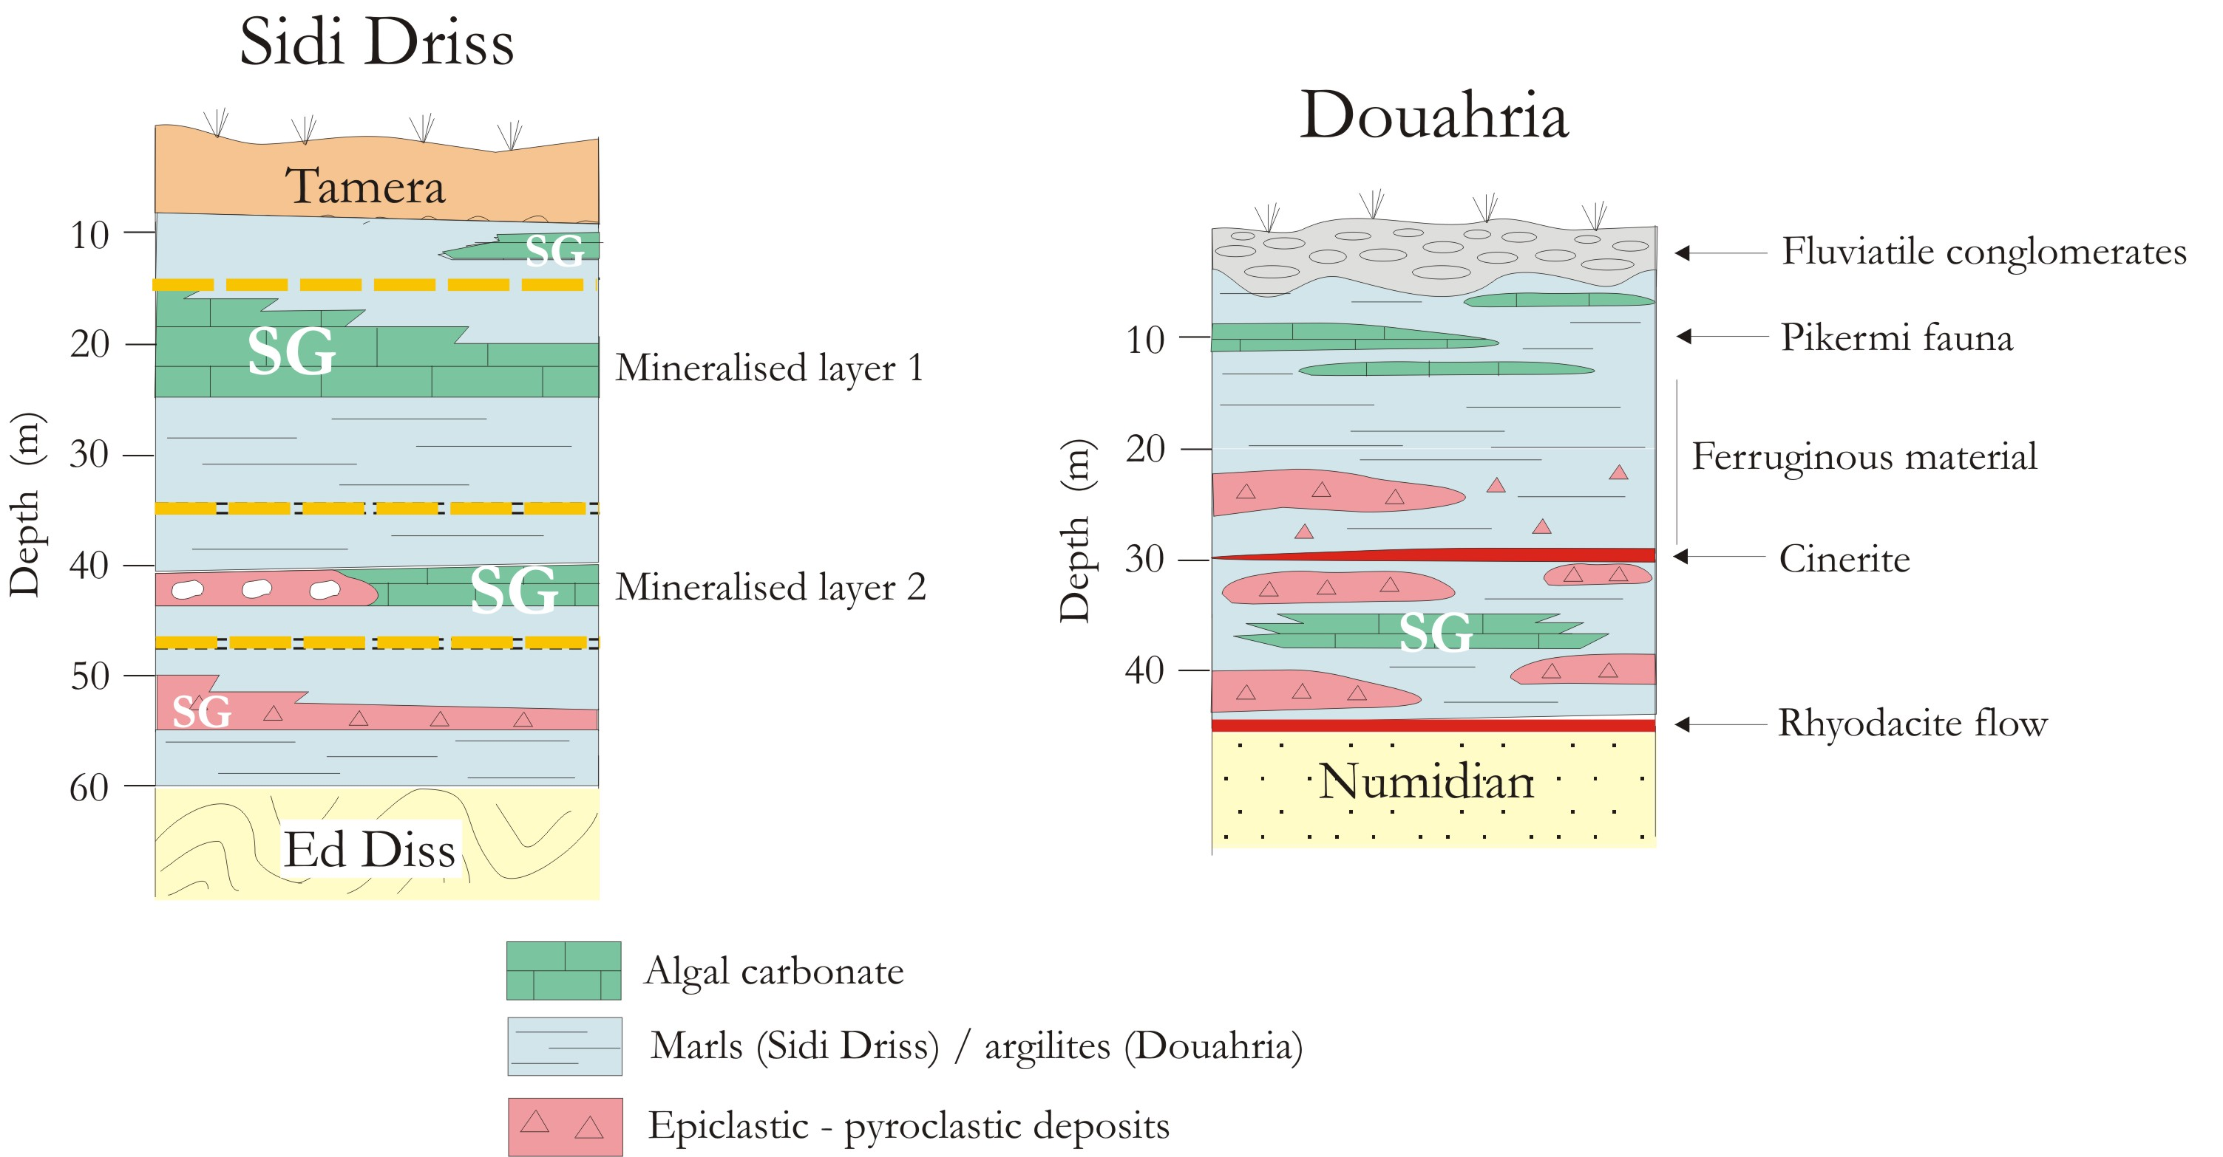
Sidi Driss and Douahria basins
- Messinian basins, shallow marine sediments
- Basin infilling: epiclastic/pyroclastic deposits, marls, carbonate lenses (hosting stratabound Pb-Zn mineralizations) and evaporites
- Heavily Fe-mineralised material at Douahria

Slide 10
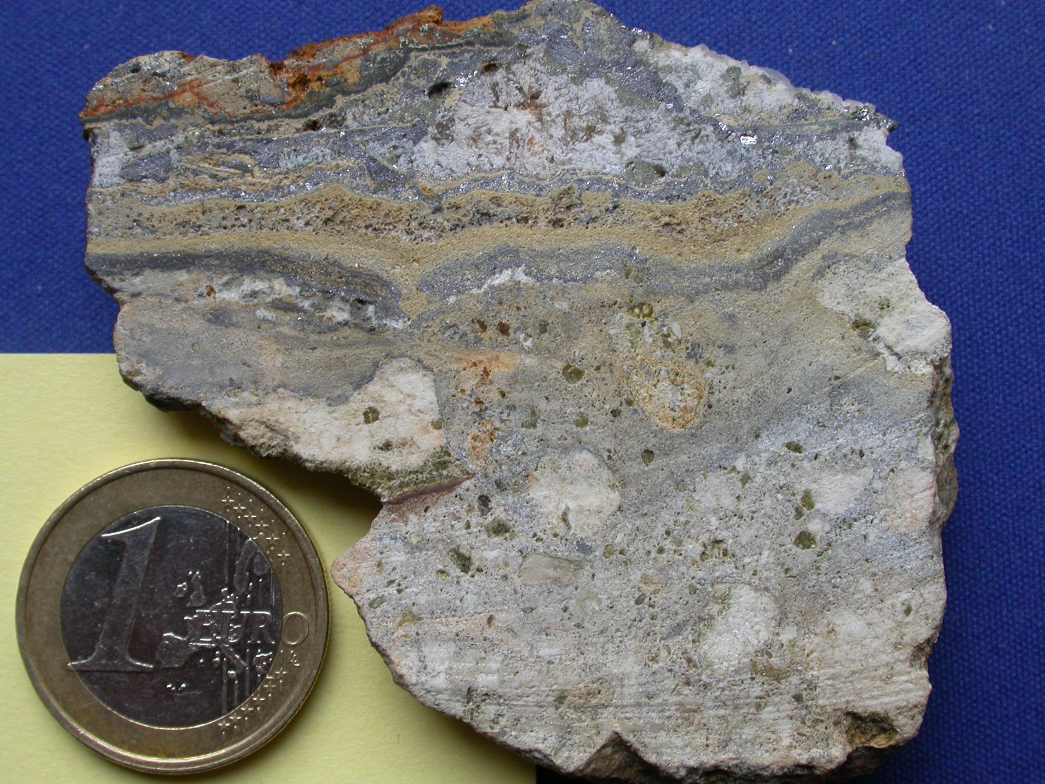
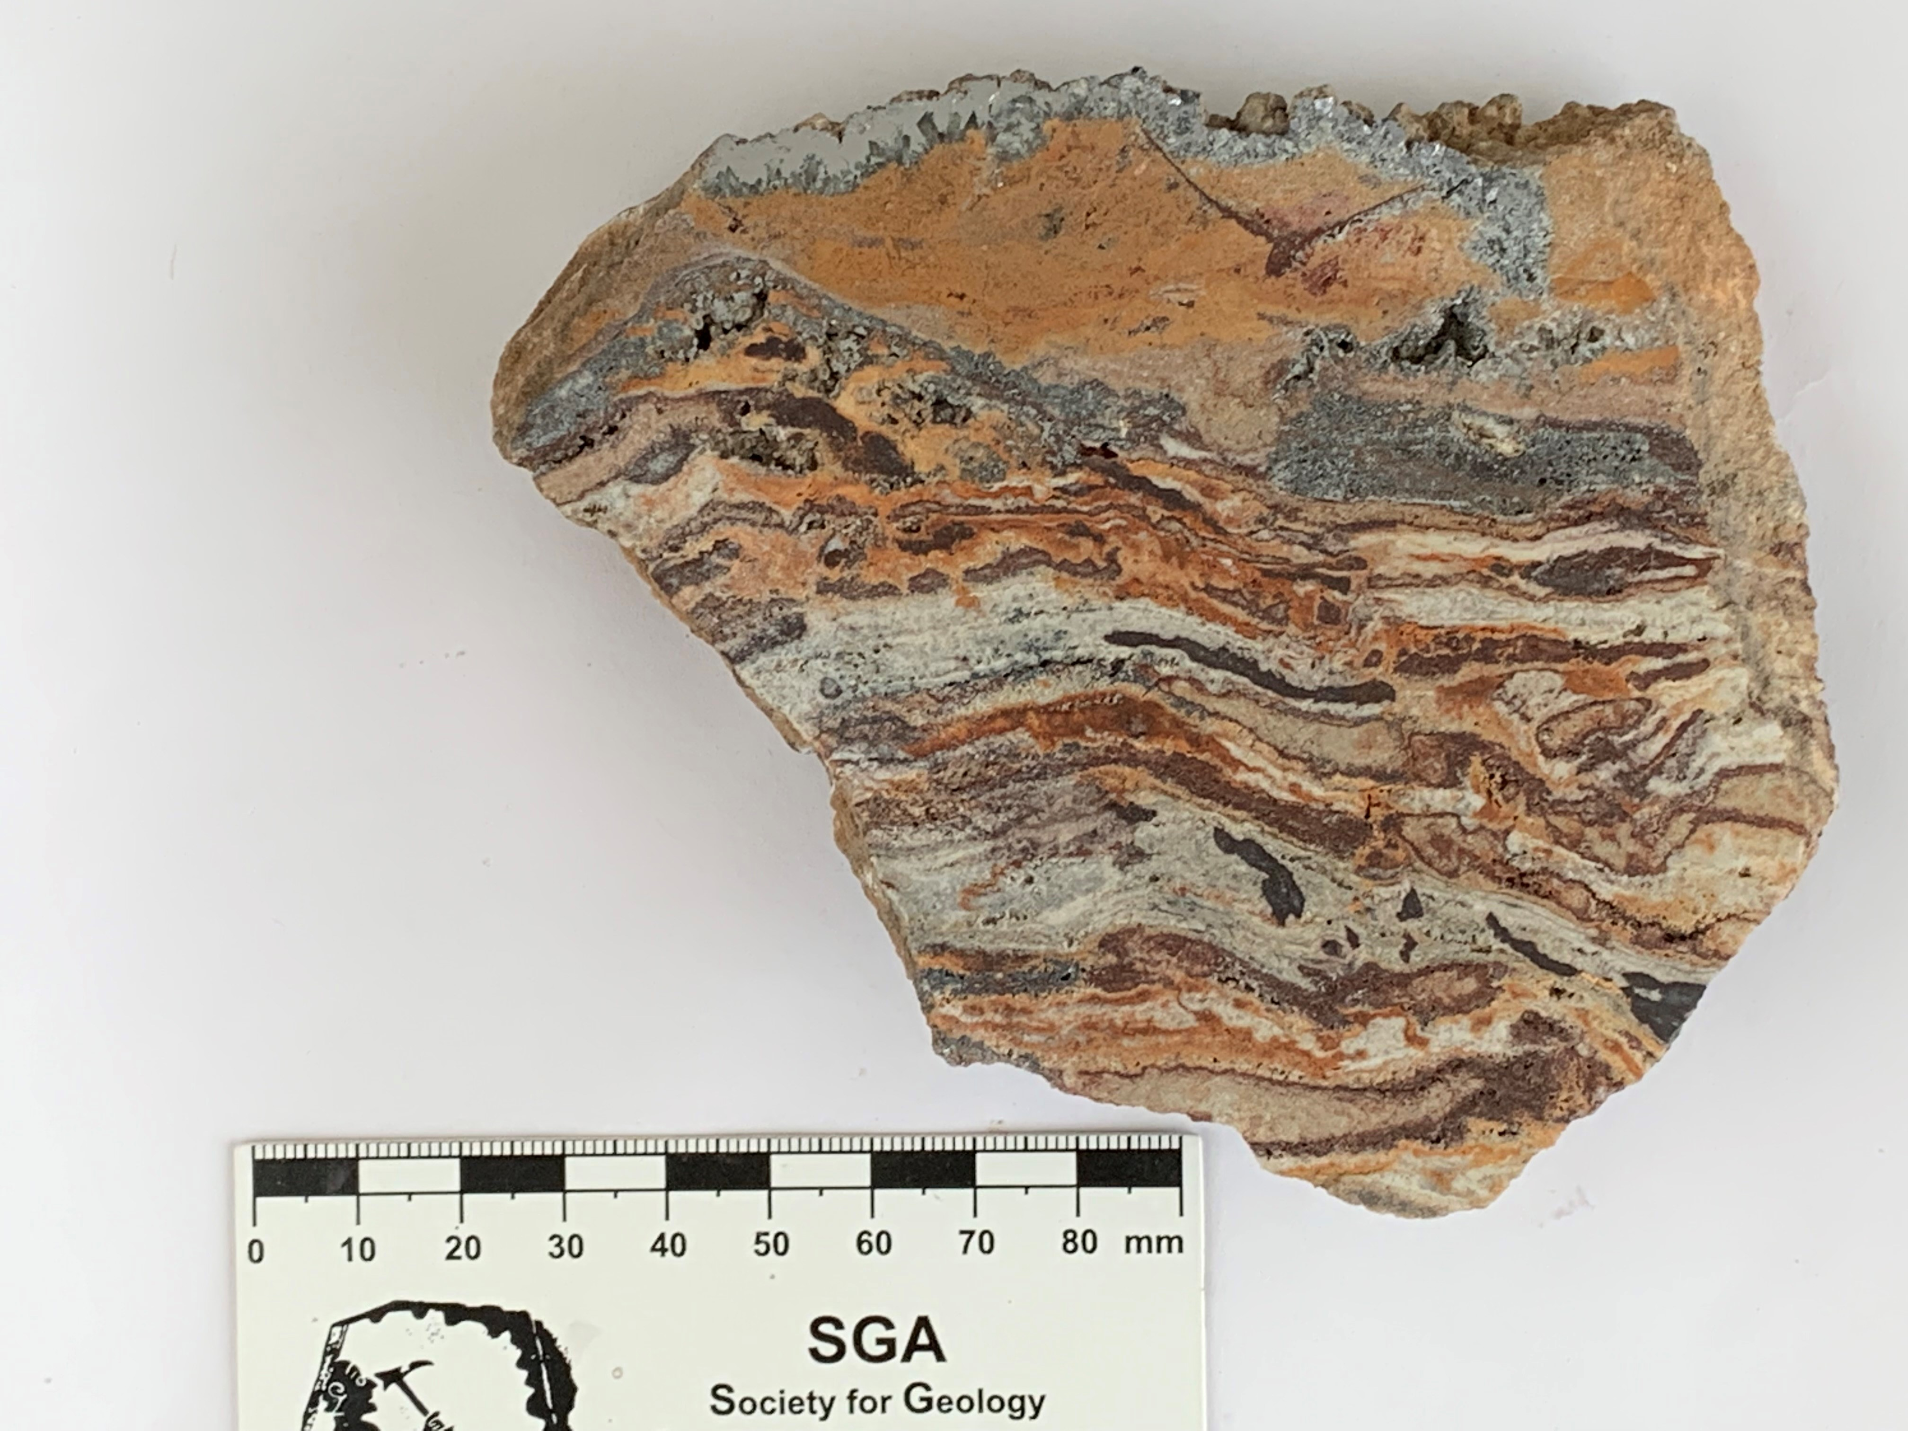
Main features of the Pb-Zn ore at Sidi Driss and Douahria
- Pb-Zn ore is mostly stratabound
- Composed of galena, sphalerite and Fe-sulphides (pyrite and marcasite)
- Banded or disseminated, replacing the host rock or filling voids
- A rhythmic alternation of mineralized layers is commonly observed
- Soft-sediment deformation suggests the syndiagenetic origin of these deposits (such as the loadcast structure in a galena layer)
Gn
Cal
Gn
Gn
Sp
Sp
Sp
Gn
Sp
FeOX
Carb
Clt
Sp
Clt
Sidi Driss
Douahria

Slide 11
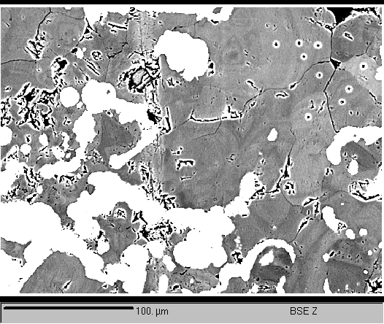
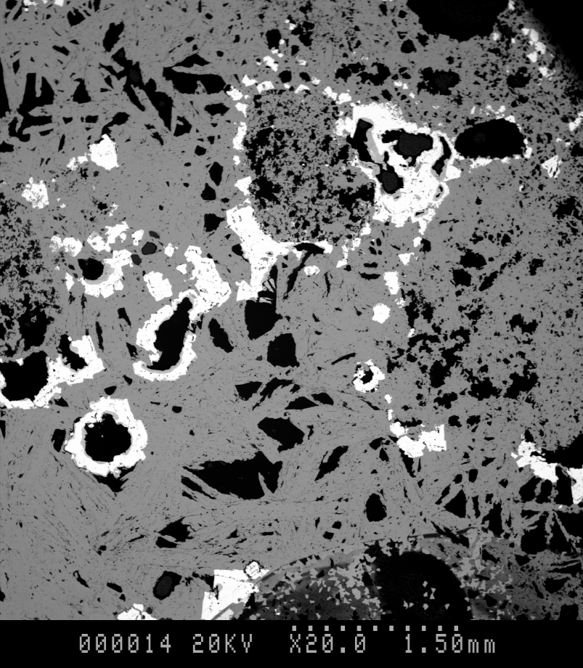
Host rocks of the Pb-Zn ore
- Fe-Mn enriched dedolomite (up to 5% Fe and 4.5%Mn) < dedolomitization - Mn-Fe fluids (Sidi Driss)
- Early sulphates (barite in Sidi Driss and celestite in both sites)
- Early replacement of dedolomite by sulphates at Sidi Driss
Sidi Driss
Sidi Driss

Slide 12
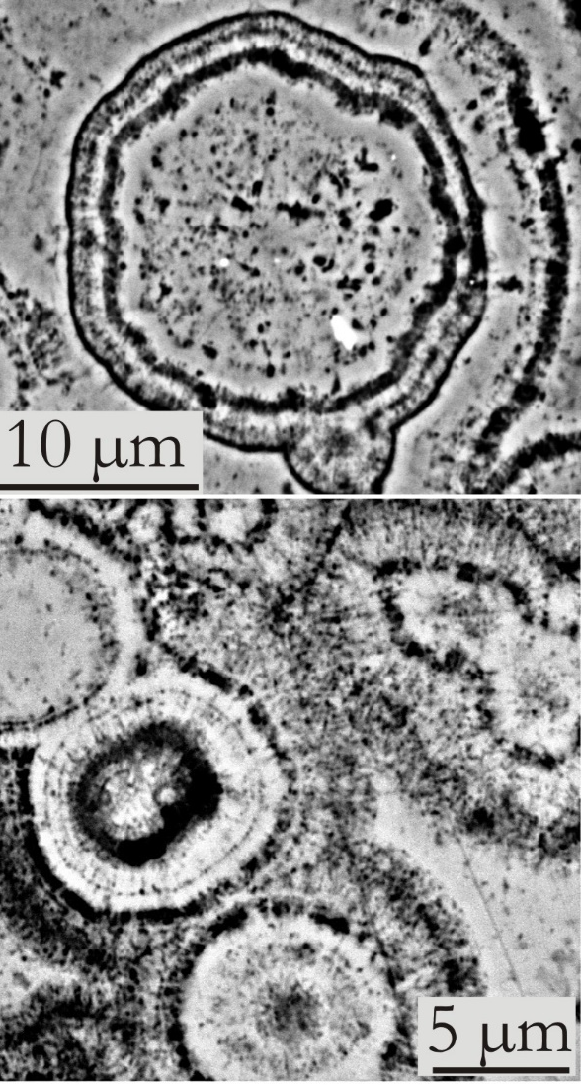
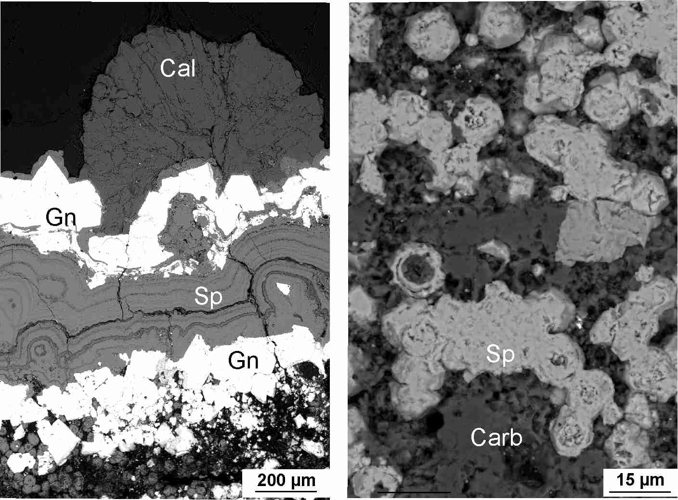
Petrography and paragenetic sequence
Sphalerite:
- exhibits spherulitic textures (up to 30 µm in diam.)
- spherules coalescence up to form colloform layers < progressive recrystallization through the early burial diagenesis
- are likely products of microbial activity

Slide 13
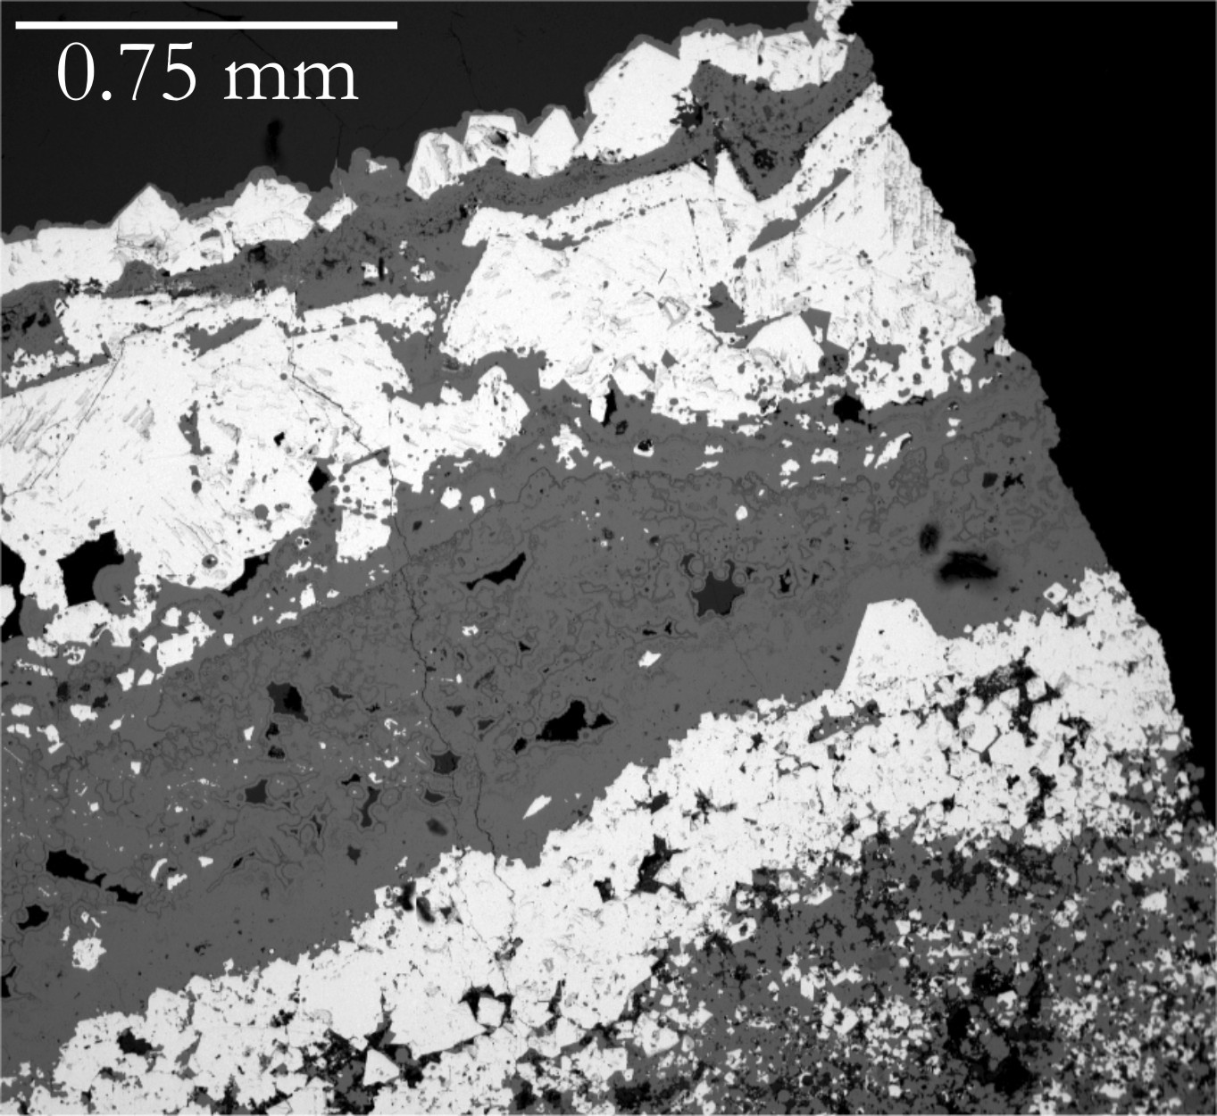
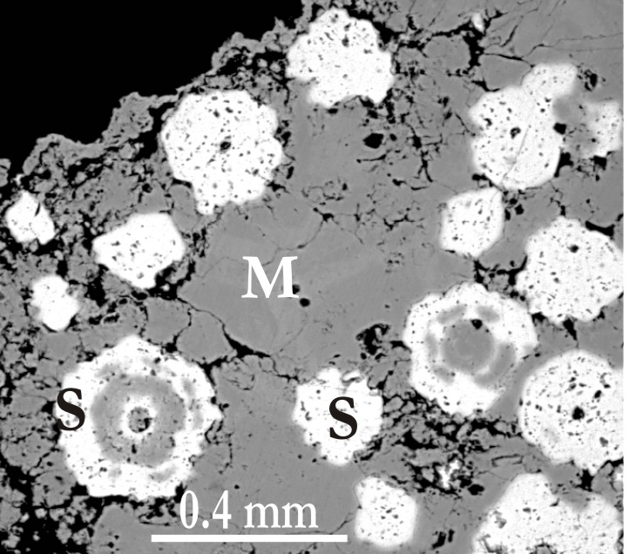
Petrography and paragenetic sequence
Galena:
- mostly forms euhedral to subhedral crystals/grains
- frequently replaced sphalerite
Pyrite and marcasite:
- replaced earlier carbonates and/or sulphides
- filled voids or are present as colloform bands
Calcite:
- fills most of the remaining voids in the carbonate host rock
Late oxidation of the sulphide assemblage, well expressed at Douahria

Slide 14
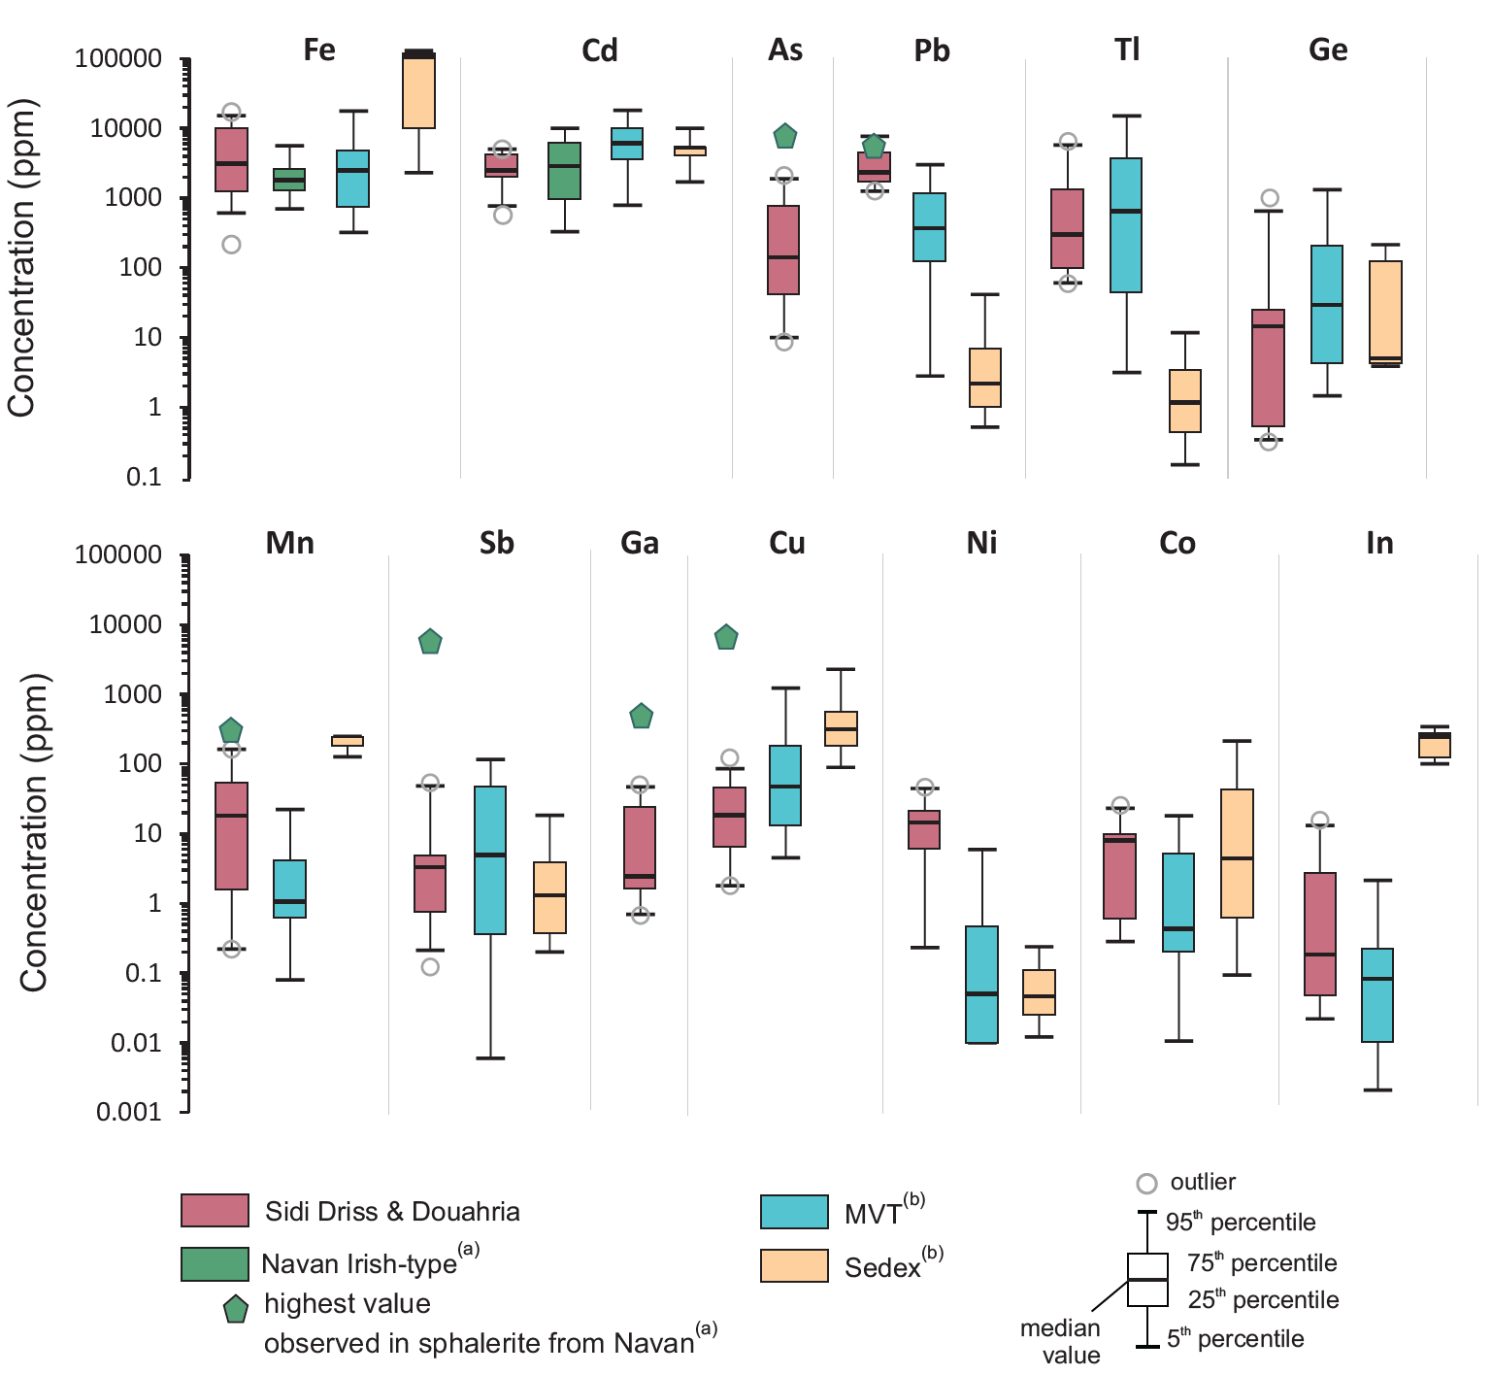
Sulphide chemistry (LA-ICPMS analyses)
Galena:
- As, Tl and Sb are the main minor and trace elements (up to 4472, 2481 and 683ppm, respectively). Low Fe and Zn contents (<60 ppm and <21 ppm)
Pyrite and marcasite:
- High but variable As contents (1.7-4477 ppm), whereas Zn, Ge, Sb are low (a few ppm)
Sphalerite:
- Variable Fe, Cd and Tl contents (215<Fe<15304 ppm; 595<Cd<15881 ppm; 69<Tl<8120 ppm, m.v. of 353 ppm Tl)
- Content in trace elements closer to the MVT rather than the Sedex (data from Hu et al., 2021)
- Comparable Fe and Cd contents with the Irish-type (Navan deposits, Gagnevin et al., 2014), with an overlap in As, Mn, Sb, Ga, and Cu concentrations
Sphalerite

Slide 15
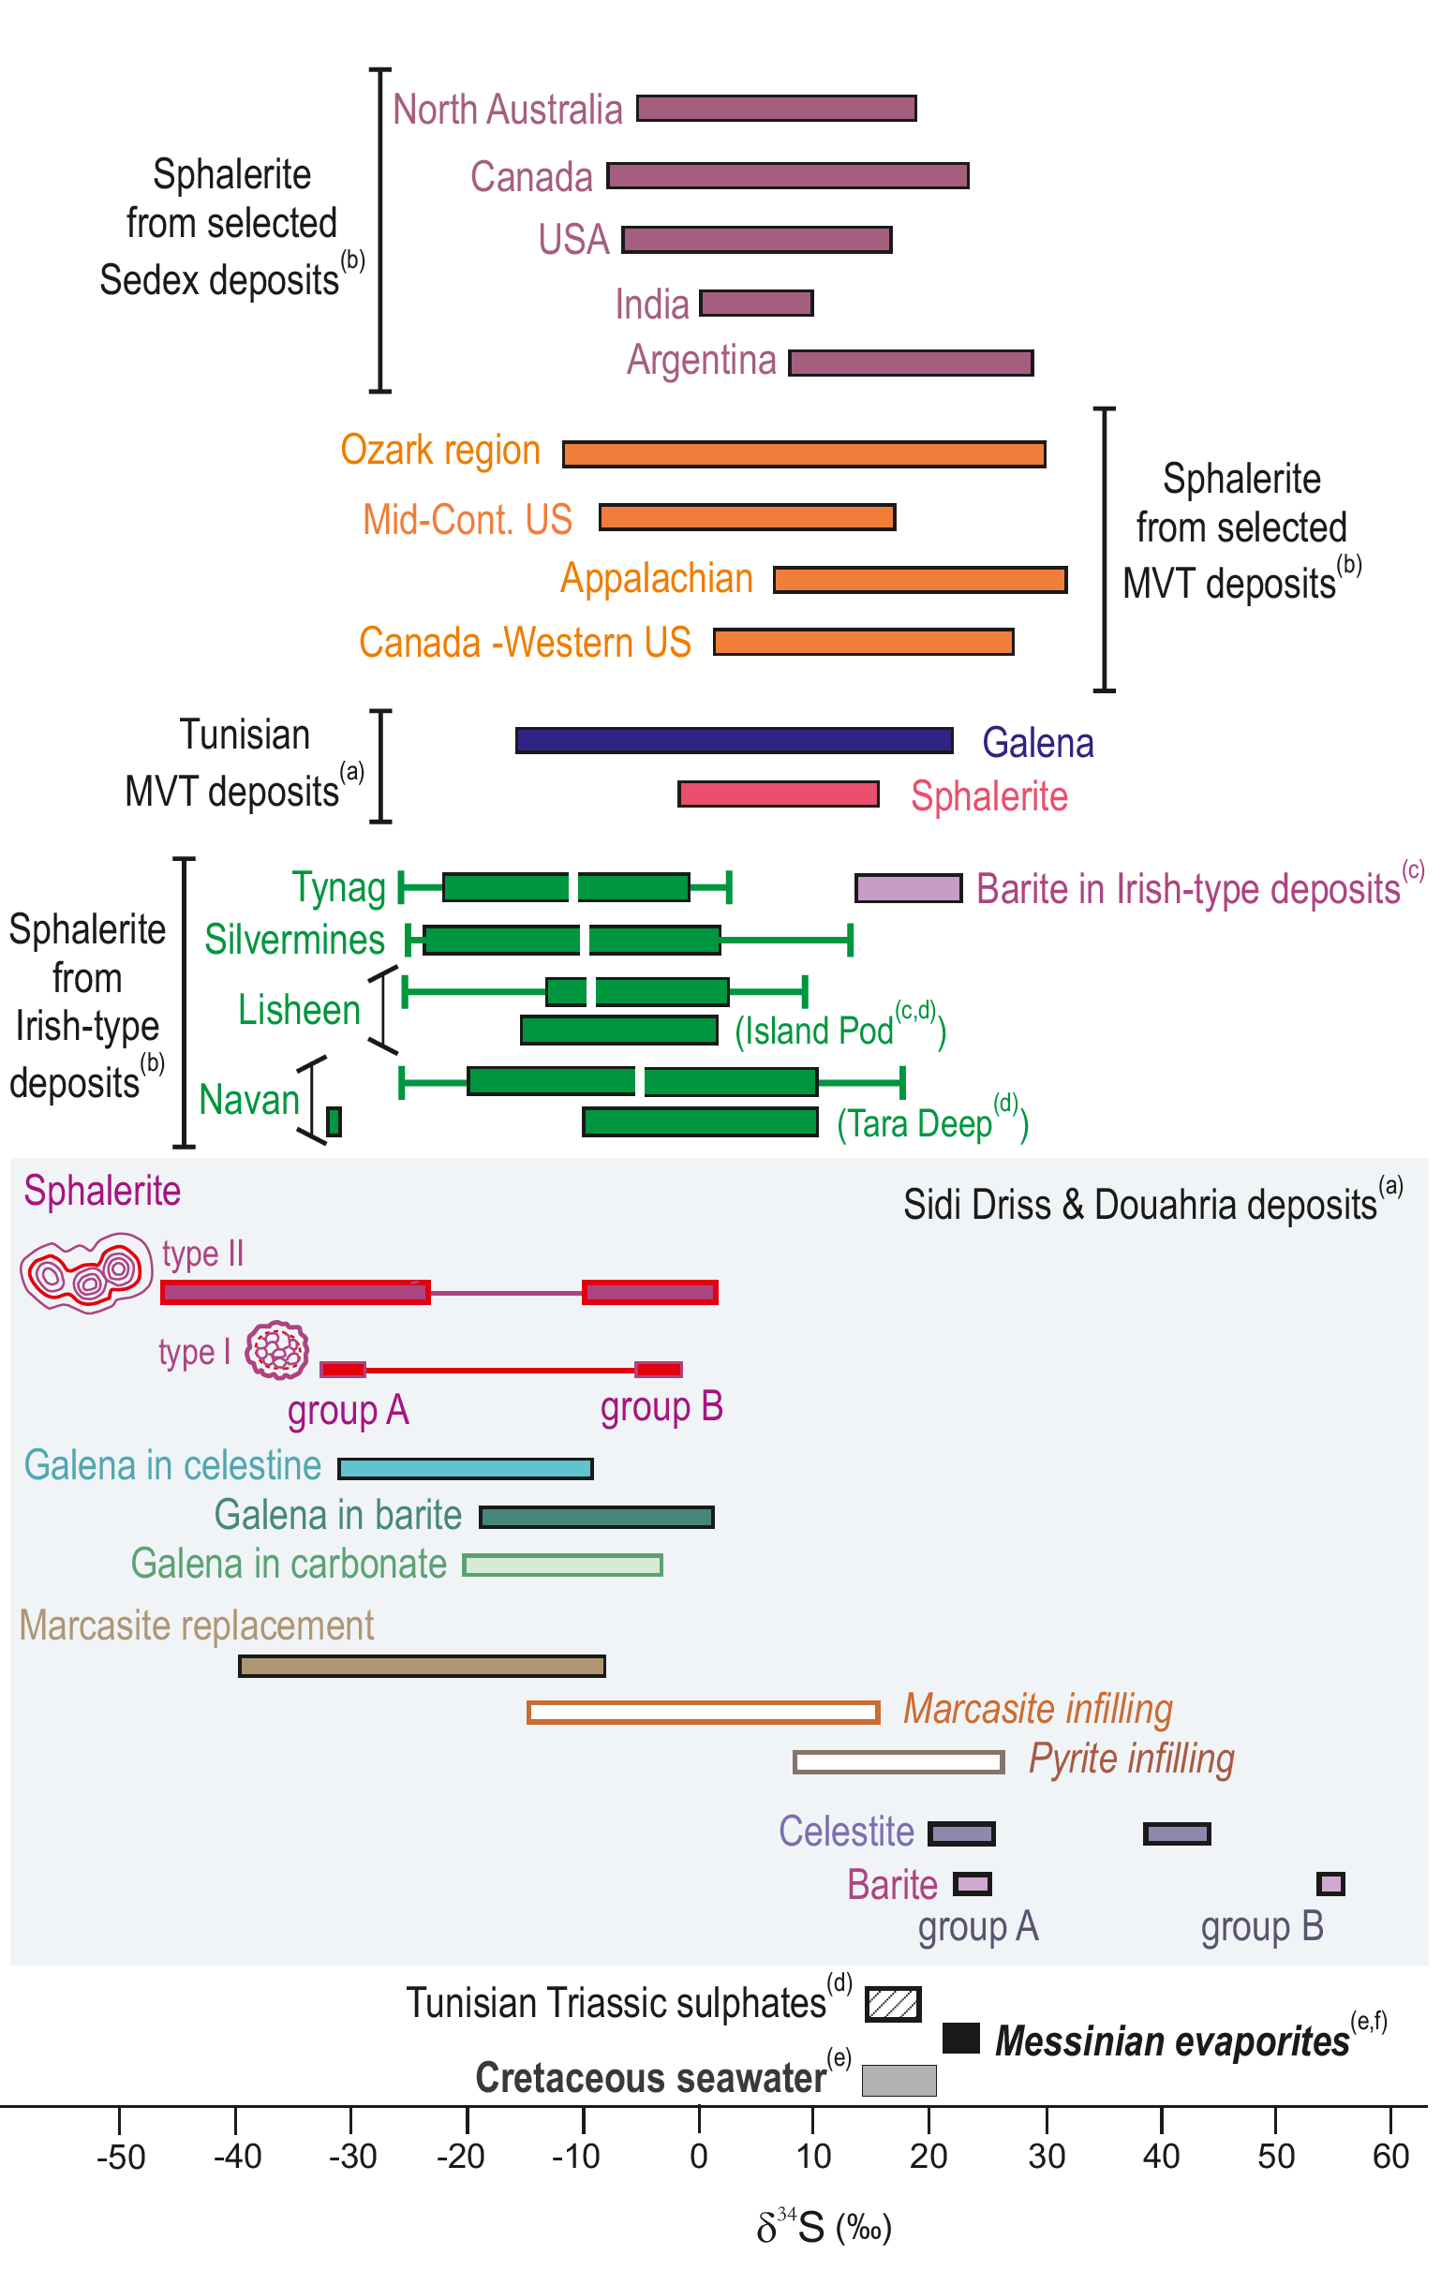
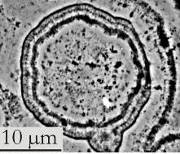
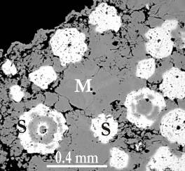
Sulphur isotope composition
sulphates forming the host rock: δ³⁴S ≈ Messinian evaporites
sphalerite:
  - Fractionnation related to BSR, likely cf. spherulitic texture
  - For the less negative values: BSR with limited sulfate input (closed system)
galena:
  - Signature inherited from sphalerite (replacement of the latter), and
  - TSR in situ, (considering T_{h}> 160°C on calcite)
Fe-sulphides:
  - Signature inherited from sphalerite and galena by replacement
  - Rayleigh fractionation in closed system
Late sulphates:
- Precipitated after light (³²S)-enriched Fe-sulphides
  Comparison with sphalerite from other deposit types:
  Closer to the Irish-type deposits
  Heavier composition for spahlerite from MVT and SedEx
∆³⁴S: -25 à -70‰
∆³⁴S: -30
to -55‰
Data are from: (a) Decrée et al. 2016 (and references therein), (b) Leach et al. (2005), and references therein), (c) Yesares et al. (2019), (d) Sheppard et al. (1996), (e) Claypool et al. (1980), (f) Paytan et al. (1998)
∆³⁴S: -60 à +5‰

Slide 16
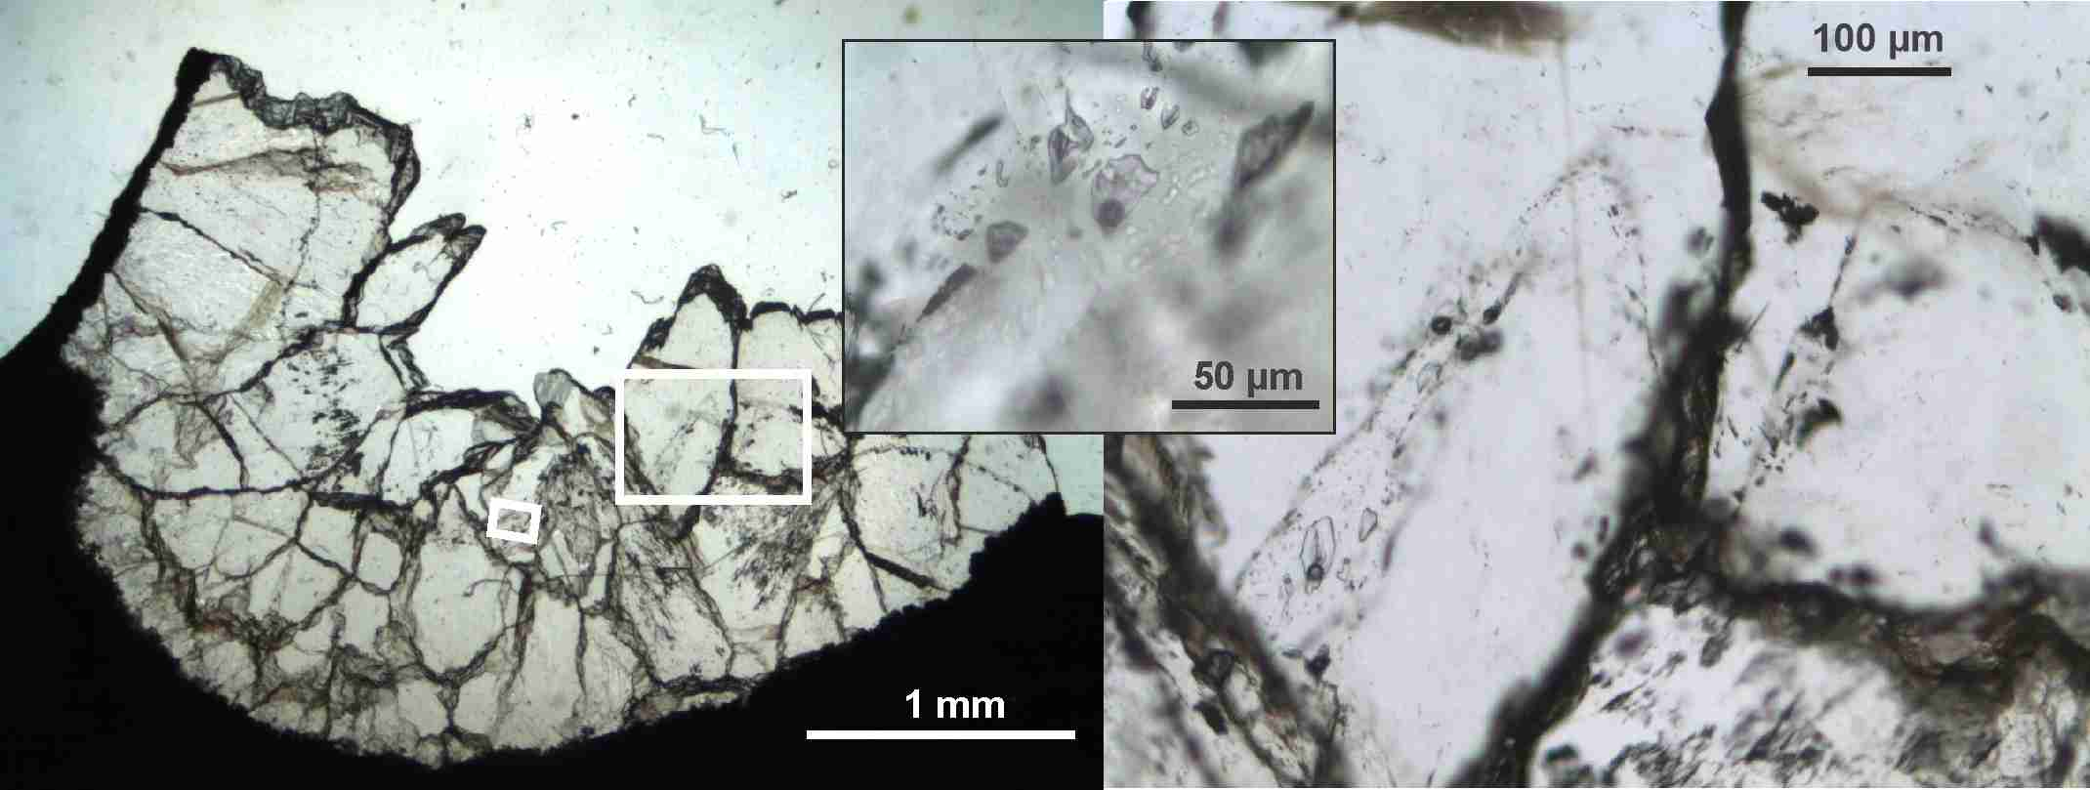
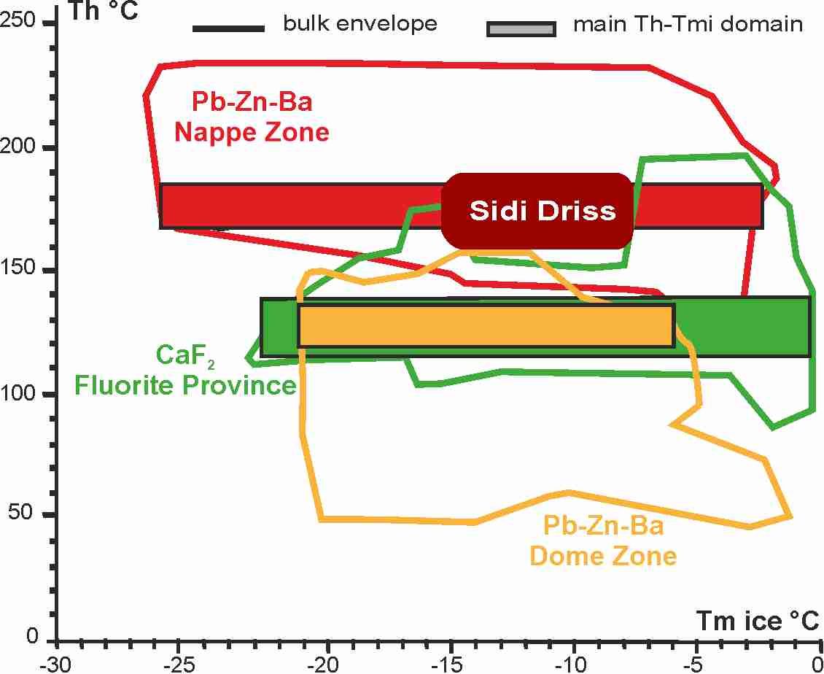
Lead isotope composition & Fluid inclusions
The Oued Belif breccia
FIs: 11.7-18.3 wt% NaCl → fluid mixing
T: 160-180°C
Decrée et al. 2016

Slide 17
Proposed model for the mineralization at Sidi Driss and Douahria
Main characteristics:
- Complex and multi-stage nature of the mineralization
- Early Mn-Fe enrichment of the host carbonates, sub-contemporaneous sulphur source, and soft-sediment texture of the ore → early/syn-diagenetic (Messinian) character
- Wide range of δ³⁴S values measured in sphalerite, galena and Fe-sulphides <
  alternating BSR fractionation (microspherulitic sphalerite of likely biogenic origin) and
  TSR fractionation
  Rayleigh fractionation
- Thermally driven fluid circulation likely linked to the Messinian mafic magmatism and/or to a concealed igneous sill at shallow depth

Slide 18
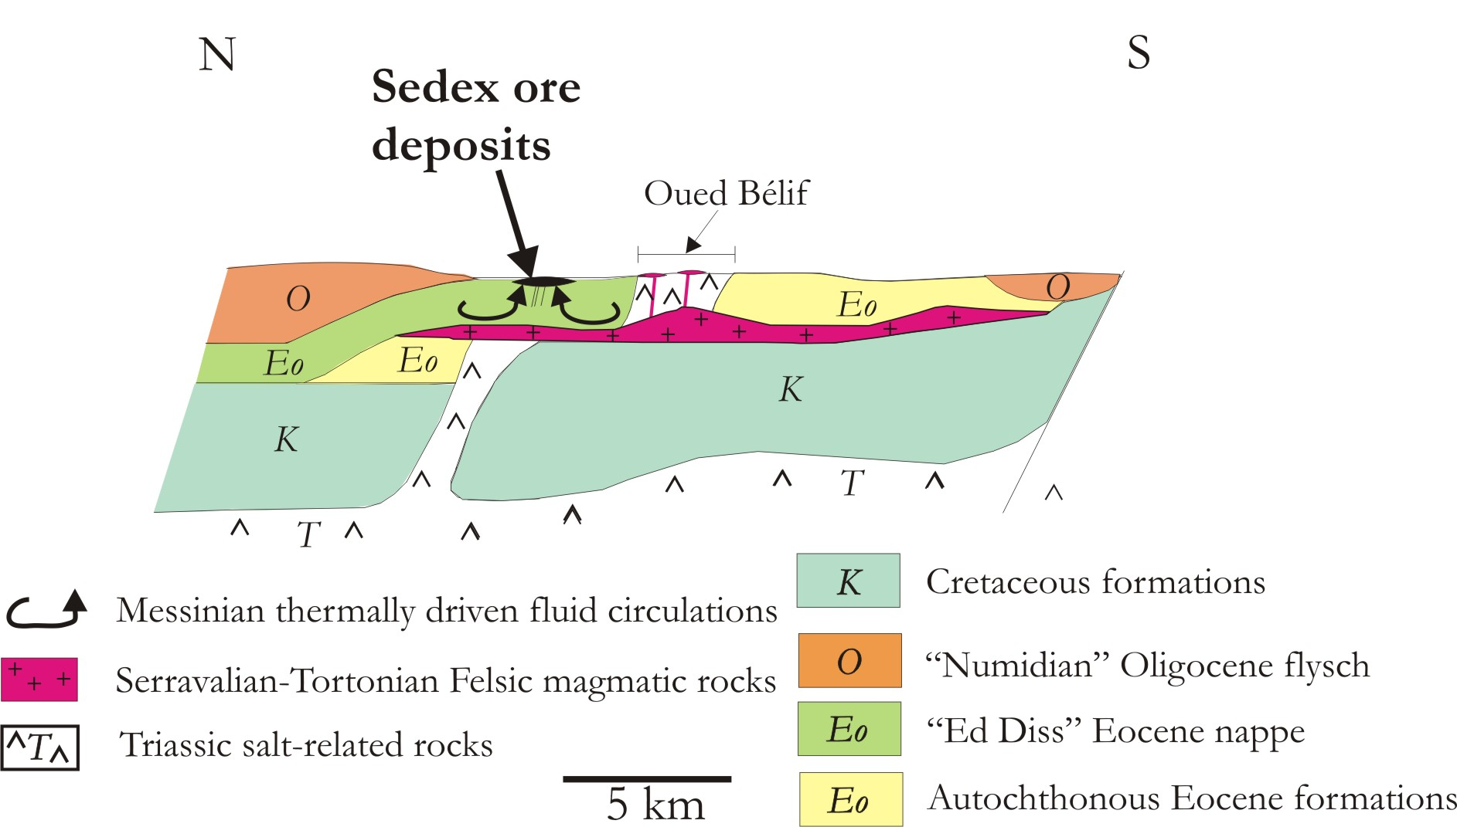
Fluid circulation pattern - Nefza Pb-Zn deposits
  → development of small-scale shallow low-temperature convection cells
- Main drains are structural discontinuities (thrust sheet boundaries, deformed diapirs and older felsic magmatic rock/sediment interfaces)
- Leaching of older felsic magmatic rocks + sediments → base metal enrichment

Slide 19
Former assignment to the SedEx-SHMS deposits & comparison with MVT deposits
Features that favour the assignment of the Nefza Pb-Zn deposits to the SHMS-SedEx type (but not exclusively) :
- the stratabound texture of their ore with ‘soft’-style sedimentary structures suggesting synsedimentary formation
- the involvement of hot fluids is inferred. They act early in the system: Fe–Mn enrichment of early diagenetic carbonates with a repartition area of this Fe-Mn aureole than the extent of base metal enrichment
Others are against:
- very low metal tonnage observed in the Tunisian deposits compared to the SedEx s.s. (limiting factor is the availability in base metals)
- chemistry of sphalerite regarding trace elements contents but also S isotopic composition
Comparison with MVT deposits:
- By and large, overlap of the trace element contents of sphalerite
- However, their S isotope composition differs significantly, with heavier δ³⁴S for sphalerite and galena from the MVT deposits

Slide 20
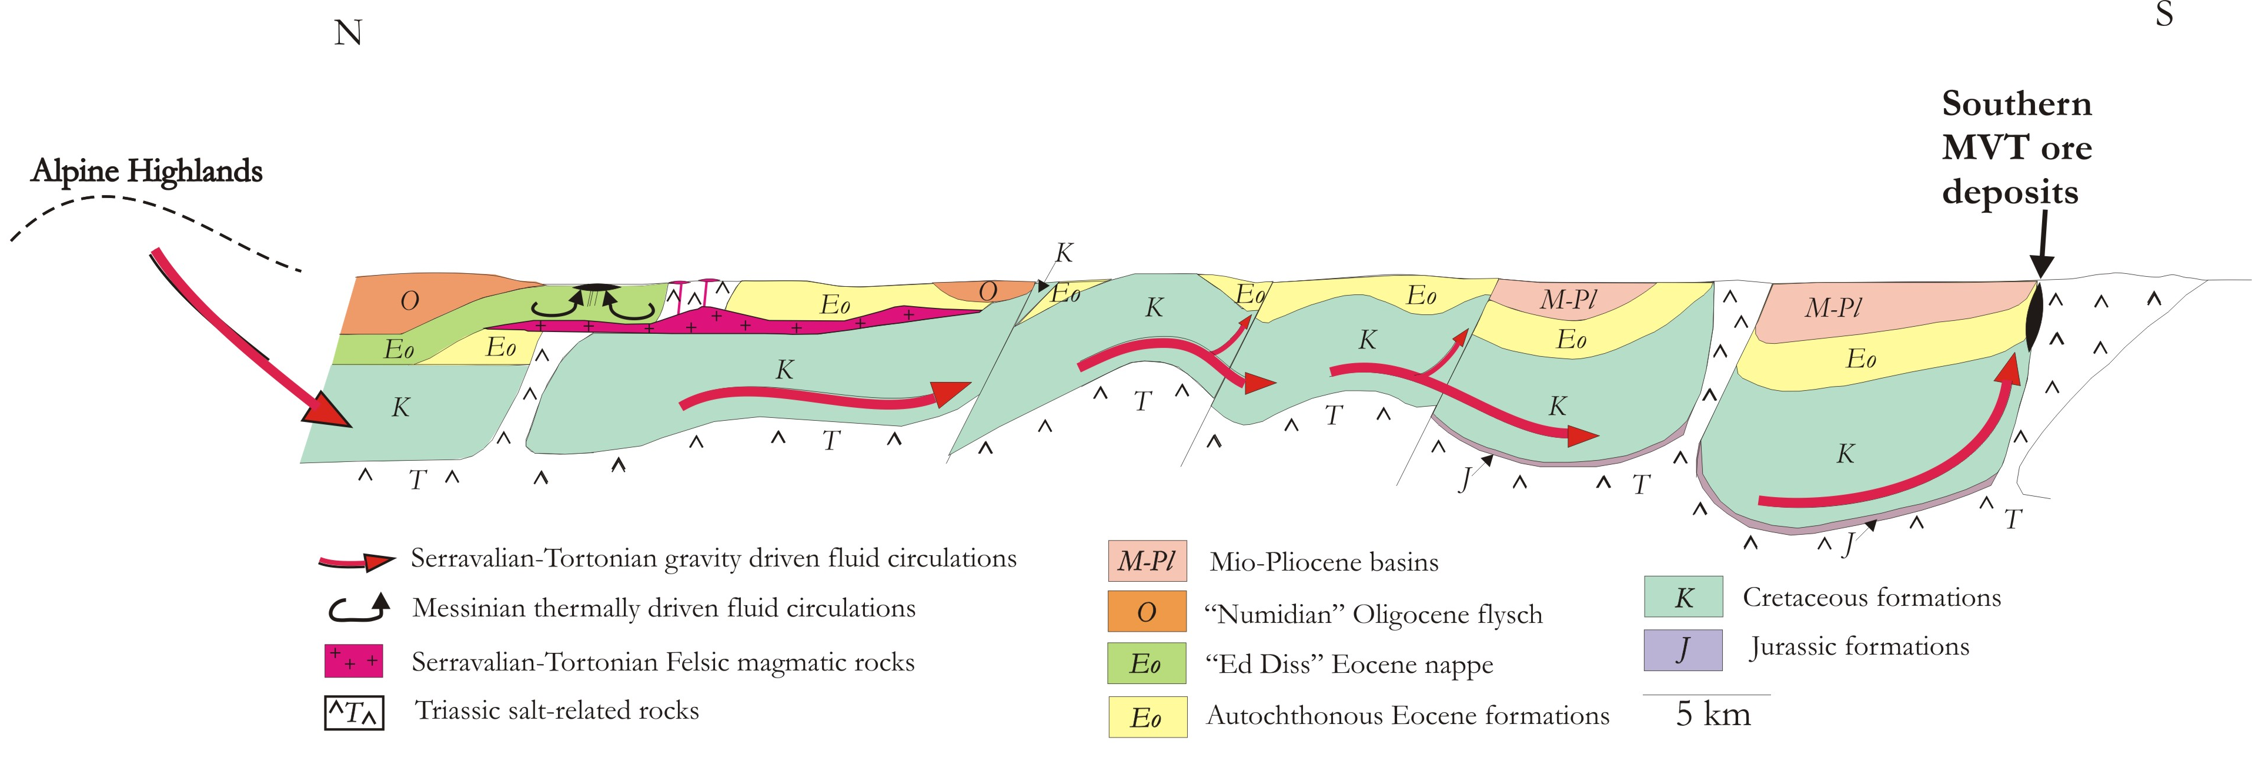
Fluid circulation pattern – Tunisian MVT deposits
- Proposed model (Kyle and Posey, 1991): gravity driven fluid circulations related to late Alpine convergence (Serravallian-Tortonian)
- Meteoric fluids infiltrated in the Alpine highlands → deep aquifers → thrusts and associated diapirs
- Greater opportunities to produce large metal deposits than the more local compaction-driven flow (overpressuring in the basin)

Slide 21
Sidi Driss and Douahria belonging to the Irish-type deposits
- Features that relate the Nefza Pb-Zn deposits to the SedEx type deposits and to the MVT deposits → hybrid class, as are the Pb-Zn deposits hosted in carbonates of the Irish orefield
- Sidi Driss and Douahria could be considered as pertaining to Irish-type deposits, as emphasized hereafter:
  All these deposits are mostly stratabound and result from the replacement of carbonate rocks
  Complex sulphide textures are observed in both deposit types; spherulitic and colloform texture of sphalerite is one of the most typical textures, with quite comparable chemistry of sphalerite
  Dominant BSR as dominant sulphate reduction process. A bimodal distribution of S isotopic composition in sulphides is reported and relates combined BSR (for the most negative δ³⁴S) and TSR (for the most positive δ³⁴S values) + effect of Rayleigh fractionation
  Alternating deposition of BSR and TSR-related sulphides is likely due to the mixing of shallow-basinal and deep-hot fluids // Two fluids evoked for the formation of the Irish-type deposits

Slide 22
Sidi Driss and Douahria belonging to the Irish-type deposits
- Sidi Driss and Douahria could be considered as pertaining to Irish-type deposits, as emphasized hereafter:
  In the Nefza district, the metal deposits are located along structures created or reactivated under transtensional regime // The Irish-type mineralization is likewise controlled by inherited normal faults in a transtentional context
  Heat generated by alkaline magmatism in extensional regime locally constitutes a driver for hydrothermal fluids for some of the Irish-type deposits // In the Nefza district, Messinian mafic magmatism would trigger/favour thermally driven fluid circulations
  Enrichment in Mn and Ba (most visible expression: Mn halo at the fringe of the orebody resulting from metal remobilization in the system) which is likely related to hydrothermal fluids

Slide 23
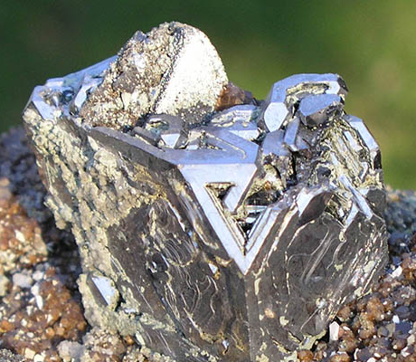
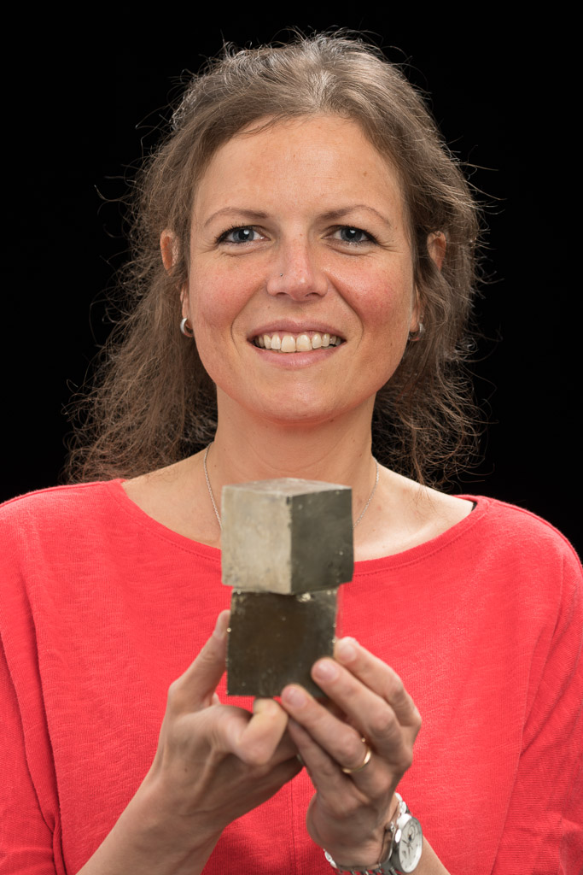
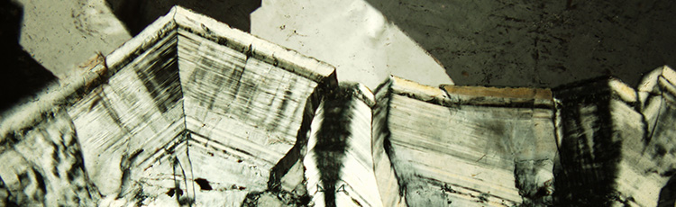
Picture of the Awardee/lecturer/…
Society for
Geology Applied
to Mineral Deposits
Est. 1965
SGA sponsored presentation
Sophie Decrée
(Geological Survey of Belgium)

Slide 24
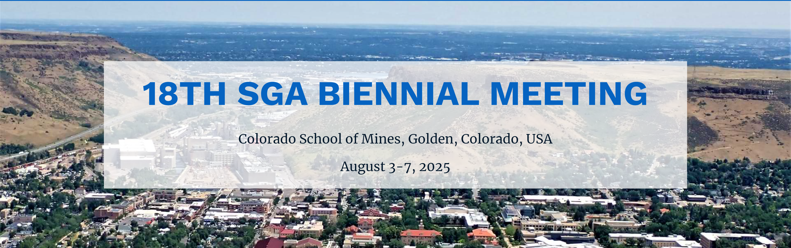

Mineralium Deposita; SGA News; SGA Special Publications
SGA Educational Fund supporting 20 Student Chapters, SGA Keynote speaker program and travel grants
SGA Mobility Grant, sponsored meetings/courses, …
Medals, Awards, Prizes and much more
Society for Geology Applied to Mineral Deposits
See www.e-sga.org
Est. 1965
~1200 members (2020) from academia, government and industry
>50 countries represented
SGA Special Publications
Highest impact factor journal in ore geology
4.767 (2021) – 5-years IF

Slide 25
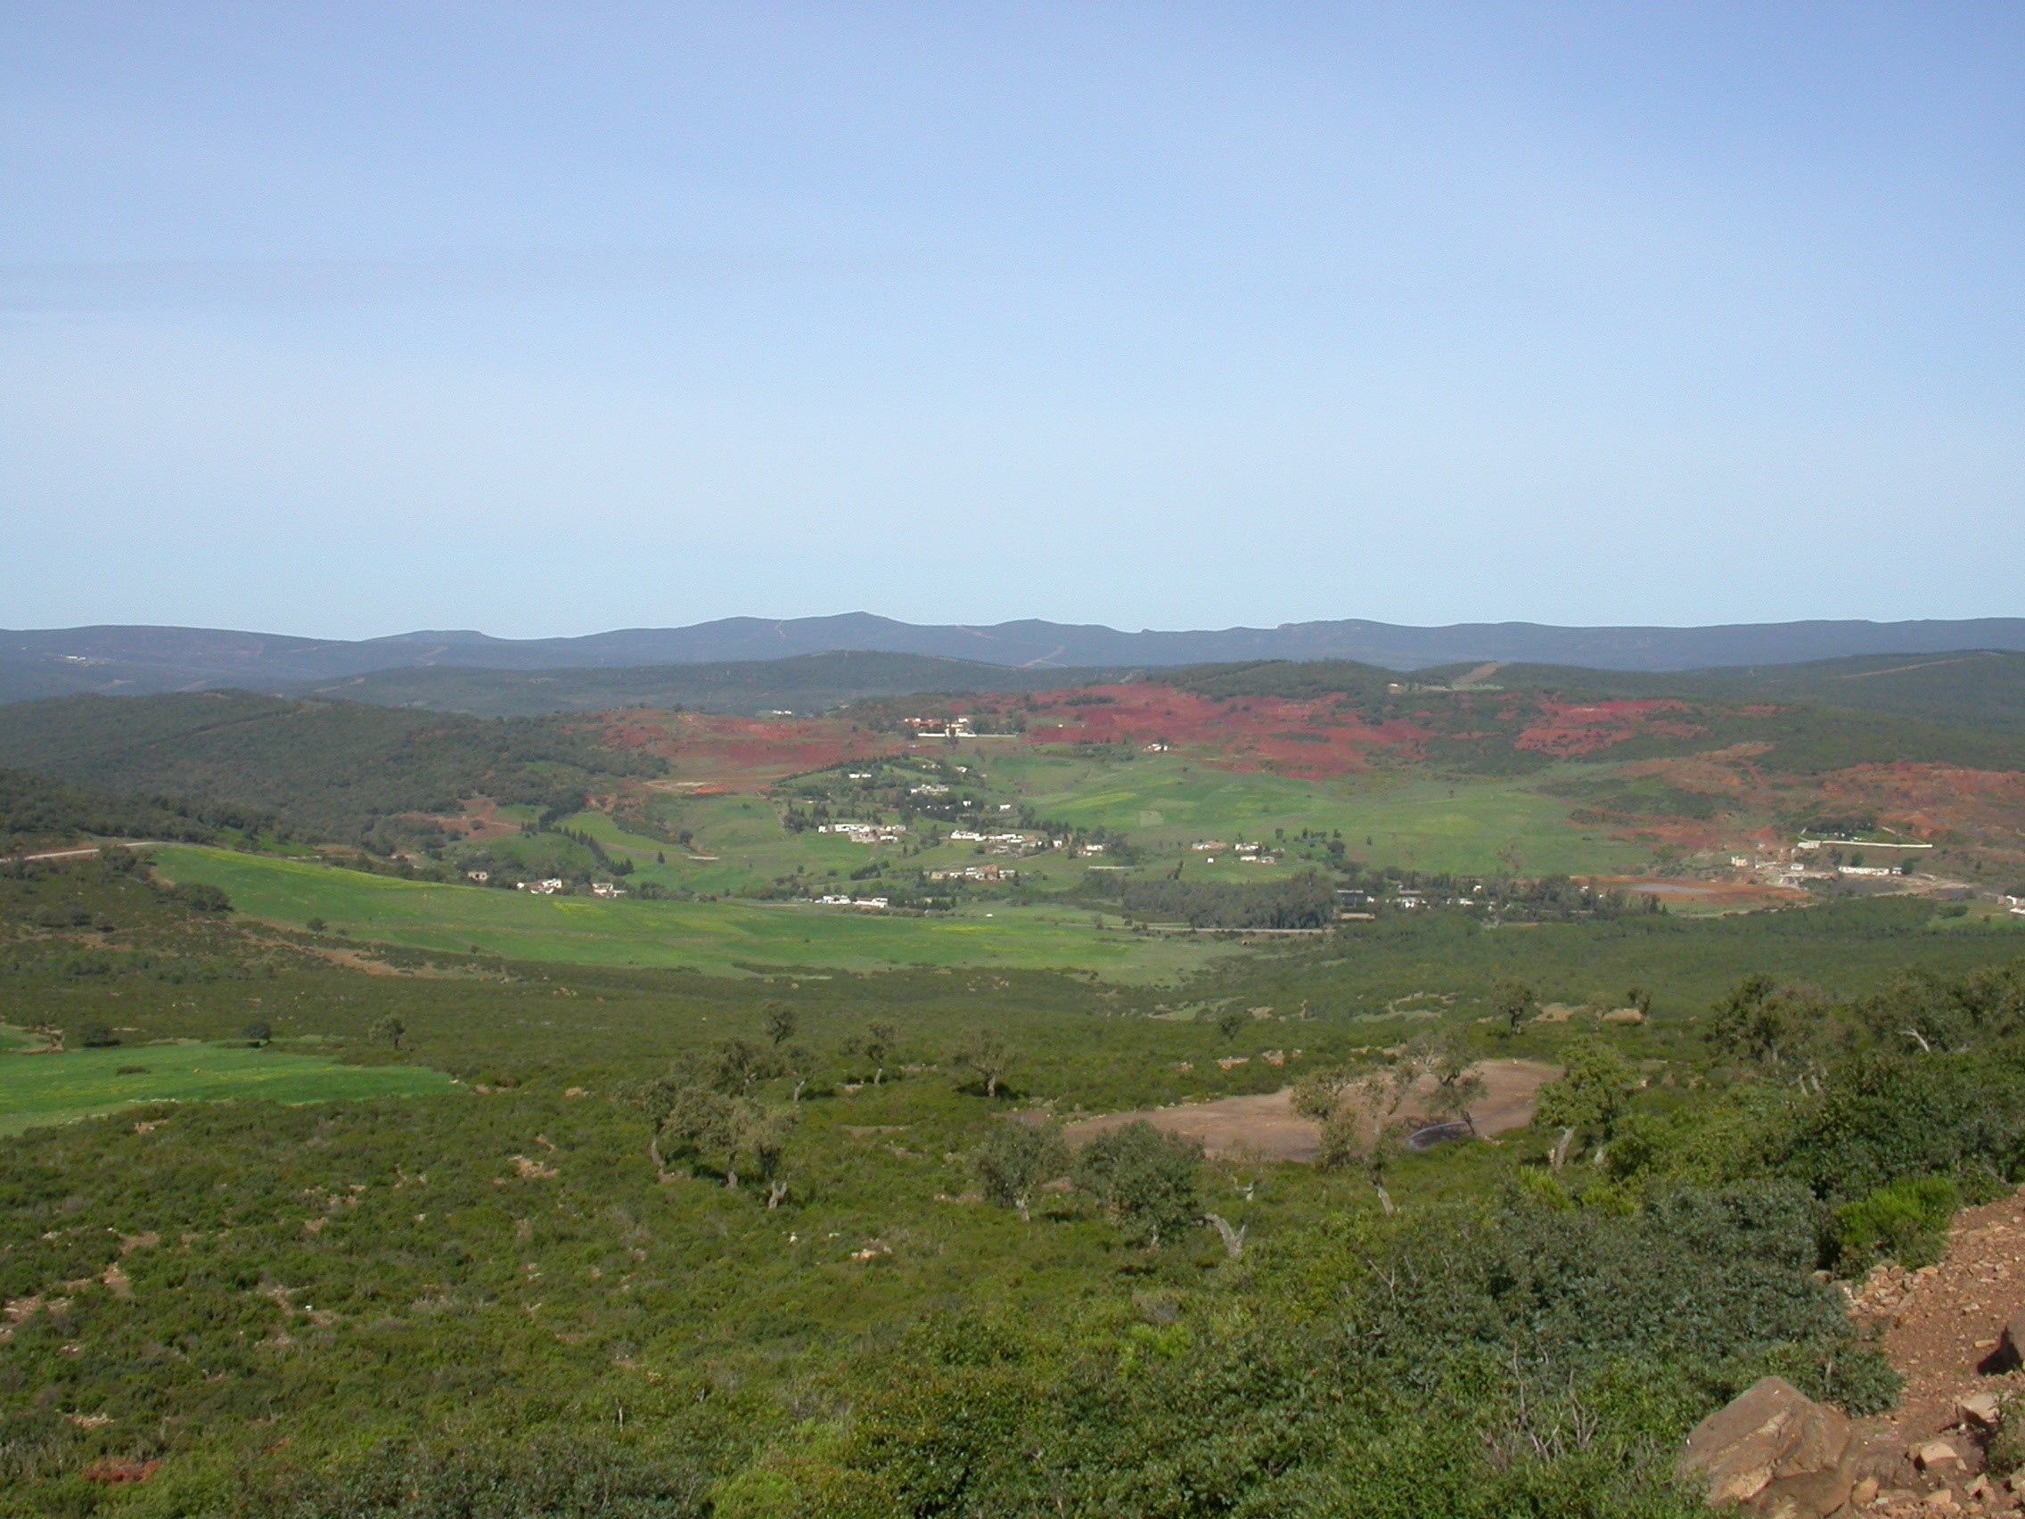
Thank you!

