Slide 1

Taking account of sulfur isotope geochemistry in the genesis of Irish-type base-metal deposits
Adrian Boyce, Tony Fallick
and
Gary Mullen
Drew Drummond and Aileen Doran*
Scottish Universities Environmental Research Centre (SUERC), East Kilbride, Glasgow, Scotland, UK
Mogul – Magcobar - Boliden Tara mines -Outokumou Oy – Vedanta – Lundin - Imperial/NHM – iCRAG*
Notes:
Many hundreds since the 1970’s
Explore the patterns of S isotopes in the major deposits, and what these tell us of the genesis of the Irish-type deposits
2 cautions: 1. S isotopes tell us about sulfur; 2. No isotope analyses should be carried out without a full understanding of the geological and mineralogical context. As Max Coleman used to say – stable isotopes is the last thing you need!

Slide 2
Basics…….
The unit – δ³⁴S – a comparison of the ratio of ³⁴S/³²S in your sample to the ratio in an international standard (a meteorite sulfide)
Fractionation – any process which alters the relative abundance of the ³⁴S/³²S ratio – equilibrium (hydrothermal precipitation) or kinetic (microbial reduction of sulfate to sulfide).
By far the biggest fractionations occur between sulfates and sulfide.
Numbers – Measured in ‰ – per mil(le). If there is more ³²S in your sample compared to the standard numbers will be negative; and vice versa.
We commonly speak of “lighter”/”lower”/”negative” and “heavier”/”higher”/”positive” when we mean enriched in ³²S or ³⁴S, respectively, versus the standard.
Notes:
Equilibrium of kinetic

Slide 3
Sulfur Origins……dual source
Coomer and Robinson (1976) Mineralium Deposita a truly seminal paper sulfur isotope study of the Silvermines Zn+Pb+barite deposit.
Seawater
Hydrothermal
Direct precipitation for sulfates
Microbial reduction of sulfate for sulfides
Brought into the deposit with the hot primary ore fluid
Notes:
Over time the vast majority of researchers – whether they believe in SEDEX, MVT or hybrid origins accept this broad interpretation of S isotopes revealing a Dual Source of S for the Irish ore deposits.
Indeed, it is now regarded as a type characteristic of the Irish-type deposits.

Slide 4
Seawater δ³⁴S
0
1
00
2
0
0
3
00
Seawater sulfate δ³⁴S today is +21.1‰ – universally
Systematic variation over the Eons (evaporites; barite; CAS)
Secular seawater sulfate curve
AGE (my)
4
00
500
6
00
7
00
8
00
Seawater sulfate δ³⁴S
versus Lower Carboniferous time
5
10
15
20
25
30
35
Lower Carboniferous seawater sulfate δ³⁴S
Varies dominantly between 12 and 24‰
Averages 15-20‰
There’s more data from Irish barite in L Carbs!
δ³⁴S
Myrs
Notes:
Compilation of Crockford et al (2019) Chemical Geology

Slide 5
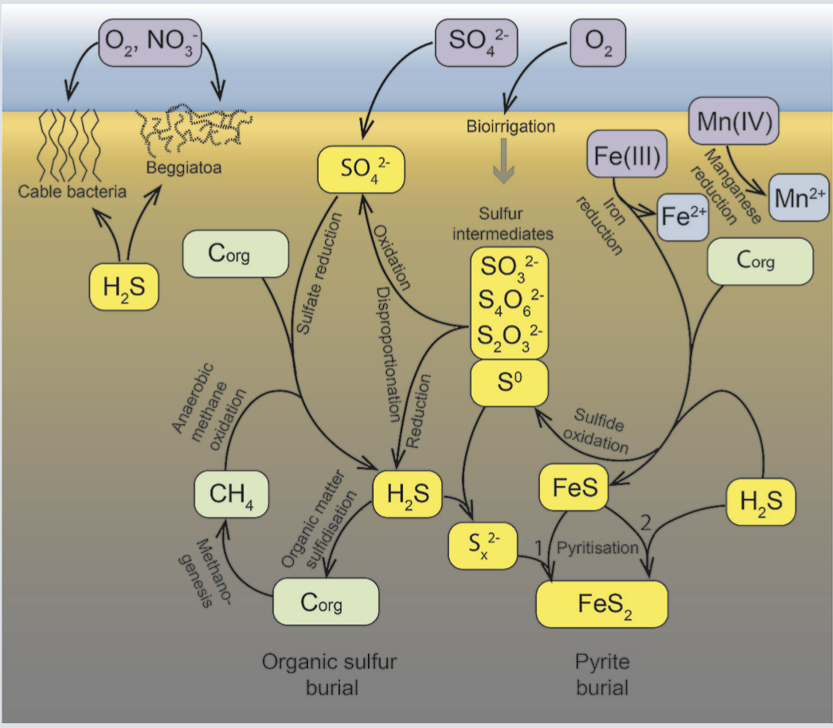
Microbial sulfate reduction
SO₄ + 2CH₂O ➝ H₂S + 2HCO₃
Sulfate reduced – organic matter oxidised
Producing H₂S is metabolic function
Ubiquitous in all marine sediments
Anaerobic
Regulates organic matter flux
A critical part of the S (and C) cycles
Notes:
Dissimilatory sulfate reduction is a respiratory process used by some bacteria and archaea to generate energy under anaerobic conditions.
Aqueous sulfate serves as the terminal electron acceptor in this process, leading to the oxidation of organic carbon compounds and sometimes hydrogen and to the production of aqueous sulfide.
Carboniferous eawater sulfate concentration considered to be approximatelyin the range of modern values – 28mMol or 2600ppm.

Slide 6
Isotopic fractionation and microbial sulfate reduction
Sulfate ³²S is consumed preferentially, resulting in sulfide enriched in ³²S – thus isotopically lighter (more negative) than sulfate.
Large effects are produced in natural systems – Δ³⁴_{SO4-H2S} often >30‰ (>> than typical non-microbial sulfate reduction)
Fractionation is inversely proportional to the microbial sulfate reduction rate – the slower the rate, the greater the fractionation
Slow rates are the norm – and thus Δ³⁴_{SO4-H2S} approaches equilibrium (~70‰) for most modern margin sediments
Pyrite is typically less than that extent by ~10 to 20‰ (-40 to -30‰ v -50‰ from seawater at ~+20‰)
Δ³⁴_{SO4-H2S}
60+
20
Slow
Fast
Sulf Red Rate
Notes:
The reduction rate depends on a suite of physiological controls – metabolic enzymes – which respond to their environment.
Distributions are characteristically broad as these are living systems, responding to their environment. Temperature; nutrient supply; etc can all impact the level of fractionation.
Different types can have different fractionation norms; and the same type can vary depending on environmental conditions.
And, of course, these microbes do not work in isolation – they are part of complex microbial communities.

Slide 7
So, what does a dual source look like?
Notes:
Tripartite distriobuition
All sulfate – in barite has a very homogeneouis signature arpund 18‰
Stratiform sulfides typically average -18‰
Epigenetic sulfides – in veins from ORS at Shallee, through to Pb and sulfosalt rich NW-trending feeders – proximal ores of Taylor and Andrew – have values averaging -1‰

Slide 8
Microbial – all the same?
Island Pod
Seawater sulfate – averaging 17.7‰
Tripartite sulfide distribution
“Early” pyrite – not mineralization event
Ore sulfide main peak
Hydrothermal sulfide
Main zone, Derryville and Bog zones
After Aileen Doran – Doran et al (2021) Econ Geol

Slide 9
Distribution of S isotopes in producing Irish-type deposits
Tara Deep
-8
26
Navan (Main)
-13
21
Galmoy
-13
18
Typical Ore
Lisheen
-11
18
Δ³⁴S_{SO4-H2S} = 29-37‰
Tynagh
-18
19
Typical Pyrite
Δ³⁴S_{SO4-H2S} = 50-60‰
Silvermines
-18
18
-40
-30
-20
-10
0
10
20
δ³⁴S (‰)
Notes:
Notes
Navan main orebody is pyrite poor
Pyrite enrichment is abundant above erosion surface in CGO and TBU – only 3% of the deposit ore.
Contrsast to Silvermines, Tynagh and Rathdowney deposits – pyrite is abundant. Indeed entire rooms of pyrite faces are common in Silvermines, for example.
This relative pyrite abundance is reflected in the mineralogy of the analysed phases – with pyrite being MUCH more commonly analysed in Waulsortian deposits, compared to Pale Beds deposits, other than the supra-erosion surface ores.

Slide 10
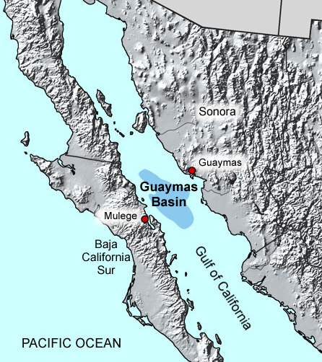
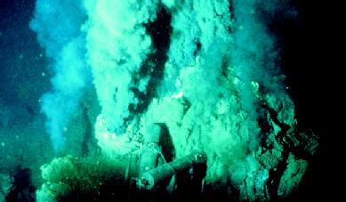
Hydrothermal stimulation of rate of microbial reduction
Sulfate reduction rates for microbes vary, but typically produce H₂S
~20 nmol cm⁻³ d⁻¹
At these low rates, 70‰ fractionations are now considered standard (e.g. Alfonso Basin).
⭐︎
By contrast, environments with hydrothermal activity, such as Guaymas Basin, often show the highest production rates of H₂S
3350 nmol cm⁻³ d⁻¹ at vent site
Non-hydrothermal sediments just outside the vent field
<12 nmol cm⁻³ d⁻¹ at vent site
Notes:
The reduction rate depends on a suite of physiological controls – metabolic enzymes – which respond to their environment.
production of a variety of different metabolic substrates support a high microbial diversity and activity in the seafloor.
This subsurface processing system produces a maze of subsurface flow pathways that ultimately reach the sediment surface, where they are evident in hydrothermal edifices of different developmental stages, hydrothermal mineral deposits, venting orifices emitting hot hydrothermal fluids, and hydrothermally active sediments.
There are two main sources of organic carbon for sulfate reduction in hydrothermal lsediments: the hydrothermal circulation,which brings up oil constituents, methane and low molecular weight organic compounds from deep and hot sediment layers, and the new biomass of free-living and symbiotic bacteria that live from the oxidation of these compounds and of which some have a chemoautotrophic metabolism. As shown by the adjacent non-hydrothermal sediment (Fig.5),the in-flux of phytoplankton derived organic matter supports only low SRRs.
Substrates for sulfate reduction here were apparently coming up from deeper sediment strata, produced by thermo-catalytic degradation of organic matter.
Sediment slurries incubated between 01C and 1201C displayed little activity in the mesophilic range below 40*C but high activity in two thermophilic ranges at 40–70*C and 70–100*C
The upper temperature limit for sulfate reduction found in the present study,100*C,

Slide 11
Bulk S Studies - Each sample represents up to
ONE MILLION TONNES of ORE
10
All Concentrates
Frequency
5
Bulk S Studies 5 LENS - representing large % of ore at Navan
0
-30
-25
-20
-15
-10
-5
0
5
10
15
20
25
30
Zn Concentrate
>90% of sulphide is from MICROBIAL source!
15
Sphalerite
Frequency
10
5
0
-30
-25
-20
-15
-10
-5
0
5
10
15
20
25
30
Frequency distribution of minor hydrothermal S source skewed by ease of sampling, and vice versa.
Pb Concentrate
15
Galena
10
Frequency
5
0
-30
-25
-20
-15
-10
-5
0
5
10
15
20
25
30
δ³⁴S
Fallick et al Economic Geology

Slide 12
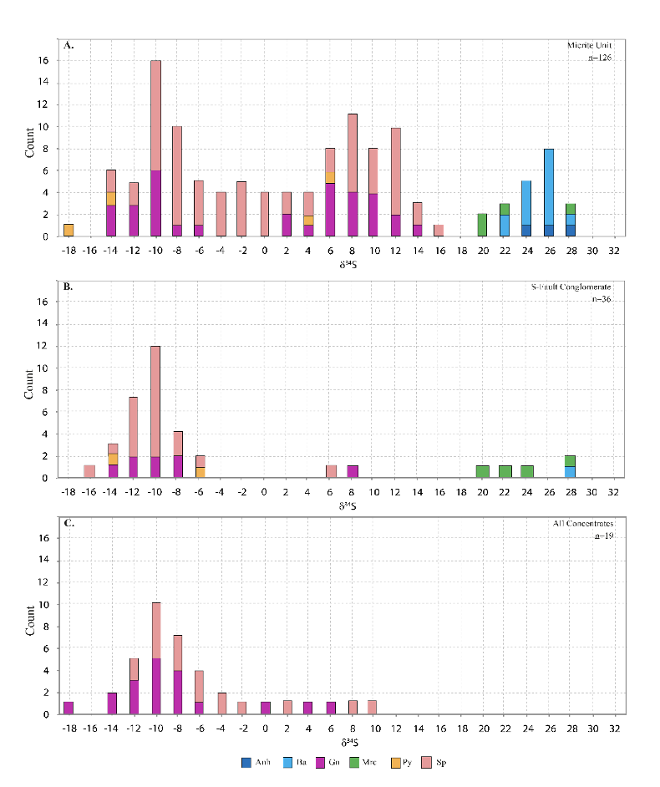
Tara Deep
Echoes the main mine in terms of concentrates too
Offset ~+5‰ in barite and main ore sulfide
Hydrothermal – the same
Not a chip of the old block fallen from an unstable terrace
See Drew Drummond paper for more details
Notes:
The 5‰ offset tells us that the microbiological – hydrothermla interaction behaves just the same as at the Main Mine – but is operating with a distinct sulfate isotope composition – of which, of course, the microbiology could care less: they just do their same thing.

Slide 13
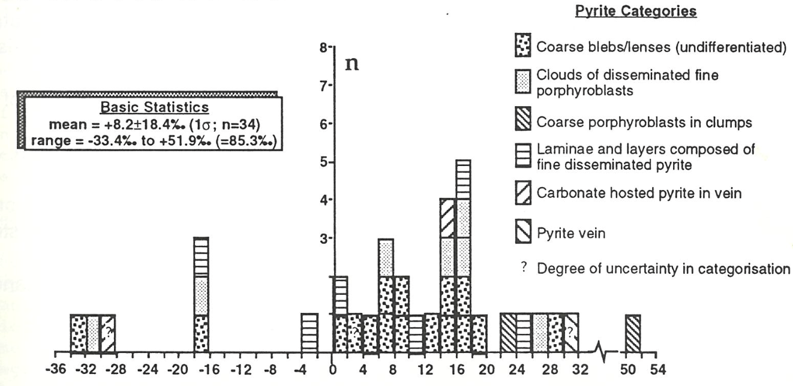
Hydrothermal
Source
Concensus of metals leached from underlying Lower Palaeozoic rocks
Navan underlying Lower Palaeozoic pyrites multigenerational
Range of δ³⁴S from -33.4 to +51.0‰
Mean = +8.2 ± 18.4‰
80% of data between 0 and +30‰, with mode of 16‰, coincident with mode in hydrothermal ore
δ³⁴S
Notes:
Mid Silurian to late Ordovician

Slide 14
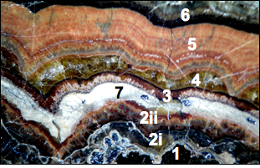
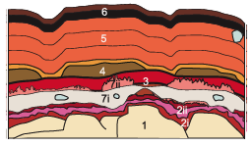
Galmoy Sphalerite Colloform
Dynamic interplay
0.5cm
Notes:
Talk about the case study. Main points:
The samples looked at are all from the Galmoy Zn-Pb Mine, Ireland
They are all sphalerite colloform textures although and accompanying study looked at the same textures in pyrite
Although these textures look relatively simple they are not they can be complex as hell and growth is not always as intuitive as you might think. Even determining younging direction can be fraught with problems!
If you want to understand sphalerite formation and what controls growth changes then you need to carefully study these textures. How can you talk about the bug picture if you don’t even understand the history of the small one?

Slide 15
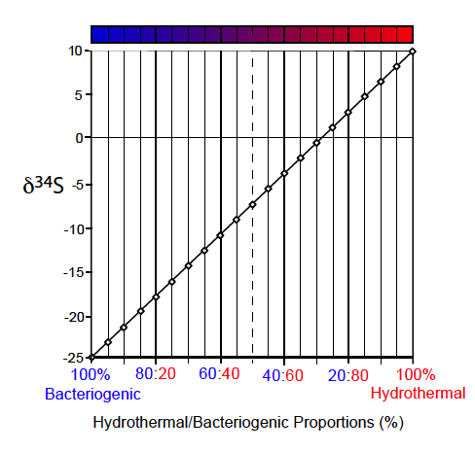
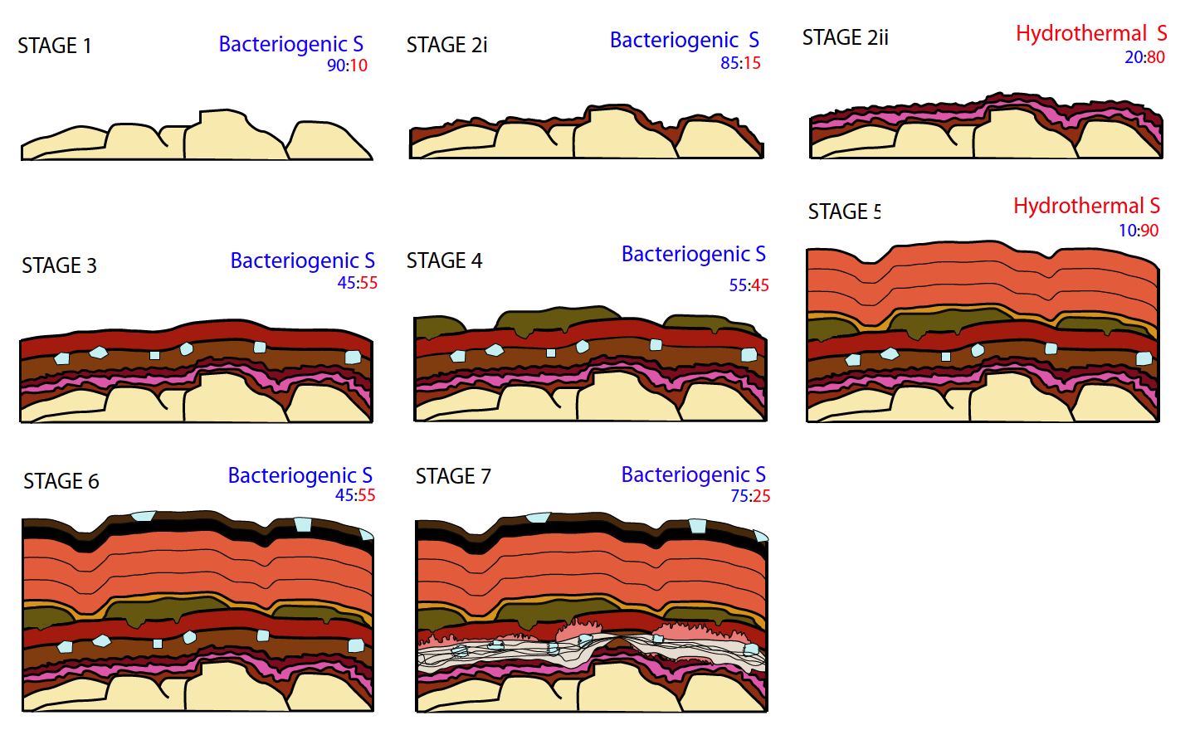
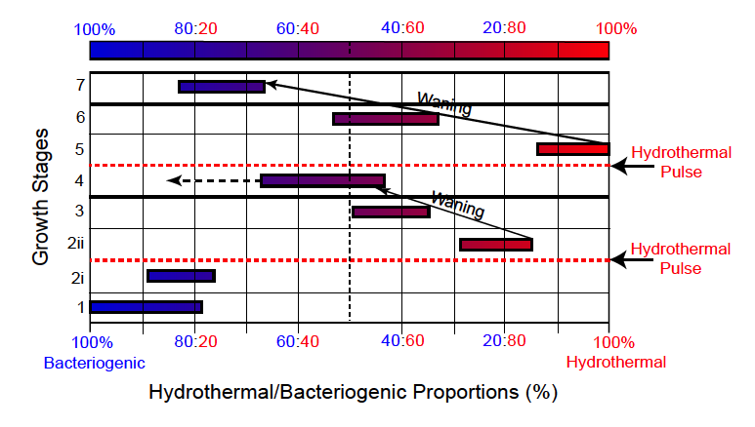
Galmoy Colloform
Growth History
Barrie et al 2009 J. Geol Soc 2009

Slide 16
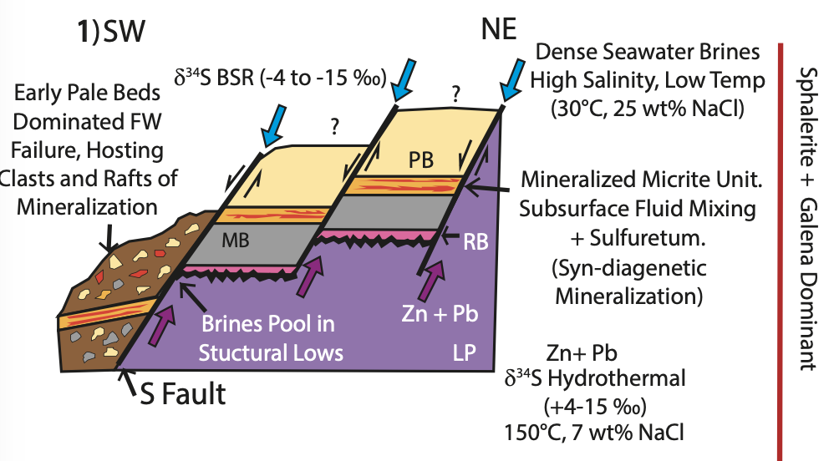
Hot hydrothermal fluid emerging from the basement into tectonically active sedimentary package.
It likely breaks down organics in the sediments, bringing nutrients and energy
The microbial systems feed off this to produce prodigious amounts of sulfide at rapid rates, delivering a reduced fractionation
Dominates the S isotopic signatures of the producers.
Dynamic interaction produces the complex textures – unravelled by terrific students like Kerr, Craig, Drew, Rob, Aileen
Why wouldn’t such an energetic fluid make an impact onto the seafloor?
Tara Deep model from Drummond et al in the IAEG volume.
Notes:
We know the mineralizing system was near the seafloor
the S data isotope speak of direct communication, with no limitation on the sulfate concentration – the system is open to the sulfate reservoir – the sea
This subsurface processing system produces a maze of subsurface flow pathways that ultimately reach the sediment surface, where they are evident in hydrothermal edifices of different developmental stages, hydrothermal mineral deposits, venting orifices emitting hot hydrothermal fluids, and hydrothermally active sediments.
Of course they will reach the surface and seep out – and fortunately for us, their passage has led to the development of an abundance of microbial activity at the interface between these extraordinary discharging fluids and the seawater which brings the source of sulfate for the sulfide which forms the bulk of these deposits.
The hydrothermal mats, mounds, and chimneys of the southern Guaymas Basin are the surface expression of complex subsurface hydrothermal circulation patterns. This subsurface processing system produces a maze of subsurface flow pathways that ultimately reach the sediment surface………
We have a fluid emerging towards this surface through a sedimentary package above the basement. It’s hot – 250°C – metal-laden – it likely interacts and breaks down organics en route (like Guaymas). It interacts with the surface sediments –bringing abundant nutrients, and likely stimulating a rich microbial environment. The micfrobial systems fed off the hydrothermal energy and nutrient input to produce prodigious amounts of sulfide at rapid rates, delivering a reduced This is the environment which produced the complexity of texture which students like the young Kerr Anderson and Aileen Doran so eloquently describe. Why wouldn’t such an energetic fluid make an impact on the seafloor?
This subsurface processing system produces a maze of subsurface flow pathways that ultimately reach the sediment surface, where they are evident in hydrothermal edifices of different developmental stages, hydrothermal mineral deposits, venting orifices emitting hot hydrothermal fluids, and hydrothermally active sediments.

Slide 18
15
5
Sphalerite
-5
Without exception – sulfides
within 3m of hanging wall of all faults have high δ³⁴S – and textures to match
-15
δ³⁴S
-15
-10
-5
0
5
10
15
Outwith this distance, bacteriogenic sulfide dominates
15
Galena
Texture and δ³⁴S define feeder faults and indicate early moving structures are important.
5
-5
-15
-15
-10
-5
0
5
10
15
Distance from fault in metres

Slide 19
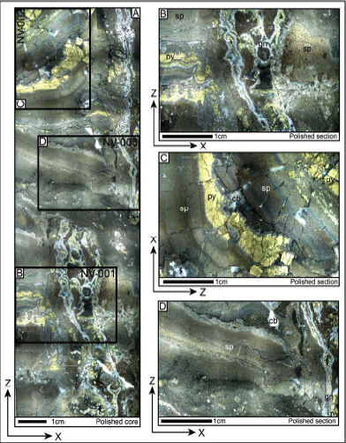

Slide 20
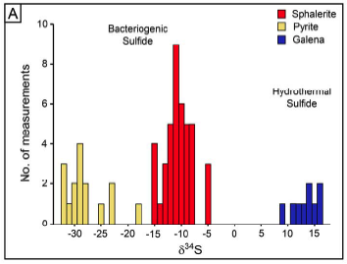
S ISOTOPES TOTALLY DISCONNECTED!

