Slide 1

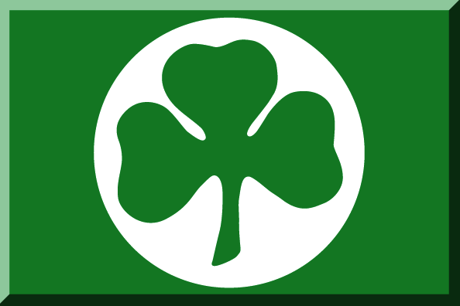



50 YEARS IRISH-TYPE Zn-Pb DEPOSITS
8-10° September
Base metals sulphides and barite (Irish type?) in the Paleozoic of SW Sardinia (Italy): facts and (a lot of) open questions
Maria Boni
&
Santoro L., Putzolu F., Mondillo N.
Dipartimento Scienze della Terra, dell’Ambiente e delle Risorse, DISTAR Università di Napoli, Federico II, Italy

Slide 2
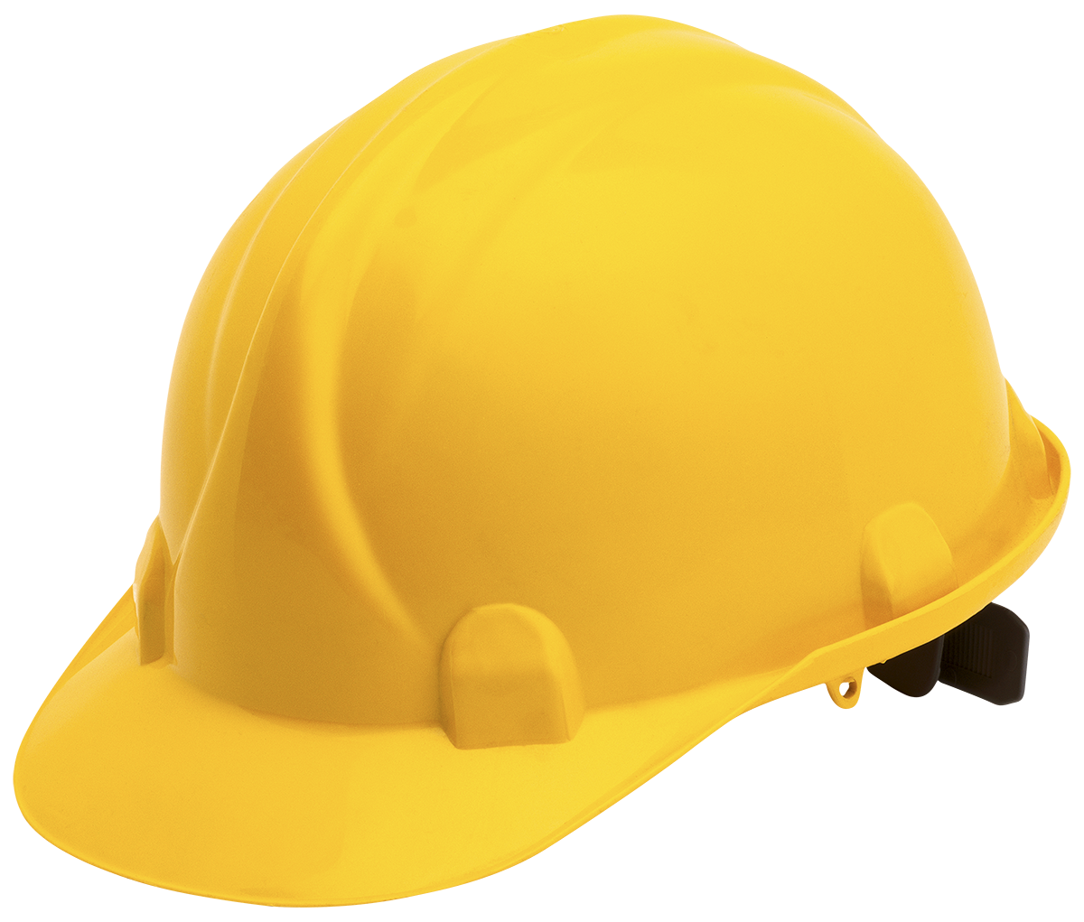
Irish deposits consist of limestone- and dolomite-hosted stratabound sphalerite-galena-pyrite and barite orebodies, formed primarily by carbonate replacement during multiple diagenetic stages
They are concentrated near normal faults, often associated with several steps of extensional tectonics during the development of sedimentary basins
Irish deposits s.s. are regarded as hybrids between MVT and SedEx styles of mineralization
Can Sardinian ores be considered as “Irish-type” deposits??
50 YEARS IRISH-TYPE Zn-Pb DEPOSITS
8-10° September

Slide 3
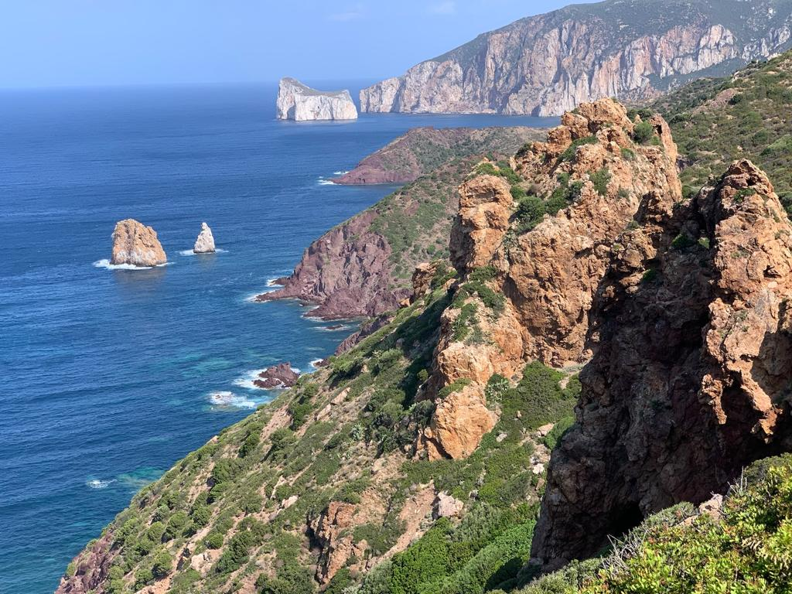
50 YEARS IRISH-TYPE Zn-Pb DEPOSITS
8-10° September

Slide 4
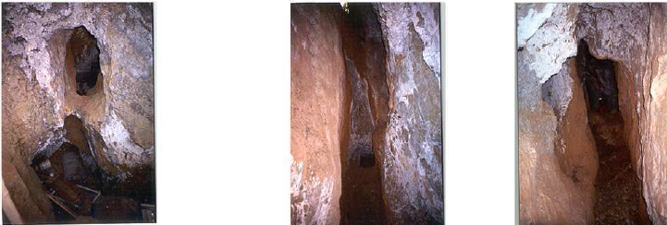
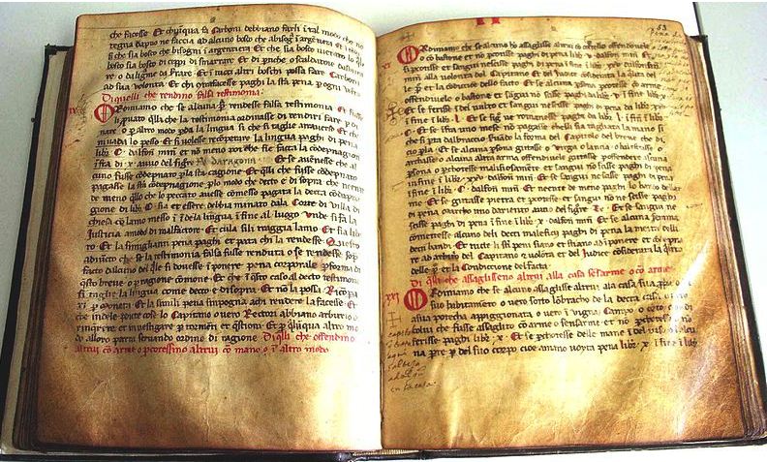
Middle Age mines
Breve di Villa di Chiesa (1327 a.C)
50 YEARS IRISH-TYPE Zn-Pb DEPOSITS
8-10° September

Slide 5
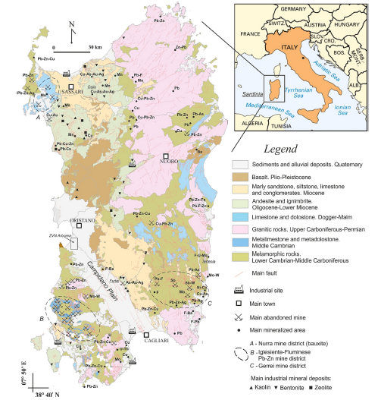
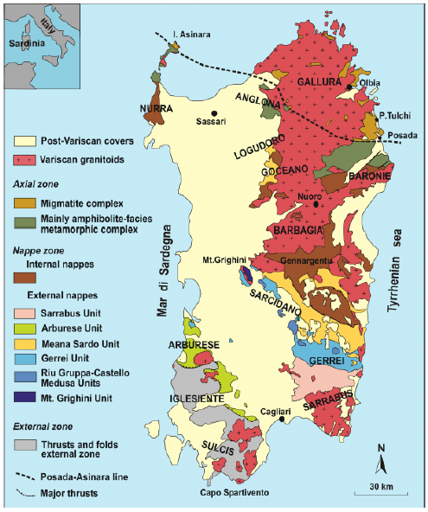
Geological setting and tectonic map
B
B
Iglesiente-Sulcis
District
“External Zone” Iglesiente-Sulcis District
B
50 YEARS IRISH-TYPE Zn-Pb DEPOSITS
8-10° September

Slide 6
Iglesiente-Sulcis district and old mines
50 YEARS IRISH-TYPE Zn-Pb DEPOSITS
8-10° September

Slide 7
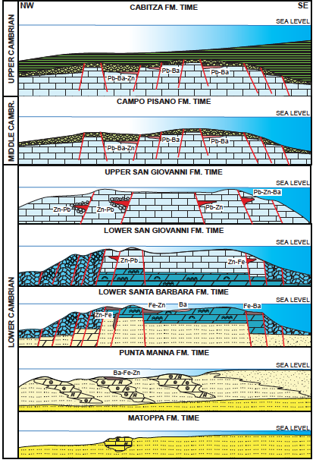
Sedimentary environment and stratigraphic record
The development of the carbonate platform in the Cambrian of Sardinia follows a multi-stage evolution, including the progression from a terrigenous carbonate ramp or a rimmed shelf attached to an easterly continental area (Nebida Group), to an isolated, subsequently flooded, carbonate platform (Gonnesa Group).
The platform was bordered by slope areas leading to western and eastern basins.
The platform was finally covered by terrigenous sediments deposited in an open marine environment (Iglesias Group).
50 YEARS IRISH-TYPE Zn-Pb DEPOSITS
8-10° September

Slide 8
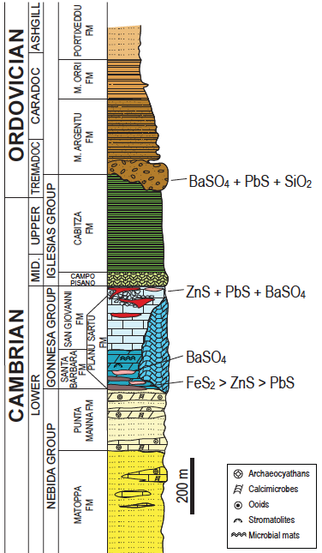
Sedimentary environment and stratigraphic record
The main control of the evolution of the Cambrian platform was a strong tensional tectonism, mirrored by abrupt facies changes, and coupled with differences in thicknesses and an abundance of breccias at several stratigraphic levels.
Tensional tectonics
Tensional tectonics
50 YEARS IRISH-TYPE Zn-Pb DEPOSITS
8-10° September

Slide 9
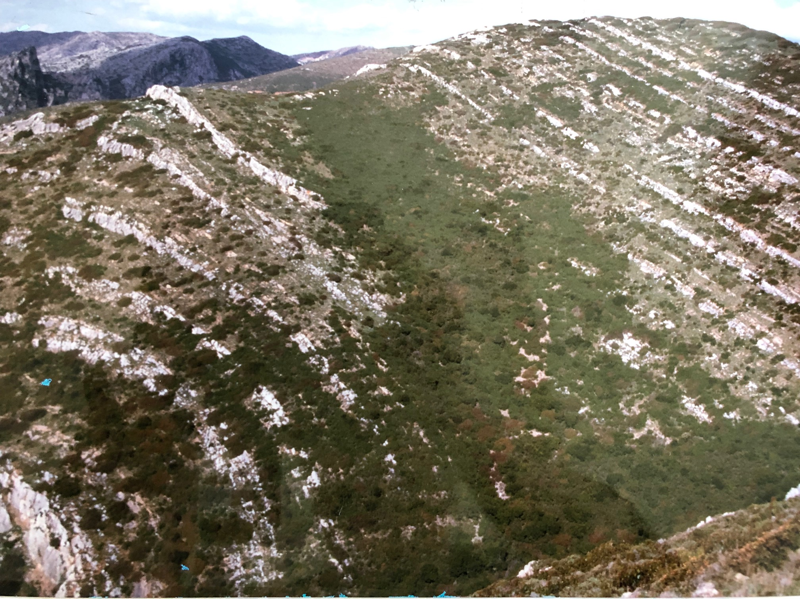
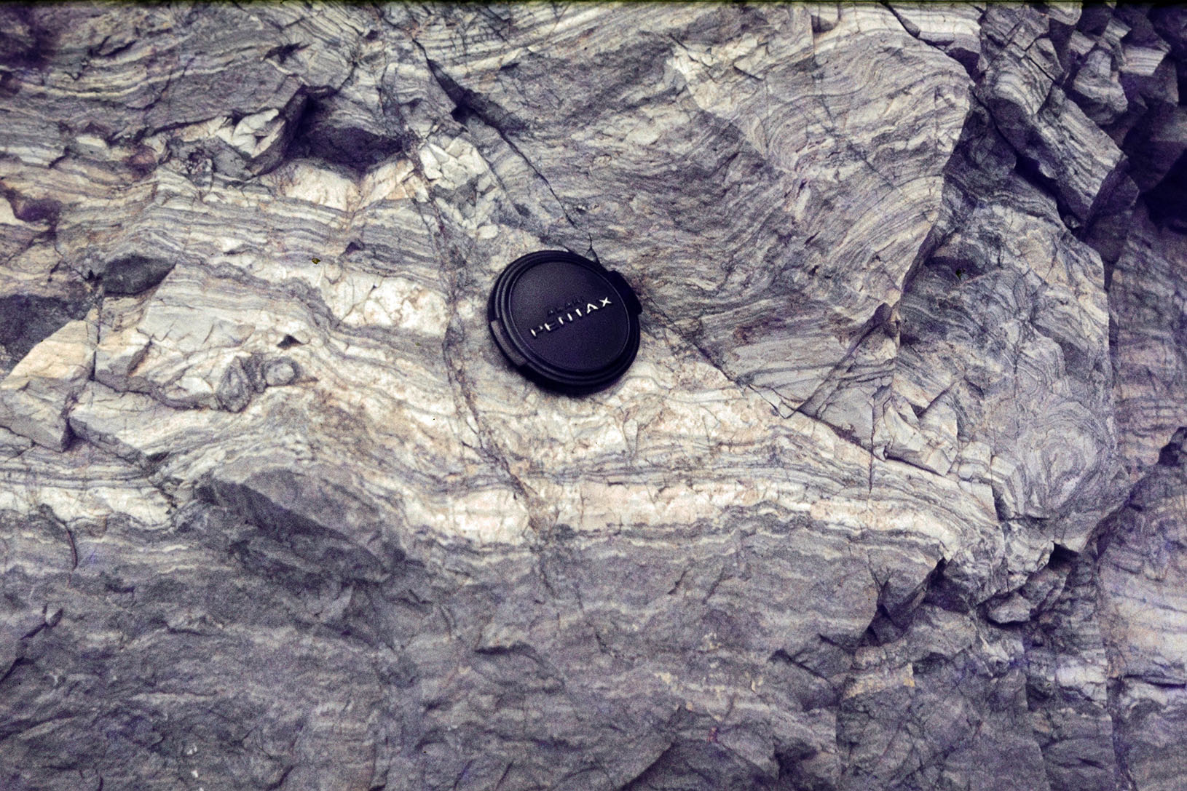
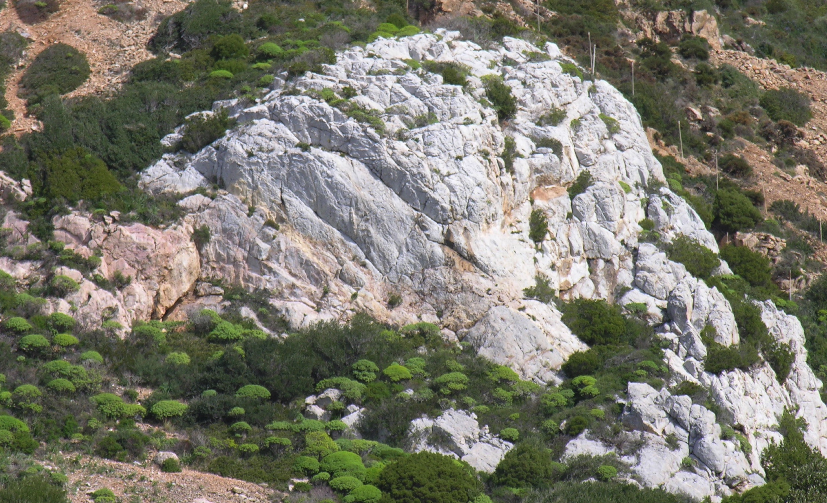
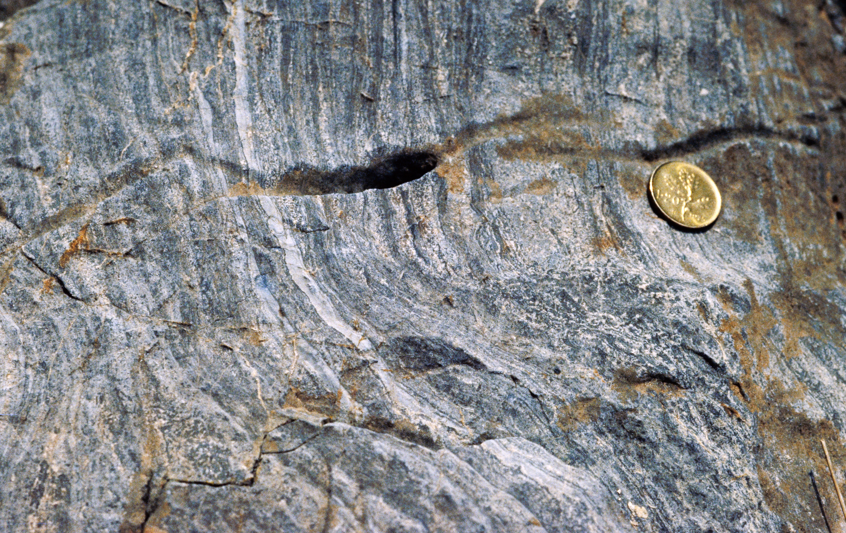
Tidal Dolomite
Sandstone
Archaeoc.+Ooids
Gonnesa Group – Lower Cambrian
Nebida Group – Lower Cambrian
Tidal Dolomite Microbial mats+Stromatolites
Lagoonal Limestone
50 YEARS IRISH-TYPE Zn-Pb DEPOSITS
8-10° September

Slide 10
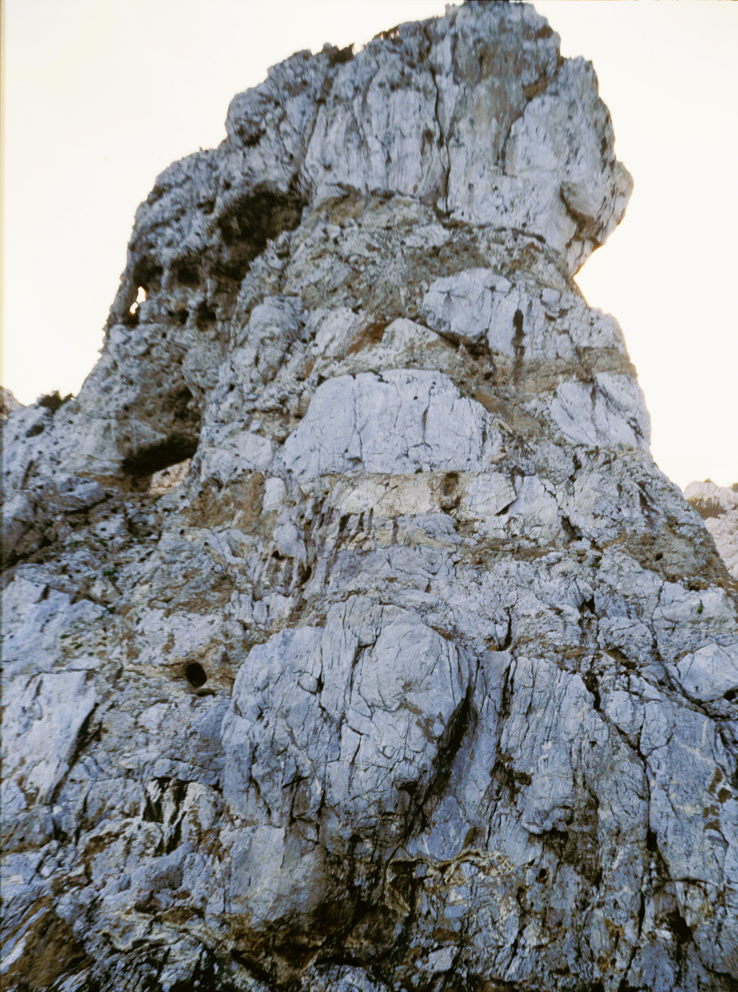
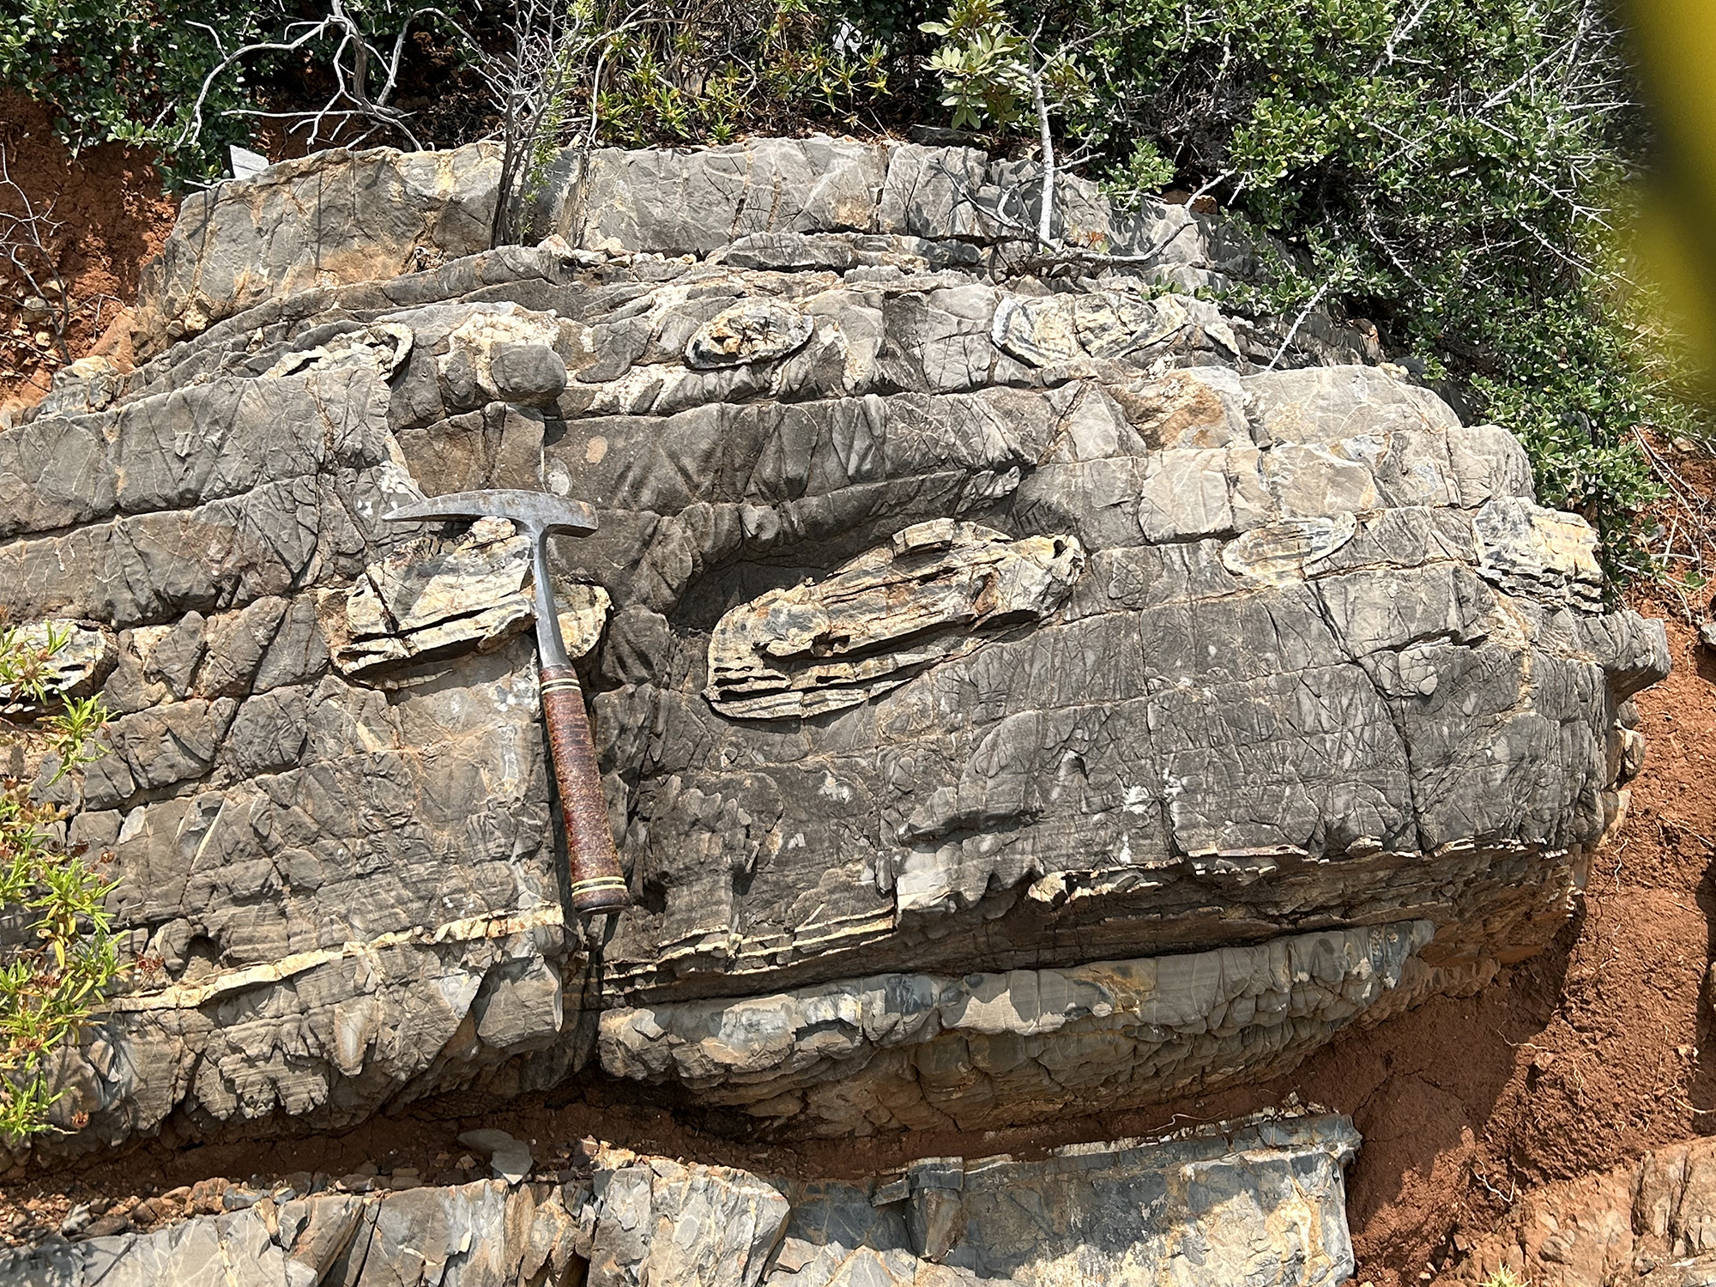
The western slope
Planu Sartu (Buggerru)
Mega-breccia on the western slope
Planu Sartu (Buggerru)
Well-bedded limestone and dolomite with chert layers and nodules on the western slope
50 YEARS IRISH-TYPE Zn-Pb DEPOSITS
8-10° September

Slide 11
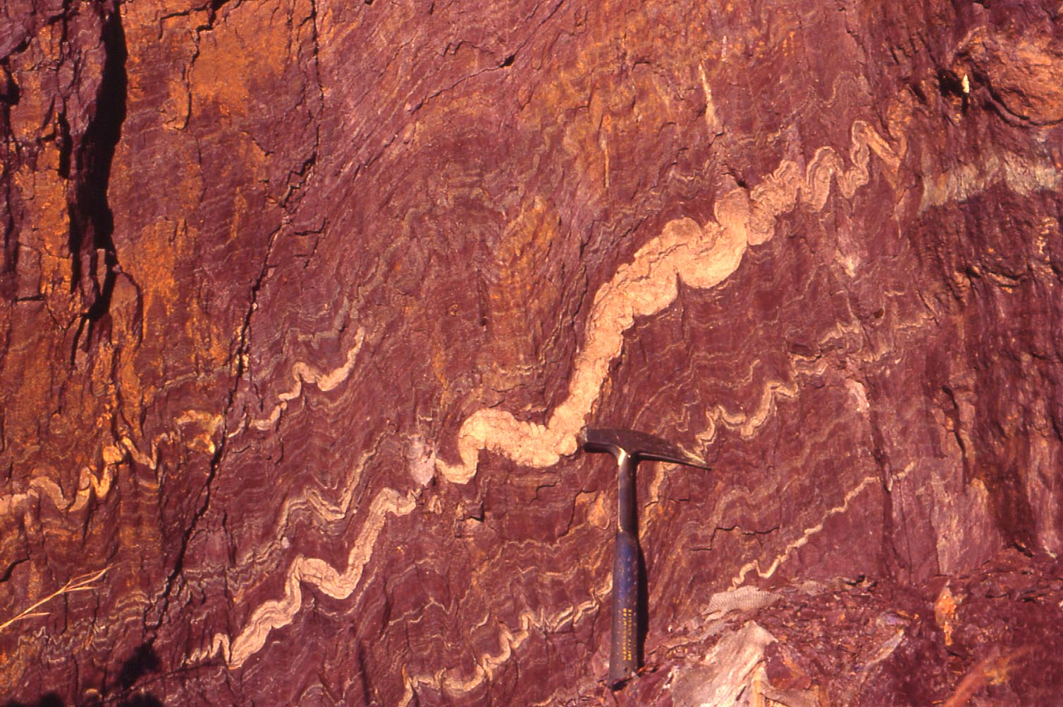
Sedimentary environment and stratigraphic record
Drowned carbonate platform: Iglesias shales (Upper Cambrian-Lower Ordovician)
Bindua
50 YEARS IRISH-TYPE Zn-Pb DEPOSITS
8-10° September

Slide 12
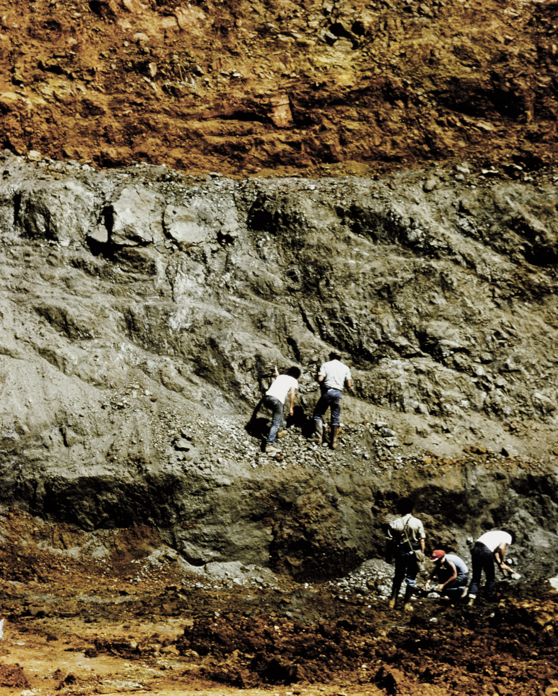
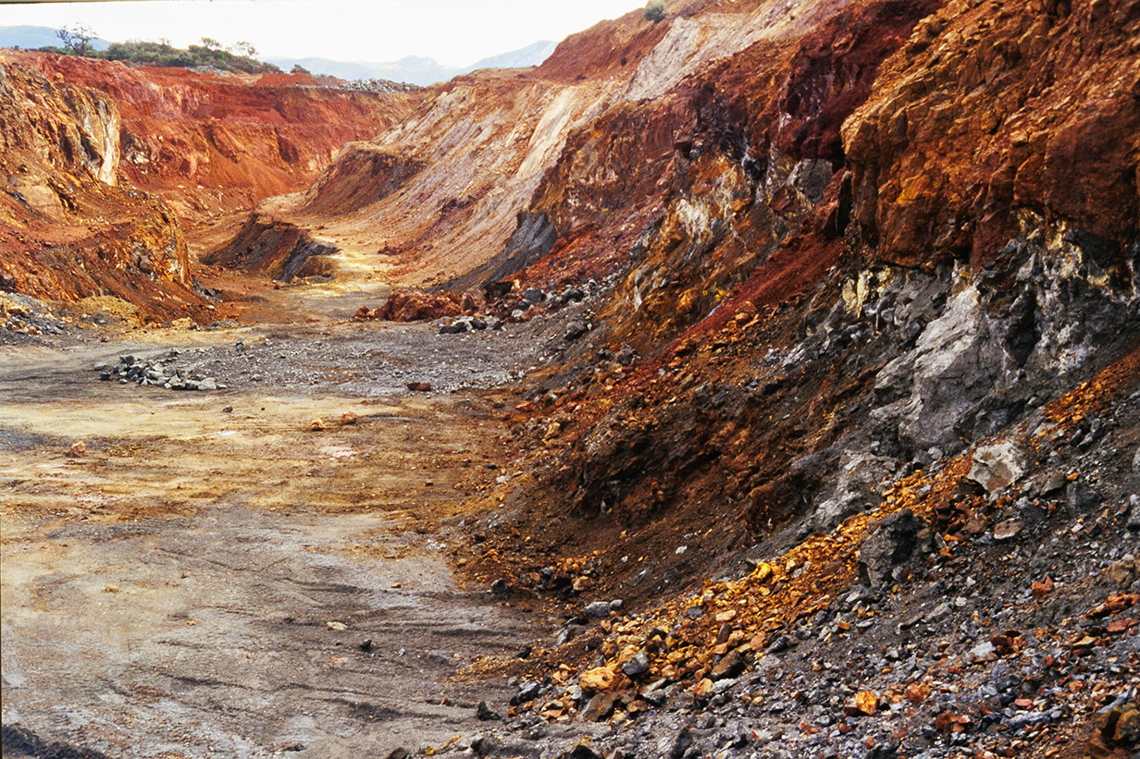
Massive sulphides mineralization
Genna Luas Iron-rich Gossan
Genna Luas Massive Pyrite body
50 YEARS IRISH-TYPE Zn-Pb DEPOSITS
8-10° September

Slide 13
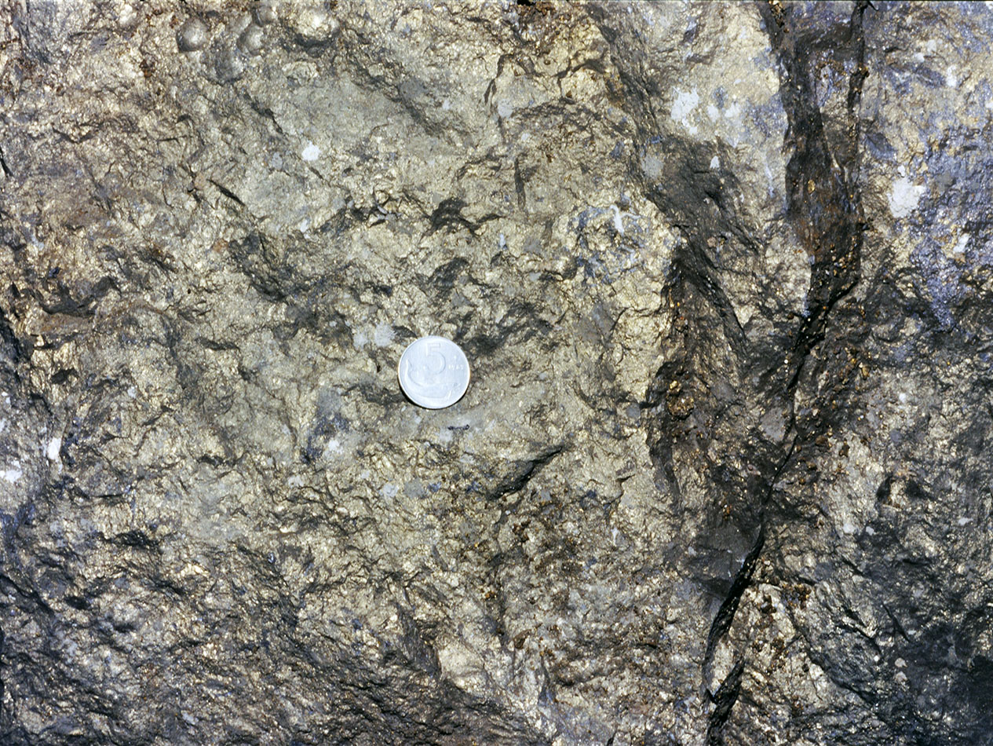
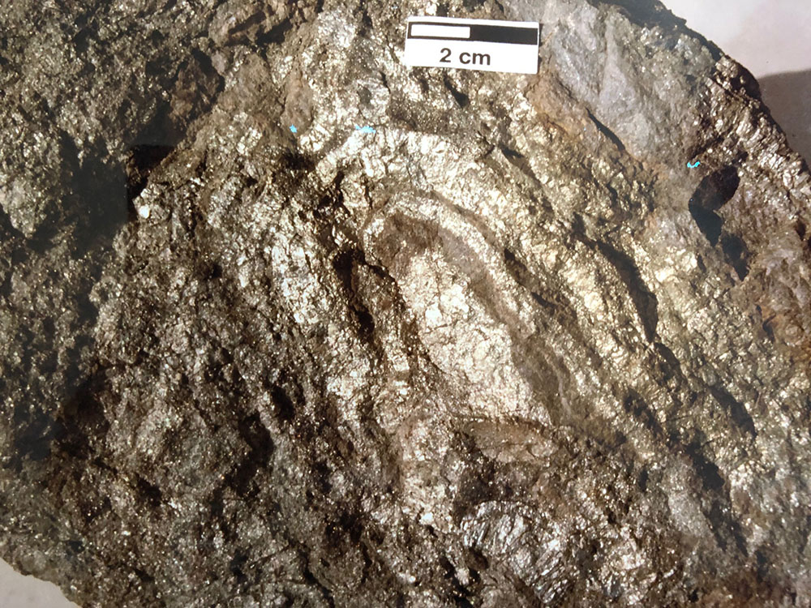
Massive sulphides mineralization
Campo Pisano
Massive Melnikovite-Pyrite
Campo Pisano
Folded Pyrite & Sphalerite
50 YEARS IRISH-TYPE Zn-Pb DEPOSITS
8-10° September

Slide 14
MVT / Irish type (?) mineralization
MVT / Irish type (?) ores
Disseminated sphalerite & pyrite in peloidal mudstone
Breccia and replacement ores (sphalerite & galena) with calcite layers and bodies
Galena & barite at the top of Gonnesa Group
50 YEARS IRISH-TYPE Zn-Pb DEPOSITS
8-10° September

Slide 15
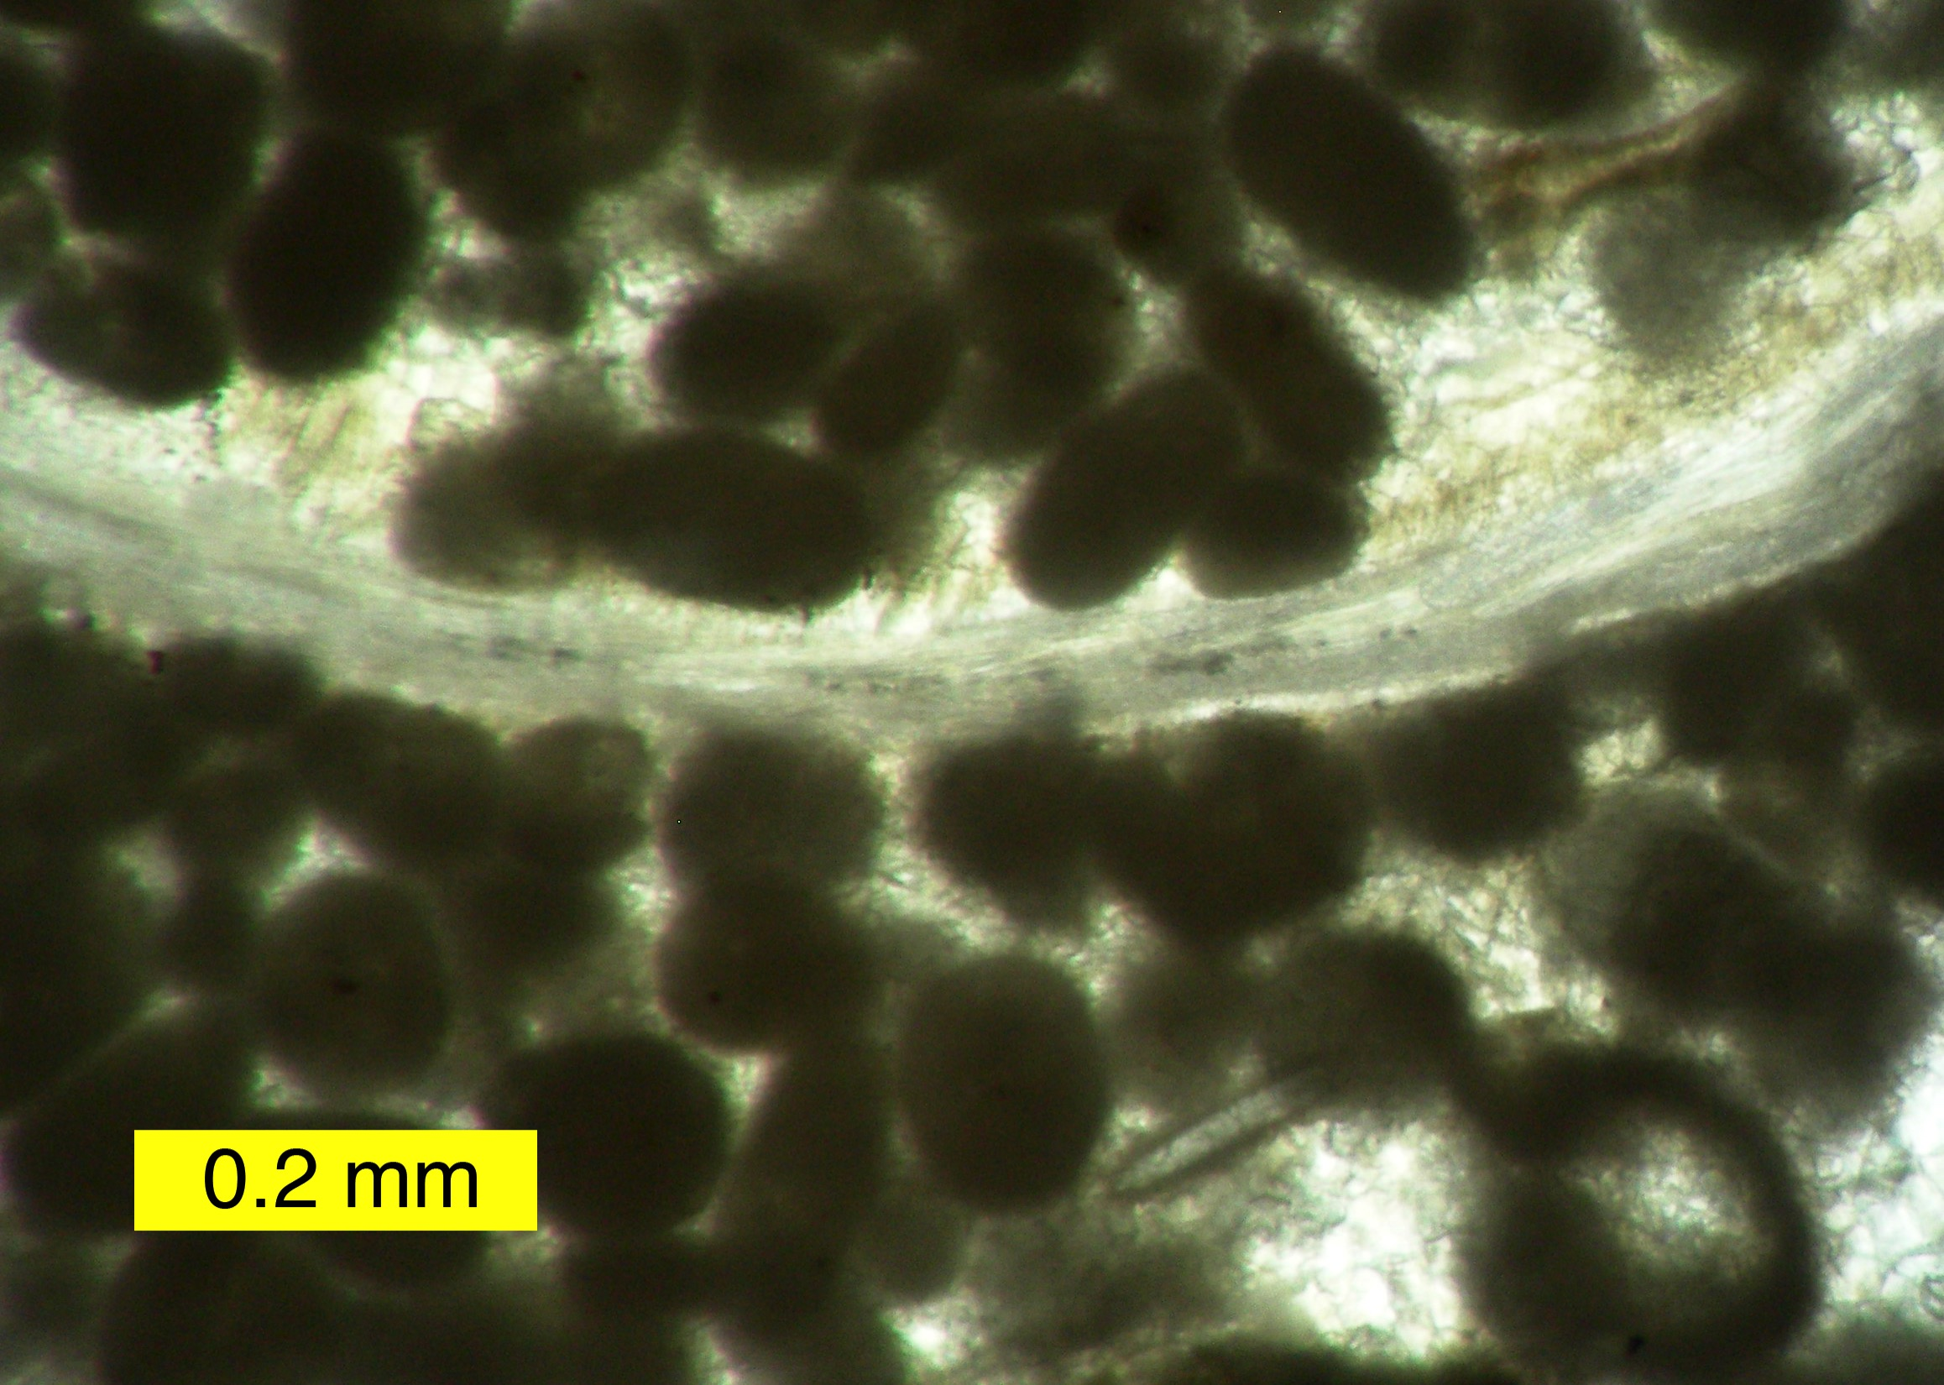
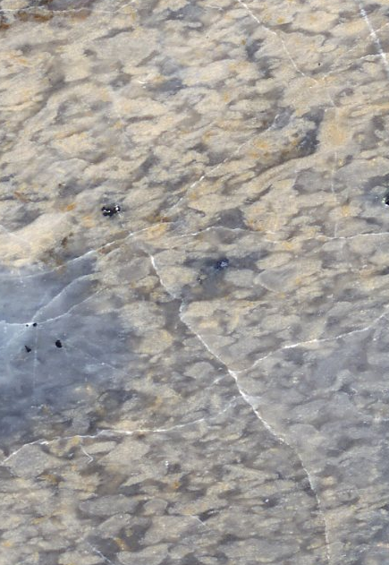
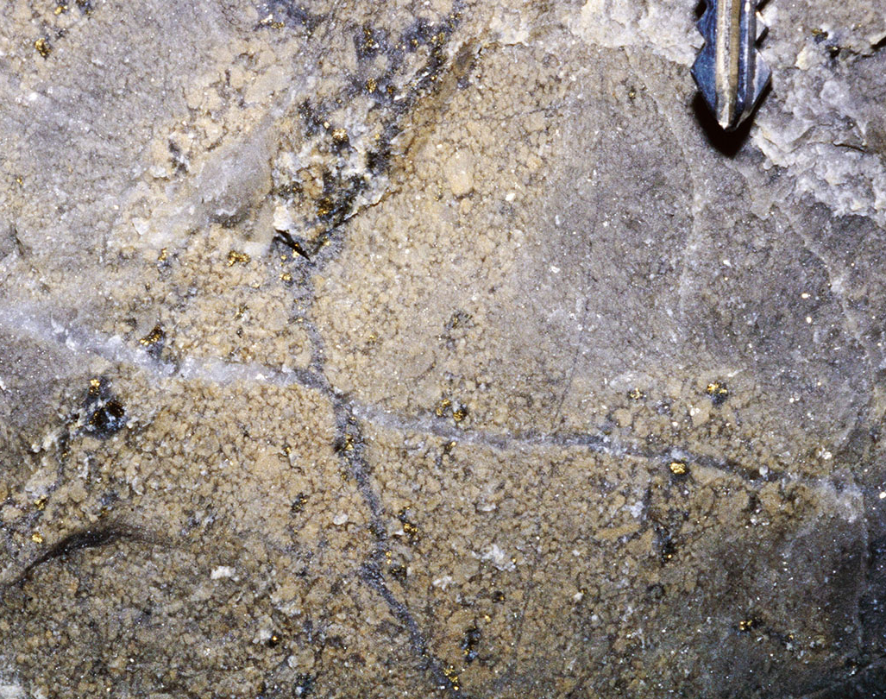
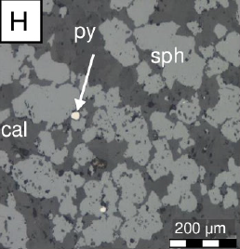
MVT / Irish type (?) mineralization
A) Sulphides disseminated and replacing mudstone
Deformed through
Variscan Orogeny
Peloidal Mudstone replaced by Yellow Sphalerite & collomorph Melnikovite/Pyrite
Sph
0.5 mm
San Giovanni Mine
50 YEARS IRISH-TYPE Zn-Pb DEPOSITS
8-10° September

Slide 16
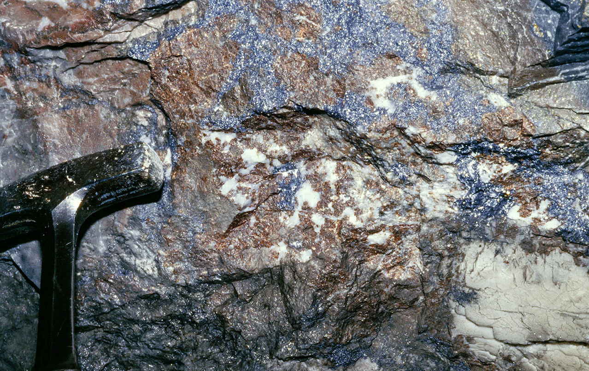
MVT / Irish type (?) mineralization
B) Sulphides replacing limestones and in cement of breccia
Dark sphalerite & galena replacing limestone
Monteponi mine
50 YEARS IRISH-TYPE Zn-Pb DEPOSITS
8-10° September

Slide 17
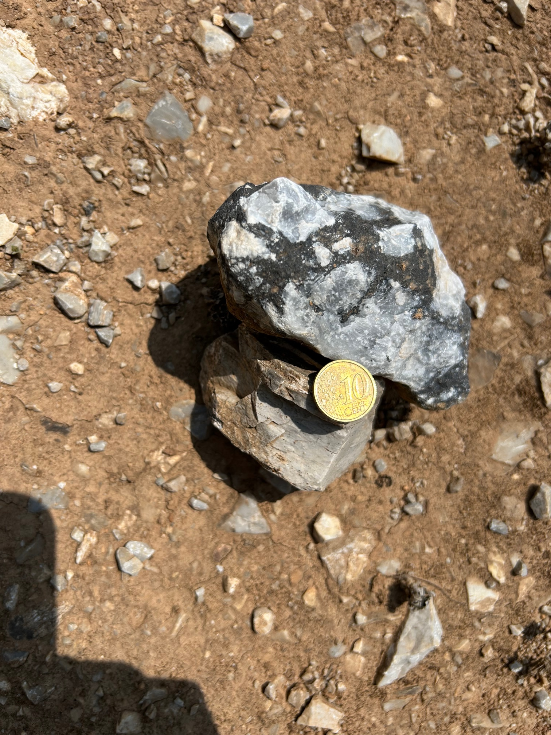
MVT / Irish type (?) mineralization
C) Barite & galena at the top of Gonnesa limestones
Microcrystalline barite &
galena replacing limestone; both are strongly deformed
S’Ega S’Acqua mine
50 YEARS IRISH-TYPE Zn-Pb DEPOSITS
8-10° September

Slide 18
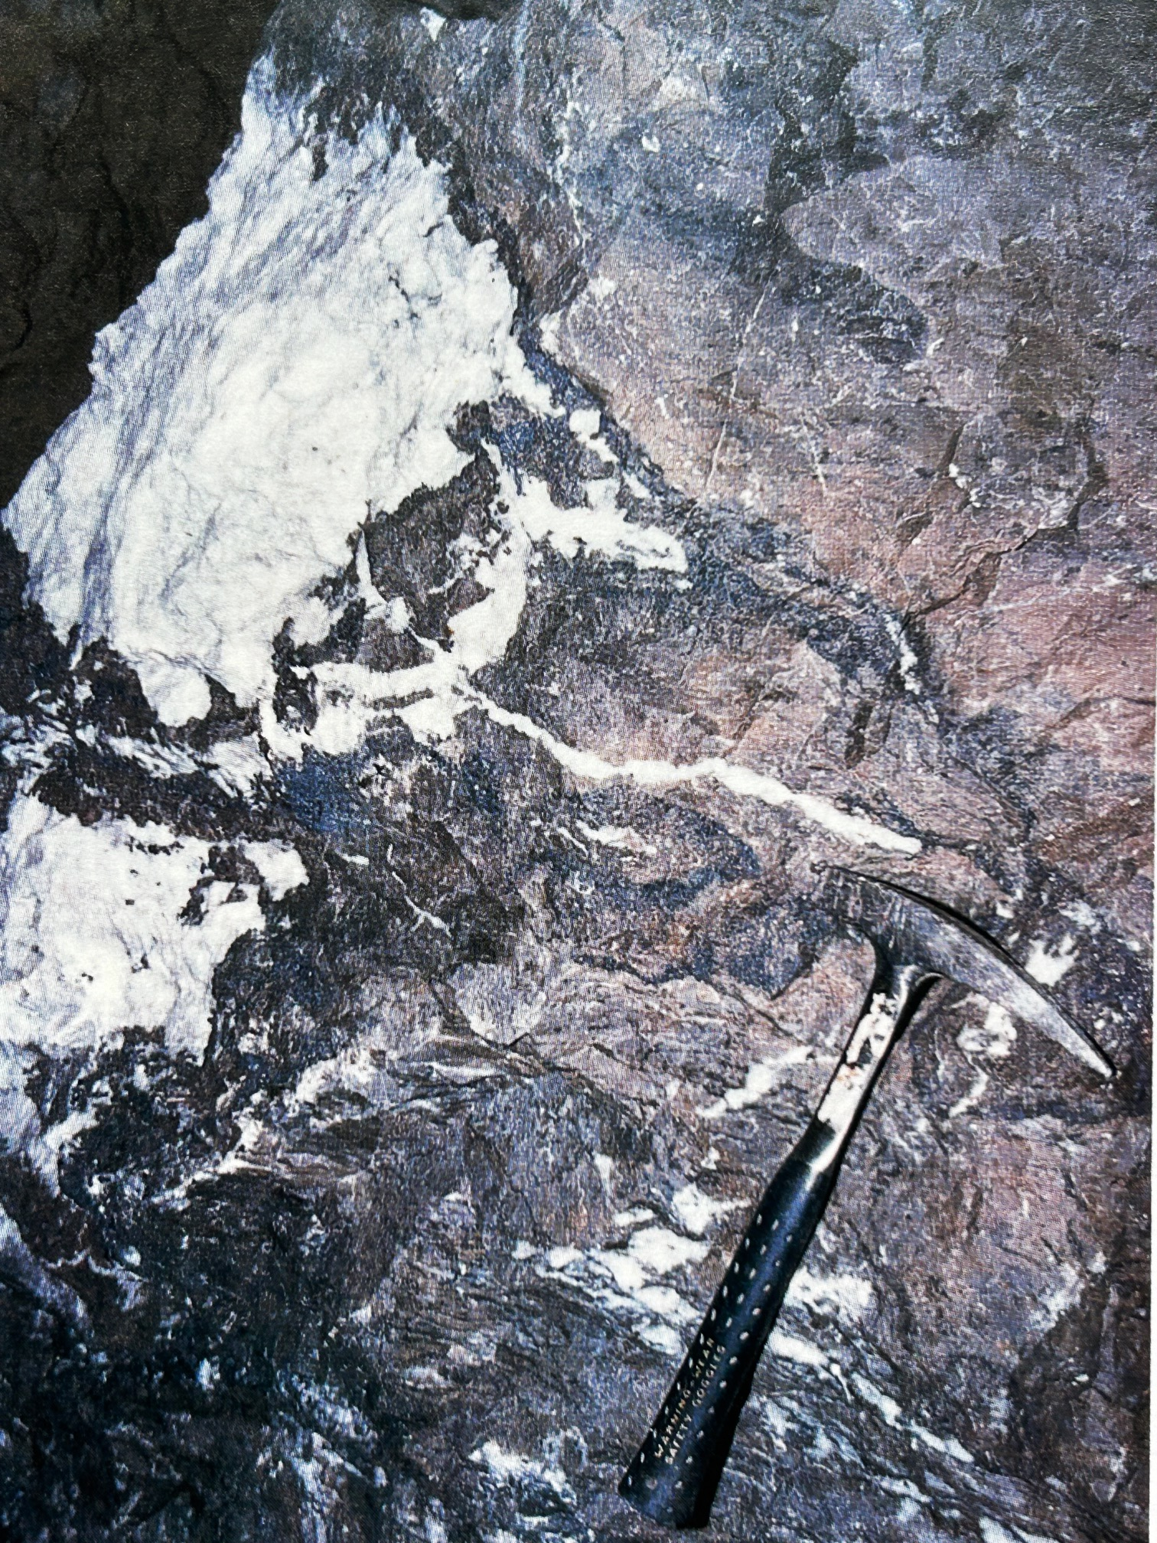
MVT / Irish type (?) mineralization
A+B Several successive ore generations
(1) “Peloidal” yellow sphalerite
(2) Dark sphalerite & galena
(3) Sparry calcite
San Giovanni mine
50 YEARS IRISH-TYPE Zn-Pb DEPOSITS
8-10° September

Slide 19
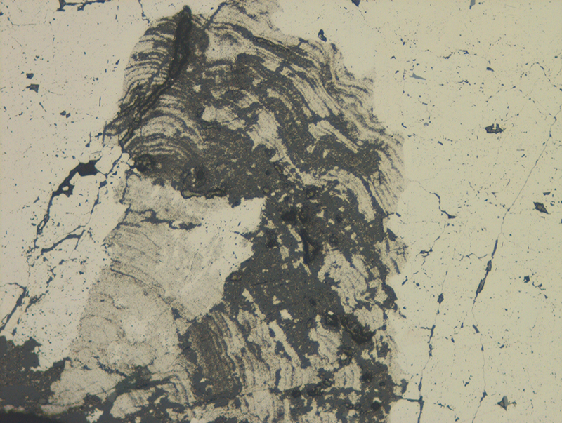
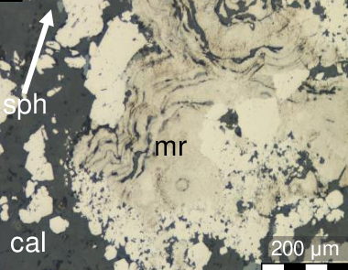
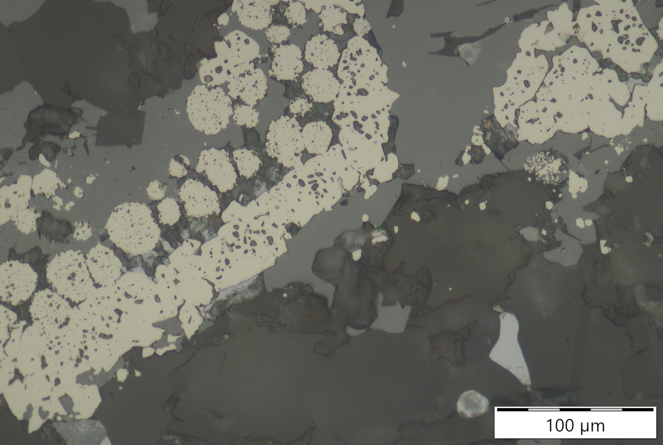
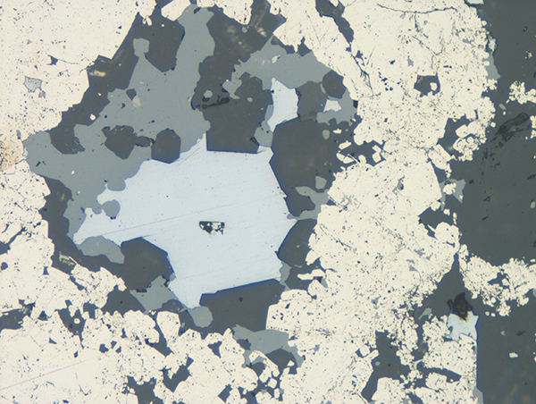
Petrographic observations
Py
Mlk
Mlk
200 µm
200 µm
Genna Luas mine - Pyrite/Melnikovite
Campo Pisano mine - Pyrite/Melnikovite
Sph
Sph
Py
Ga
Py
200 µm
100 µm
Masua mine - Pyrite concretions & Sphalerite
Masua mine - Pyrite, Sphalerite, Galena
50 YEARS IRISH-TYPE Zn-Pb DEPOSITS
8-10° September

Slide 20
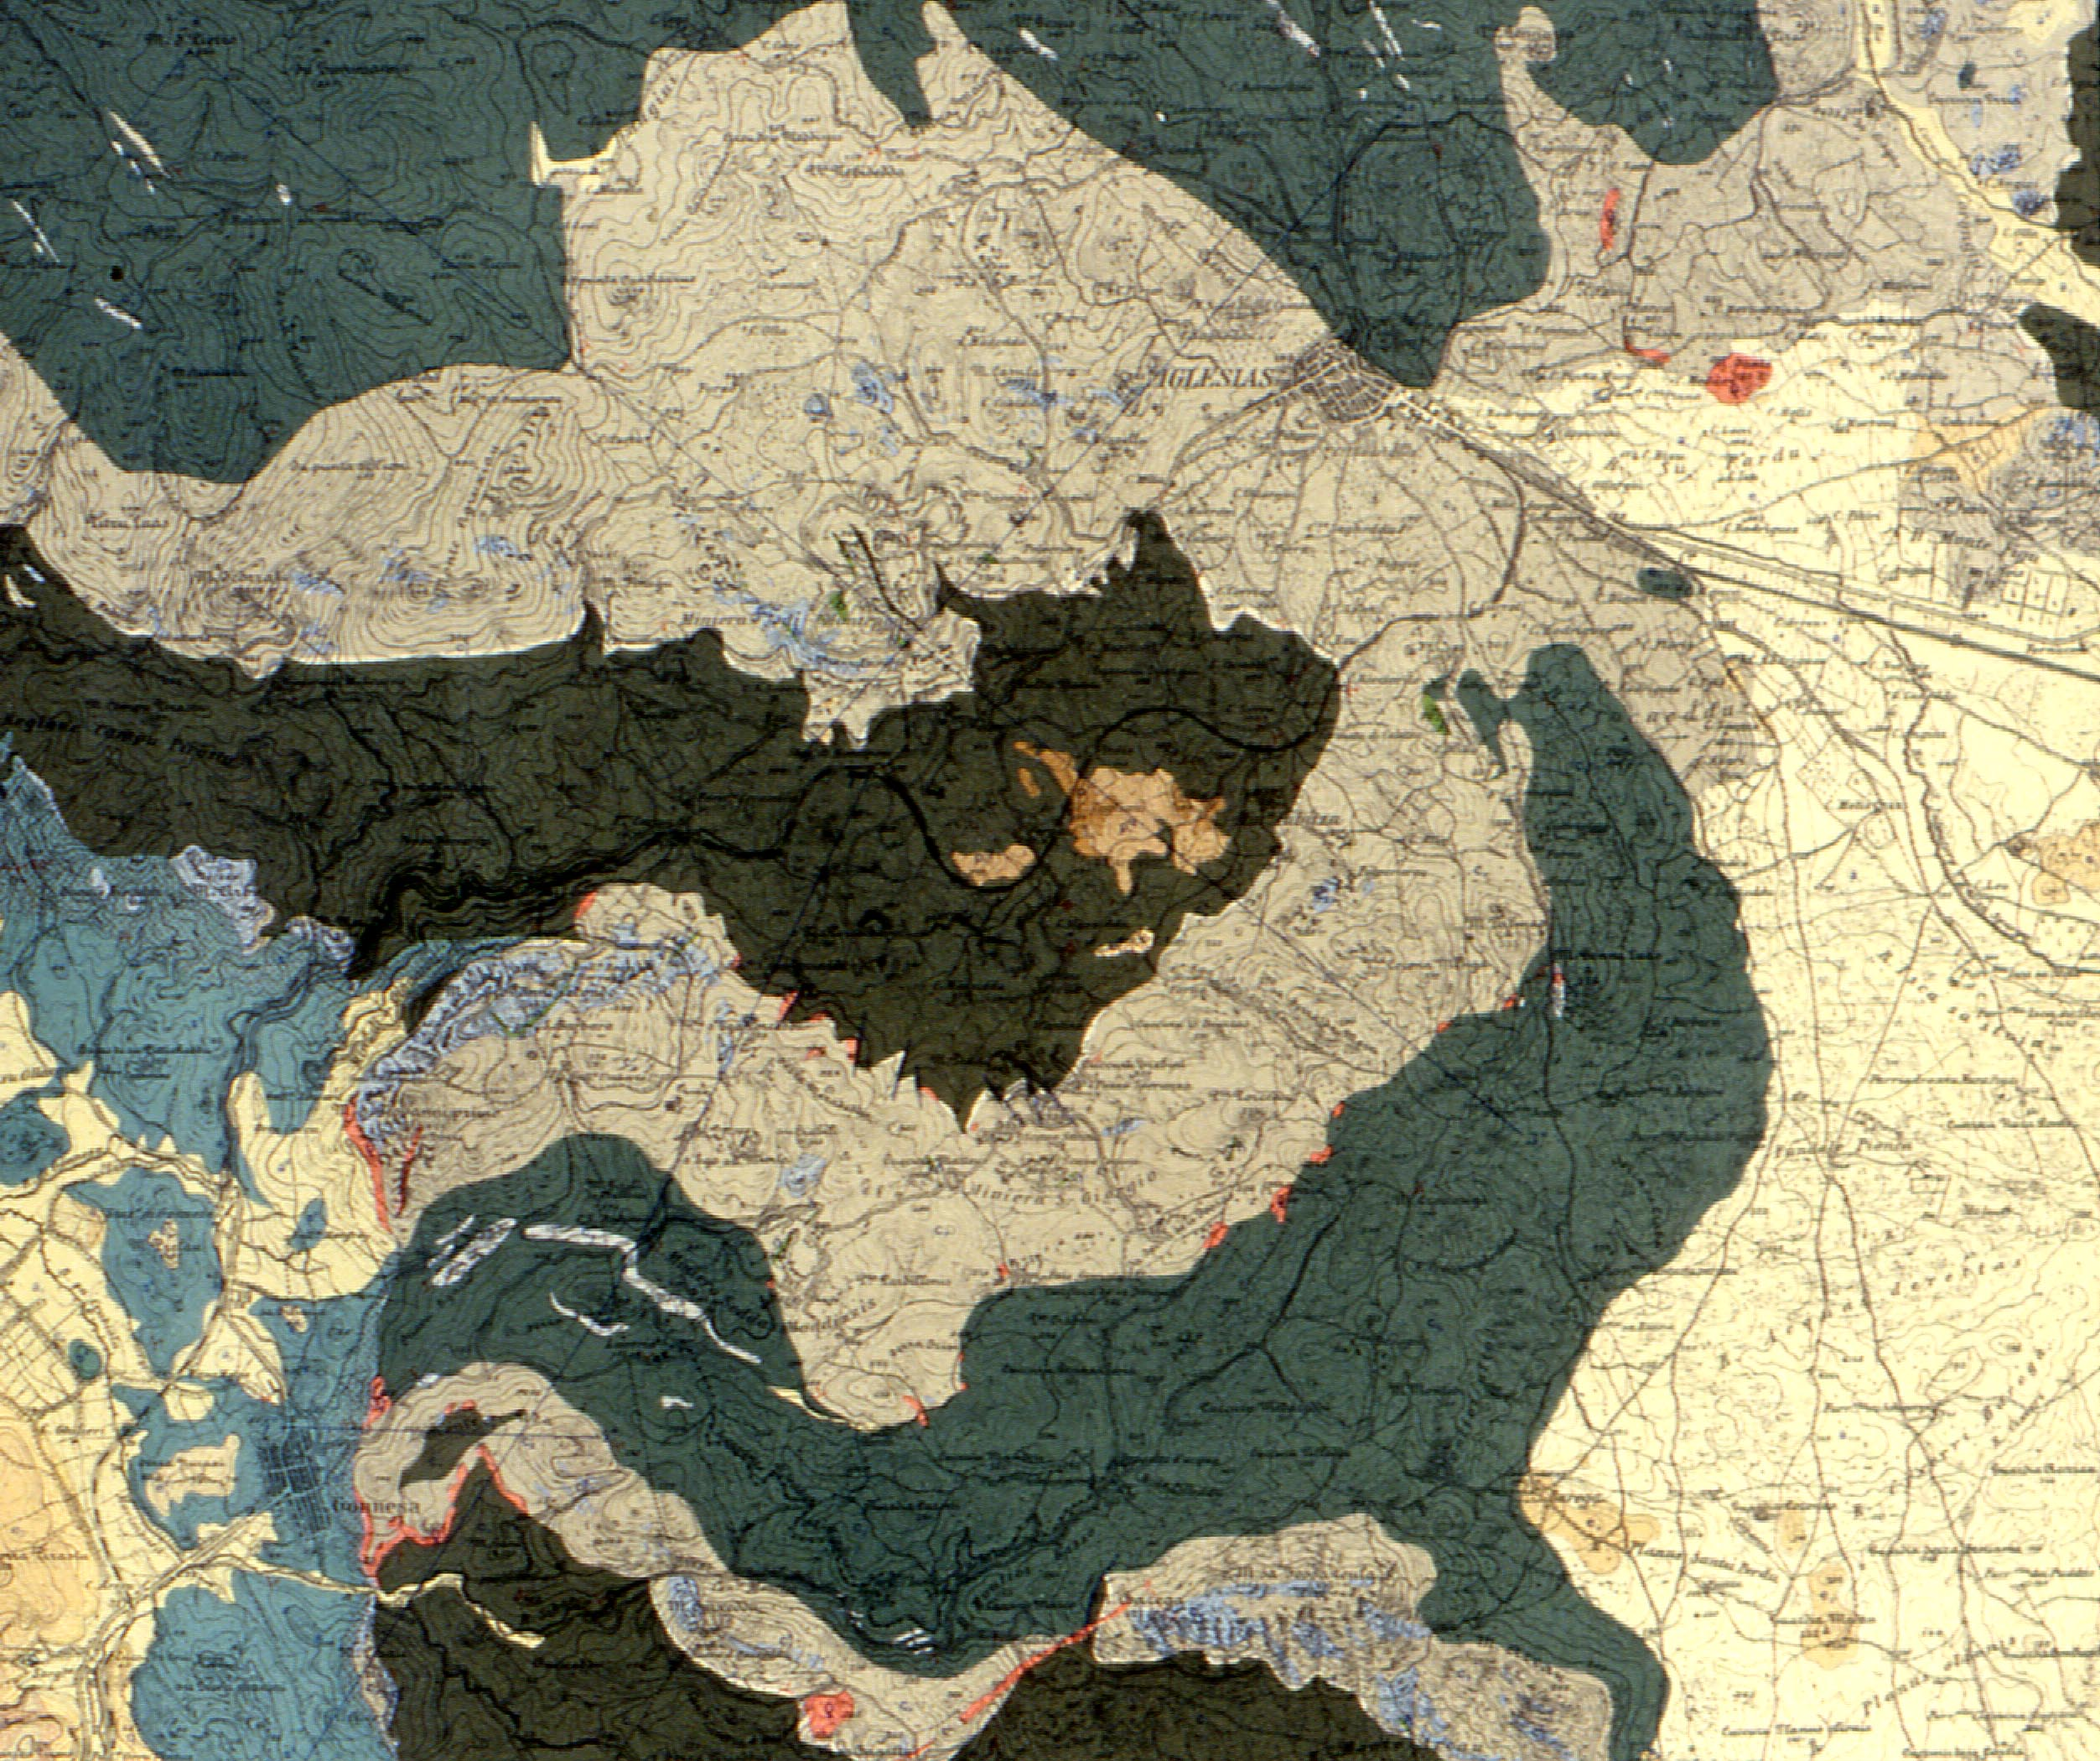
Caledonian “Sardic” deformation phase – “E-W” folds
Old (1920) geological map of the Iglesias syncline
Ordovician “Sardic” tectonic phase (E-W)
50 YEARS IRISH-TYPE Zn-Pb DEPOSITS
8-10° September

Slide 21
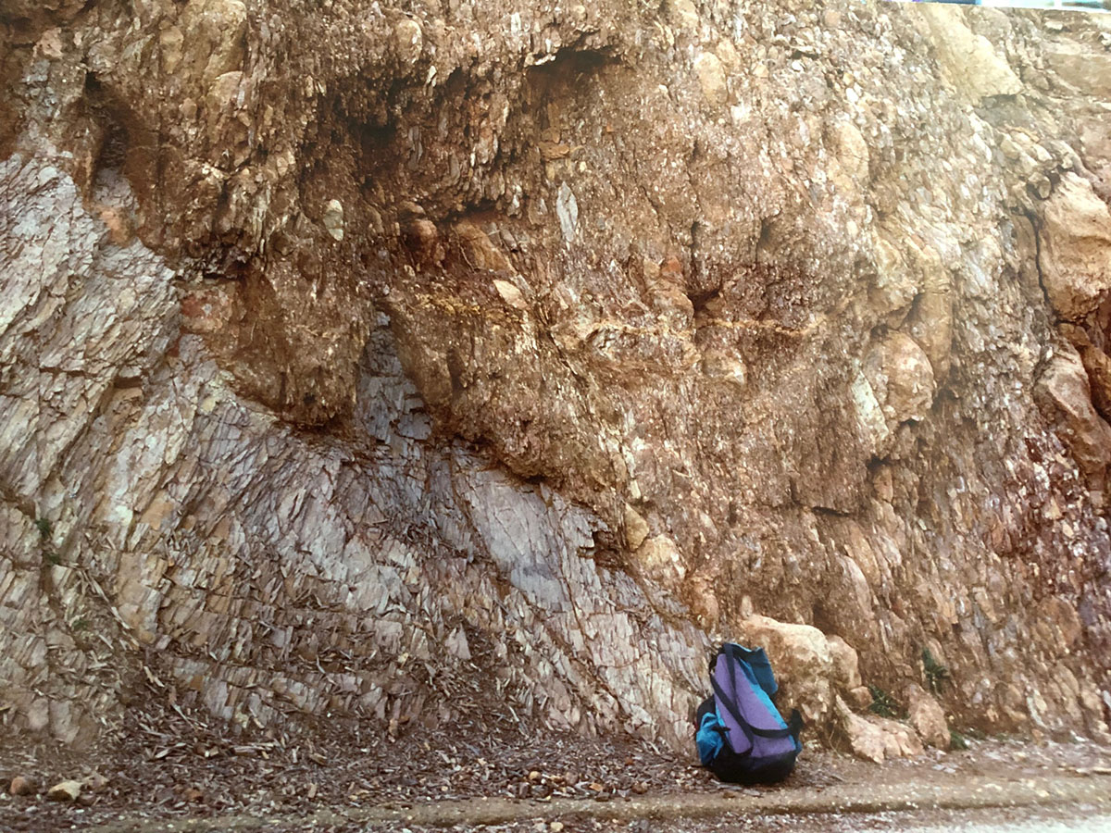
Unconformity between Cambrian shales and Ordovician conglomerate. Both are deformed later by Variscan orogeny
50 YEARS IRISH-TYPE Zn-Pb DEPOSITS
8-10° September

Slide 22
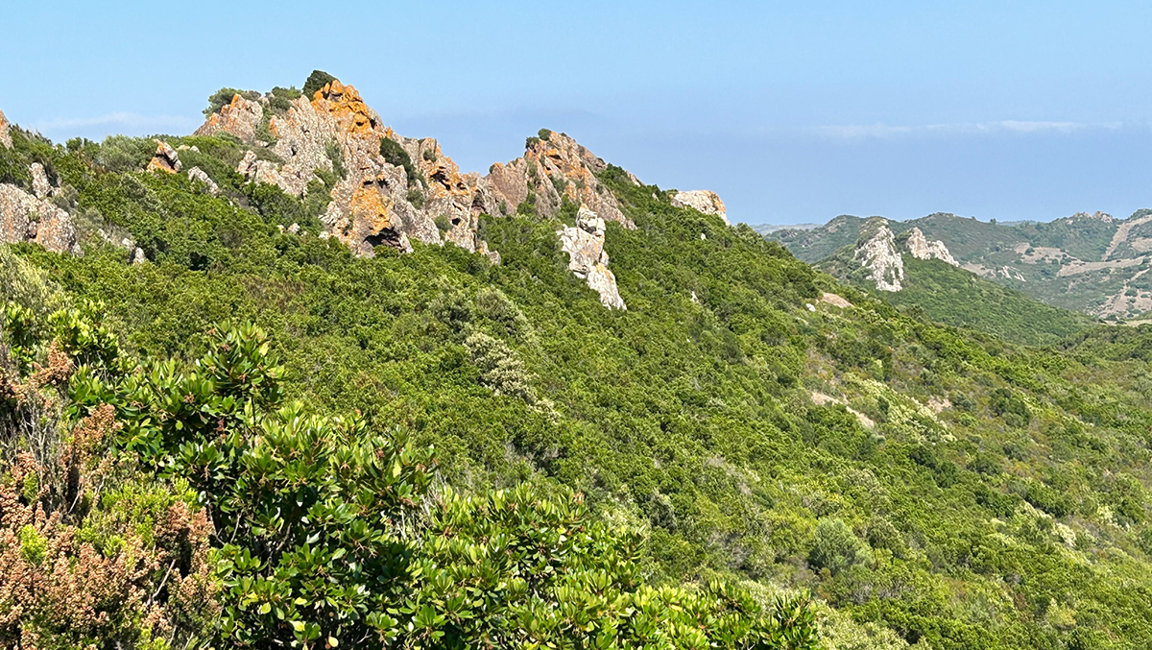
Upper Ordovician Sulcis
(1)
(1)
(2)
(2)
Bacu Abis
Ordovician silicified conglomerate (“Puddinga” AUCT.) (1) with carbonate breccia deposits (2) at the base. Both lithologies are sparingly mineralized with barite and sulphides.
50 YEARS IRISH-TYPE Zn-Pb DEPOSITS
8-10° September

Slide 23
Variscan deformation phases
1st Variscan phase:
“E-W” folds overprinting those of the Sardic phase
2nd Variscan phase:
“N-S” folds associated with a penetrative axial plane cleavage
(approximately subvertical and
N-S striking)
Old (1920) geological map of the Iglesias syncline
Devono-Carboniferous Variscan tectonic phase (N-S)
50 YEARS IRISH-TYPE Zn-Pb DEPOSITS
8-10° September

Slide 24
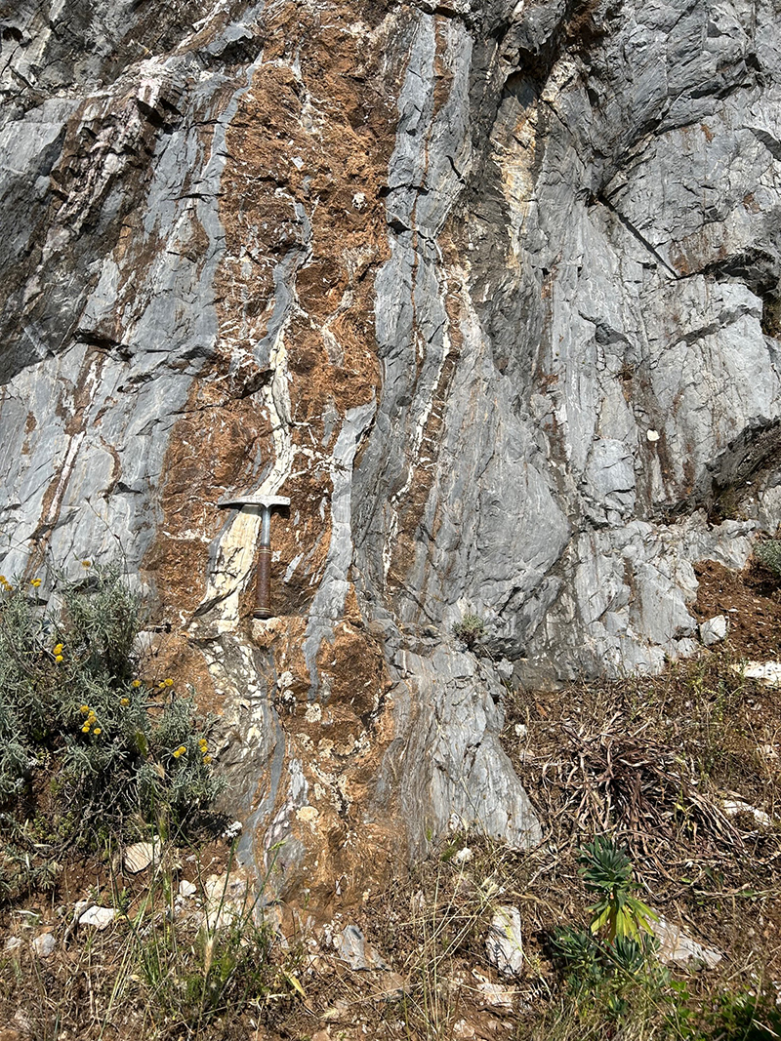
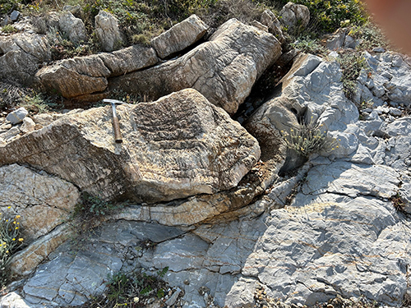
Variscan Deformation
Buggerru – San Nicolo’
Folded and twinned calcite layer
S’Ega S’Acqua – Stretched and deformed
dolomite layers (brown) in grey limestone
50 YEARS IRISH-TYPE Zn-Pb DEPOSITS
8-10° September

Slide 25
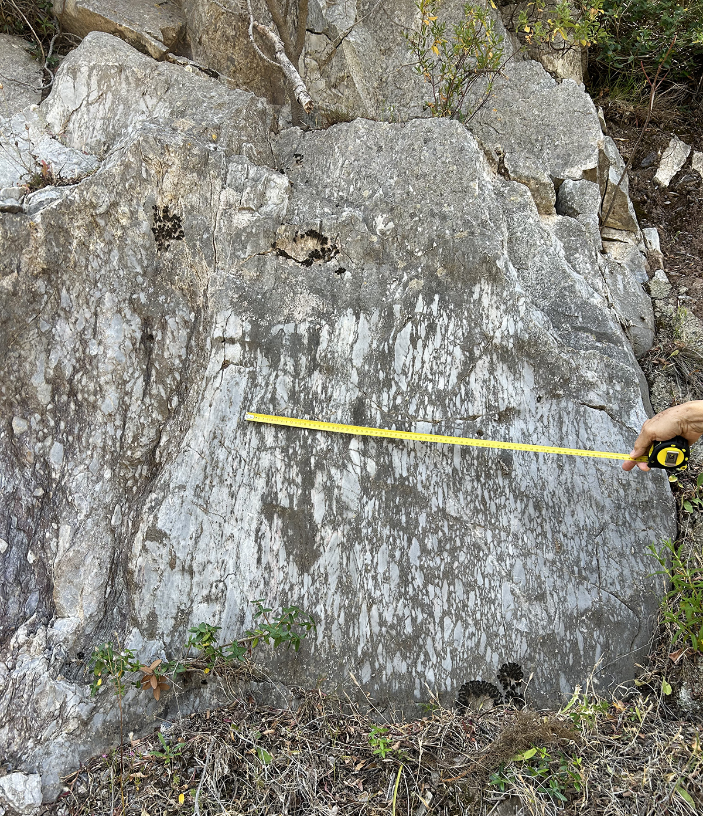
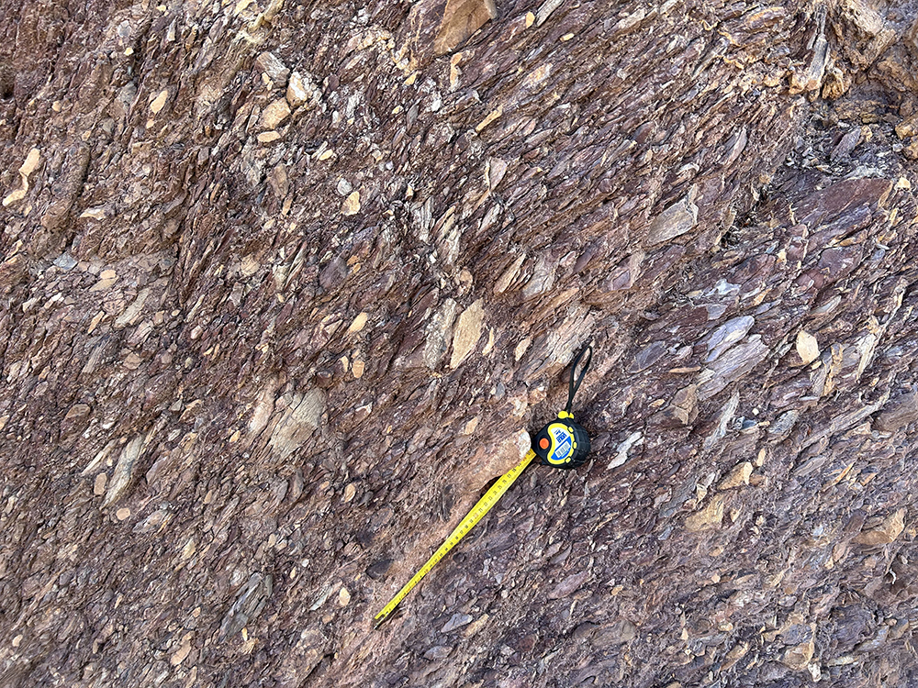
Variscan Deformation
Nebida. Upper Ordovician conglomerate
showing the N-S Variscan cleavage
Nebida. Upper Ordovician carbonate breccia showing the N-S Variscan cleavage
50 YEARS IRISH-TYPE Zn-Pb DEPOSITS
8-10° September

Slide 26
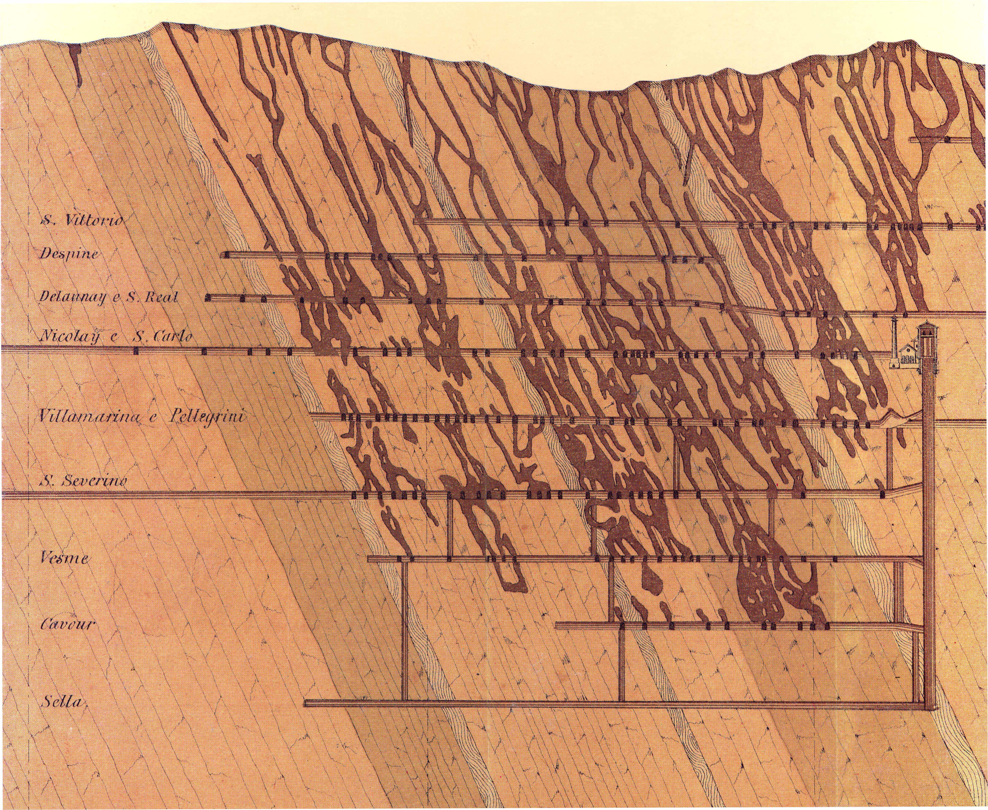
Monteponi mine - old section of the mineralized bodies aligned along
the main Variscan cleavage (approximately N-S striking)
50 YEARS IRISH-TYPE Zn-Pb DEPOSITS
8-10° September

Slide 27
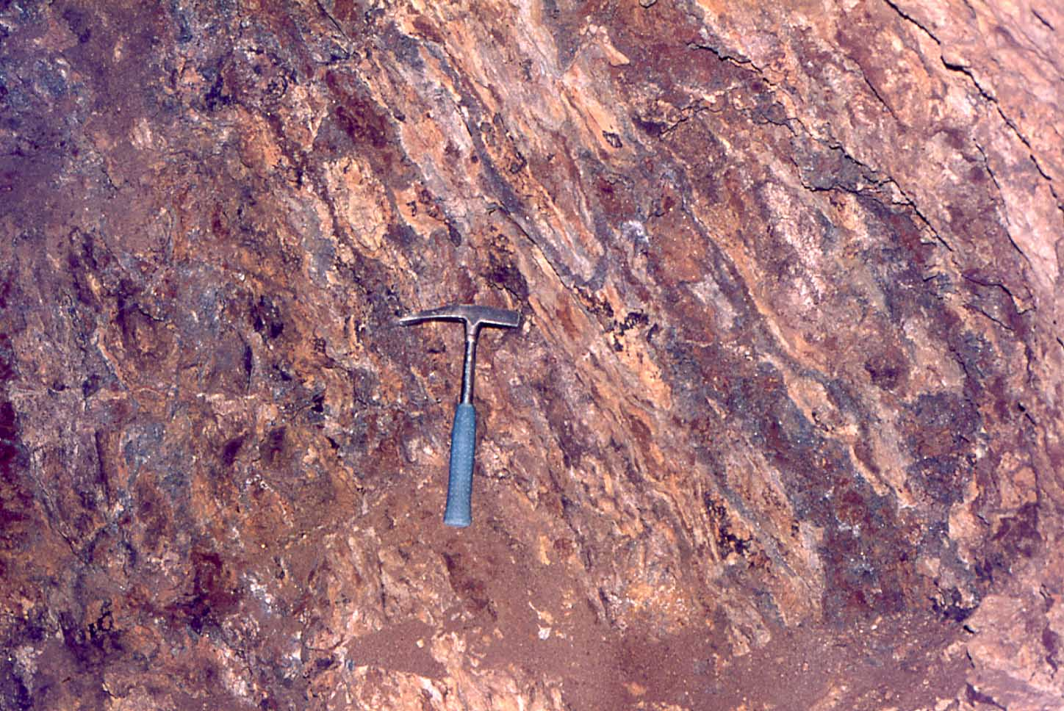
Monteponi mine lev.-60 - carbonate-hosted oxidized sulphides aligned along the main Variscan cleavage (approximately N-S striking)
50 YEARS IRISH-TYPE Zn-Pb DEPOSITS
8-10° September

Slide 28
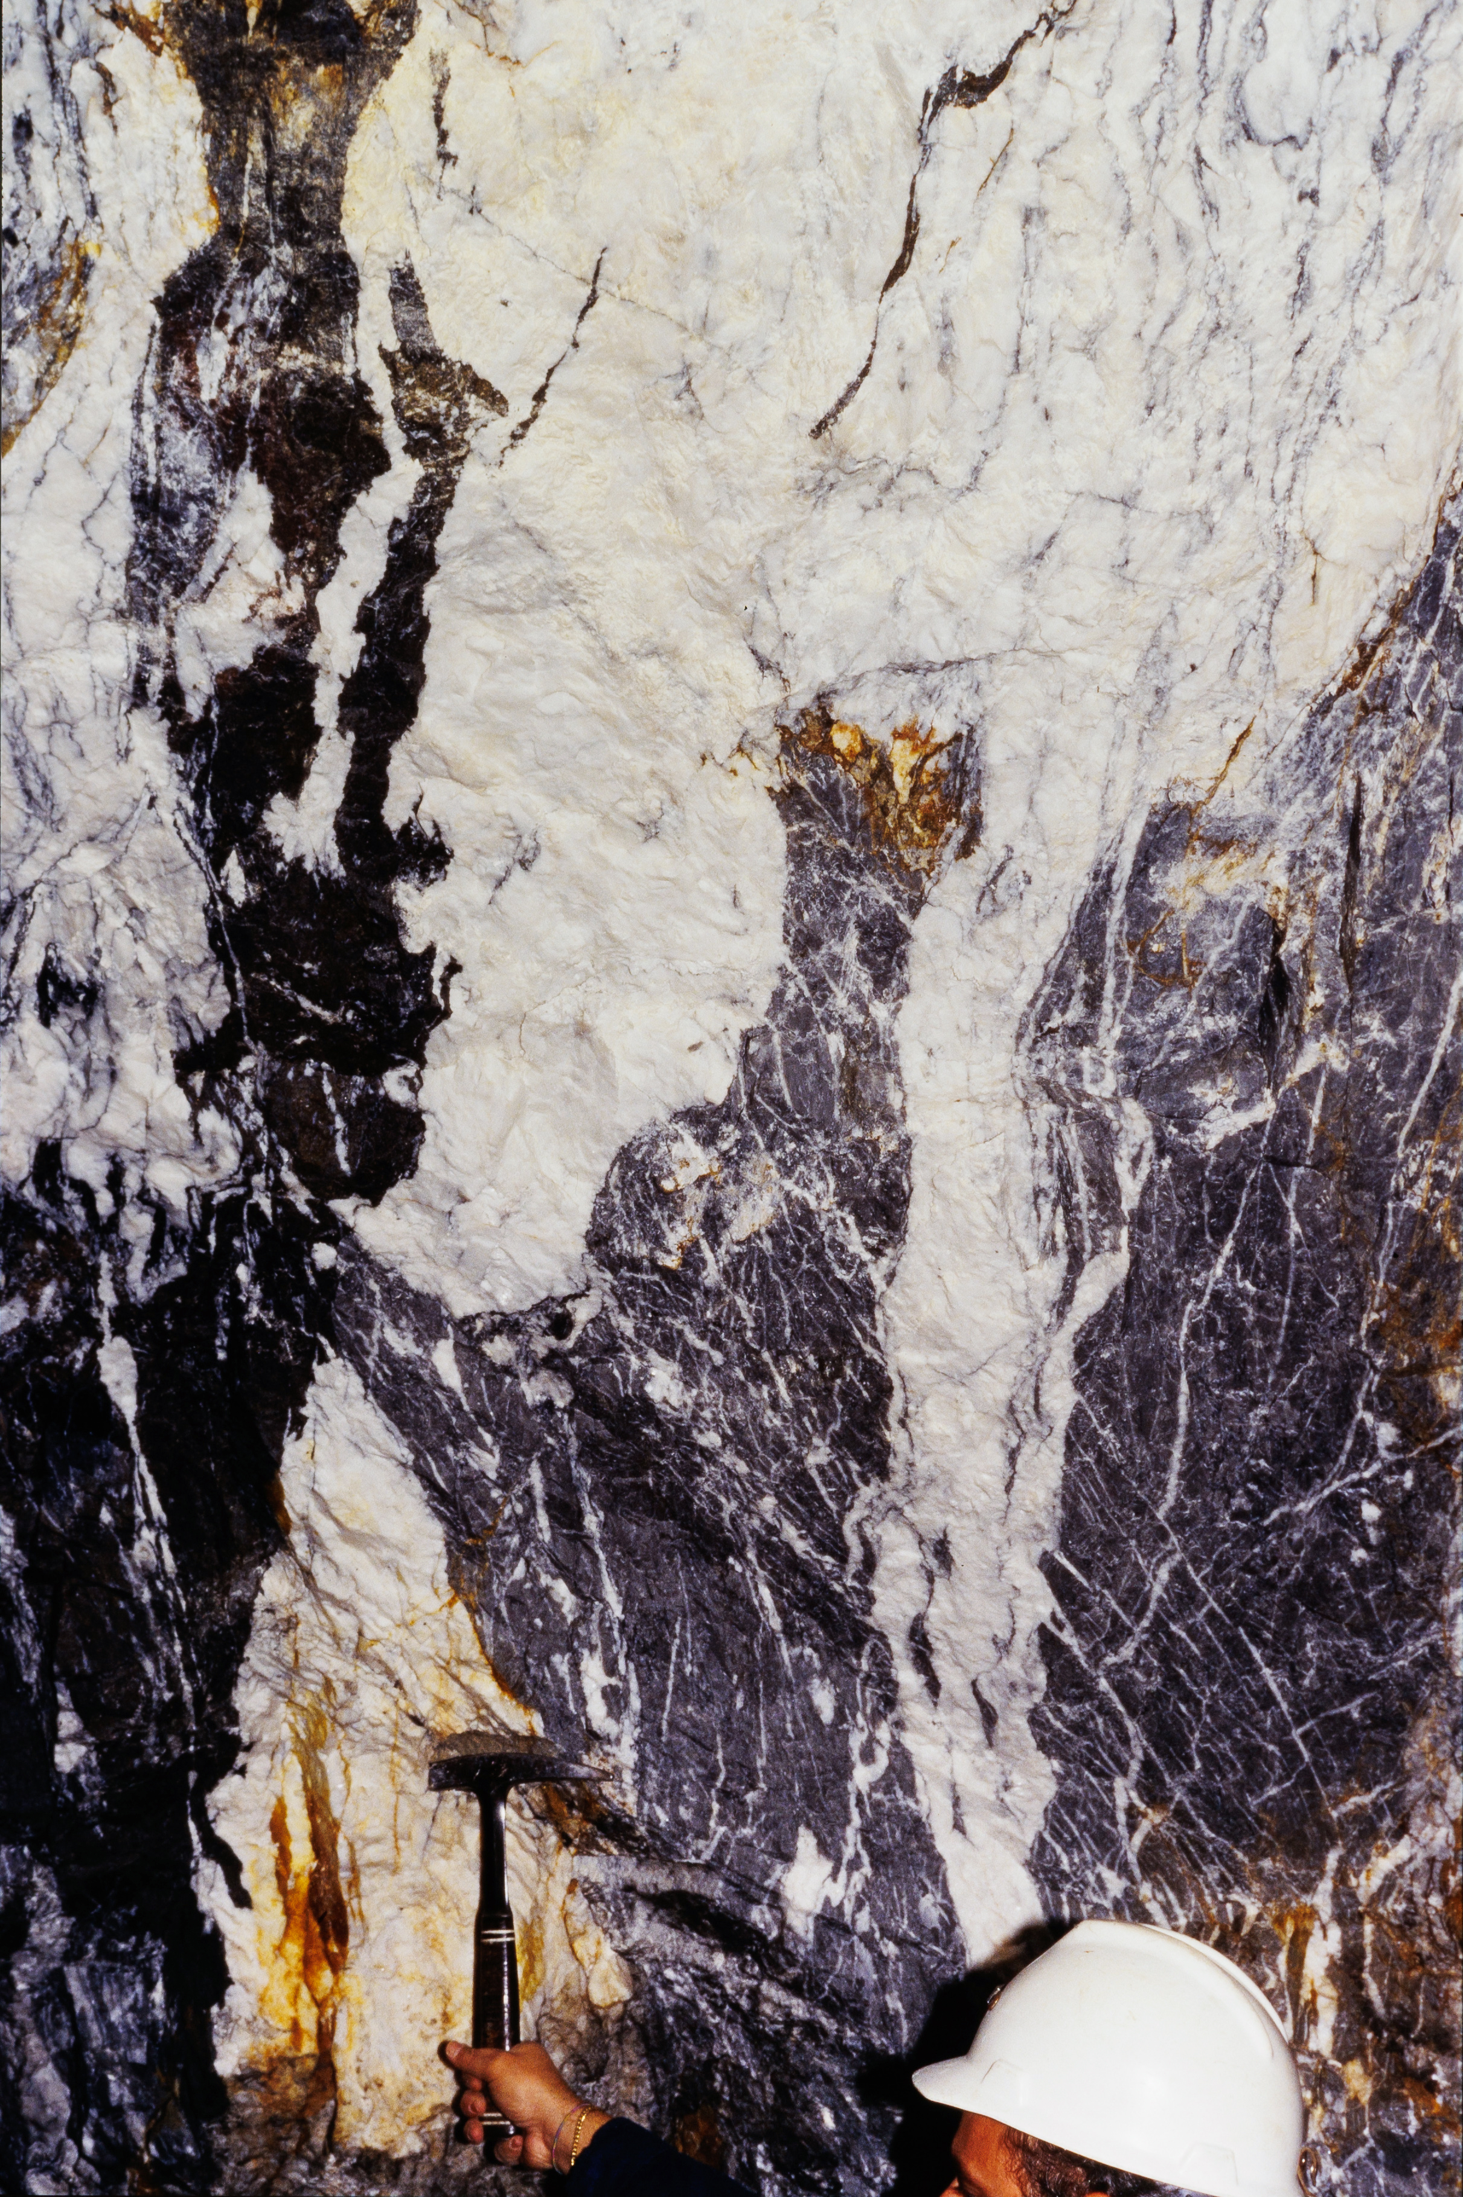
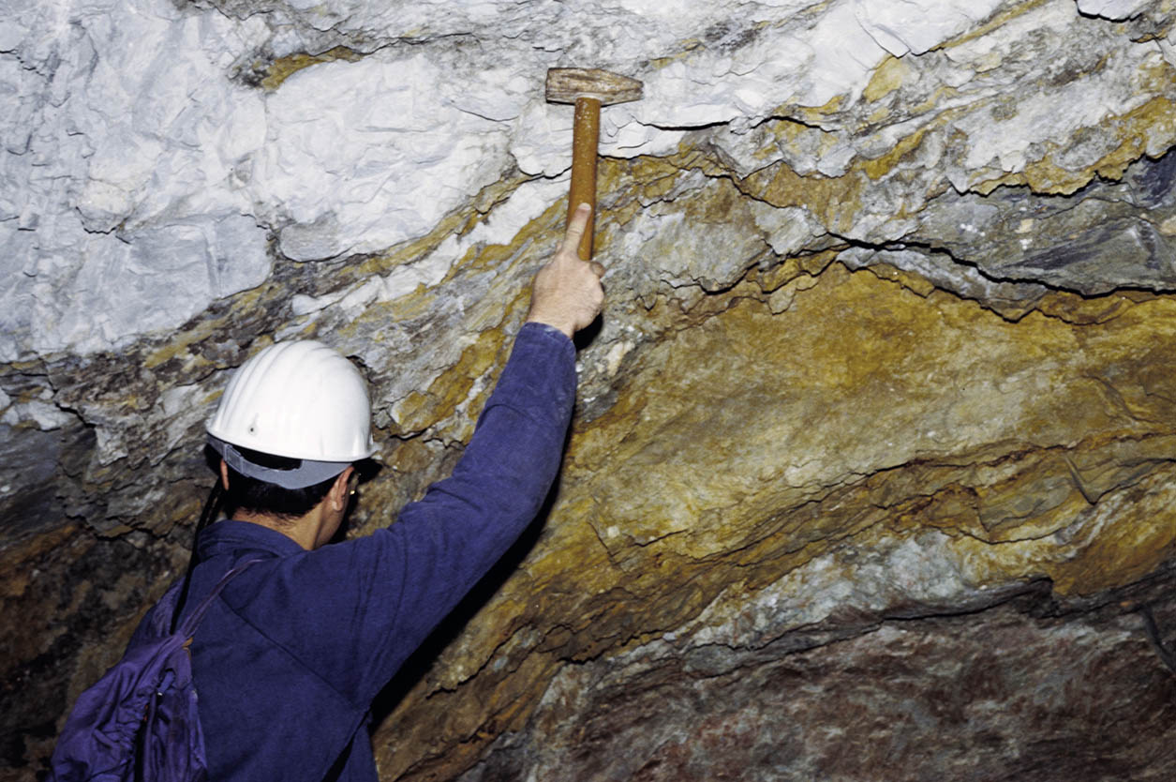
Seddas Moddizzis mine
Calcite bodies associated with sulphides
oriented along the N-S Variscan cleavage
San Giovanni mine
50 YEARS IRISH-TYPE Zn-Pb DEPOSITS
8-10° September

Slide 29
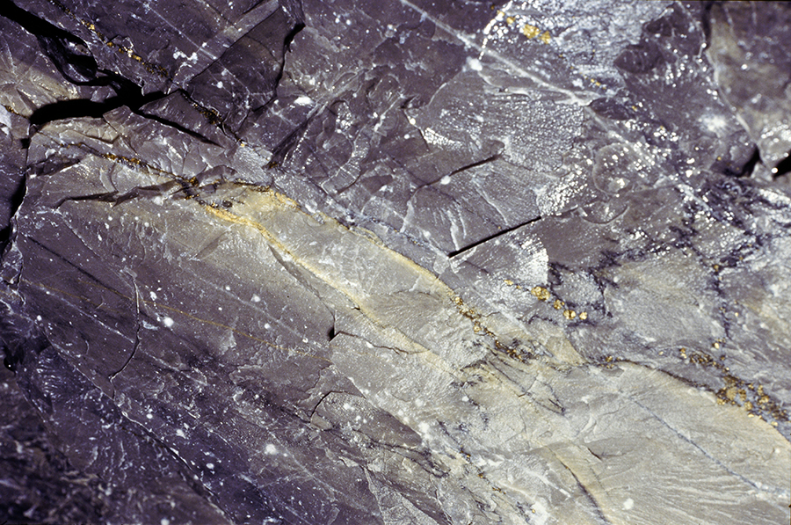
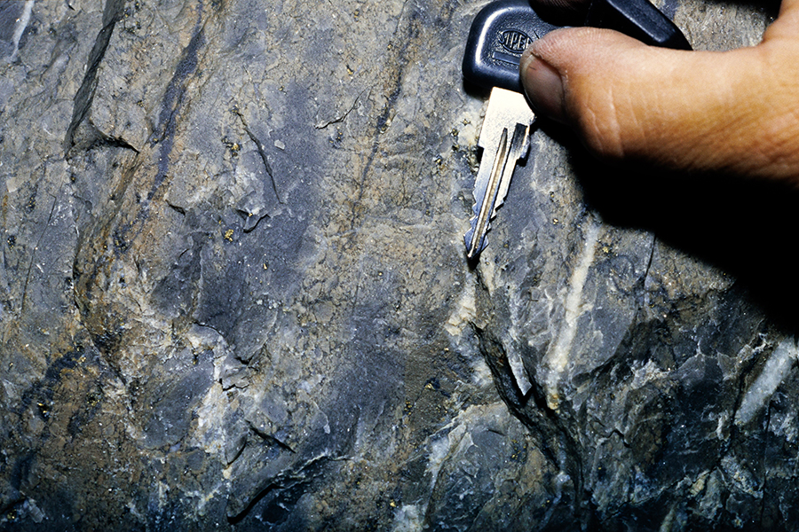
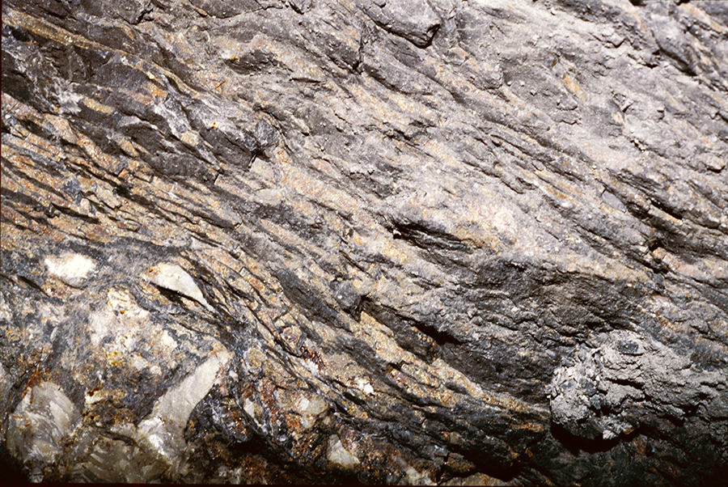
San Giovanni mine. Massa Pozzo 2
(1)
San Giovanni mine. Massa Pozzo 3
(2)
(1) “Yellow” sphalerite in limestone
(2) “Peloidal” sphalerite in limestone
(3) Red sphalerite in shale & breccia
The mineralizations are stretched
following the N-S Variscan cleavage
San Giovanni mine. Contatto W
(3)
50 YEARS IRISH-TYPE Zn-Pb DEPOSITS
8-10° September

Slide 30
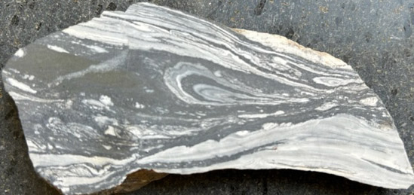
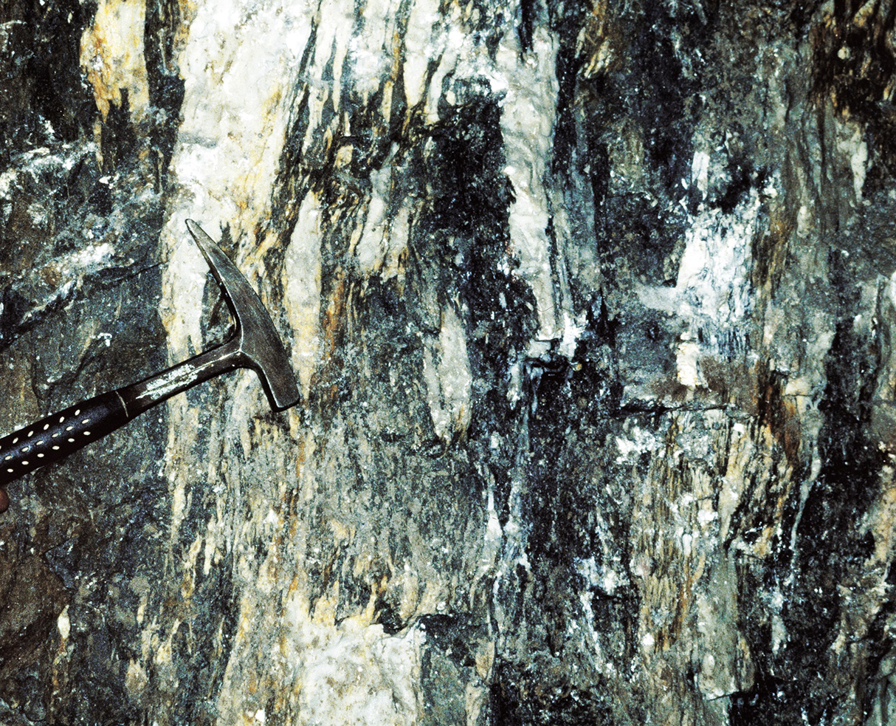
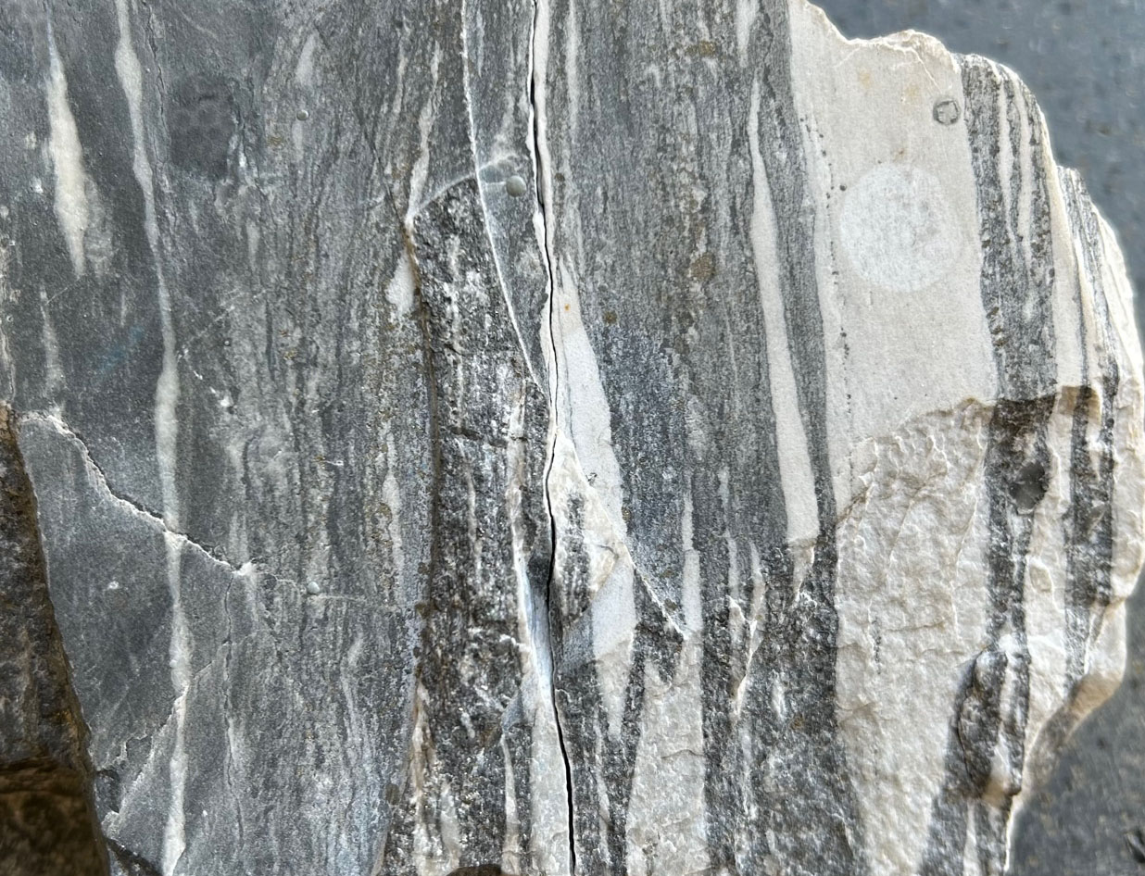
1 cm
Scalittas mine (Masua) Strongly deformed
Cambrian limestone and sulphides
2 cm
Planu Sartu mine (Buggerru)
Mineralized and deformed breccia
Scalittas mine (Masua) Strongly deformed breccia
with Cambrian limestone clasts. Sulphides in the matrix
50 YEARS IRISH-TYPE Zn-Pb DEPOSITS
8-10° September

Slide 31
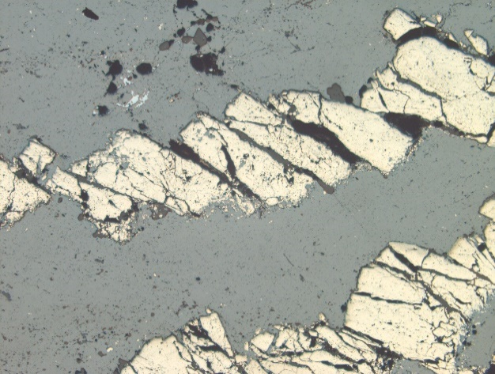
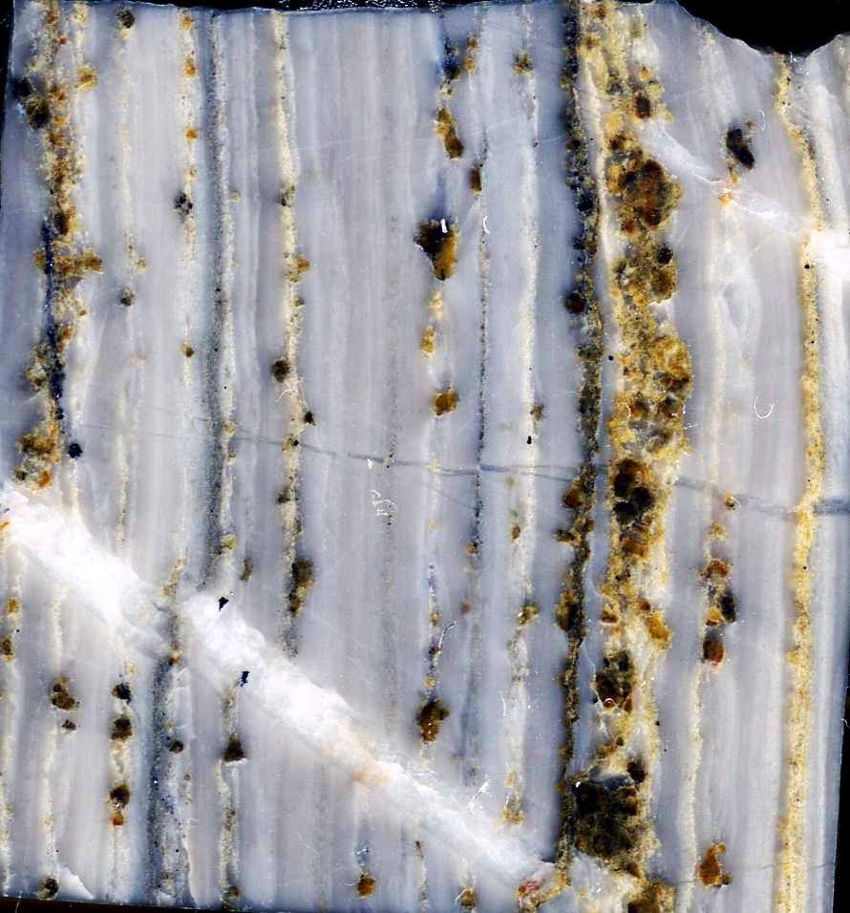

Microeffects of Variscan tectonics
Brittle deformation
pyrite
sphalerite
sphalerite
2 mm
pyrite
Boudinage
Variscan foliation
sphalerite
Pressure
shadows
galena
1 mm
calcite
500 µm
50 YEARS IRISH-TYPE Zn-Pb DEPOSITS
8-10° September

Slide 32




Py
Sph
Sph
Py
Sphalerite & Pyrite oriented along a Variscan fault; Ba-rich Muscovite, Al-rich dioctahedral
Chlorite (dunbassite)
Folded Sphalerite & Pyrite
Py
Chl
Sph
Cal
Sph
400 µm
Folded Sphalerite, Al-rich dioctahedral Chlorite
Pyrite, Sphalerite & twinned Calcite
50 YEARS IRISH-TYPE Zn-Pb DEPOSITS
8-10° September

Slide 33

1920
1995
Old and “less old” maps of Iglesias syncline showing the few limestone outcrops in a sea of brown dolomite
50 YEARS IRISH-TYPE Zn-Pb DEPOSITS
8-10° September

Slide 34

Post Variscan dolomitization
Cambrian Limestone
Fe-rich hydrothermal Dolomite
Nebida Coastal Road
50 YEARS IRISH-TYPE Zn-Pb DEPOSITS
8-10° September

Slide 35


Post-Variscan dolomitization (underground exposures)
2 hydrothermal dolomite generations (saddle
dolomite), both following the Variscan cleavage
Fe-rich dolomite is NOT oxidized
and NOT deformed
50 YEARS IRISH-TYPE Zn-Pb DEPOSITS
8-10° September

Slide 36



Skarn from late- to post-Variscan granite intrusions
2 cm
Sideru Boi Skarn – Wollastonite, Andradite, Epidote, Chlorite, Magnetite-Hematite, Chalcopyrite
marble
Py
Sph
Bor
200 µm
Su Zurfuru Skarn Breccia – Garnet, Wollastonite, Hedenbergite, Epidote, Sphalerite, Chalcopyrite
Filone Morettu Skarn – Pyrite, Sphalerite, Bornite
50 YEARS IRISH-TYPE Zn-Pb DEPOSITS
8-10° September

Slide 37

Post Variscan mineralization (undeformed)
M.Boni
1977
San Giovanni mine – Ag-rich galena and barite in paleokarst breccia at “Grotta Pisani”
50 YEARS IRISH-TYPE Zn-Pb DEPOSITS
8-10° September

Slide 38


Ga
Frb
Py
500 µm
Galena, pyrite & freibergite
Underground pillar in the “Scavi Pisani” (San Giovanni mine). Post-Variscan hydrothermal breccia
50 YEARS IRISH-TYPE Zn-Pb DEPOSITS
8-10° September

Slide 39




Monteponi. Old Pisan Ovens for Silver Ore
3 cm
San Giovanni mine
Silver-rich ore in paleokarst: Ag-galena, Ankerite, Calcite.
Internal sediments in paleokarst with barite and black chert. Barega mine
50 YEARS IRISH-TYPE Zn-Pb DEPOSITS
8-10° September

Slide 40




Secondary nonsulphides “Calamines”
Primary sulphides
Smithsonite & Hemimorphite
50 YEARS IRISH-TYPE Zn-Pb DEPOSITS
8-10° September

Slide 41
Conclusions I
The Lower Palaeozoic-hosted mineralization of SW Sardinia can be only partly classified as “Irish-type”.
The massive sulphides in the tidal dolomites at the base of the Gonnesa Group with their abundance of pyrite and Fe-rich sphalerite, might have been deposited syngenetically or during early diagenesis on the sea floor or along active faults/feeder channels (SedEx?).
On the contrary, it is reasonable to consider that a significant part of sulphides as well as barite in the limestone-hosted orebodies formed through replacement of the carbonate host and as breccia filling during several diagenetic and post-diagenetic stages. WHEN?
Sulphides in the cement and matrix of multi-generational breccias are particularly abundant close to the Cambrian platform margins and along several NW-SE tectonic lineaments. This also demonstrates a pristine structural control on the mineralization in specific areas of SW Sardinia.
50 YEARS IRISH-TYPE Zn-Pb DEPOSITS
8-10° September

Slide 42
Conclusions II
Strong evidence of tectonic control is bound also to the small Upper Ordovician sulphides/barite deposits, with the Cambrian carbonates acting as structural highs that followed a pattern of already active lineaments.
The effects of Variscan deformation and low-grade regional metamorphism on the pre-Variscan ores in SW Sardinia include changes in: (a) the geometry of sulphide orebodies, and (b) the mineralogy and textures of the ore and gangue minerals. Major and trace element contents of minerals were probably modified as well.
The deposition of post-Variscan ores was also subjected to structural control: the lineaments hosting the veins and paleokarst orebodies were conditioned by the extensional tectonics active at the end of the Variscan orogeny, that lasted throughout the Mesozoic.
50 YEARS IRISH-TYPE Zn-Pb DEPOSITS
8-10° September

Slide 43

THANK YOU
50 YEARS IRISH-TYPE Zn-Pb DEPOSITS
8-10° September

