Slide 1
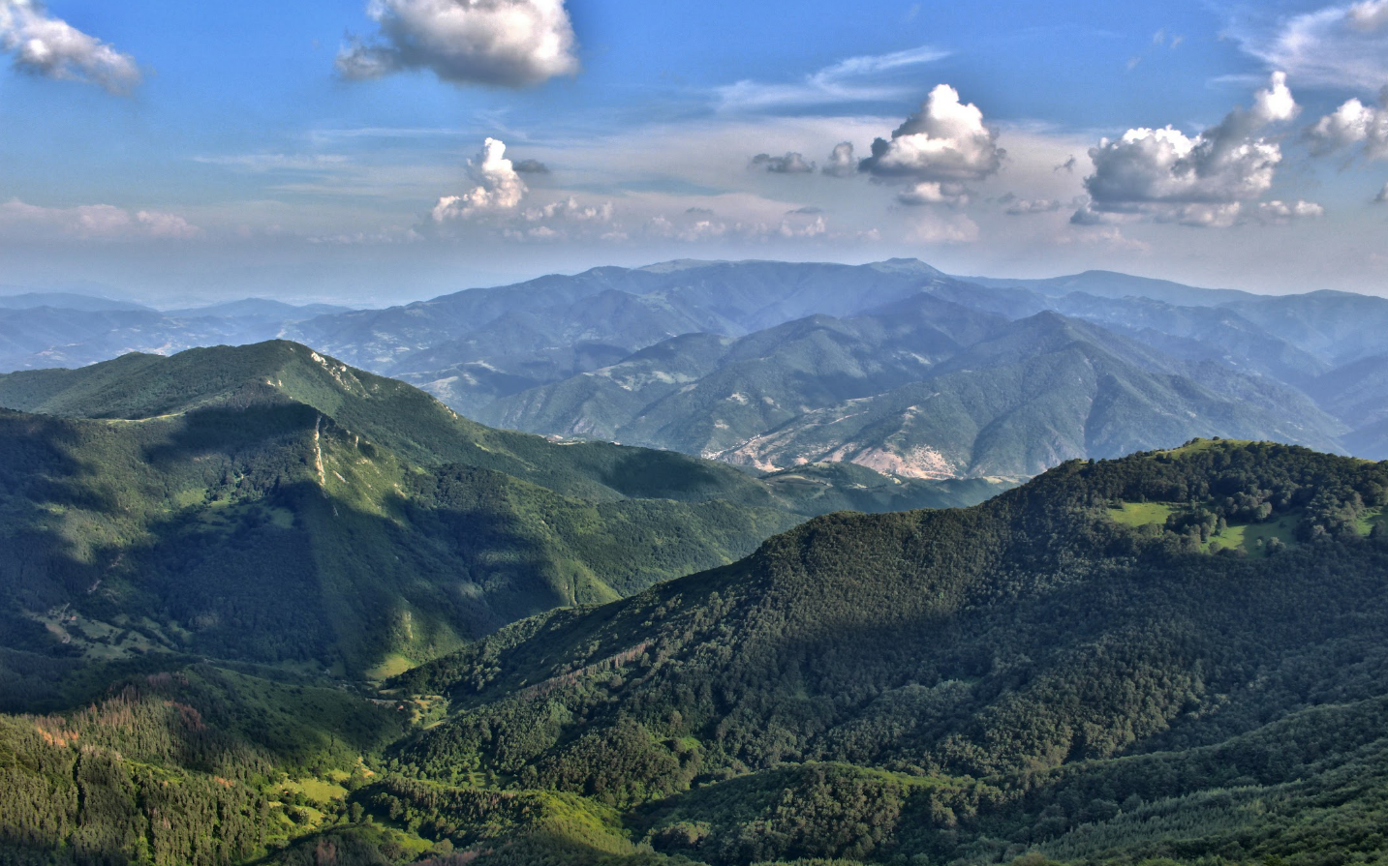

Sedmochislenitsi, Bulgaria
Colin J Andrew
Седмочисленици
Стратиформите олово, цинкоби и медни
Ирландска тип ?
Колин Андрю

Slide 2
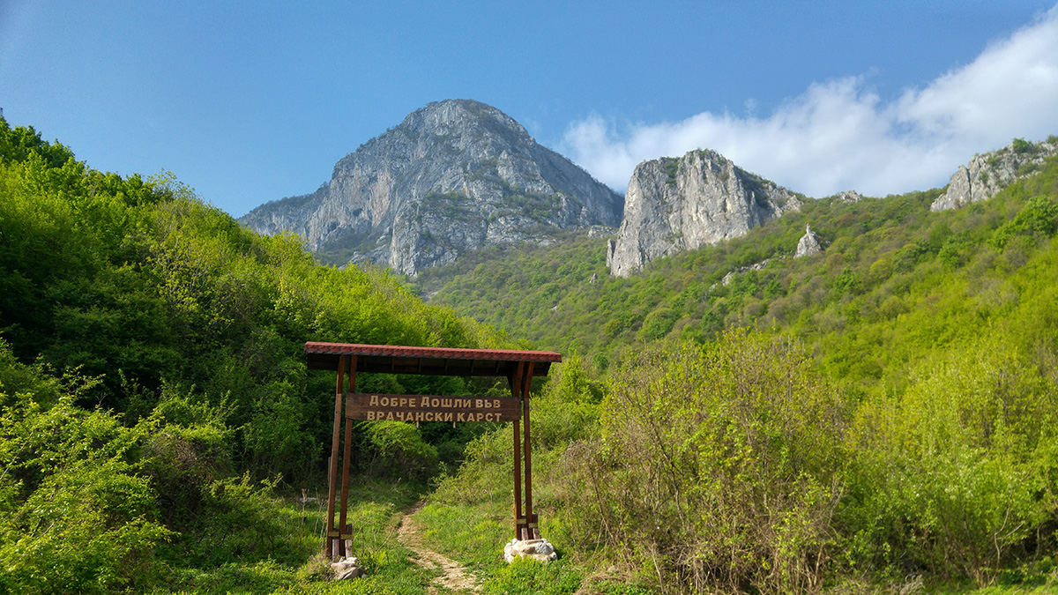

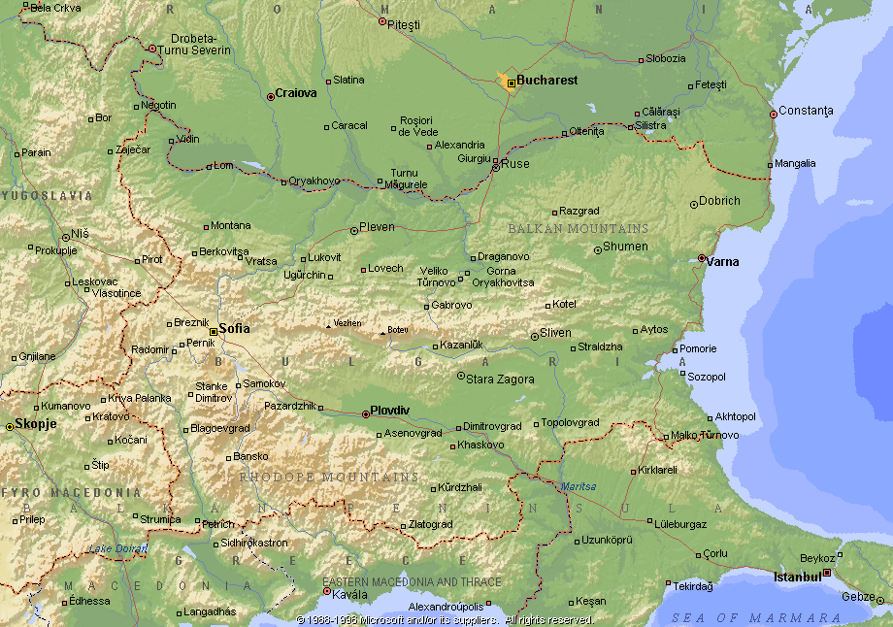
Sedmochislenitsi, Bulgaria
Colin J Andrew
Notes:
Mineralization in Western Balkan crops out largely along the flanks of the deeply incised River Iskar and its tributaries between 300 to 1600m above mean sea level in a physiographic area known the Vrachanski Karst. The Triassic carbonate-hosted stratiform-stratabound base-metal deposits comprise more than 120 occurrences of lead, zinc, copper and silver mineralization located to the south of the regional town of Vratsa. This also includes the large (>250Mt) iron-barium (plus sub-economic lead-zinc) Kremikovtsi deposit situated to the north of Sofia, which, together comprise the Kremikovtsi-Iskar Orefield. The Sedmochislenitsi deposit, located approximately 35 km north of Sofia, is the most significant of these Zn-Pb-Cu deposits and is hosted within Triassic (Anisian-stage) limestones and dolomites of the Iskar Group. The deposits have been compared to the famous Alpine-type Zn-Pb deposits

Slide 3
Introduction
Sedmochislenitsi, Bulgaria
Colin J Andrew
Pb-Zn deposits hosted by Triassic carbonates of the Eastern and Southern Alps are generally classified as “APT deposits” – a subset lying between Irish-type and MVT’s.
At some APT deposits hydrothermal carbonates pre- and post-dating the ore-forming event show that base-metal mineralization occurred shortly after the deposition of the Anisian to Carnian-aged host rocks. This implies that the deposits formed syndiagenetically at shallow burial depth prior to the early Jurassic western Tethys rifting phase.
Lying at the same stratigraphic level within the Anisian to Carnian Stages are classical SedEx type deposits at Vares in Bosnia, Bobija in Serbia and Kremikovtsi in Bulgaria.
Sedmochislenitsi lies at a similar stratigraphic level as both but demonstrates characteristics that may be interpreted as being more Irish-type.
Notes:
The Sedmochislenitsi deposit, located approximately 35 km north of Sofia, is the most significant and the best studied of these Zn-Pb-Cu deposits and is hosted within Triassic (Anisian-stage) limestones and dolomites of the Iskar Group. The deposits have been compared to the famous Alpine-type Zn-Pb deposits

Slide 4
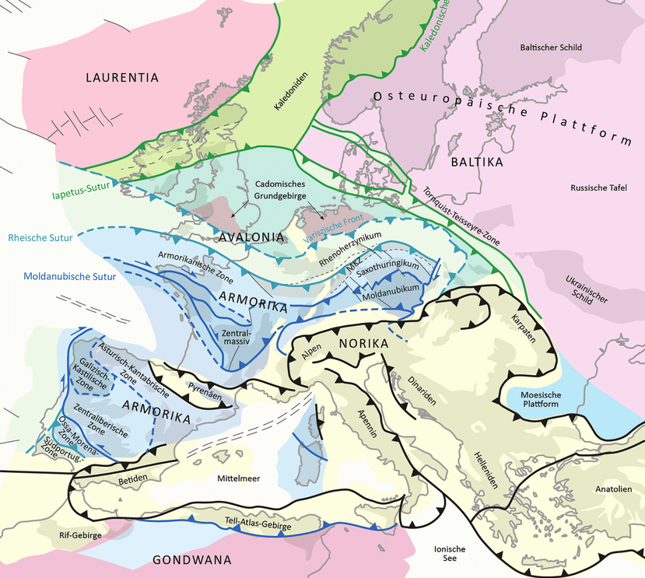
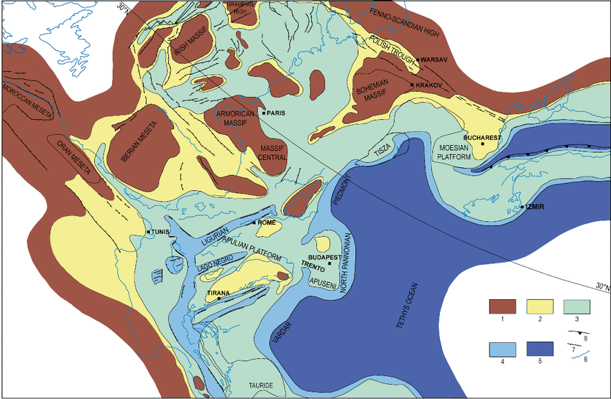
Sedmochislenitsi, Bulgaria
Colin J Andrew
Carbonate-hosted
SedEx (Varesh-type)
APT District
Vardar Tethys
Sedmochislenitsi
Bleiberg - Mezica
Vares
Sedmochislenitsi
Bobija
Continental
Coastal Plain
Shelf
Basin & Slope
Deep Marine
Kremikovtsi
Tectonostratigraphic Units
(From Harff, J. et al (2017)
Palaeogeographic Setting – Early Triassic (Anisian Stage)
After Cosentino et al (2010)
Notes:
The two carbonate platforms, facing each other from the opposite passive continental margins of Gondwana and Laurentia / Baltica, are the locale for numerous carbonate-hosted deposits in the Alps, Dinarides and Moesia.
Contemporaneous deep water marine basin, or the Dinaric Gulf of the Tethys Ocean hosts classical zoned SedEx deposits as at Vares, Bobija and Kremikovtsi and possibly elsewhere such as Rudabanya in northern Hungary

Slide 5
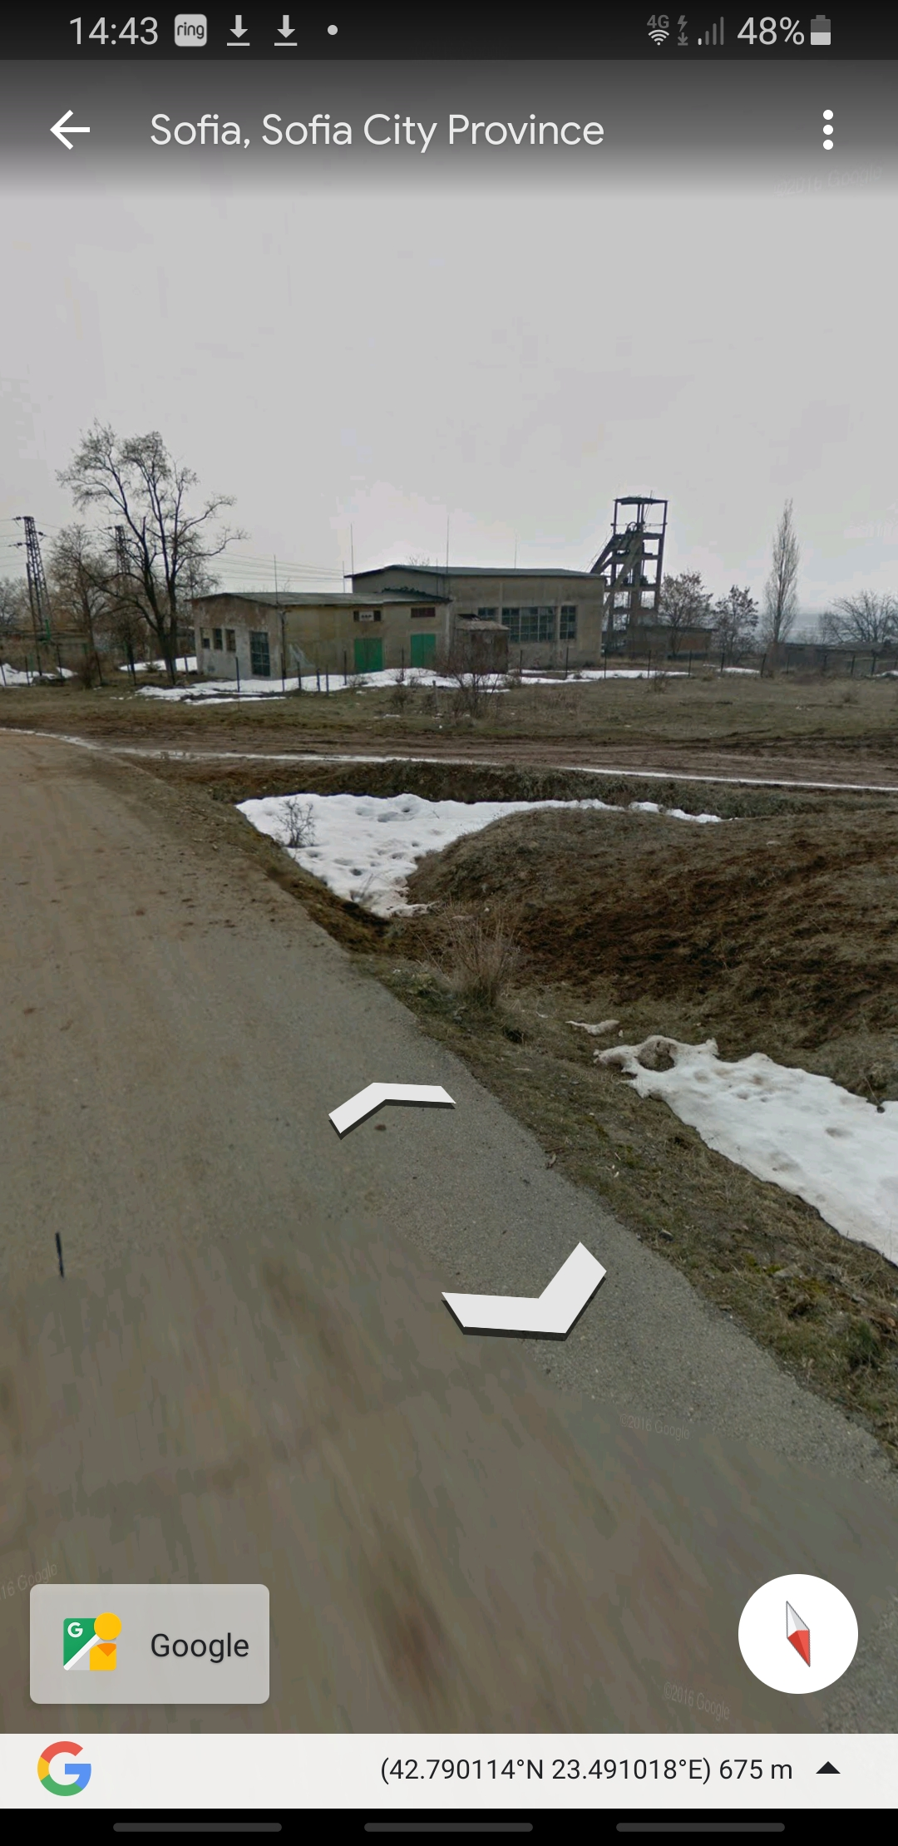
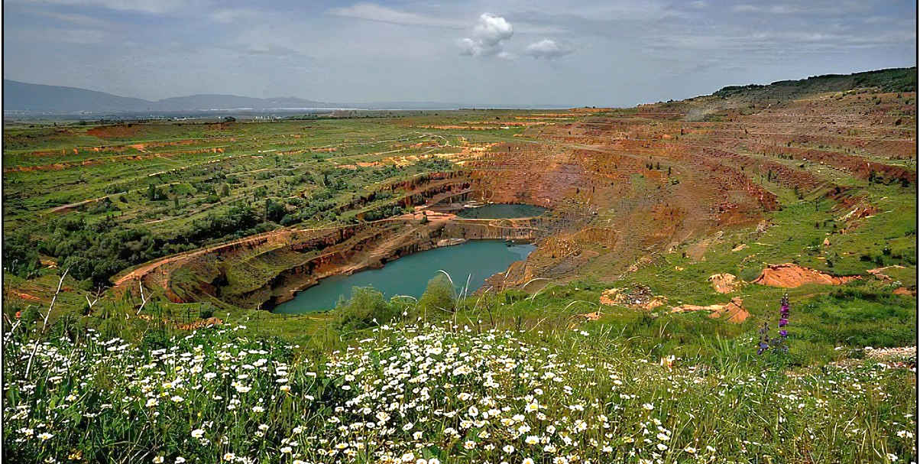
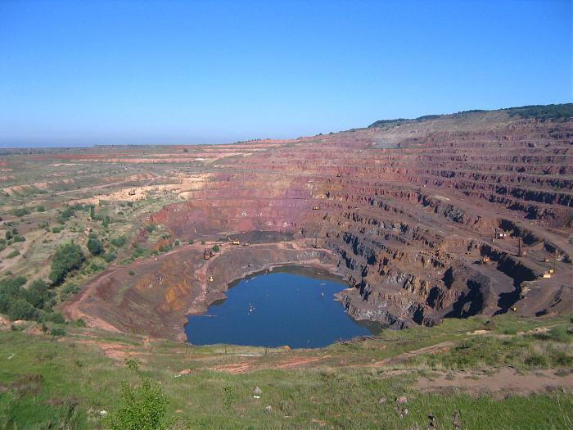
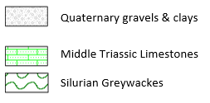
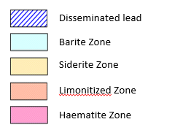
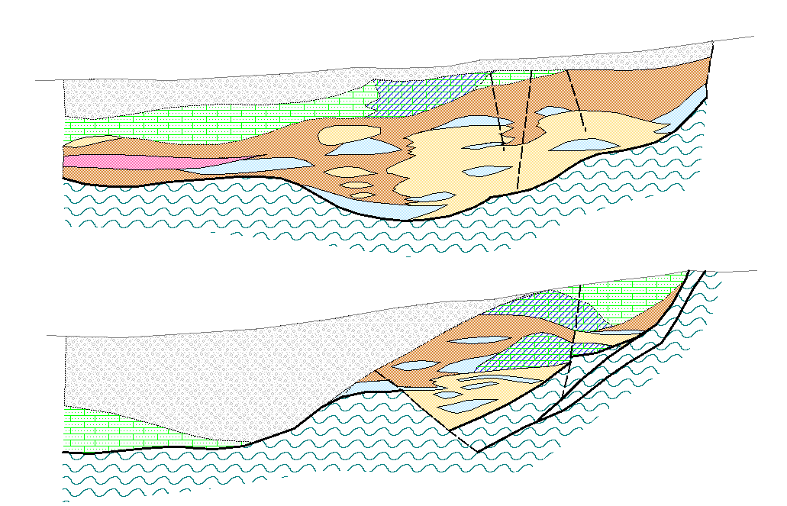
The Kremikovtsi deposit produced in excess of 47Mt of mixed siderite and haematite iron ores averaging 31.4% Fe between 1951-1995.
The orebody contains:
250 Mt of iron ores (limonite + siderite + haematite), 29 Mt of barite and 10.4Mt of lead mineralization averaging 1.2% Pb.
The orebody is stratiform lying within Triassic carbonates and is considered to be a zonal carbonate-hosted SedEx type.
Sedmochislenitsi, Bulgaria
Colin J Andrew
Kremikovtsi, Bulgaria
EAST
WEST
300m
200m
100m
0m
NORTH
SOUTH
300m
200m
100m
0m
From Popov (1989) and Damyanov (1995)

Slide 6
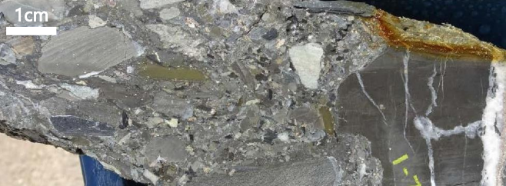
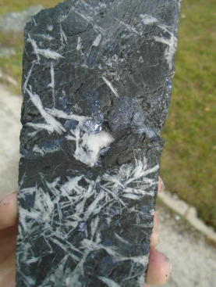
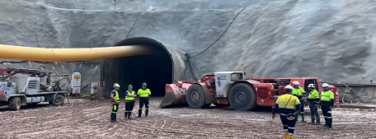
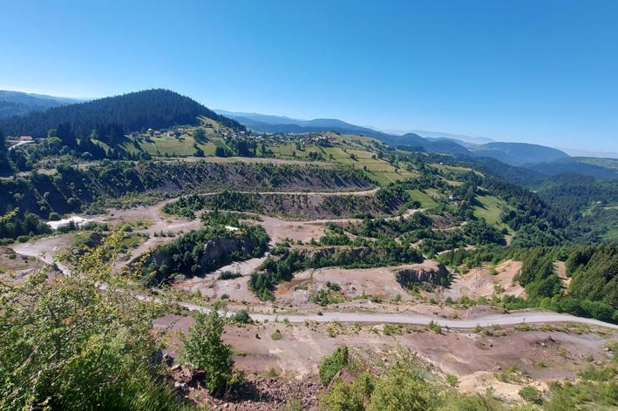
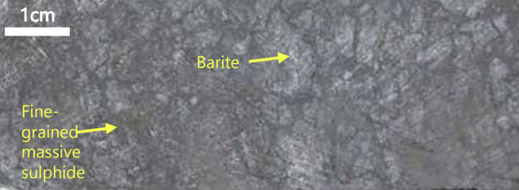
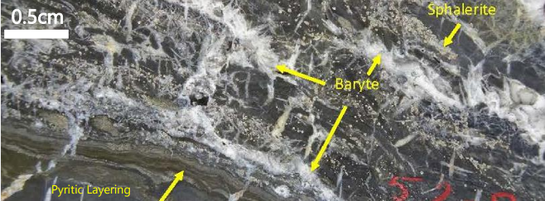
Vares (Rupice), Bosnia
Sedmochislenitsi, Bulgaria
Colin J Andrew
Mineralized clasts
1cm
The Rupice deposit at Vares was historically mined in the 1970’s with production totalling around 30Mt, and is currently being developed by Adriatic Metals plc.
Ag, Zn, Pb, Cu, Au and barite mineralization occurs within a dolomite unit within a Triassic-aged flysch sequence of shales, cherts, calcwackes and arenaceous limestones. The principal host to mineralization is a poorly sorted polymict breccia, showing variation in clast type and size. Mineralization is present in both matrix and clasts.
Lath shaped barite
after gypsum (??)
Rupice SedEx 12.0Mt @ 4.1% Zn, 2.6% Pb, 0.6% Cu, 149 g/t Ag, 1.4 g/t Au, 25.1% BaSO₄
Vares Fe Ore 147.4Mt @ 32.8% Fe (siderite), 24.2Mt 31.7% Fe (haematite)

Slide 7
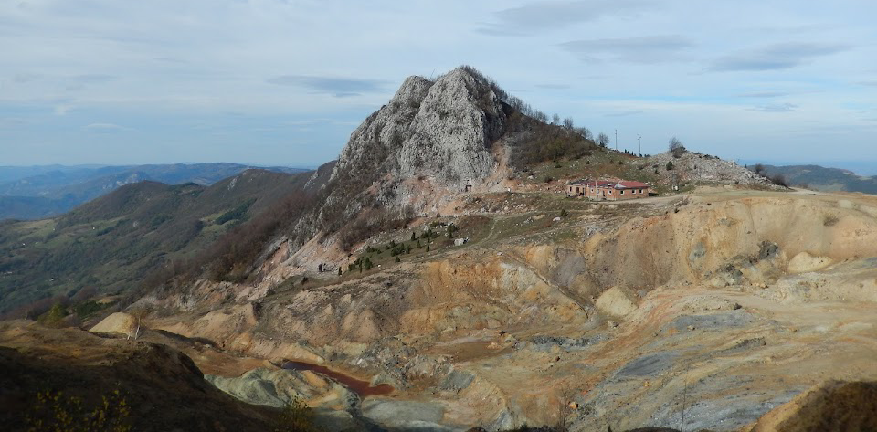
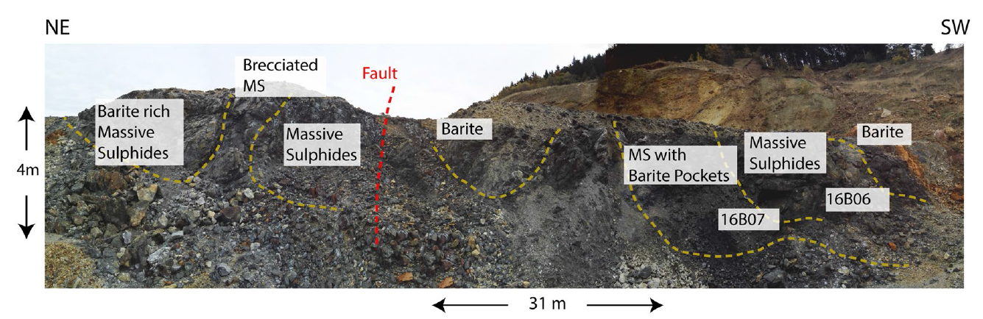
Sedmochislenitsi, Bulgaria
Colin J Andrew
Bobija, Western Serbia
Orebody averages 28.3% BaSO₄, 3.92% Pb, 3.75% Zn, 0.84% Cu, 87 g/t Ag
The sulphide mineralization consists of fine-grained pyrite, sphalerite, galena and tetrahedrite, and is associated with abundant barite. A feeder zone is present in the immediate footwall of the ore mineralization. The deposit is stratabound and hosted by a Triassic sedimentary sequence dated by U:Pb zircon at 243.15 ± 1.3 Ma (Mid-Triassic, close to the boundary between the Anisian and the Ladinian).
Massive sulphides with clastic fabrics
From Prelevic et al 2019

Slide 8
Sedmochislenitsi, Bulgaria
Colin J Andrew
Carbonate-hosted
SedEx (Varesh-type)
APT District
Sedmochislenitsi
Bleiberg - Mezica
Varesh
Sedmochislenitsi
Continental
Coastal Plain
Shelf
Basin & Slope
Deep Marine
Kremikovtsi
Tectonostratigraphic Units
(From Harff, J. et al (2017)
Palaeogeographic Setting – Early Triassic (Anisian Stage)
After Cosentino et al (2010)

Slide 9
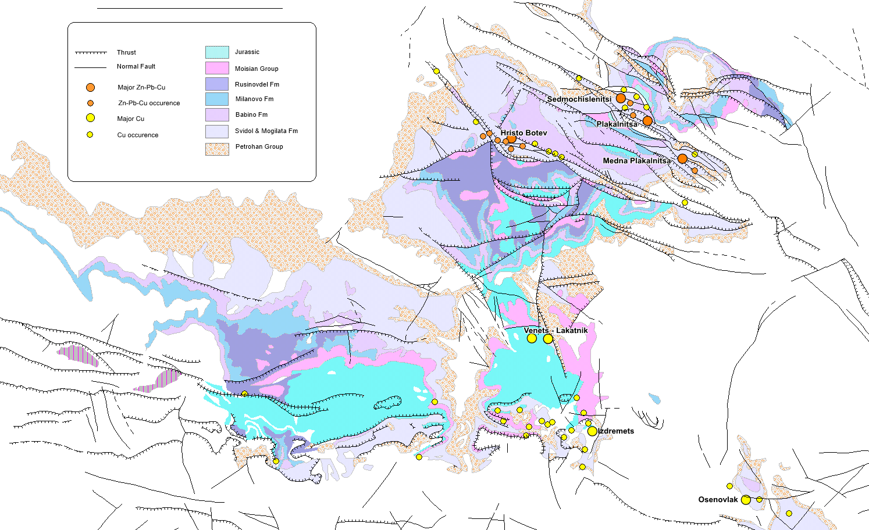

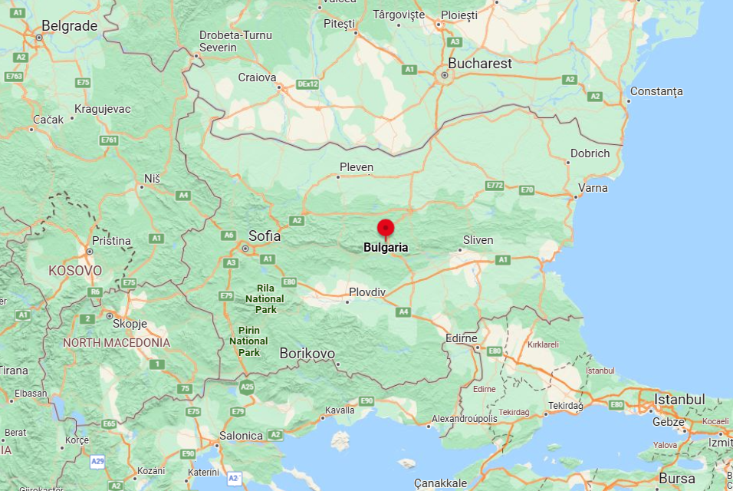
Sedmochislenitsi, Bulgaria
Colin J Andrew
Geology from Bulgarian Geological Survey Maps K3425-Berkovica, K3436-Vratsa, K-3447-Sofia & K3448-Botevgrad
Mineral Deposits of the Vratsa District
Plakalnitsa 1.38 Mt @ 1.45% Cu
Sedmochislenitsi 0.77 Mt @ 0.72% Cu
Izdremets 0.78 Mt @ 0.74% Cu
Venets - Lakatnik 1.98 Mt @ 0.50% Cu
Osenovlak 0.43 Mt @ 1.03% Cu
Hristo Botev 0.07 Mt @ 0.71% Cu
Plakalnitsa 0.65 Mt @ 2.84% Zn+Pb
Sedmochislenitsi 10.67 Mt @ 1.63% Zn+Pb
Izdremets 0.38 Mt @ 3.13% Zn+Pb
Hristo Botev 0.26 Mt @ 2.21% Zn+Pb
Osenovlak 0.05 Mt @ 3.15% Zn+Pb
Notes:
Vratsa district located around 45km NNE of the capital Sofia

Slide 10
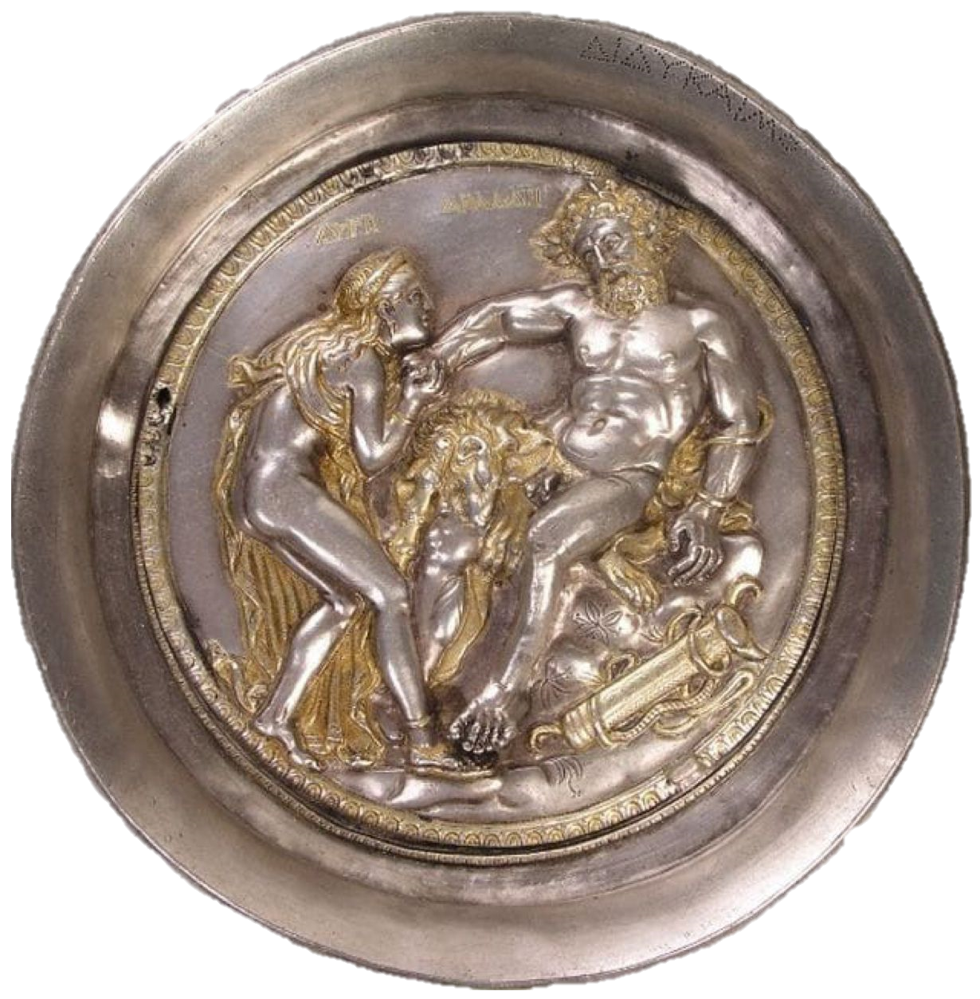
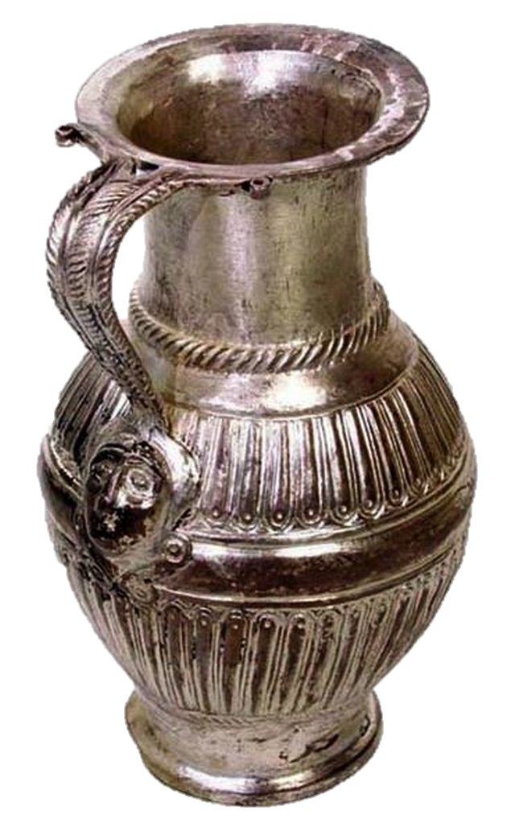
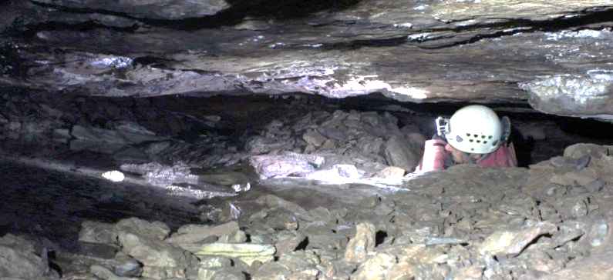
Sedmochislenitsi, Bulgaria
Colin J Andrew
History
Mining in the Vratsa area dated back to the Thracians and evidenced by the Rogozen Treasure of 165 objects weighing 20 kg of silver dated to around 500 BCE.
Thracian age silver workings in Vratsa District
Notes:
It was discovered by chance in the autumn of 1985 by tractor driver Ivan Dimitrov, digging a hole for an irrigation system in his garden

Slide 11


Sedmochislenitsi, Bulgaria
Colin J Andrew
History
Mining continued following the Roman conquest in 29 BCE for both lead and copper and again recommenced in the Middle Ages (13th-14th Century) by Saxon miners from the Erzgebirge. Under the Ottomans mining again recommenced in the 19th Century and again in 1902 after independence.
During the period 1916-18 the mines sold lead and copper concentrates both to the British and Germans. Mining continued in a limited way up to 1952 when the post-war socialist centrally planned economy reorganized the mines.
Notes:
Intrerestingky the mining company

Slide 12
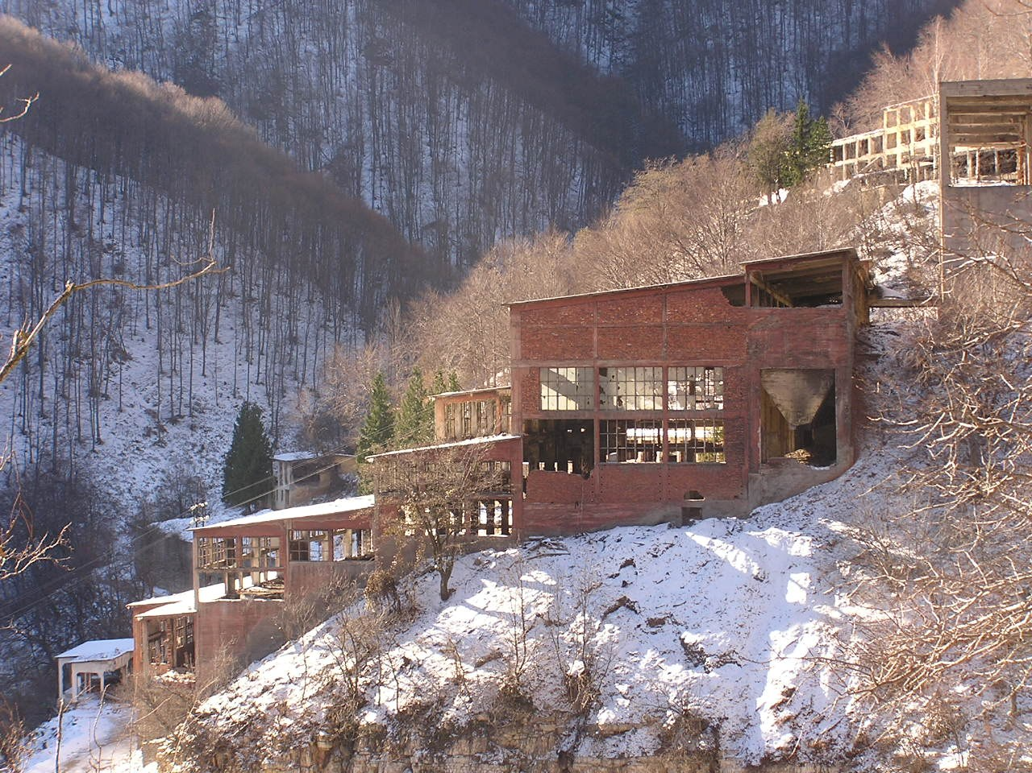
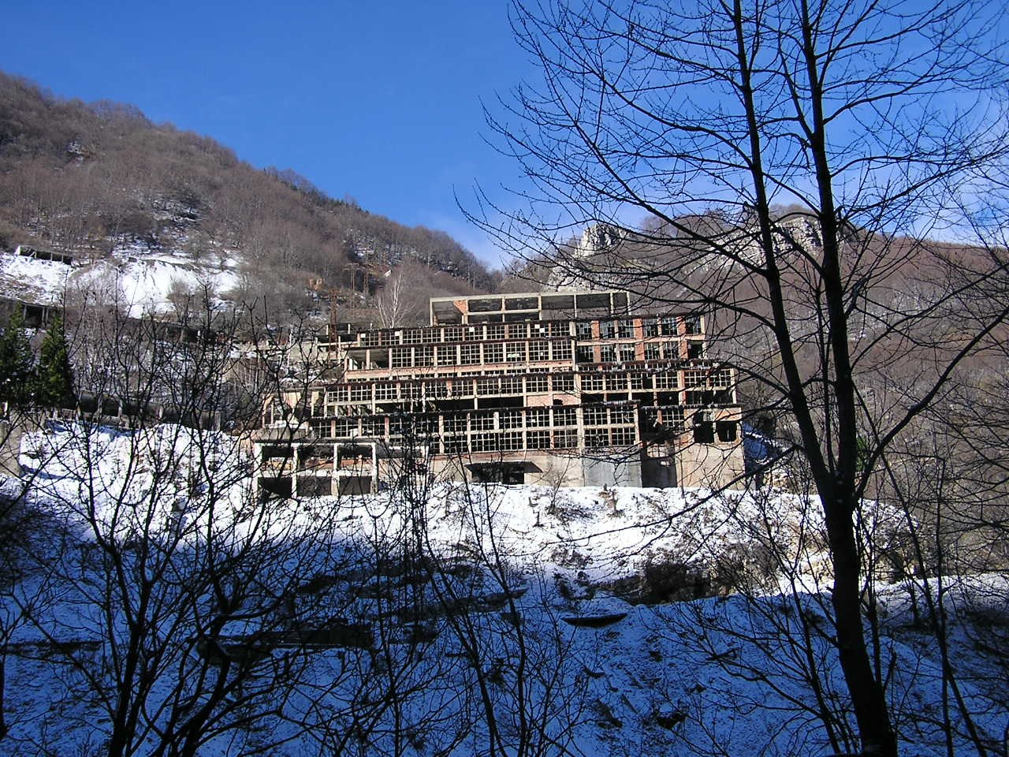
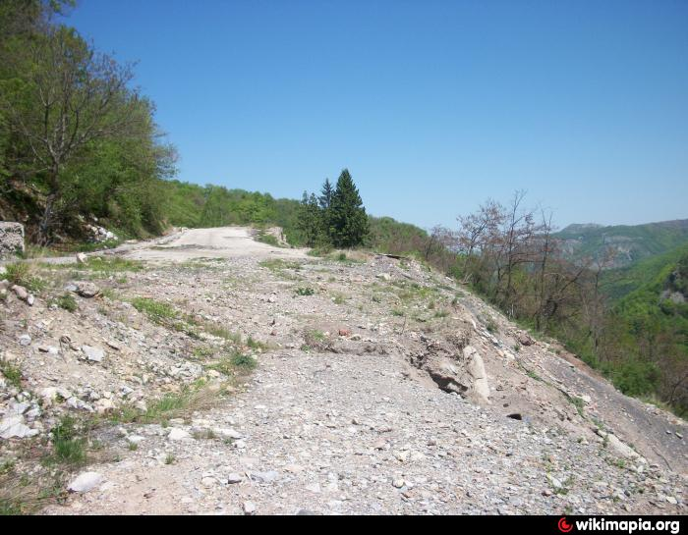
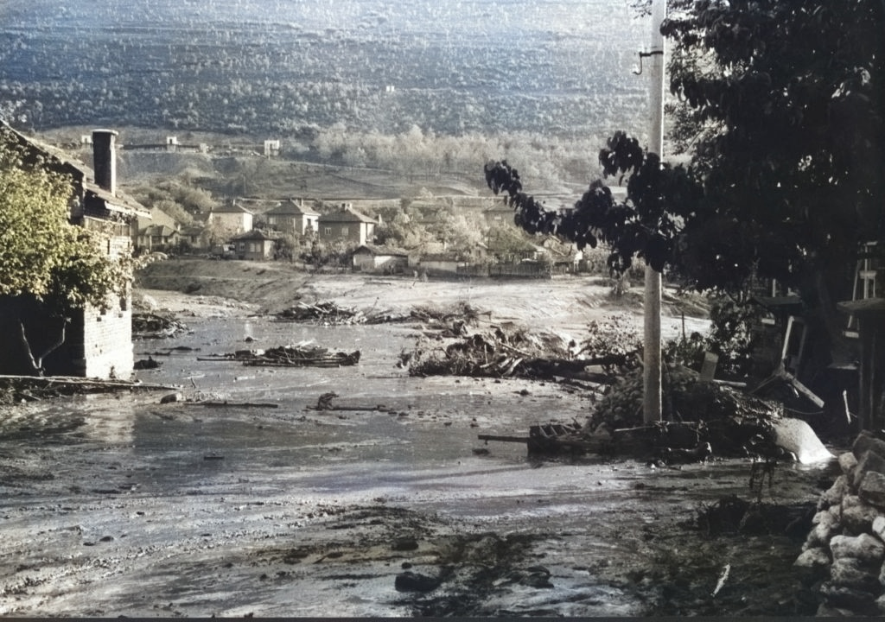
Sedmochislenitsi, Bulgaria
Colin J Andrew
Mir Flotation Plant
The Medna-Plakalnitsa and Sedmochislenitsi mines operated for around 90 years until closure 1998 with a total recorded production for Sedmochislenitsi (1950-1995) of
10,673,200 tonnes at 1.00% Pb, 0.63% Zn, 44 g/t Ag and
765,100 tonnes at 0.72% Cu.
(Милев et al., 1996)
Dumps at Mir Mine
Tailings Disaster in Zgorigrad 1966
Mir Flotation Plant
Notes:
Sedmochislenitsi differs significantly from the other Alpine-type deposits in the fact that it contains a substantial body of copper mineralization comprised of chalcopyrite, bornite and tennantite with significant amounts of silver sulphosalts and native silver. In addition, the presence of Ni-sulphides and arsenides and mercurian copper minerals bears close comparison with some of the Irish deposits such as Tynagh and the Lisduff Oolite mineralization at Lisheen

Slide 13
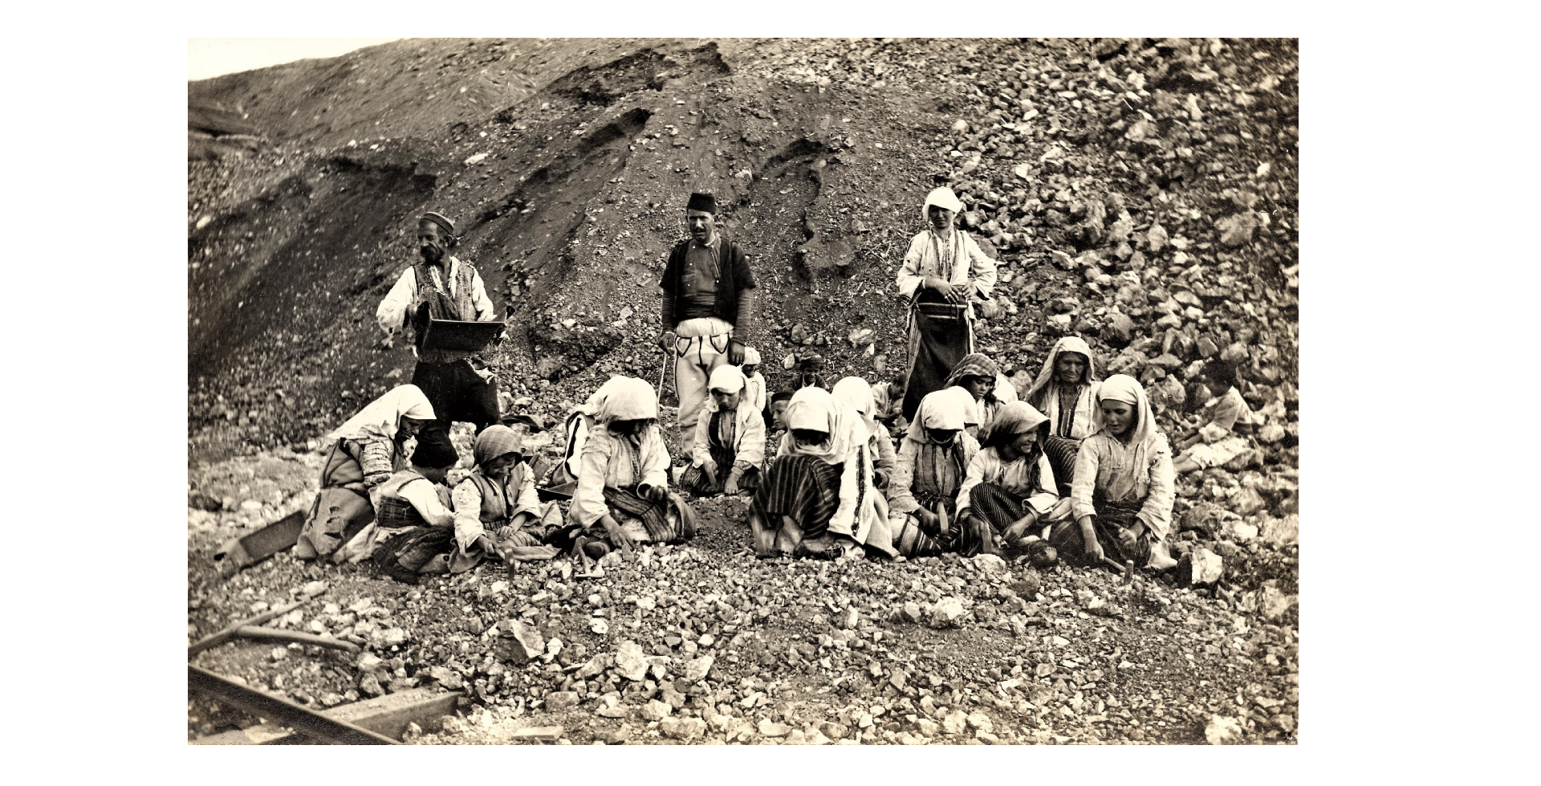
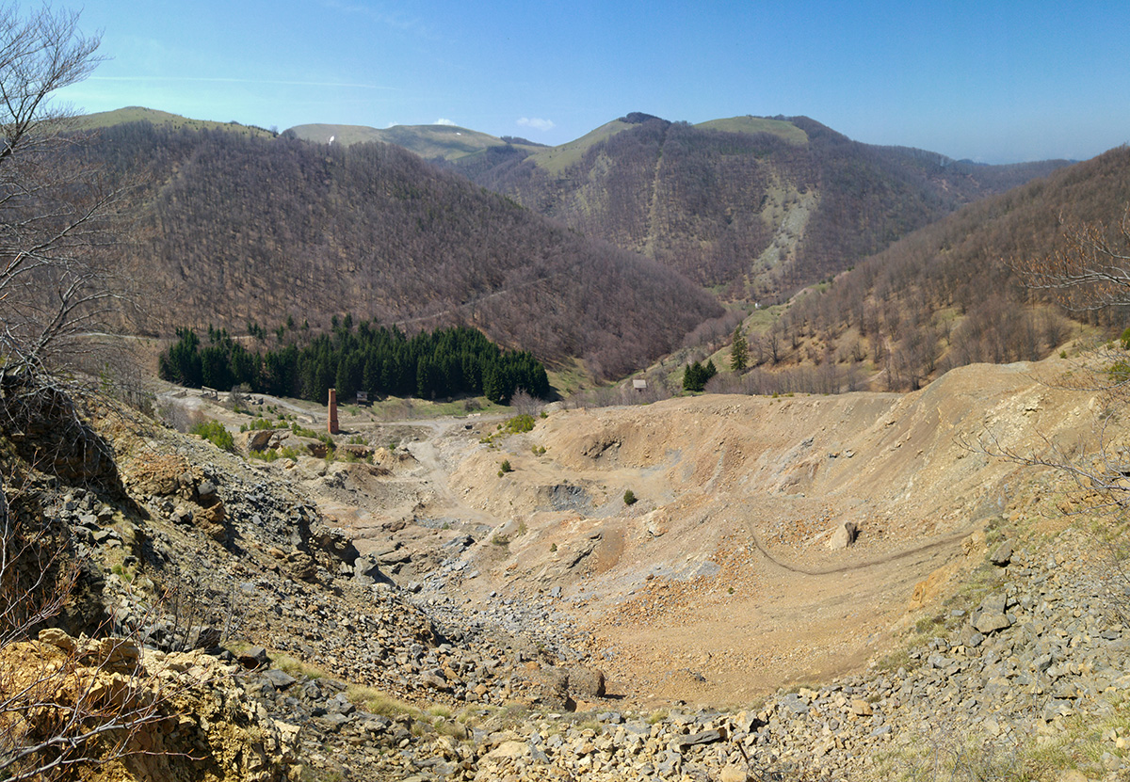
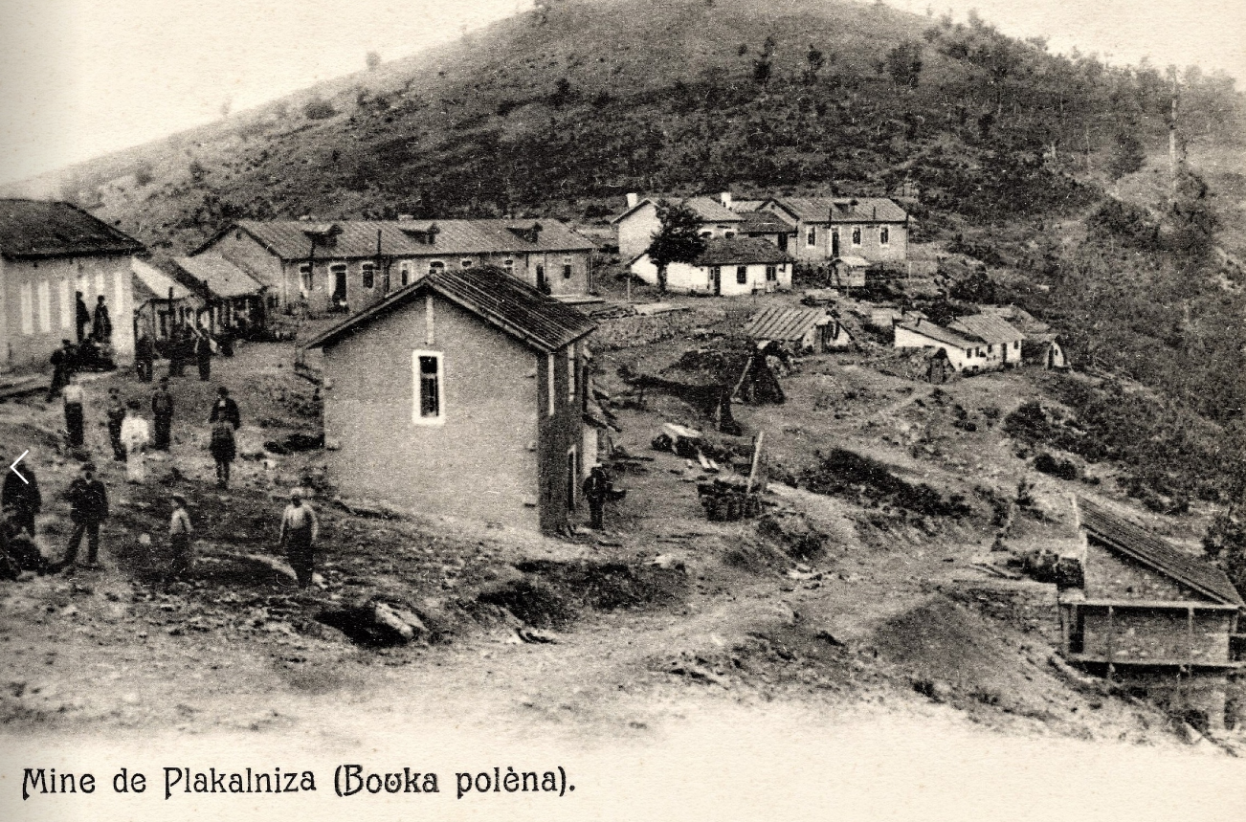

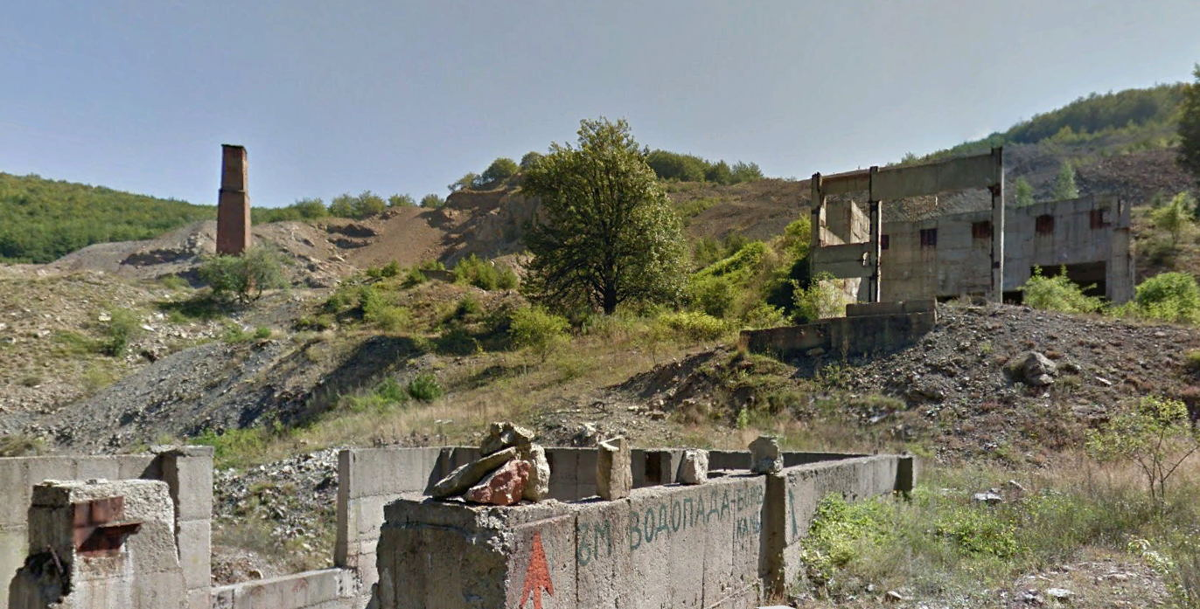
Sedmochislenitsi, Bulgaria
Colin J Andrew
Medna-Palkalnitsa Mine 1910
Medna-Plakalnitsa Mine 1908
Medna-Plakalnitsa
Medna-Plakalnitsa Mine 2008
Medna-Plakalnitsa (1902-1978)
649,400 tonnes at 1.41% Pb, 1.43% Zn and 1,380,400 tonnes at 1.45% Cu
(Милев et al., 1996)

Slide 14
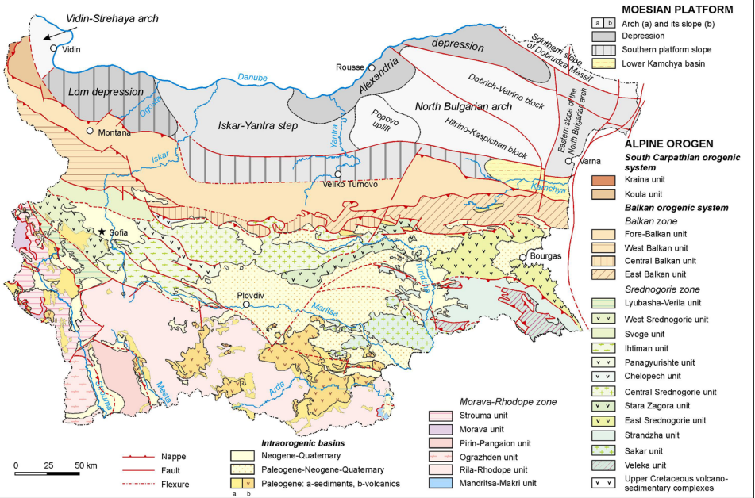
Sedmochislenitsi, Bulgaria
Colin J Andrew
Moisian Platform
Balkan / Stara Planina
Srednogoria
Rhodopes
Tectonic Setting
From Zagorchev, I. & Budarov, K. (2008)
Notes:
The area lies within the central-eastern part of the Alpine “Western Balkan Tectonic Zone” The mineralized Triassic succession forms the base of the Mesozoic cover over the pre-Mesozoic Balkan terrain – a Precambrian to Cambrian ophiolite-island arc assemblage, unconformably overlain by a Palaeozoic sedimentary sequence. The Mesozoic was accreted to the Palaeozoic basement of the Moesian platform (located to the north) in Upper Carboniferous times.

Slide 15
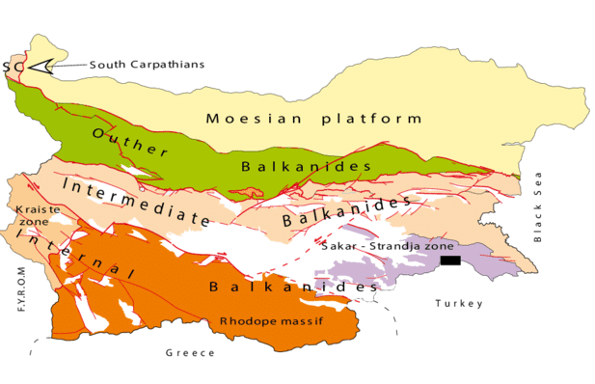
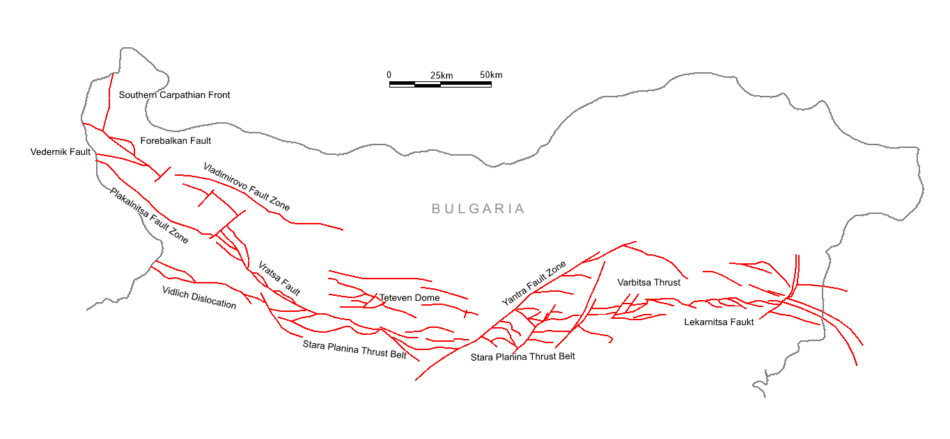
Sedmochislenitsi, Bulgaria
Colin J Andrew
Tectonic Zones of the Stara Planina
Inverted Early Alpine extensional structures
Sedmochislenitsi
Stara Planina
Fore Balkan Sub-Region
Late Alpine thin-skinned thrusts and strike-slip faults
Reactivated early Alpine or older
Notes:
The Tertiary Balkan fold-thrust belt consists of two clearly distinct parts: an Eastern one dominated exclusively by a thin-skinned thrusting and a western one with considerable basement involvement requiring the existence of
deep detachment levels in the crust.
The Tertiary Balkan Fold-Thrust Belt originated mainly through a basement driven shortening and north-vergent compressional fabrics with several phases of reactivation. The Alpine orogenic belt consists of dominantly north-verging thrust sheets and
fold structures of different rank that resulted from multiphase collisions and related compressional events in Late Triassic, mid-Jurassic, mid-Cretaceous, Late Cretaceous and mid-Eocene time.

Slide 16
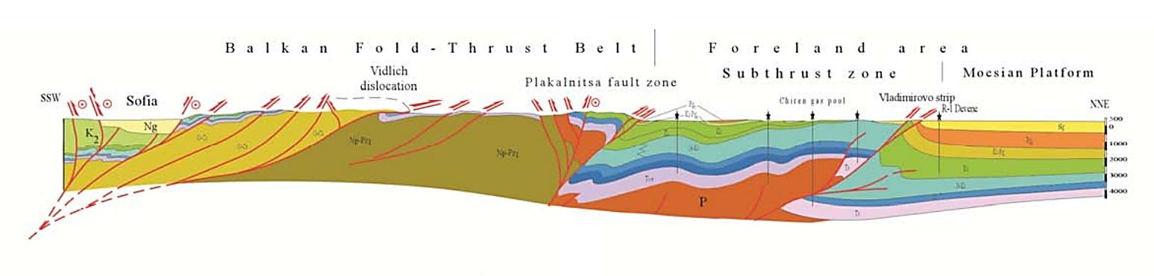

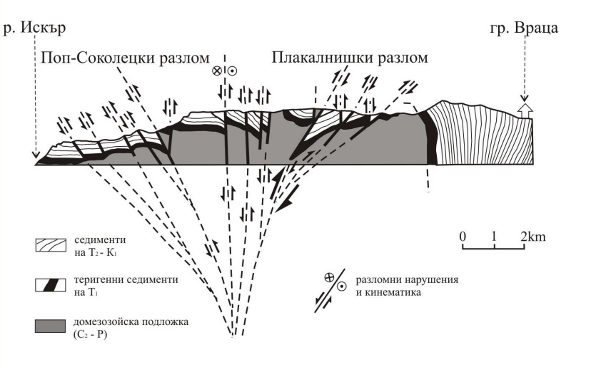

Sedmochislenitsi, Bulgaria
Colin J Andrew
B a l k a n F o l d - T h r u s t B e l t S u b t h r u s t Z o n e M o e s I a n P l a t f o r m
Vidlich
Dislocation
Plakalnitsa Fault Zone
Sofia
Vladamirovo Strip
0m
1000m
2000m
3000m
4000m
Neoproterozoic to Palaeozoic
Tr
Palaeozoic
Tr
Kilometers
0 5 10 20 50
SECTION ACROSS THE DRAGOYBALKAN (VRATSA) FAULT ZONE
From Vangelov et al (2013)
River Iskar
Sedmochislenitsi
Vratsa
Pop-Sokolets Fault Zone
Plakalnitsa Fault Zone
SW
NE
Middle & Upper Triassic to
Cretaceous sediments.
Lower Triassic terrigenous sediments.
Lower Palaeozoic basement.
Fault showing sense
of movement
After Rentzsch (1963)
Notes:
The western part of the Western Balkan Tectonic zone is formed by the Berkovitsa block, an anticlinorium comprising a Palaeozoic core and Mesozoic cover. From north and south this block is bound by large deep crustal faults known as the Plakalnitsa fault zone and Pop-Sokolets faults respectively. These are complex fault zones associated with the formation of additional folds and horizontal dislocations (along the bed surfaces). The vertical displacement along the Plakalnitsa fault zone is about 4,000m and that along the Pop-Sokolets fault over 1,500m.

Slide 17
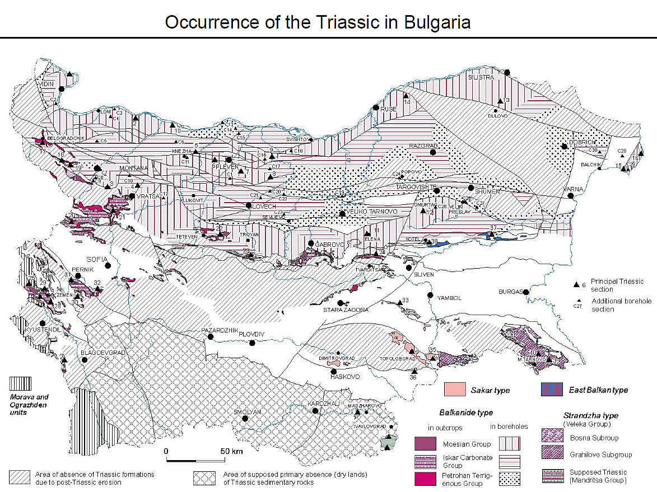
Sedmochislenitsi, Bulgaria
Colin J Andrew
Triassic in Bulgaria
From Zagorchev, I. & Budarov, K. (2008)
Notes:
The Triassic began after the end of the Variscan with erosion of the orogen and formation of the Late Permian to earliest Triassic arid plains with braided fluvial systems of Bunter sandstone type being deposited. Differential subsidence, accompanied by rifting, led to marine transgression towards the end of the Early Triassic, and to a stable marine regime during the Middle to Late Triassic with regression in latest Triassic times.

Slide 18
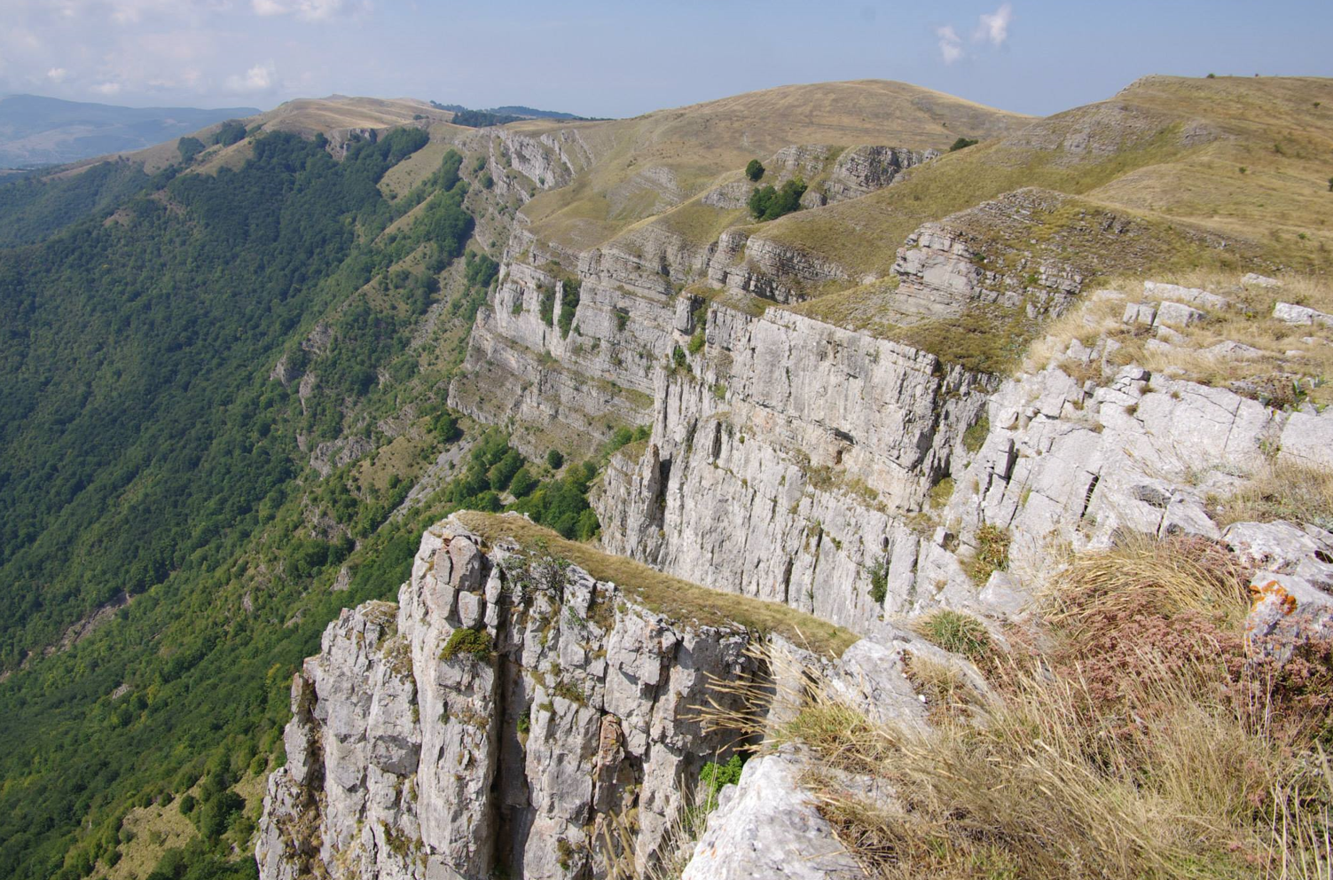
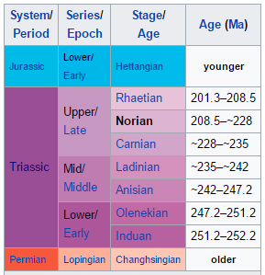
Sedmochislenitsi, Bulgaria
Colin J Andrew
Norian
Anisian
Stratigraphy
Notes:
The Triassic succession forms the base of the Mesozoic cover and is subdivided into three units: the Petrohan Terrigenous Group consisting predominantly of fluvial deposits; the Iskar Carbonate Group (~480m thick) composed of shallow-marine carbonates and mixed siliciclastic-carbonate rocks; and the Moesian Group represented by siliciclastic-carbonate and carbonate rocks

Slide 19
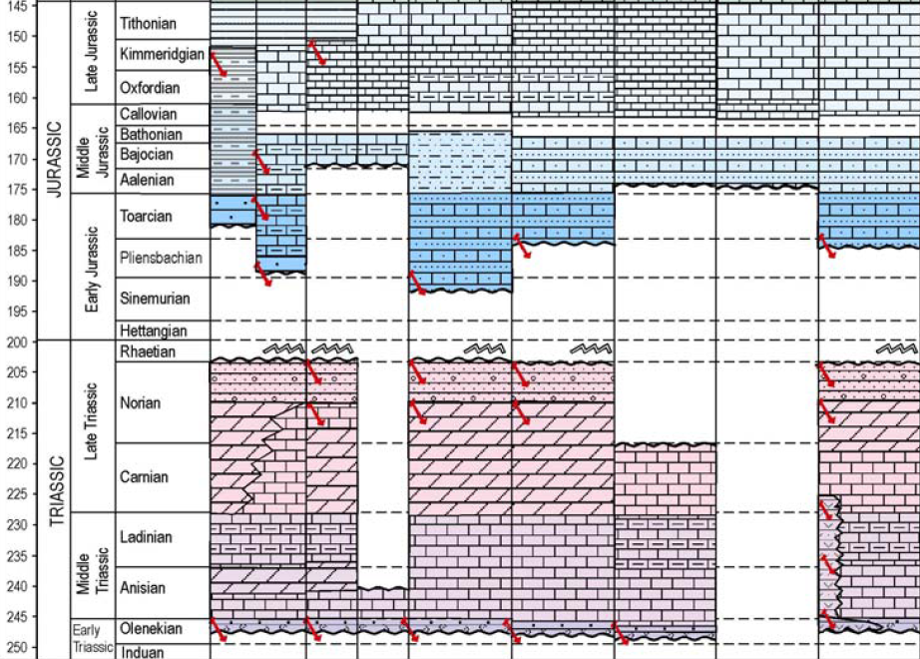




Sedmochislenitsi, Bulgaria
Colin J Andrew
Tectonics during Triassic in Bulgaria
Unconformity, uplift and folding
Principal APT deposit level
Extension, Rifting & Inversion
Extension & Rifting
Volcaniclastics
Vratsa District Zn-Pb-Cu
Extension & Rifting
Shallow-water limestones
Secondary dolomites
Mixed clastics and marls
Deep-water limestones and shales
Volcanics & Volcaniclastics
Tectonic Event
Notes:
The Upper Permian to Upper Triassic sequence represents a complete transgressive/regressive cycle of several hundred meters of continental and shallow-marine sediments including both early- and late-stage evaporites. The initial (embryonic) rifting processes are indicated by the presence differential subsidence and by mafic and intermediate volcanics hosted within the Lower Triassic succession.

Slide 20
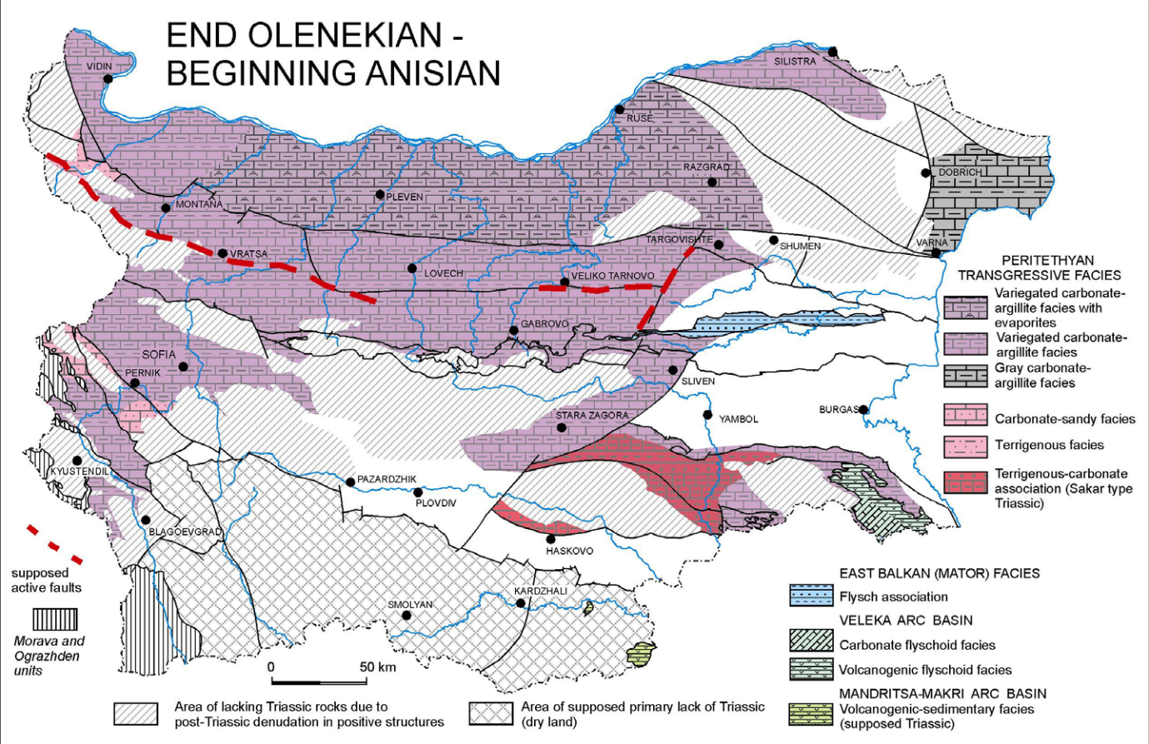
Sedmochislenitsi, Bulgaria
Colin J Andrew
Triassic facies at beginning of Anisian Stage in Bulgaria
From Zagorchev, I. & Budarov, K. (2008)

Slide 21
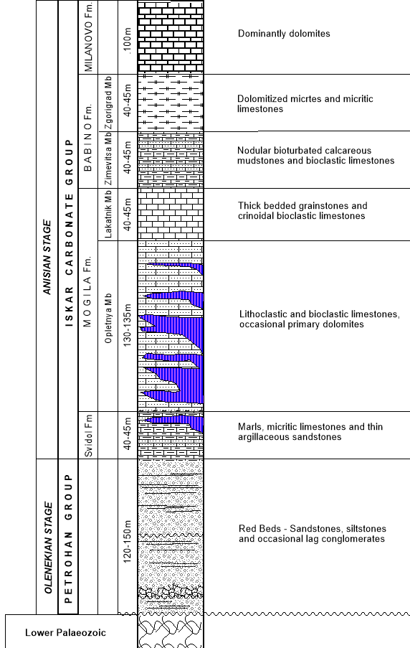
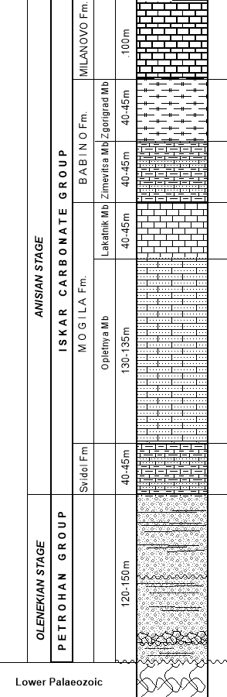
Sedmochislenitsi, Bulgaria
Colin J Andrew
During the Early Triassic braided fluvial systems of formed followed by differential subsidence, accompanied by rifting, led to marine transgression towards the end of the Early Triassic, to a stable marine regime during most of the Triassic with regression in latest Triassic times.
The Mogila Formation (170-180m) is comprised of peritidal sandstones, flaser and linsen bedded siltstones and mudstones and argillaceous limestones and dolomites with well-developed exposure surfaces, cross-bedding and bioturbation.
The Svidol Formation (40-45m) shows sub-tidal, inter-tidal and supra-tidal argillaceous carbonate sediments deposited on inner ramp, mid-ramp and outer ramp.
The Petrohan Group (120-150m) comprises three third order fluvial sequences of red-bed sandstones, siltstones and mudstones deposited in braided, anastomosing and high sinuosity, meandering fluvial systems of Bunter Sandstone affinity
Ajdanlijsky et al. (2019)
Notes:
The lowermost part of the Triassic is dominated by terrigenous red beds mainly representing fluvial but also, rarely, alluvial deposits that litho-stratigraphically are referred to as Petrohan Terrigenous Group. The uppermost 50–55m of the Petrohan Terrigenous Group is comprised of fluvial channel and near-channel sandstones and overbank silts, becoming thinner bedded and increasingly argillaceous towards the top.

Slide 22
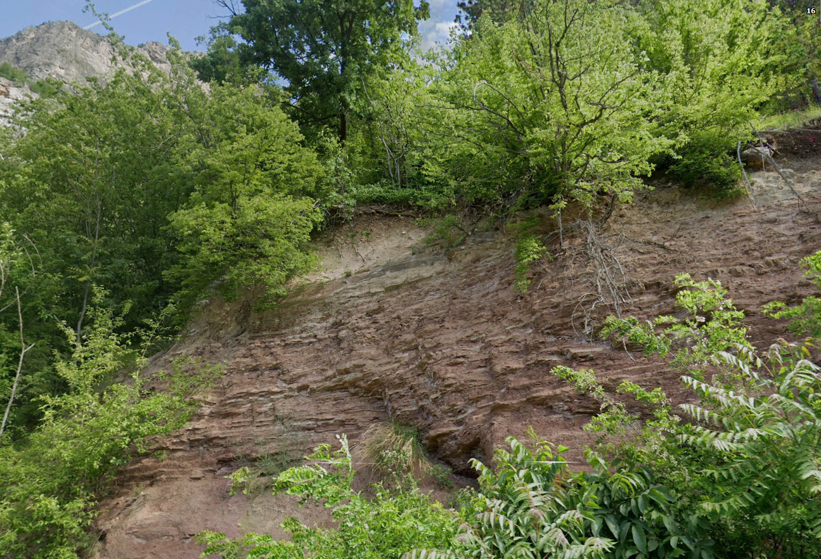
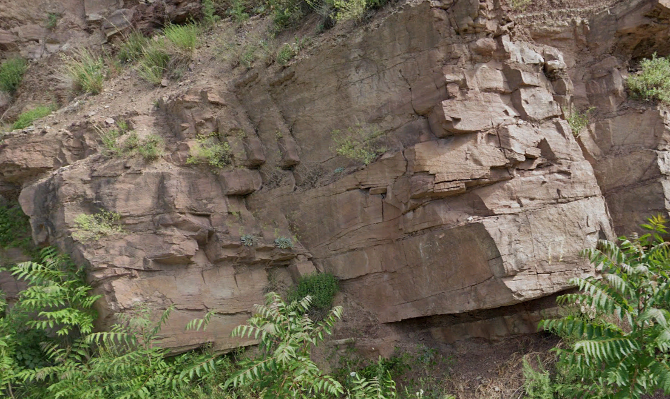
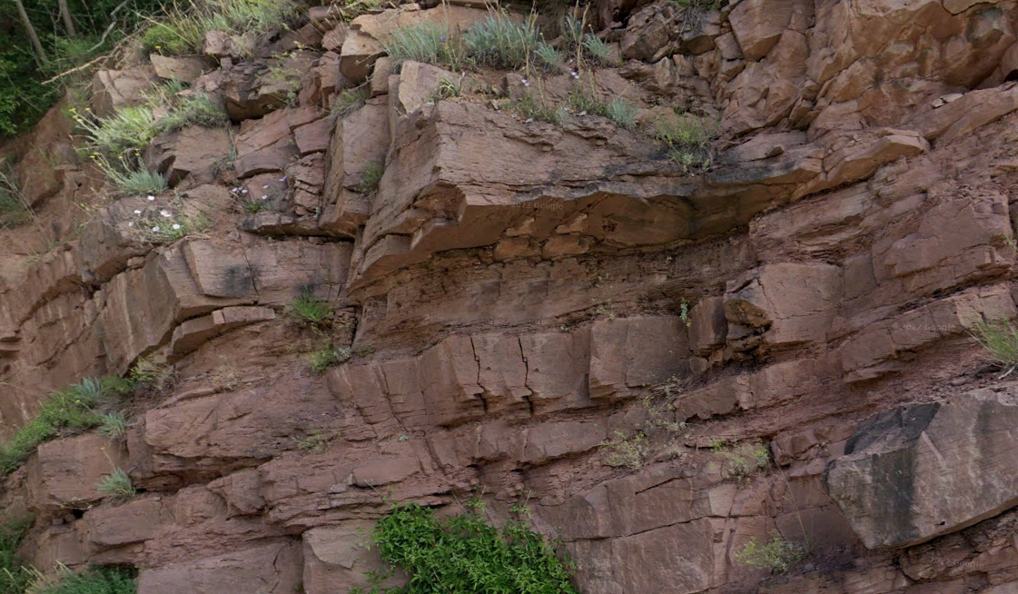
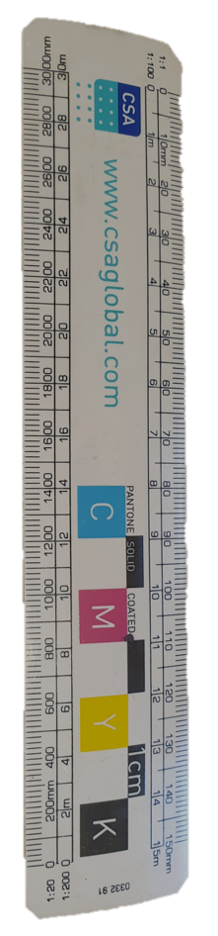
Sedmochislenitsi, Bulgaria
Colin J Andrew
Petrohan Group
The uppermost 50–55m of the Petrohan Terrigenous Group is comprised of fluvial channel and near-channel sandstones and overbank silts, becoming thinner bedded and increasingly argillaceous towards the top.
Ajdanlijsky et al, (2019)

Slide 23
Sedmochislenitsi, Bulgaria
Colin J Andrew
During the Early Triassic braided fluvial systems of formed followed by differential subsidence, accompanied by rifting, led to marine transgression towards the end of the Early Triassic, to a stable marine regime during most of the Triassic with regression in latest Triassic times.
The Mogila Formation (170-180m) is comprised of peritidal sandy limestones, flaser and linsen bedded siltstones and mudstones and argillaceous limestones and dolomites with well-developed exposure surfaces, cross-bedding and bioturbation.
The Svidol Formation (40-45m) shows sub-tidal, inter-tidal and supra-tidal argillaceous carbonate sediments deposited on inner ramp, mid-ramp and outer ramp.
The Petrohan Group (120-150m) comprises three third order fluvial sequences of red-bed sandstones, siltstones and mudstones deposited in braided, anastomosing and high sinuosity, meandering fluvial systems of Bunter Sandstone affinity
Ajdanlijsky et al. (2019)

Slide 24
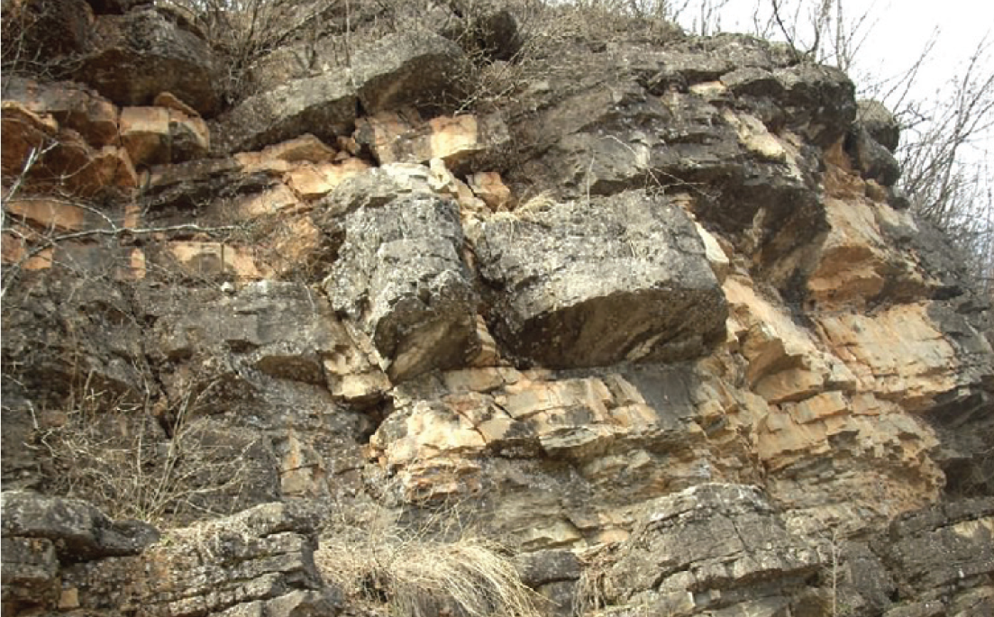
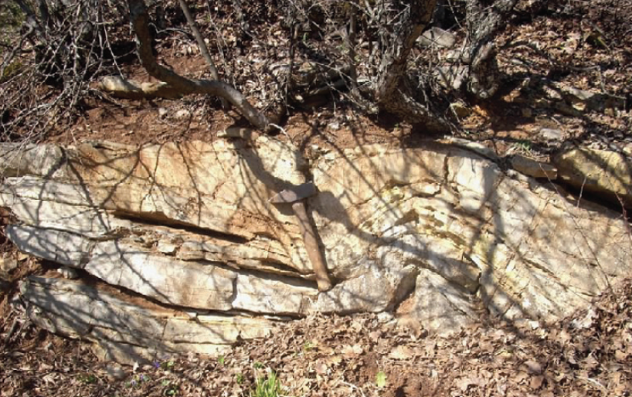

Svidol Fm.
Sedmochislenitsi, Bulgaria
Colin J Andrew
The Svidol Formation comprises a series of argillaceous and silty limestones which become increasingly marly and then cleaner upwards into micrites and oolitic limestones.
Notes:
The lowermost part of the Iskar Carbonate Group is represented by a transitional continental to marine, mixed siliciclastic–carbonate, tidal-dominated succession of the Svidol Formation

Slide 25
Sedmochislenitsi, Bulgaria
Colin J Andrew
During the Early Triassic braided fluvial systems of formed followed by differential subsidence, accompanied by rifting, led to marine transgression towards the end of the Early Triassic, to a stable marine regime during most of the Triassic with regression in latest Triassic times.
The Mogila Formation (170-180m) is comprised of peritidal sandstones, flaser and linsen bedded siltstones and mudstones and argillaceous limestones and dolomites with well-developed exposure surfaces, cross-bedding and bioturbation.
The Svidol Formation (40-45m) shows sub-tidal, inter-tidal and supra-tidal argillaceous carbonate sediments deposited on inner ramp, mid-ramp and outer ramp.
The Petrohan Group (120-150m) comprises three third order fluvial sequences of red-bed sandstones, siltstones and mudstones deposited in braided, anastomosing and high sinuosity, meandering fluvial systems of Bunter Sandstone affinity
Ajdanlijsky et al. (2019)

Slide 26



Mogilata Fm (Opletnya Mb)
Oplet
Sedmochislenitsi, Bulgaria
Colin J Andrew
Opletnya Mb. matrix-supported floatstone rich in pebble-sized subrounded intraclasts.
Opletnya Mb. clast-supported lag deposit of intraformational conglomerate.
(from Ajdanlijsky et al, 2019)
Notes:
The lowest part of the Mogila Formation (the Opletnya Member and the principal host to the mineralization at Sedmochislenitsi), ranges from 130m to over 180m in thickness, and is dominated by a well-pronounced cyclicity bounded by transgressive surfaces and comprises micritic and argillaceous limestones, dolomitic limestones and dolomites while siliciclastic–terrigenous and siliciclastic–carbonate rocks, comprise an insignificant part of the succession as occasional thin beds. Detrital quartz and clay are restricted to discrete thin levels whilst grainstones containing ooids, peloids and bioclasts are dominant, locally with well-developed crossbedding and bioturbation. Laminated mudstones, often with synsedimentary pyrite are common in the lowermost part of the member. An important feature of the lower part of the Opletnya Member is the occurrence of hardgrounds bounding cyclic parasequences, an aspect that may have significance during mineralization.

Slide 27


Sedmochislenitsi, Bulgaria
Colin J Andrew
Host Rocks - Soft Sediment Deformation
Small-scale channel in Opletnya Mb (Mogila Formation) that laterally corresponds to a level with sigmoidal synsedimentary deformation.
Two erosional surfaces in Opletnya Mb (Mogila Formation) partly developed in dolomitized limestone, the lower one forming a channel over 50 cm deep that marks a sequence boundary.
Photographs from Ajdanlijsky et al, 2019

Slide 28


Sedmochislenitsi, Bulgaria
Colin J Andrew
Host Rocks - Soft Sediment Deformation
12cm thick bed in Opletnya Mb. (Mogila Formation) with sigmoidal soft-sediment deformation structures with concave top surface that pinches out laterally.
Sigmoidal soft-sediment deformation Opletnya Mb. (Mogila Formation). Indicative of seismically induced liquefaction or fluidization during early diagenesis.
Photographs from Ajdanlijsky et al, 2019
Notes:
Synsedimentary deformation, some showing a sigmoidal geometry and slump folding, along with clast supported lag conglomerates, are observed throughout almost the entire Opletnya Member suggesting some contemporaneous tectonism. Other common features of the Opletnya Member are erosional surfaces locally showing channel morphology which, in many cases, the channel flanks are steep to almost vertical, indicating a relatively advanced degree of early lithification of the sediment into which the channel was cut.

Slide 29

Sedmochislenitsi, Bulgaria
Colin J Andrew
Sedmochislenitsi, Bulgaria
Colin J Andrew
Milanovo Fm.
Lakatnik Mb
Babino Fm.
Mogila Fm.
Mogila Fm.
Opletnya Mb
Svidol Fm.
Petrohan Gr.
Ajdanlijsky et al, 2019

Slide 30
Sedmochislenitsi, Bulgaria
Colin J Andrew
Geology from Bulgarian Geological Survey Maps K3425-Berkovica, K3436-Vratsa, K-3447-Sofia & K3448-Botevgrad
Mineral Deposits of the Vratsa District
Plakalnitsa 1.38 Mt @ 1.45% Cu
Sedmochislenitsi 0.77 Mt @ 0.72% Cu
Izdremets 0.78 Mt @ 0.74% Cu
Venets - Lakatnik 1.98 Mt @ 0.50% Cu
Osenovlak 0.43 Mt @ 1.03% Cu
Hristo Botev 0.07 Mt @ 0.71% Cu
Plakalnitsa 0.65 Mt @ 2.84% Zn+Pb
Sedmochislenitsi 10.67 Mt @ 1.63% Zn+Pb
Izdremets 0.38 Mt @ 3.13% Zn+Pb
Hristo Botev 0.26 Mt @ 2.21% Zn+Pb
Osenovlak 0.05 Mt @ 3.15% Zn+Pb

Slide 31

Sedmochislenitsi, Bulgaria
Colin J Andrew
SW
Sedmochislenitsi – Plakalnitsa District
NE
Sokolets District
Dragoybalkan Fault Zone
Ladinian Babino & Milanovo Formations
Anisian Svidol & Mogila Formations
Olenekian Petrohan Group
Palaeozoic metasediments
Mineral Deposit
0 1 2
kilometres
Regional Cross-Section
From Minčeva-Stefanova (1965, 1972, 1978)

Slide 32
Sedmochislenitsi, Bulgaria
Colin J Andrew
Geology from Bulgarian Geological Survey Maps K3425-Berkovica, K3436-Vratsa, K-3447-Sofia & K3448-Botevgrad
Mineral Deposits of the Vratsa District
Plakalnitsa 1.38 Mt @ 1.45% Cu
Sedmochislenitsi 0.77 Mt @ 0.72% Cu
Izdremets 0.78 Mt @ 0.74% Cu
Venets - Lakatnik 1.98 Mt @ 0.50% Cu
Osenovlak 0.43 Mt @ 1.03% Cu
Hristo Botev 0.07 Mt @ 0.71% Cu
Plakalnitsa 0.65 Mt @ 2.84% Zn+Pb
Sedmochislenitsi 10.67 Mt @ 1.63% Zn+Pb
Izdremets 0.38 Mt @ 3.13% Zn+Pb
Hristo Botev 0.26 Mt @ 2.21% Zn+Pb
Osenovlak 0.05 Mt @ 3.15% Zn+Pb

Slide 33


Sedmochislenitsi, Bulgaria
Colin J Andrew
Medna-Plakalnitsa Mine
After Rentzsch (1963)
Section through the Medna-Plakalnitsa Mine area
Notes:
Note the orebody is folded thus confirming a pre-Alpine age

Slide 34


Sedmochislenitsi, Bulgaria
Colin J Andrew
Geology from Bulgarian Geological Survey Maps K3425-Berkovica, K3436-Vratsa, K-3447-Sofia & K3448-Botevgrad

Slide 35

Sedmochislenitsi, Bulgaria
Colin J Andrew
North-West
South-East
WNW
ESE
Ovchi Grub
Zambina Mogila
Markova Mogila
Ladinian Milanovo Formation
Anisian Mogila Formation
Anisian Svidol Formation
Sedmochislenitsi Mine
Medna Plakalnitsa Mine
Pb-Zn dominant mineralization
Cupriferous mineralization
0 400 1000
metres
Dip Section through the District
From Minčeva-Stefanova (1965, 1972, 1978)
Notes:
Note over 6km of strike extent but becomes increasingly cupriferous to SE

Slide 36




Sedmochislenitsi, Bulgaria
Colin J Andrew
Dumps at Boruv Kamuk
0 1000m 2000m
Portal to 850m Level, Mir.

Slide 37

Sedmochislenitsi, Bulgaria
Colin J Andrew
Sedmochislenitsi
Mir Mine Site
Milanovo Fm
View towards the NW from above Medna-Plakalnitsa

Slide 38
Sedmochislenitsi, Bulgaria
Colin J Andrew
Geology from Bulgarian Geological Survey Maps K3425-Berkovica, K3436-Vratsa, K-3447-Sofia & K3448-Botevgrad

Slide 39


Sedmochislenitsi, Bulgaria
Colin J Andrew
Milanovo Formation
Mogila Formation
Svidol Formation
Carboniferous phyllites
SW
NE
Dolomitization
Sulphide Mineralization
Black Matrix Breccias
0 50 100
Metres
Mineralized zones shown include both Zn-Pb and Cu
Section across the Sedmochislenitsi Deposit
Section from Minčeva-Stefanova (1965, 1972, 1978)
Notes:
The Black Matrix Breccia described by Rentzsch (1963) and termed “mylonites” by Minčeva-Stefanova (1967) locally includes sulphide clasts, and thus would appear to be closely analogous to similar rocks commonplace in several deposits in the Irish Midlands (Lisheen, Galmoy, Pallas Green, Stonepark and, possibly, Silvermines. Such Black Matrix Breccias are generally considered to be spatially related to mineralizing processes in the Irish Midlands.

Slide 40


Sedmochislenitsi, Bulgaria
Colin J Andrew
SW
NE
Dolomitization
Mogila Fm
Svizdol Fm
Carboniferous phyllites
Galena
Galena – Sphalerite
Sphalerite
Tennantite - Chalcopyrite
Tennantite – Bornite
0 50 100
Metres
After Atanassova (2015)

Slide 41

Sedmochislenitsi, Bulgaria
Colin J Andrew
SW
NE
Dolomitization
Mogila Fm
Svizdol Fm
Carboniferous phyllites
Galena
Galena – Sphalerite
Sphalerite
Tennantite - Chalcopyrite
Tennantite – Bornite
Galena
Galena – Sphalerite
Sphalerite
Tennantite - Chalcopyrite
Tennantite – Bornite
0 50 100
Metres
After Atanassova (2015)

Slide 42



Sedmochislenitsi, Bulgaria
Colin J Andrew
5cm
5cm
5cm
Sphalerite mineralization
with pyrite-marcasite spheroidal
aggregates and framboidal pyrite.
Banded sphalerite var.
Schallenblende.
Fracture filling sphalerite
cutting early dolomite.

Slide 43



Sedmochislenitsi, Bulgaria
Colin J Andrew
5cm
5cm
5cm
Compact mineralization bornite
and chalcocite.
Compact galena-chalcopyrite-minerals of fahlore group mineralization associated with metamorphosed organics.
Galena, bornite and tennantite.

Slide 44



Sedmochislenitsi, Bulgaria
Colin J Andrew
5cm
5cm
5cm
Mercurian silver, stromeyerite,
chalcocite and bornite.
Pyrargyrite in galena-sphalerite
-chalcopyrite- freibergite
mineralization.
Barite veining and replacement
of dolomites.

Slide 45

Sedmochislenitsi, Bulgaria
Colin J Andrew
Early Dolomitization
SW
NE
Dolomitization
Milanovo Fm.
Mogila Fm
Svizdol Fm
Carboniferous phyllites
0 50 100
Metres
Important to note that fabric selective dolomitization occurs from very early within bioturbation worm burrows and as heterolithic “ribbon rocks” to hydrothermally associated crosscutting dolomite haloes to the sulphides.

Slide 46

Sedmochislenitsi, Bulgaria
Colin J Andrew
Zn-Pb mineralization
SW
Pb Zn+Pb Zn+Fe
NE
Dolomitization
Galena
Sphalerite
Iron Sulphides
Milanovo Fm.
Mogila Fm
Svizdol Fm
Carboniferous phyllites
0 50 100
Metres

Slide 47

Sedmochislenitsi, Bulgaria
Colin J Andrew
Cu mineralization
SW
NE
Dolomitization
Galena
Tennantite-Chalcopyrite
Bornite
Milanovo Fm.
Mogila Fm
Svizdol Fm
Carboniferous phyllites
Gal
Cpy + Tn
Bn
0 50 100
Metres
Notes:
The cupriferous mineralized bodies show greater intensity of sulphide mineralization with bedding parallel lenes of massive chalcopyrite, galena, pyrite, bornite and tennantite developed within barite bearing dolomites. Fabrics are generally indistinct but there is evidence of collapse brecciation and replacement of both clasts and wall-rock lithologies

Slide 48


Sedmochislenitsi, Bulgaria
Colin J Andrew
Combined Mineralization
SW
NE
Dolomitization
Galena
Sphalerite
Iron Sulphides
Milanovo Fm.
Mogila Fm
Svizdol Fm
Carboniferous phyllites
0 50 100
Metres
Notes:
Minčeva-Stefanova (1965) interpreted the brecciated texture to have formed as a result of the cementation of mineralized or unmineralized rock fragments with sulphide and carbonate minerals on one hand and, on the other, as a consequence of replacement of sedimentary breccias in which the fragments and the cement are replaced in various degrees because of the differences in the contents of calcareous, dolomitic and marly constituents.

Slide 49









Sedmochislenitsi, Bulgaria
Colin J Andrew
Early Diagenetic Mineralization
Erosion / Exposure Surface
Bituminous Dolomite
Sandy and silty Dolomites
Sphalerite – Dolomite silt with ripple cross-bedding
Resedimented breccia of sphaleritic / dolomitic silts
Crystalline galena ( ) Pyrite ( )
Leached cavities after gypsum with dolomite rims.
200cms
Mineralized horizon
Erosion surface
Pyrite
Sketch of mineralized layers in Block 12 Haulage. (After Rentzsch, 1960)
Notes:
Rentzsch came to a different interpretation noting that in Block 9 of the mine there is a resedimented breccia of sandy and intraclastic dolomite with fragments of melknikovite whilst in the conveyor drive of Block 12 concordant lenses of cross-laminated sphalerite-dolomite pelite with minor galena occur. These thin mineralized horizons have a distinctive sharp footwall which appears to be a scour surface and the granular sphalerite-dolomite overlying these surface es shows grading and imbricated exfoliated rhythmic clasts of melknikovite/marcasite.

Slide 50


Sedmochislenitsi, Bulgaria
Colin J Andrew
Ripple cross-bedded sphalerite/dolomite sediments.
Sedmochislenitsi Block 12 Haulage.
Slump horizon comprising resedimented fragments of marcasite/pyrite, sphalerite-dolomite pelites and dolomite pelites.
Sedmochislenitsi Block 12 Haulage.
Finely layered (graded?) sphalerite-dolomite pelite
Medna-Plakalnitsa, 60-12A Stope
2cm
2cm
2cm
All photographs from Rentzsch (1963)
Notes:
Rentzsch describes in detail repetitive cyclicity of the stratified mineralized lenses of a unit comprising a basal horizon of dark grey bituminous dolomite gradationally passing up into a sandy dolomite with muscovite, then via a sharp contact into a horizon comprising cross-laminated and/or graded sphalerite-dolomite peloids with imbricate clasts of melknikovite crusts which he interpreted as being mudflows.

Slide 51

Sedmochislenitsi, Bulgaria
Colin J Andrew
Py
Py
Sph
Sph
Sph
Sph
Py
2cm
5cm
Navan 2-3 Lens
Sedmochislenitsi Block 12 Haulage.

Slide 52


Sedmochislenitsi, Bulgaria
Colin J Andrew
5cm
5cm
5cm
Sedmochislenitsi - Block 12 Haulage.
Sedmochislenitsi Block 12 Haulage.
Navan, 2-5 Lens
Notes:
Rentzsch (1963) has described that the better mineralized levels within the zinc-lead zones are laterally extensive and exhibit soft-sediment deformation fabrics and textures. The sphalerite-dolomite sediments also contain fragments of colloform marcasite-melknikovite and gel pyrite along with organic-rich mudstone intraclasts and display a variety of textures, including grading, loading, and slumping. Such descriptions bear close similarity to those described at Navan by Anderson et al (1998) and Boast et al (1981) at Tynagh.

Slide 53

Sedmochislenitsi, Bulgaria
Colin J Andrew
Graded bed
Crystalline galena
Displacive nucleated growths of sphalerite
Graded bed
0.5cm
Fine grained dolomite-sphalerite sediment with grading, displacive growth of sphalerite and late crystalline galena.
Sedmochislenitsi, Mir Mine, 850m Level.

Slide 54


Sedmochislenitsi, Bulgaria
Colin J Andrew
Sphaleritized allochems from pelletal sparite.
Aggregate of sphalerite peloids enveloping dolomite crystals within a fine dolomitic silt.
Sedmochislenitsi Block 12
Rentzsch (1963)
Navan, 2-5 Lens.
Anderson et al (2019)
200 um
200 um
Notes:
Zn-bearing calcite and pyrite have features typical of bacterial colonies. Kucha et al (2010) have reported similar peloids from Bleiberg which they interpreted as being in situ metabolic products of sulphate-reducing bacteria

Slide 55



Sedmochislenitsi, Bulgaria
Colin J Andrew
5cm
Collapse breccia with schallenblende and calcite.
Sedmochislenitsi
5cm
2cm
Collapse breccia of sphalerite clasts in marcasite.
Lisheen
Microcrystalline sphalerite and later coarse galena replacing matrix to breccia.
Tynagh

Slide 56


Sedmochislenitsi, Bulgaria
Colin J Andrew
2cm
2cm
Fracture breccia cemented by banded galena, chalcopyrite and dolomite.
Sedmochislenitsi
Fracture breccia of galena and minor chalcopyrite cutting earlier pyritized dolomite.
Silvermines Lower G-Zone

Slide 57



Sedmochislenitsi, Bulgaria
Colin J Andrew
Zn-Pb Phase
Cu Phase
After Minčeva-Stefanova, (1965)
and Atanassov & Kirov (1973)

Slide 58


Sedmochislenitsi, Bulgaria
Colin J Andrew
Pre “ore” Main ore stage Late
Sedmochislenitsi Zn-Pb Orebodies
After Minčeva-Stefanova, (1965)
and Atanassov & Kirov (1973)
Lisheen Main Zone Zn-Pb, Ireland
After Doran (2022)

Slide 59


Sedmochislenitsi, Bulgaria
Colin J Andrew
Main Ore Stage Ag / Hg
Sedmochislenitsi Copper Orebodies
After Minčeva-Stefanova, (1965)
and Atanassov & Kirov (1973)
Gortdrum Cu-Hg-Ag, Ireland
After Steed (1975)

Slide 60

Sedmochislenitsi, Bulgaria
Colin J Andrew

Slide 61
Sedmochislenitsi, Bulgaria
Colin J Andrew
Trace element geochemistry of sphalerites
Sedmochislentsi Zn-Pb Phase
Sedmochislentsi Cu-Zn-Pb phase
Alpine Deposits (Mean Values)
Sedmochislenitsi Data from Rentzsch (1963)
Alpine Data from Melcher et al (2023)

Slide 62
Sedmochislenitsi, Bulgaria
Colin J Andrew
Trace element geochemistry of sphalerites
In summary:
Sedmochislentsi sphalerites are significantly different in their trace element geochemistry being considerably higher in Fe and As
Sedmochislentsi Zn-Pb Phase
Sedmochislentsi Cu-Zn-Pb phase
Alpine Deposits (Mean Values)
Sedmochislenitsi Data from Rentzsch (1963)
Alpine Data from Melcher et al (2023)

Slide 63


Sedmochislenitsi, Bulgaria
Colin J Andrew
Ge:Ga Ratios
Plots of the homogenization temperatures from fluid inclusions against the Log₁₀ Ga:Ge ratio show some discrimination between Palaeozoic-hosted vein deposits, carbonate-hosted MVT / APT deposits and Irish-type deposits in Ireland.
Sedmochislentsi values fall within the Irish-type field.
Sedmochislenitsi data from Rentzsch (1963) and Vangelova et al (2020).
Other data from Moller (1985) and Mladenova & Valchev (1998)
Vein-type Deposits
Palaeozoic-hosted vein types
Homogenization Temperature ºC
Irish-type
Irish-type
MVT-type
MVT / APT-types
Hi-Lo trends shown

Slide 64
Sedmochislenitsi, Bulgaria
Colin J Andrew
General Paragenetic Comparatives
Sedmochislenitsi and the Irish Midlands Zn-Pb deposits share a relatively simple mineral assemblage comprising pyrite-sphalerite-galena deposited in multyple phases within a lithifying carbonate host sequence.
Ni-Co occurs within both early and late iron sulphides
Overall the mineralization passes from an early iron (both sulphide and oxide) phase prior to the main Zn-Pb ore stage
Tennantite-Tetrahedrite and Arsenopyrite are minor components, generally late stage and proximal to potential “feeder” structures.
The Cu-Ag-Hg mineralization at Sedmochislenitsi is later than the Zn-Pb and bears strong similarities to the Cu-Ag-Hg deposits at Gortdrum, Aherlow and Tullacondra in the Munster Basin.
The Cu-Ag-Hg deposits show an early Ni-Co enriched pyrite phase followed by increasing amounts of grey coppers and a final mercury-silver rich phase.

Slide 65
Sedmochislenitsi, Bulgaria
Colin J Andrew
Sulphur Isotopes
From: Shanks, P. (2014)
From: Boast, M. et al (1981)
Classic MVT
Old Lead Belt
Pine Point
Early Late
Viburnum Trend
Tynagh
Silvermines
Ireland
Lisheen
Navan
Bleiberg
Alps &
Dinarides
Mezica
δ³⁴S (‰ CDT)
Raible
Early Late
Sedmochislenitsi
-25 -20 -15 -10 -5 0 +5 +10 +15 +20 +25 +30 +35
δ³⁴S (‰ CDT)
Sedmochislenitsi data from Dimitrov, R. et al (1986)

Slide 66




Sedmochislenitsi, Bulgaria
Colin J Andrew
Geology from Bulgarian Geological Survey Maps K3425-Berkovica and K3436-Vratsa
Curvilinear normal fault.
Alpine Thrust
Alpine Fault
HW Syncline
Zn-Pb Mineralization
Cu Mineralization
X
X
0 2 4

Slide 67
Sedmochislenitsi, Bulgaria
Colin J Andrew
Styles of Mineralization
Evidence of soft sediment deformation and differential lithification exploited by mineralizing fluids indications of early diagenetic onset of mineralization.
Progression of increasingly deeper styles of mineralization coincident with paragenesis.
Complex multi-generational dolomitization.
Superposition of later stages of sulphides and well developed zonation within mineralized zones.

Slide 68

Sedmochislenitsi, Bulgaria
Colin J Andrew
All Irish-type deposits show the following characteristics
as to their structural and stratigraphic setting:
Hosted on the hanging wall of normal fault zones, frequently overlying transtensional basement shear zones.
Faults were syn-depositionally active during late rifting.
Faults control margins of intra-platform basins, marked by significant carbonate facies and thickness variations.
Host rocks are typically the first major clean carbonate unit in the sequence.
Host rocks are more permeable or reactive than other lithologies in the sequence.
Sedmochislenitsi

Slide 69

Sedmochislenitsi, Bulgaria
Colin J Andrew
Irish-type deposits show the following characteristics:
Sedmochislenitsi
The deposits comprise single or multiple stacked lenses; are stratabound and display generally stratiform morphologies.
Some deposits display pre-mineralization, diagenetic or hydrothermal dolomite alteration of the host rocks .
They display complex sulphide mineral fabrics and textures ranging from exhalites to early replacement of the host rock and infill of diagenetic solution cavities exhibiting open-space fill, disruption brecciation and re-sedimentation.
Mineralogically they are relatively simple comprising sphalerite, galena, Fe sulphides & barite, (minor Cu, Ag, As, Ni) in a gangue of calcite, dolomite & silica.
Metals are laterally and horizontally zoned, typically being Pb-rich closest to feeder structures and at the base of the orebody.
Sulphur isotopes show δ³⁴S from -44 to +14‰ indicative of two sources - bacteriogenic and hydrothermal. This is a distinctive feature of classic Irish-type deposits.
Evidence from fluid inclusions of fluid mixing is commonplace with a hot fluid interacting with a cooler saline to hypersaline H₂S-rich formation water.
Notes:
To sum up: there vis a body of evidence that suggests that Sedmochislenitsi has many similarities to the overall model for Irish-type deposits notably in its relative approximately coeval timing to the deposition and diagenesis of the host sediments. The presence of contemporary SedEx type deposits (which also have Irish type features) also renders many similarities to the range of styles seen in the Irish Midlands.

Slide 70


Acknowledgements
Sedmochislenitsi, Bulgaria
Colin J Andrew
Sedmochislenitsi, Bulgaria
Colin J Andrew
This paper was only possible because of the detailed observations and publications of a number of previous authors working whilst the Sedmochislenitsi mines were in operation, principally Jordanka Minčeva-Stefanova of the Bulgarian Academy of Sciences in Sofia, together with Johannes Rentzsch whose Doctoral Thesis from Bergakademie Freiberg formed the core data sources albeit they drew very different conclusions from their work.

Slide 71



Sedmochislenitsi, Bulgaria
Colin J Andrew
Благодарим ви много
So is Sedmochislenitsi Irish-type ?

Slide 72

Sedmochislenitsi, Bulgaria
Colin J Andrew

